Slide 1


Public-need Project Proposal
How to invest smart in NYC Real State?
by Marcel Socorro CIS-541-11

Slide 2

What’s the best location to buy and renting as Airbnb?
Purpose:
Income
Why?
Hunch
Analysis
How?
Geolocation and Prescriptive Analysis

Slide 3
Source: NYC Airbnb Open Data
Structured Data. Dataset 49k rows
Hypothesis: Is the average price per night significantly
Different in the 5 Counties of NYC
4 weeks to get results using existing dataset.
No new data collection

Slide 4
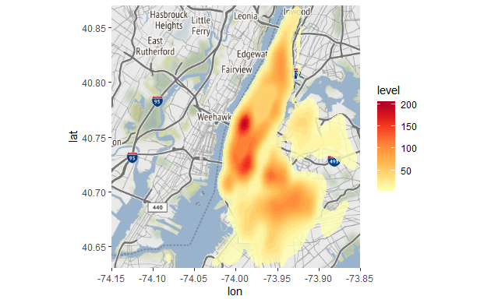
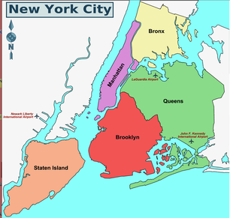
Heat Map “Current Airbnb Host” using GgMap
Where is Airbnb Core Business located in NYC?

Slide 5
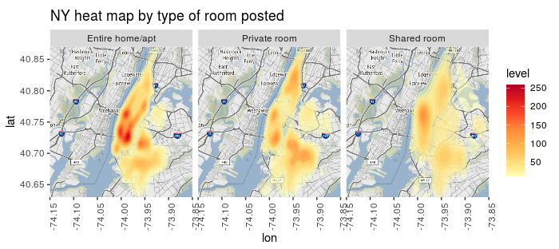
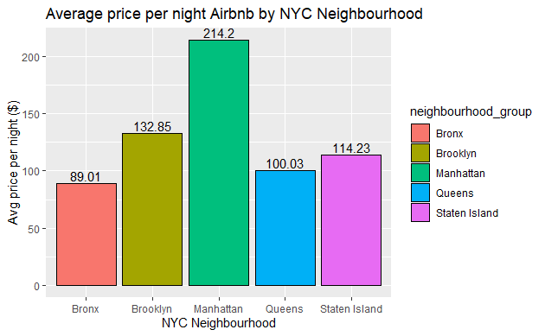
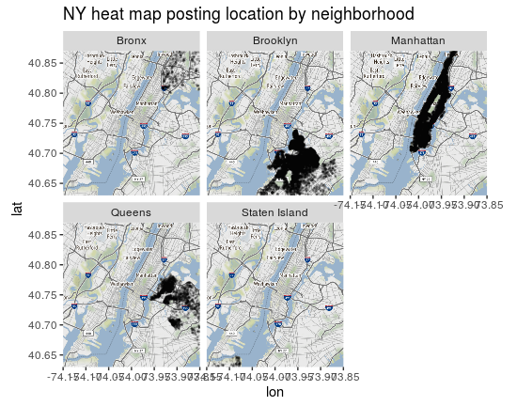
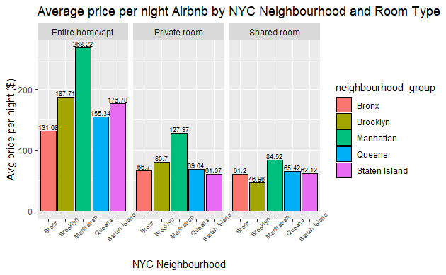
Exploratory Data Analysis
Is the Average price per night significantly different
according to the county where the business is located?
Is the Average price per night significantly different according to the type of room posted?

Slide 6
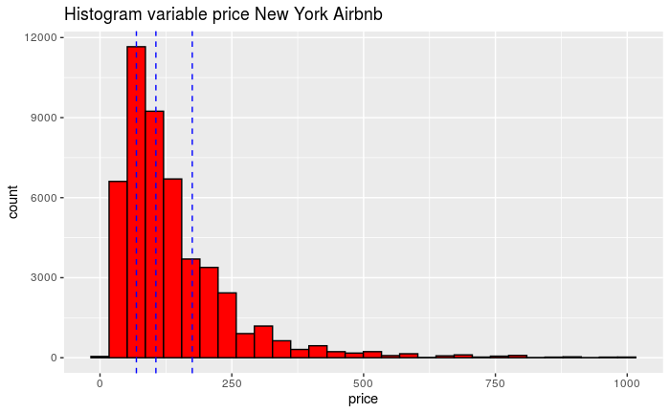
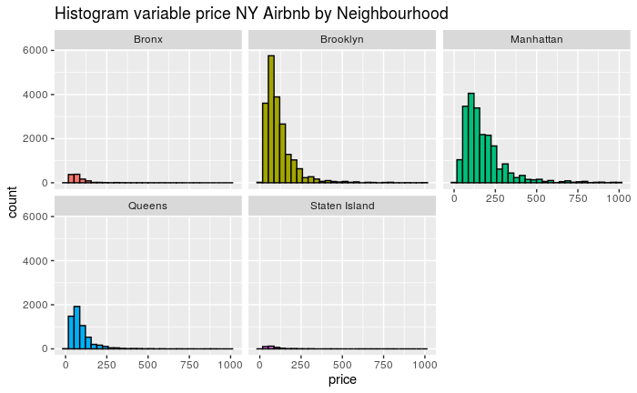
Exploring the Problem. Questions to be answered
and tested through statistical models
Based on the previous summary(1Q, Median and 3Q), 4 different classes will be generated.
0-69 $/night----economic
69-106 $/night—standard
106-175 $/night-comfort
175-Max $/night-luxury
What’s the best Model to estimate the class determined through range of pricing based on the variables:
-Quantity of reviews
-Neighborhood type
-Type of room
What’s the accuracy for this predictive model?

Slide 7
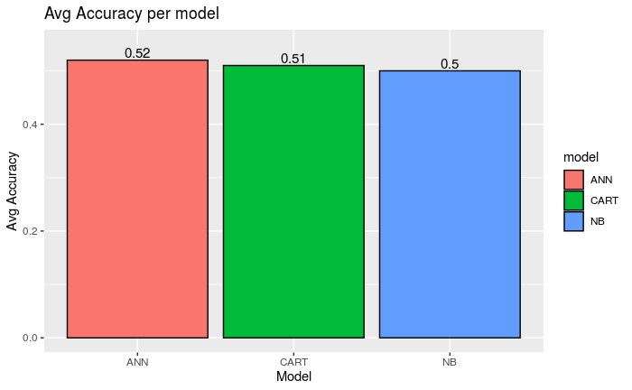

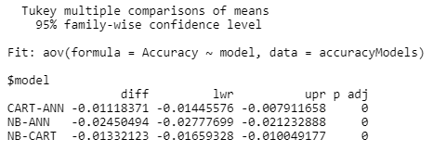
Modeling. Hypothesis testing
According to ANOVA results with a pvalue less than alpha (0.05) there is a significant difference among the models for the set of accuracy results obtained. Which is the model significantly different? ```{r}
According to Tukey test, the 3 pairs are significantly different among them. ANN has the highest avg accuracy so it will be chosen as the best model to predict the variable class determined by 4 pricing ranges.

Slide 8
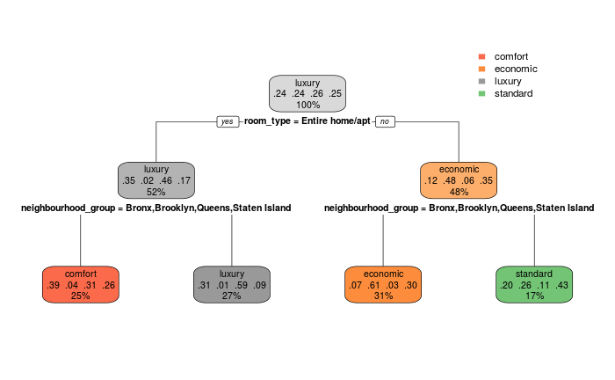
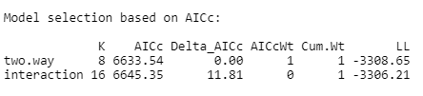
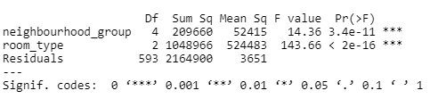
Variables impacting the model
In the tree, it could be seen that the variables impacting the class prediction are, "neighborhood_group" and room_type
Two different possible relationships between our variables, two models are compared:
1-A two-way ANOVA without any interaction (two.way. Assumes there is no interaction between the two independent variables
2-A two-way ANOVA with interaction. Assumes that there is an interaction between the two independent variables
Two-way ANOVA without interaction is the best model.
In both variables pvalue are less than α. There is an effect from the row factors room_type and neighborhood, which means that at least one row mean is different from the other, in each group.

Slide 9
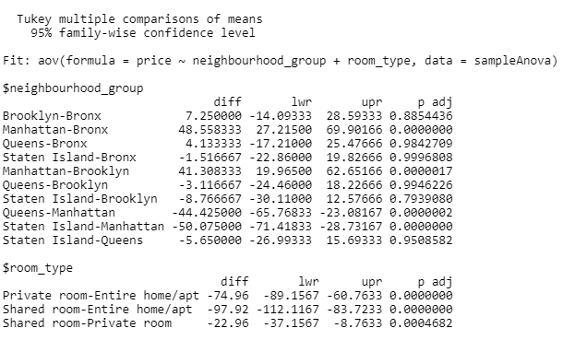
Which combinations are significantly different in terms of price NYC Airbnb
Combinations not significantly diff
Tukey test
Combinations significantly different

Slide 10
Conclusions
Three different models were built to predict the class based on pricing range through the independent variables:
-Quantity of reviews
-Neighborhood type
-Type of room
ANN model is the best model to predict this class with an average accuracy of 52% in the prediction of 4 different classes.
The variables impacting the most in this prediction are:
-Neighborhood type
-Type of room
Two-way ANOVA model proved that both variables has an impact in the variable price which means that at least one row mean is different from the other, in each group.
Tukey results proved that the 3 levels in the variable type of room are significantly different among them. Meanwhile in the variable neighborhood group, only one level is significantly different from the rest, this neighborhood is Manhattan.

