Slide 1

Using Machine Learning to Predict Weather Conditions
Marcela Acosta
July 2024

Slide 2
Objective and Hypotheses
Objective:
Explore how machine learning can predict weather conditions and evaluate its effectiveness and accuracy.
Hypotheses:
1. Using historical weather data, machine learning can accurately predict the frequency of extreme weather events.
2. Supervised learning models are particularly effective at forecasting specific weather conditions.
3. Warmer temperatures correlate positively with the occurrence of pleasant weather days.

Slide 3
Data Source and Biases
Data Source:
European Climate Assessment & Data Set (ECA&D) project.
Potential Biases:
Collection Bias: Changes in instrumentation, measurement methods, or station location over time.
Sampling Bias: Data collected from 18 specific stations out of 26,321 stations across Europe.
Data Accuracy:
The data is considered accurate due to daily collection and a wide range of measured variables (temperature, wind speed, snow, global radiation, etc.).

Slide 4
Data Optimization
Optimization Methods Used:
Gradient Descent: To find the best-fit line or curve by minimizing the error.
Decision Tree Pruning: To simplify the model and avoid overfitting.
Complex Matrix: To evaluate and improve model accuracy through testing and validation.

Slide 5
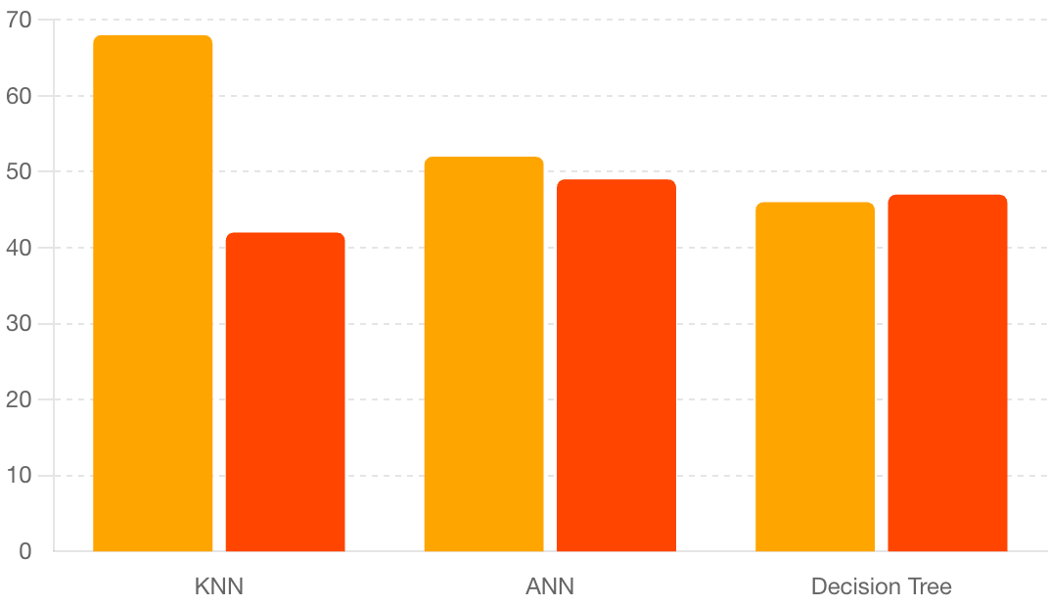
Supervised Learning Algorithms
Algorithms Used:
K-Nearest Neighbors (KNN):
Training Accuracy: 68%
Test Accuracy: 42%
Artificial Neural Network (ANN):
Training Accuracy: 52%
Test Accuracy: 49%
Decision Tree:
Training Accuracy: 46%
Test Accuracy: 47%

Slide 6
Summary and Next Steps
Summary of Hypotheses and Methods:
The hypotheses were validated using KNN, ANN, and Decision Tree models.
KNN was the most consistent, although both KNN and ANN showed overfitting issues, and Decision Tree was the most accurate overall.
Next Steps:
Continue optimizing the Decision Tree model.
Explore ensemble methods combining supervised and unsupervised models.
Extend research to uncategorized patterns using unsupervised learning.

Slide 7
THANK YOU!
Any questions?
GitHub repository
You can contact me at: mpab28@gmail.com

