Slide 1
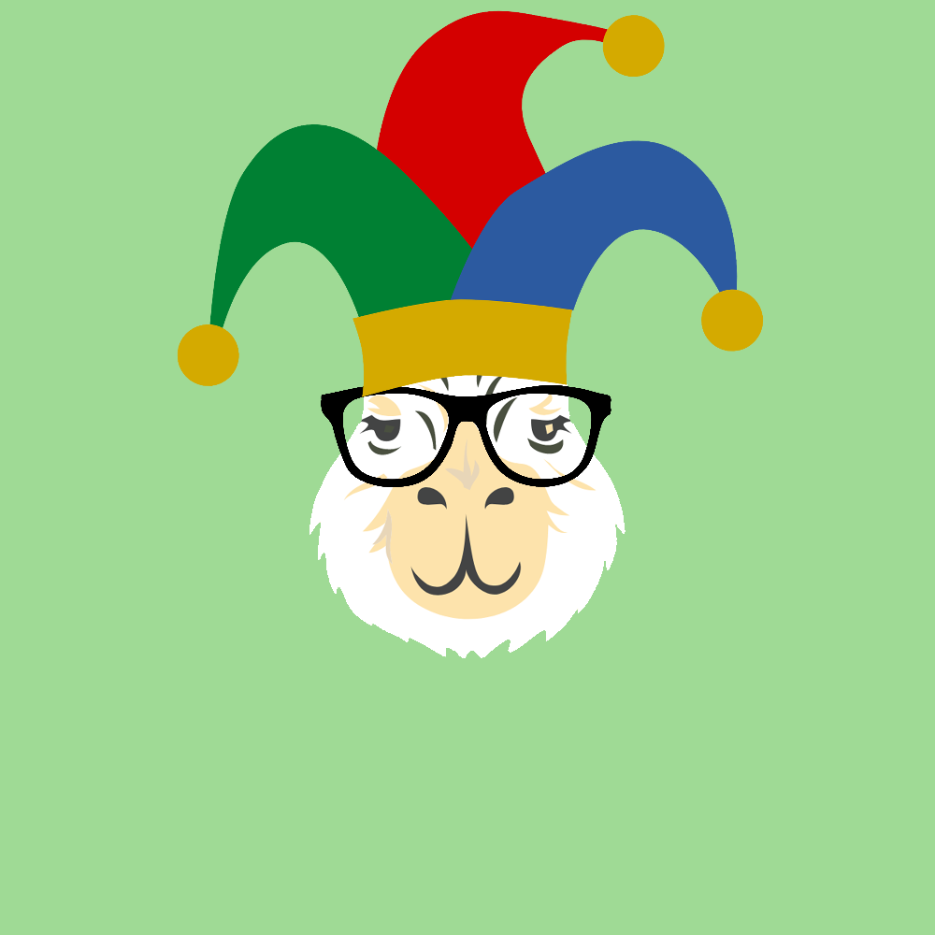
NFTs
And Our Journey To The Creation Of The Cryptobara Collection
A project by: Marcela Castano Rina Weiner Frank Lau Monique Ferguson

Slide 2
Overview
Let’s make an NFT!
Artistic Development
Pinata and IPFS
Smart Contract
Minted Cryptobara Collection & Dapp

