Slide 1
TEACHING DECK
The Architecture of Intent
A Framework for Designing Delegated Systems
Marcel Aldecoa · 2026
Position-and-framework paper · ~15,000 words / 34 pages
TEACHING DECK · COMPANION TO THE PAPER

Slide 2
ROADMAP
What we'll cover
01
The problem
Why intent is a design surface, and the judgment gap of 2024–2026
02
The framework
Five archetypes · four dimensions · seven failures · spec-driven development
03
Application
Coding agents, computer-use agents, composition with DevSquad Copilot
04
Honest accounting
What is novel, what is borrowed, what we deliberately don't claim
05
Take-homes
Limitations, where the framework breaks, what to try Monday morning
The Architecture of Intent · Marcel Aldecoa, 2026
02 / 20

Slide 3
01 · THE PROBLEM
“
Delegation is a structural problem.
Humans must express intent precisely enough that a non-human
executor can act on it without supervisory rescue.
The framework's central claim is that intent is a primary design artifact distinct from implementation. AI agents are the class where this becomes load-bearing — because the executor is probabilistic.
The Architecture of Intent · Marcel Aldecoa, 2026
03 / 20

Slide 4
01 · THE PROBLEM
The judgment gap
An execution-first bias in current agent harnesses
SENIOR ENGINEER
LLM AGENT (with AskUserQuestion)
• Surfaces ambiguity before acting
• Executes first, even on under-specified work
• Asks "is this what you mean?"
• Pauses rarely, even when tools exist
• Refuses ill-posed work
• Reaches for action before reaching for clarification
• Treats clarification as load-bearing
• Tool exists; judgment to use it is not yet calibrated
The Architecture of Intent · Marcel Aldecoa, 2026
04 / 20

Slide 5
01 · HONEST ACCOUNTING
What we claim, what we don't
Reviewers reward narrow novelty claims. Overclaiming gets punished.
CLAIMED AS NOVEL · 3
EXPLICITLY NOT CLAIMED
• Cat 7 (Perceptual Failure) for perceiving-then-acting agents
• SDD as a discipline — lineage: spec-kit, DevSquad
• Orthogonality of agency × autonomy (extends Shavit & Agarwal 2023)
• Archetypes as concept — lineage: Anthropic Building Effective Agents
• Fix-locus framing of the failure taxonomy
• Four dimensions individually — lineage: SAE J3016, Shavit & Agarwal
• Cat 1–6 as categories — synthesis from common practice
The Architecture of Intent · Marcel Aldecoa, 2026
05 / 20

Slide 6
02 · ACTIVITIES
Five activities, one canvas
The framework is organized along an activity spine. Each activity binds a specific load-bearing list; reading the framework along the spine makes the rest fit together.
Activity
Binds
Output
Frame
5 archetypes · 4 dimensions
Archetype + calibration
Specify
12 spec sections · sub-blocks
The canonical spec
Delegate
8 pattern categories · 4 oversight
Bound agent + oversight
Validate
7 failure cats · 4 signal metrics
Diagnosed failures, fix-locus
Evolve
Closed loop · audit · versioning
Structural amendments
The Architecture of Intent · Marcel Aldecoa, 2026
06 / 20

Slide 7
02 · THE FRAMEWORK
Four load-bearing elements bound to the spine
The synthesis is the larger contribution. The four bind into a framework you can apply in design, in spec review, and in post-incident diagnosis.
01
02
03
04
ARCHETYPES
DIMENSIONS
FAILURE TAXONOMY
PROTOCOL
Five canonical delegation shapes
Four orthogonal calibration dials
Seven categories by fix locus
Spec-Driven Development
Advisor · Executor · Guardian · Synthesizer · Orchestrator
Agency · Autonomy · Responsibility · Reversibility
Cat 1 (Spec) → Cat 6 (Model) · Cat 7 (Perceptual) — NOVEL
An executable spec the agent runs and a human validates
The Architecture of Intent · Marcel Aldecoa, 2026
07 / 20

Slide 8
02.1 · ARCHETYPES
Five canonical delegation shapes
Pre-commit a system to one shape before design begins. Composition is permitted.
Archetype
Primary intent
Examples
Advisor
Surfaces options; the human acts
Code-review suggester · search agent
Executor
Acts within a defined scope
CI/CD pipeline · deploy agent
Guardian
Vetoes; protects a boundary
Compliance gate · safety filter
Synthesizer
Combines inputs into a new whole
Research summarizer · report generator
Orchestrator
Coordinates other agents/services
Multi-agent supervisor · planner
The Architecture of Intent · Marcel Aldecoa, 2026
08 / 20

Slide 9
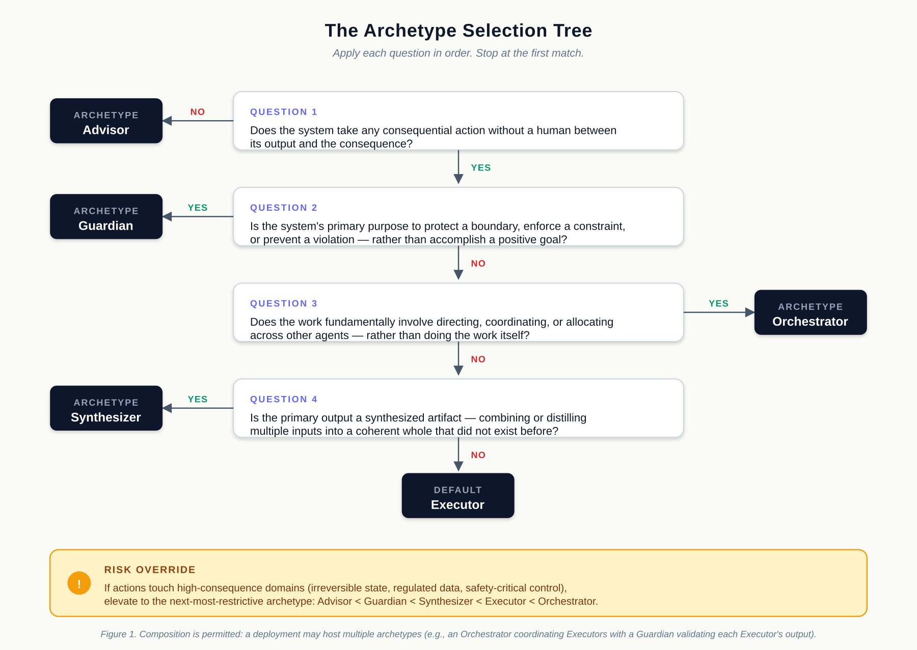
02.1 · ARCHETYPES
The selection tree
Apply each question in order. Stop at the first match. Risk-override applies.
Figure 1. Composition is permitted: a deployment may host multiple archetypes.
The Architecture of Intent · Marcel Aldecoa, 2026
09 / 20

Slide 10
02.2 · DIMENSIONS
Four orthogonal dials, set deliberately in the spec
Most teams collapse these into "how autonomous is the agent?" — the intuition hides the calibration work.
AGENCY
AUTONOMY
RESPONSIBILITY
REVERSIBILITY
discretion
operation
accountability
consequence
How much judgment when instructions don't fully cover the situation
How much of the work runs without human intervention at each step
How accountability is distributed across the humans around the agent
How easy or hard it is to undo what the agent did
The Architecture of Intent · Marcel Aldecoa, 2026
10 / 20

Slide 11
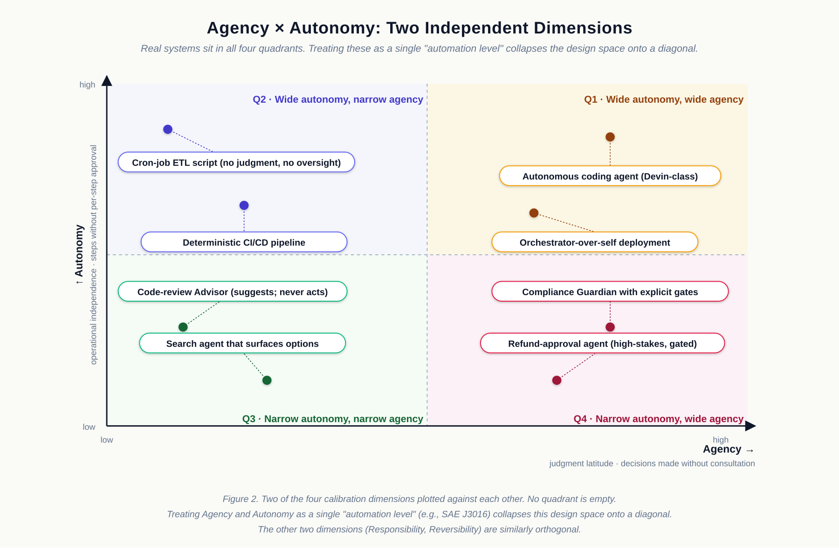
02.2 · DIMENSIONS
Agency × Autonomy: orthogonal, not collinear
Treating both as a single "automation level" (e.g., SAE J3016) collapses the design space onto a diagonal. Real systems sit in all four quadrants.
Figure 2. The other two dimensions (Responsibility, Reversibility) are similarly orthogonal.
The Architecture of Intent · Marcel Aldecoa, 2026
11 / 20

Slide 12
02.3 · FAILURE TAXONOMY
Seven categories, organized by fix locus
Diagnostic test: "If a competent agent had executed this spec as written, would the outcome have been correct?"
#
Name
Failure shape
Fix locus
Cat 1
Spec
Spec was incomplete, ambiguous, or wrong
Update the spec
Cat 2
Capability
Agent lacked or misused a tool
Add or fix the tool / manifest
Cat 3
Scope creep
Agent did adjacent work it wasn't authorized
Tighten NOT-authorized clauses
Cat 4
Oversight
Error escaped the review checkpoint
Redesign the oversight model
Cat 5
Compounding
Early error cascaded through later steps
Checkpoint at the handoff
Cat 6
Model-level
Model failed despite a correct spec
Narrow scope, switch model, or accept residual
Cat 7
Perceptual
Perception diverged from environment state
Structural controls + verification step
The Architecture of Intent · Marcel Aldecoa, 2026
12 / 20

Slide 13
02.3 · THE NOVEL CATEGORY
Cat 7 — Perceptual Failure
The system's perception of the environment diverged from the actual state, and the system acted on the wrong perception.
FOUR SUB-CATEGORIES
WHY A SEPARATE CATEGORY
Misidentification
Confirmation gate before high-consequence actions
■
Prior taxonomies don't partition this — MAST, hallucination survey, OWASP LLM Top 10
Missed element
Screenshot-then-verify before consequential action
■
Applies only to perceiving-then-acting systems — computer-use · browser-use · robotic
Hallucinated element
Element-allowlist + DOM-grounded verification
■
The fixes don't live in the prompt — they live in the spec, manifest, and verification step
State miscount
Re-verify position-based facts at action time
■
Smallest contribution that gives the taxonomy a slot for a class already observed
The Architecture of Intent · Marcel Aldecoa, 2026
13 / 20

Slide 14
02.4 · SPEC-DRIVEN DEVELOPMENT
SDD: the executable protocol layer
A spec the agent can run and a human can validate. Lineage: spec-kit (GitHub), DevSquad (Microsoft).
13 CANONICAL SECTIONS
HOW THE FRAMEWORK MAPS IN
· 1. Problem statement
· 2. Objective
■
Agency
· 3. Authorized scope
· 4. NOT-authorized scope
lives in §3 (scope) and §4 (NOT-authorized)
■
Autonomy
· 5. Tool manifest
· 6. Invariants
lives in §10 (oversight model)
· 7. Non-functional
· 8. Acceptance criteria
■
Responsibility
· 9. Execution instructions
· 10. Oversight model
lives in §1 (problem) and §11 (validation)
■
Reversibility
· 11. Validation
· 12. Spec evolution log
lives in §5 (manifest) and §6 (invariants)
· 13. Spec gap log
■
Each failure cat
maps to a specific update site
The Architecture of Intent · Marcel Aldecoa, 2026
14 / 20

Slide 15
03 · APPLICATION · CODING AGENTS
Coding agents — where structural fixes compound
Most coding-agent failures look novel; nearly all map to a Cat 1–6 fix-locus.
01
The deleted-tests failure
Cat 1 / Cat 3 hybrid. Fix in the spec (§4 NOT-authorized) and in CI (test-skip set monotonic) — never only in the prompt.
02
Three structural controls
(1) PR-only branch protection. (2) Tool manifest excludes unrestricted shell. (3) Test-suite invariant in CI.
03
The discipline
Structural fixes live in spec / manifest / CI / platform. Prompt-level patches don't compound.
04
What Cat 7 does NOT do here
Coding agents are text-only. They have no perception–action interface that can diverge from environment state.
The Architecture of Intent · Marcel Aldecoa, 2026
15 / 20

Slide 16
03 · APPLICATION · COMPUTER-USE
Computer-use — where Cat 7 becomes load-bearing
Anthropic Computer Use · OpenAI Operator · Gemini computer use — vision-then-action systems.
NEW FAILURE SURFACES
FOUR STRUCTURAL CONTROLS
■
Lookalike-domain navigation
■
Sandboxed environment
homoglyph · typo · subdomain confusion
no host credentials, files, extensions
■
Visual instruction injection
■
Auth-scope minimization
rendered text treated as authoritative
redirects don't carry session cookies
■
Modal popup interception
■
Domain allowlist
adversarial dialog read as legitimate prompt
non-allowlisted redirect halts and surfaces
■
High-consequence gates
irreversible-action class always gates
The Architecture of Intent · Marcel Aldecoa, 2026
16 / 20

Slide 17
03 · APPLICATION · DEVSQUAD
Composition with Microsoft DevSquad Copilot (2026)
DevSquad provides the cadence; the framework provides the design vocabulary. They compose cleanly when the artifact mapping is explicit.
Phase
DevSquad activity
Framework artifact
1–2
Envisioning + Spec the slice
Archetype committed; provisional dimensions
3
Plan only what the slice needs
Invariants in §6; ADRs constrain §8
4
Decompose that slice
Least-Capability tool subset per task
5
Implement with TDD discipline
Spec acceptance suite gates each commit
6
Learn in the open
Categorize Cat 1–7; trace to fix locus
7
Review in independent context
Validation in fresh sub-agent context
8
Refine continuously
Four signal metrics drive next sprint
The Architecture of Intent · Marcel Aldecoa, 2026
17 / 20

Slide 18
04 · LIMITATIONS
Where this framework breaks
Position-and-framework paper. No quantitative validation at scale yet — acknowledged explicitly.
01
Position paper, not empirical
Applied across three worked examples. Quantitative validation across many independent deployments is future work.
02
Coarse partitions
Five archetypes, four dimensions, seven categories — opinionated rather than derived.
03
Fleet governance scales to ~50 tenants
v2.4.0 added a Multi-Tenant Fleet Governance chapter (Operations) with four moves: constraint inheritance, cross-tenant isolation, partitioned telemetry, platform-tier failure-locus. At hundreds of tenants, additional org machinery is needed.
04
Cardinality is judgment, not theorem
Reasonable readers may propose six categories or eight; the framework's working choice is seven.
05
Cat 7 sub-categories may evolve
Computer-use is young; the four sub-categories will likely be revised as the deployment surface matures.
The Architecture of Intent · Marcel Aldecoa, 2026
18 / 20

Slide 19
05 · TAKE-HOMES
What to try Monday morning
Five concrete experiments any team can run on the system they're building today.
01
Pick one agent system you're operating
Run the archetype decision tree against it. Does the result match what you have today?
02
Write the spec for its most consequential action
Use the canonical template. Focus on §3 (scope) and §4 (NOT-authorized). The first draft will feel incomplete — that is the point.
03
Categorize the first three failures
Apply the diagnostic test, walk Cat 1–7, trace to the fix locus. How many were spec gaps versus model limits?
04
Surface ambiguity, don't resolve
When the spec is unclear, the agent's job is to surface, not to guess. Wire AskUserQuestion into the harness AND calibrate the judgment to use it.
05
Compound the learning
Each diagnosed failure improves a spec or a skill. The improvement is durable and propagates to every future task.
The Architecture of Intent · Marcel Aldecoa, 2026
19 / 20

Slide 20
DISCUSSION
Three prompts to start the conversation
01
Where in your team is intent currently implicit, and where would making it explicit pay off most?
02
What's the last agent failure you saw — and which Cat 1–7 was it, really?
03
Are your structural controls (spec, manifest, CI, platform) doing the work that today still lives in prompts?
Paper · marcelaldecoa.github.io/TheArchitectureOfIntent · Companion book at the same site

