Slide 1

Information Retrieval in Context A Case Study with the COVID-19 Pandemic
Bachelor’s thesis presentation
Marcel Braasch
Goethe Universität Frankfurt
11/06/2020

Slide 2
Contents
Introduction
Motivation
Aim
Recap: vector space models
Context-based IR approach
Context
Notes:
Introduce a context-based IR approach which is
tailored to COVID-19,
user-centric,
analysed by conducting experiments and
of theoretical nature.

Slide 3
Introduction – Academics
2004 – 2015: Abitur in Butzbach
2011 – 2012: High school year in California, USA
2015 – 2018: Studies in business and physics (not completed)
2018 – 2020: Bachelor’s in Computer Science with a minor in linguistics at Goethe University Frankfurt
2020 – now: Master’s in Data Engineering and Analytics majoring in ML and NLP at Technical University Munich

Slide 4
Motivation
COVID-19 pandemic is a new scenario for most of us
Uncertain how to behave correctly
Large volume of information
Dynamic information landscape
People use search tools to complement their information need
Search engines possibly too general to find fitting information
Explicit search query may not express intent of the user
Goal: find the context around the user

Slide 5



Aim
Mom
“I am wondering how affected my son is by the corona virus. Is he a transmitter of the virus as well?”
“Should my child wear a face mask at school”
Documents
User
Has
Information need
Formulates
Query
Retrieval function
Returns
Retrieved documents

Slide 6
Aim
User
Has
Information need
Formulates
Documents
Explicit Query
Feedback
Retrieval function
Returns
Retrieved documents

Slide 7
Aim
User
Ambiguity of words
Choosing words not present in target documents
Choosing incorrect words / missing background knowledge
Has
Information need
Information loss
Formulates
Loses
Documents
Explicit Query
Implicit Intent
Feedback
Retrieval function
Returns
Retrieved documents

Slide 8
Aim
User
Has
Information need
Formulates
Loses
Model this intent in the form of context by understanding the user’s interest
Explicit Query
Implicit Intent
Context
Retrieval function

Slide 9
Aim
User
Has
Information need
Formulates
Loses
Explicit Query
Context
Retrieval function

Slide 10
Vector space models
Word embedding
king
queen
man
woman
Notes:
Before I explain how to model or represent that context I want quickly introduce the underlying information retrieval model in use.

Slide 11
Vector space models
king
queen
royalty
man
woman
female

Slide 12
Vector space models: documents
Documents about dogs
Documents about cats
8
6
7
”Are cats good with kids?”
5
Top 5 documents: 4, 2, 3, 1, 7
4
2
3
1
Notes:
We can now do the same thing we did with single concepts with documents and sentences. I am not going to talk about the exact method in use. Now imagine in addition to the embedded corpus we throw in a sentence or a question we are interested in. The model in use will now embed this question according to its sematic similarity to the documents.

Slide 13
Contextual problems in IR
Same search queries may be expected to yield different results
Search queries may be imprecise
The weighting of terms in a search queries may be incorrect
“Should my child wear a face mask”
Notes:
Punkt 1 - Example: Mercury
Punkt 2 – the issue could be on the asker due to missing background knowledge or on the documents side due to using other other terms than what the asker used
Due to the approach chosen (VSM) this is not much of a problem because even if concepts are phrased differently they should be at about the same position
Punkt 3 – the main thing this approach is trying to exploit. Assume a corpus of documents comprised of n corona documents.

Slide 14
Contextual problems in IR
Same search queries may be expected to yield different results
Search queries may be imprecise
The weighting of terms in a search queries may be incorrect
“Should my child wear a face mask”
Seemingly unimportant sub-topics may not be captured well
Notes:
Punkt 1 - Example: Mercury
Punkt 2 – the issue could be on the asker due to missing background knowledge or on the documents side due to using other other terms than what the asker used
Due to the approach chosen (VSM) this is not much of a problem because even if concepts are phrased differently they should be at about the same position
Punkt 3 – the main thing this approach is trying to exploit.
There are two concepts in the question asked.
If it is a corona article, the main concept addressed by it will be the face mask.
Rather subtle (suttle) or latent topics like the child are not paid much attention to.

Slide 15
Approach idea
Documents with topic face mask
Documents with topic children
4
Documents with both mask / children
5
1
Step 1
Query: ”Should my child wear a face mask?”
8
9
4, 5, 1, 8, 9 are retrieved
2
3
Step 2
7
Re-rank with context: ”School”
9, 8, 1, 5, 4 is re-ranking result
Notes:
We can now do the same thing we did with single concepts with documents and sentences. I am not going to talk about the exact method in use. Now imagine in addition to the embedded corpus we throw in a sentence or a question we are interested in. The model in use will now embed this question according to its sematic similarity to the documents.

Slide 16
Context
What contexts are relevant (in a pandemic setting)?
How to represent context (textually)?
How to find the correct context?

Slide 17
What contexts are relevant (in a pandemic setting)?

Slide 18
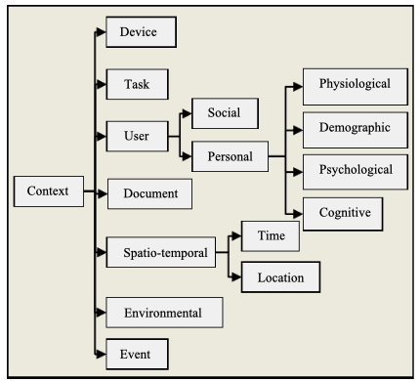
Contexts of relevance
Work our way through general taxonomies of contexts
In the context of a pandemic, especially task, social, and event seem important

Slide 19
Contexts of relevance: social
Social
Role
User
Context
Personal
Location
Task
Event
The role one takes may imply the locations one may be interested in
Virus behaves differently in certain locations
Possible locations to differentiate may be schools, hospitals, gyms, sports fields, airplanes, trains

Slide 20
Contexts of relevance: event & task
Social
Role
User
Context
Personal
Location
Task
Topic
Event
COVID-19
The COVID-19 pandemic in principle brings two large classes of topics one may be interested in either
the impact it has or
the mitigation measures against it
The COVID-19 pandemic in principle brings two large classes of topics one may be interested in either

Slide 21
Contexts of relevance: summary
Though many contexts are presented only a few selected ones were investigated
In this thesis I especially investigated a user’s interest in
a location setting, often interest in schools
the mitigation measures, trying to find the correct realization out of face masks, hand washing, social distancing, surface cleaning and air filtration

Slide 22
How to represent context (textually)?

Slide 23
Representation of Context
Query: “Should my child wear a face mask?”
4
5
1
8
9
”School”
2
3
7

Slide 24
Representation of Context
Experimental Setting
Four concept topics hand washing, social distancing, face masks and air circulation were chosen
For each topic four hand picked articles were chosen
For each of the topics we try to find possible good representations
Finally the representations are compared with the articles. The closest are the best
Hand washing
Social Distancing
Face masks
Air circulation
1 | 2 | 3 | 4 | 1 | 2 | 3 | 4 | 1 | 2 | 3 | 4 | 1 | 2 | 3 | 4
Terms
Wikipedia
Summaries

Slide 25
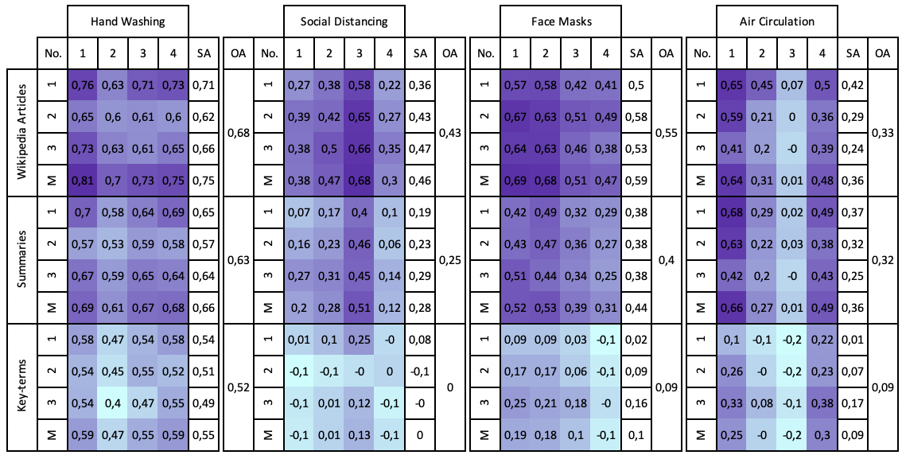
Representation of Context
Interpretations
Wikipedia articles are closest
Summaries are not far off and might be fine-tuned to get better results
Some articles are closer/further to all embeddings → captures all concepts better

Slide 26
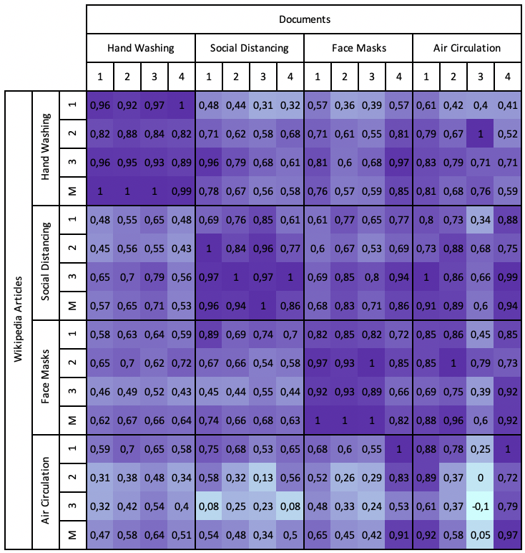
Representation of Context
Experimental Setting
Make sure not every Wikipedia article is close to every newspaper document
Compare every article with every document
Normalized for visualization purposes
Interpretations
Dark diagonal → most Wikipedia articles are close to their respective topic
Intra-class Wikipedia article quality may differ significantly

Slide 27
How to find the correct context?

Slide 28
Optimization of Context
Explicitly gaining user information has been in use for decades One could explicitly ask for more user context
User does not always want to fine-tune the system due to
time constraints
privacy concerns
One can implicitly infer the user’s interest

Slide 29
Optimization of Context: example
Assume a corpus of documents embedded in space
Assume a context of mitigation measures embedded in space
Assume a context of locations embedded in space
Assume a previous sequence of clicked documents
For each context space map each document to its closest corresponding topic
Place a searcher amidst the contexts and move it in the direction of the mapped sequence
For the next query, re-rank according to the topic which is closest to the searcher
Documents | Doc 1 | Doc 2 | Doc 3 | Doc 4
Locations | School | School | Kindergarten | School
Mitigation measure | Hand washing | Hand washing | Hand washing | Hand washing
School
Kindergarten
Hand
Washing

Slide 30
Limitations
Last scenario is a theoretical construct and not thoroughly tested
Assumed clean sequence – noisy sequences will certainly occur
Assumed distinct topic borders

Slide 31
Thank you for your attention.
Questions?

Slide 32
References
Slide 12:
[1] Ethayarajh, K., Duvenaud, D., & Hirst, G. (2018). Towards understanding linear word analogies. arXiv preprint arXiv:1810.04882.
Slide 19:
[2] Boughareb, D., & Farah, N. (2014). Context in information retrieval.

