Slide 1
Detection of Bias and Debiasing
Seminar Ethics in NLP
Marcel Braasch
Technical University Munich
06/23/2021

Slide 2
Table of Contents
01
02
03
04
What is bias
Bias in NLP
Basic introduction
and examples
Examples and introduction to the problem statement
Annotation Practices
Detecting bias
Practices in dataset creation and how to obtain data
Paper results and experiments by Geva et al.
Debiasing
Ethical Implications of bias
05
Current ideas and practices in NLP debiasing
06
Discussion on implications and current issues

Slide 3
What is bias?

Slide 4
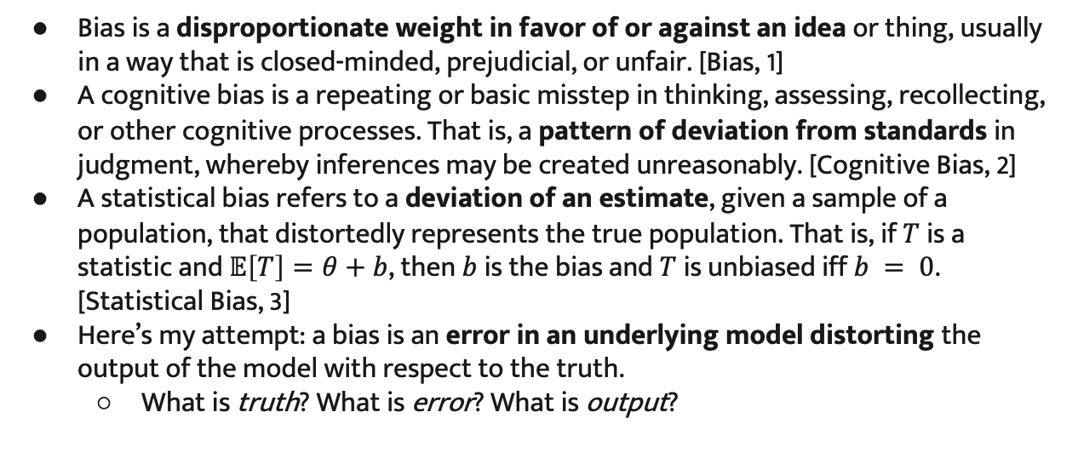
What is bias?
Bias is a disproportionate weight in favor of or against an idea or thing, usually in a way that is closed-minded, prejudicial, or unfair. [Bias, 1]
A cognitive bias is a repeating or basic misstep in thinking, assessing, recollecting, or other cognitive processes. That is, a pattern of deviation from standards in judgment, whereby inferences may be created unreasonably. [Cognitive Bias, 2]
A statistical bias refers to a deviation of an estimate, given a sample of a population, that distortedly represents the true population. That is, if $T$ is a statistic and $𝔼\left[T\right]=θ+b$, then $b$ is the bias and $T$ is unbiased iff $b = 0$. [Statistical Bias, 3]
Here’s my attempt: a bias is an error in an underlying model distorting the output of the model with respect to the truth.
What is truth? What is error? What is output?
1
Notes:
⇨ What is truth? (“truth is the property of being in accord with fact or reality”, now what is fact/reality –
does certainly shifts w.r.t society, time, HOWEVER, whole different discussion)
⇨ What is a model? (= data model, machine learning model, human, etc.)
⇨ What is output? (= e.g. what a model

Slide 5
Bias in NLP

Slide 6
Bias in NLP
Language view
01
Inherent bias in language
Socio-cultural view
02
E.g., race, identity, political orientation or gender bias
Technical view
biased datasets, biased models or both
03
Let‘s have a quick look at a few examples.
1

Slide 7
Bias in NLP
Bias in natural language does not have to be positively/negatively co-notated
We can, e.g., be biased toward using a word or phrase unproportionally often
Example: You want to train a model captioning images. The domain is drawings created by your mom, hence you annotate data yourself. Examples of your annotations
“This is a sunflower” “This is a lawn mower” “This is a Labrador”
➜ Model will be clearly biased towards using “This is … ” when creating captions.
Question 1: How to prevent one’s individual bias from having such a big impact?
Question 2: If this is not a harmful bias, why would we care in the first place?
1

Slide 8
Bias in NLP [example: translation bias]
Er ist Programmierer
Die Assistentin des CEOs
MT Model
MT Model
Es programado
El assistente del CEO
1

Slide 9
Bias in NLP [example: word vector bias]
doctor
criminal
nurse
police
man
black
woman
white
Gender bias word vectors
Racial bias word vectors
1

Slide 10
Anno-tation practices

Slide 11
Annotation practices
Usually, one can distinguish between two data generating processes
The dataset is handcrafted by a group of people [Section 04: Detecing Bias]
The dataset is sourced from the internet [Section 05: Debiasing]
Generating large datasets has become one of the main drivers of progress in NLP
A common recent practice is to
have a group of workers generate a massive number of high-quality annotations
where only a few workers annotate the majority of the dataset examples
➜ Raises concerns about data diversity and the ability of models to generalize, especially when the task is to generate free text.
Notes:
If an annotator consistently uses language patterns that correlate with the labels,
neural model can pick up on those, which can lead to an over-estimation of model performance.

Slide 12
Annotation practices
Geva et al. (2019) analyzed the following datasets [11]
OpenBookQA
MNLI
CommonSenseQA
5500 samples
84 annotators
➜ 65 samples each
400.000 samples
380 annotators
➜ 1000 samples each
11.000 samples
130 annotators
➜ 85 samples each

Slide 13
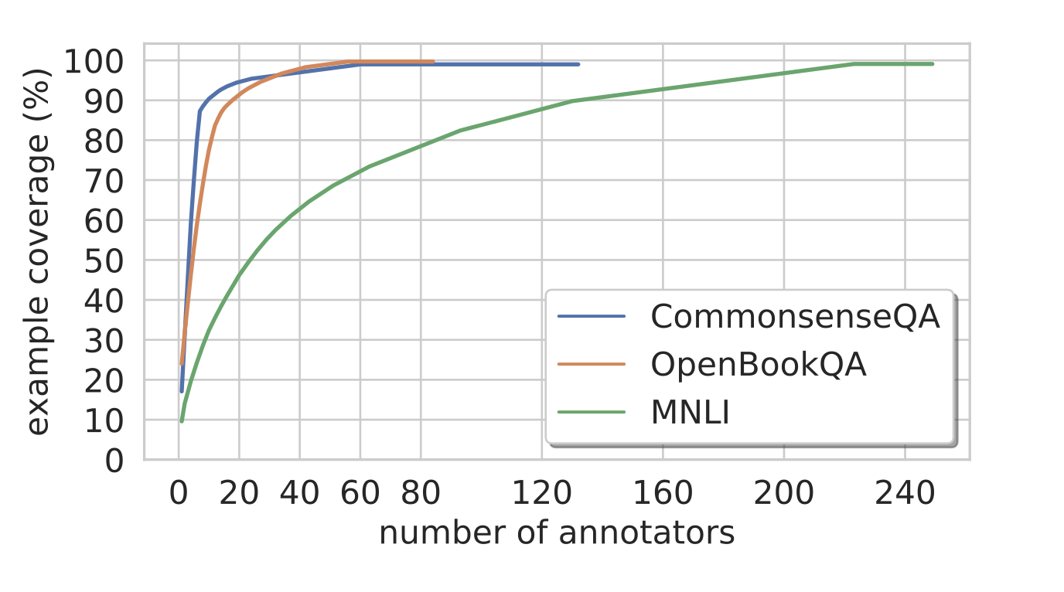
Annotation practices
CommonSenseQA
10% / 13 annotators created
90% of the data set
OpenBookQA
25% / 20 annotators created
90% of the dataset
MNLI
55% / 130 annotators created
90% of the dataset
➜ annotator distribution skewed, very few annotators create the vast majority of dataset
➜ in tasks that involve creative writing, this may have implications on data diversity
➜ may lead to an over-estimation of model performance.

Slide 14
— Geva et al. conducted three experiments
1. Utility of annotator information
2. Annotator recognition
3. Generalization across annotators
▶︎Model for all experiments: BERT_{BASE} fine-tuned to respective task

Slide 15
Detecting bias

Slide 16
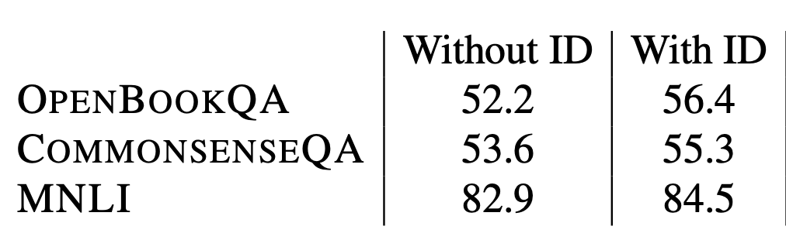
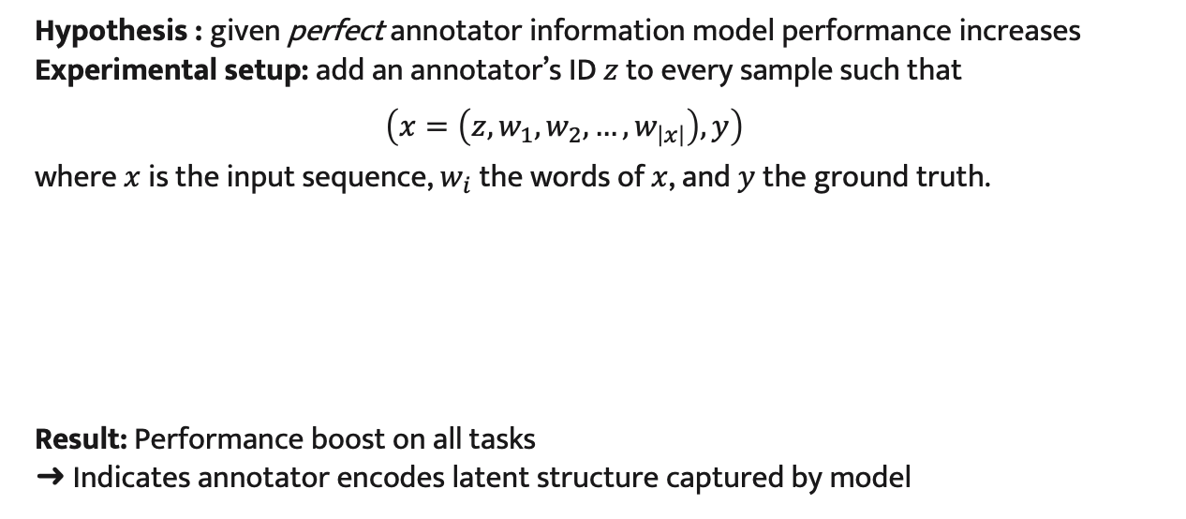
Detecting bias [experiment 1]
Hypothesis : given perfect annotator information model performance increases Experimental setup: add an annotator’s ID $z$ to every sample such that
$\left(x=\left(z, w_{1}, w_{2},…, w_{\left|x\right|}\right),y\right)$
where $x$ is the input sequence, $w_{i}$ the words of $x$, and $y$ the ground truth.
Result: Performance boost on all tasks
➜ Indicates annotator encodes latent structure captured by model
Absolut gain
+ 4.2%
+ 1.7%
+ 1.6%

Slide 17
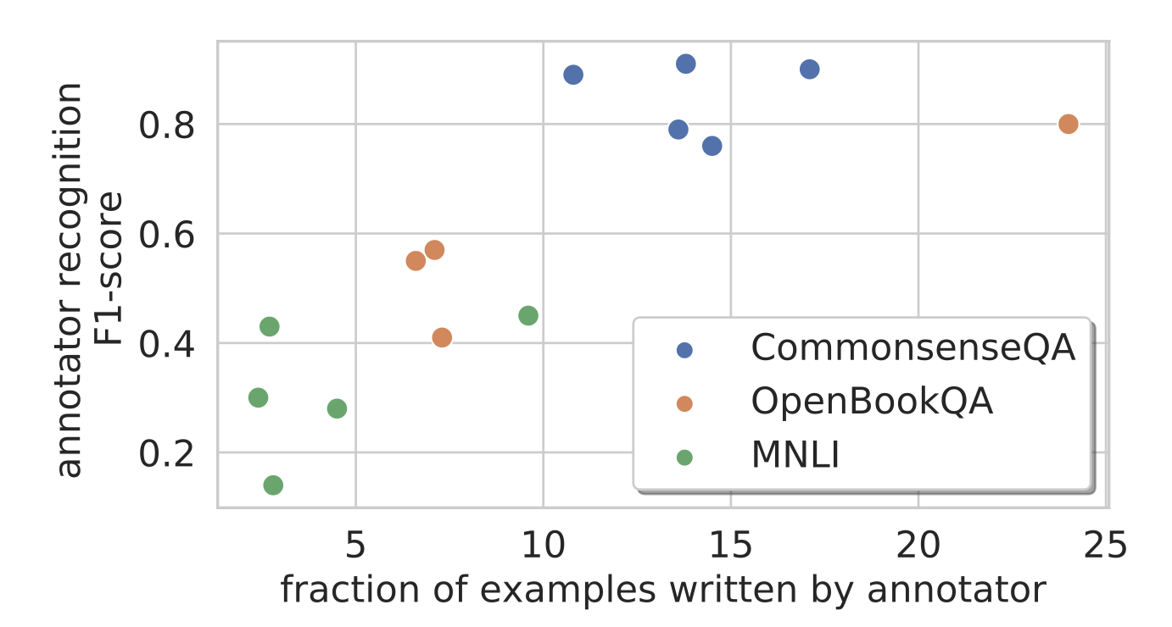
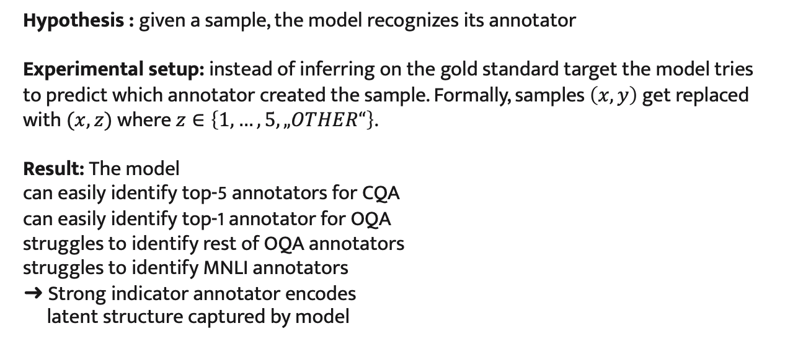
Detecting bias [experiment 2]
Hypothesis : given a sample, the model recognizes its annotator
Experimental setup: instead of inferring on the gold standard target the model tries to predict which annotator created the sample. Formally, samples $\left(x,y\right)$ get replaced with $(x,z)$ where $z∈\left\{1,…,5, „OTHER“\right\}$.
Result: The model
can easily identify top-5 annotators for CQA
can easily identify top-1 annotator for OQA
struggles to identify rest of OQA annotators
struggles to identify MNLI annotators
➜ Strong indicator annotator encodes
latent structure captured by model

Slide 18






$$𝒮_{𝒵}$$
$$𝒮_{𝒵}$$
$$𝒯$$
$$𝒮_{z}$$
$$𝒯$$
$$𝒮_{z}$$

Slide 19



Detecting bias [experiment 3]
Hypothesis : given example sets Sample set $𝒮_{z}⊂𝒮⊂ 𝒟$and two disjoint subsets $𝒮 \backslash 𝒮_{z}$ and $𝒮_{z}$. The model trained on $𝒮 \backslash 𝒮_{z}$ does not generalize well to $𝒮_{z}$.
Multi annotator data split
5 splits with 5 random low-productivity annotators
Single annotator data split
5 splits for each annotator in top 5
Train Set
Dev Set
Train Set
Dev Set
$$𝒮 \backslash 𝒮_{𝒵}$$
$$𝒮_{𝒵}$$
$$𝒮 \backslash 𝒮_{z}$$
$$𝒮_{z}$$
$$𝒮_{𝒵}$$

Slide 20
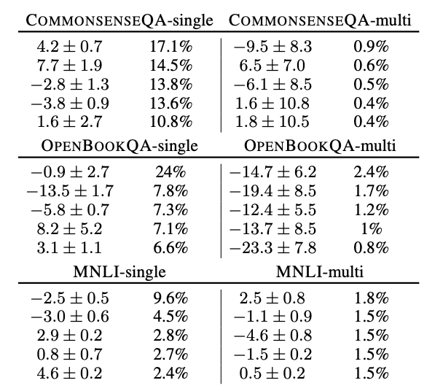



Detecting bias [experiment 3]
Multi annotator data split
Performance radically decreased for OpenBookQA
➜ Model does not generalize well to examples generated
by unseen annotators
For CommonsenseQA and MNLI
performance dropped in half of
the cases
Recall, OpenBookQA was most
skewed annotator distribution
$$𝒮_{train}$$
$$𝒮_{dev}$$
$$𝒮_{𝒵}$$

Slide 21
Detecting bias [experiment 3]
Single annotator data split
About 50% of the cases has lower generalization performance from many to one annotator
Issue: Presumably not very meaningful as
annotators’ sample difficulty may vary
substantially. A negative result for,
e.g., annotator 3 may be because his
samples where much more difficult.
not because of a bias.
➜ Idea: Control for task hardness and annotator bias.
$$𝒮_{train}$$
$$𝒮_{dev}$$

Slide 22
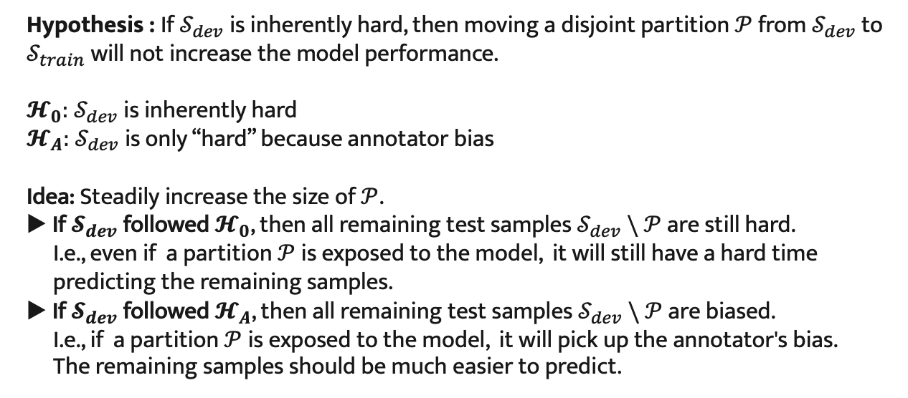
Detecting bias [experiment 3]
Hypothesis : If $𝒮_{dev}$is inherently hard, then moving a disjoint partition $𝒫$ from $𝒮_{dev}$ to $𝒮_{train}$ will not increase the model performance.
$𝓗_{0}:$ $𝒮_{dev}$is inherently hard
$𝓗_{A}:$ $𝒮_{dev}$is only “hard” because annotator bias
Idea: Steadily increase the size of $𝒫$.
▶︎ If$𝓢_{dev}$ followed $𝓗_{0}$, then all remaining test samples $𝒮_{dev} \backslash 𝒫$ are still hard.
I.e., even if a partition $𝒫$ is exposed to the model, it will still have a hard time predicting the remaining samples.
▶︎ If$𝓢_{dev}$ followed $𝓗_{A}$, then all remaining test samples $𝒮_{dev} \backslash 𝒫$ are biased.
I.e., if a partition $𝒫$ is exposed to the model, it will pick up the annotator's bias.
The remaining samples should be much easier to predict.

Slide 23
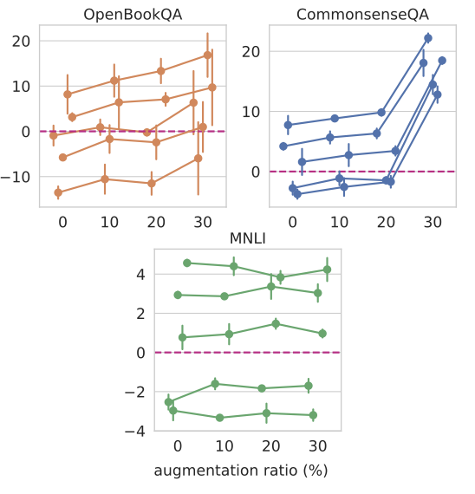
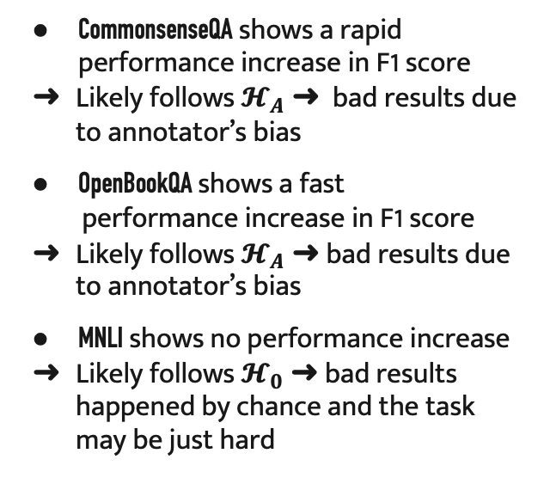
Detecting bias [experiment 3]
CommonsenseQA shows a rapid performance increase in F1 score
➜ Likely follows $𝓗_{A}$ ➜ bad results due to annotator’s bias
OpenBookQA shows a fast
performance increase in F1 score
➜ Likely follows $𝓗_{A}$ ➜ bad results due to annotator’s bias
MNLI shows no performance increase
➜ Likely follows $𝓗_{0}$ ➜ bad results happened by chance and the task may be just hard

Slide 24
Detecting bias [Summary]
Geva et al. conducted three experiments
1. Utility of annotator information
2. Annotator recognition
3. Generalization across annotators

Slide 25
Debiasing

Slide 26
Debiasing
For the next section we will be shifting away from the idea of an annotator bias induced by very few people to a different form of bias:
Societal and structural bias, often encountered in huge large-scale corpora sourced from the internet
These corpora have billion of sentences which are impossible to scan by hand
However, powerful models like GPT-3 will certainly pick up biases if they occur often enough
In the following, we will quickly discuss the types of models that pick up these biases, skim over proposed solutions and more thoroughly enlighten a recent work

Slide 27
Debiasing
All NLP models pick up unfair biases from data and can produce toxic output, e.g.,
Static word embeddings (e.g., CBOW, Skip-Gram, fastText, etc.)
Contextualized word embeddings (e.g., GloVe, ELMo, BERT embeddings, etc.)
Pre-trained language models (GPT-2, GPT-3, BERT, T5, etc.)
For most models various debiasing algorithms have been proposed.
Quickly take a look the following approach by Schick, Udupa and Schütze (2021) [10]:
“Self-Diagnosis and Self-Debiasing: A Proposal for Reducing Corpus-Based Bias in NLP “

Slide 28
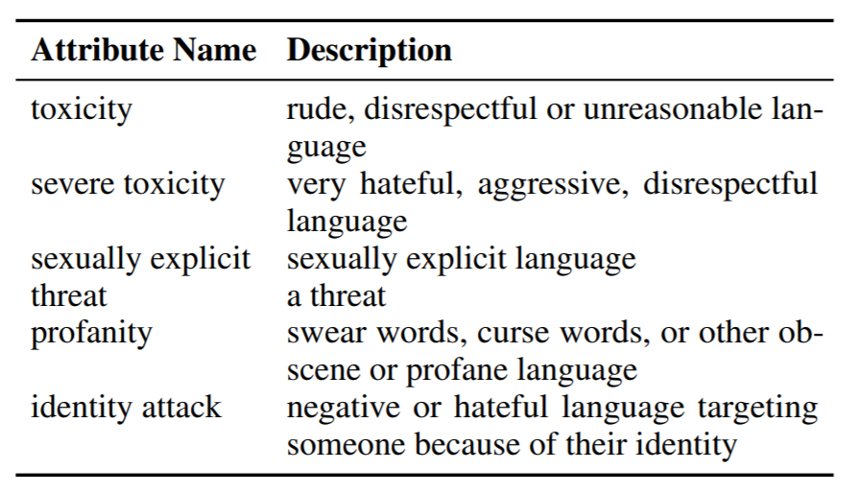
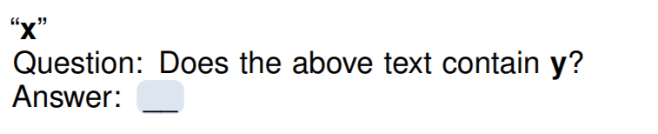
Debiasing [self-diagnosis]
Bias type: undesired and harmful output (e.g., toxic, hateful language)
Idea: Does a pretrained language model know when they produce undesirable output?
Approach: Follows a few-short learning idea. Provide a general description of the undesirable categories and ask the model whether its output belongs the these categories
We do this by using a self-diagnosis template.

Slide 29
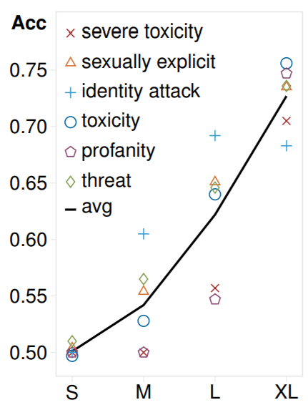
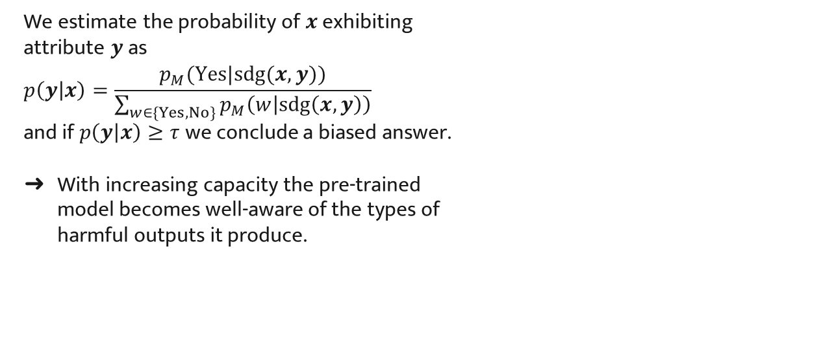
Debiasing [self-diagnosis]
We estimate the probability of $x$ exhibiting
attribute $y$ as
$$p\left(y | x\right)=\frac{p_{M}(Yes|sdg(x,y))}{\sum_{w∈\{Yes,No\}}{p_{M}\left(w | sdg\left(x,y\right)\right)}}$$
and if $p\left(y | x\right)≥τ$ we conclude a biased answer.
➜ With increasing capacity the pre-trained
model becomes well-aware of the types of
harmful outputs it produce.
➜ If the model recognizes these outputs it
might as well make use of that knowledge
to mitigate undesired predictions

Slide 30
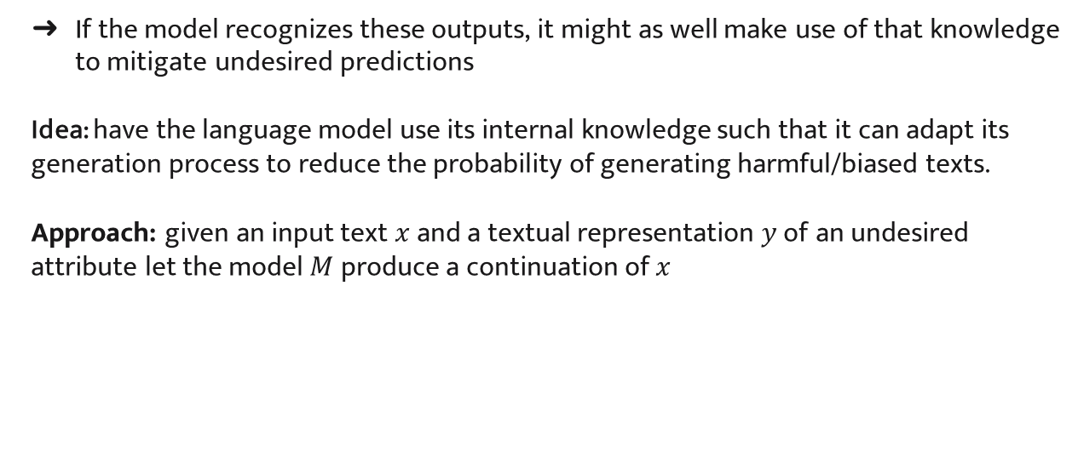
Debiasing [self-debiasing]
➜ If the model recognizes these outputs, it might as well make use of that knowledge
to mitigate undesired predictions
Idea: have the language model use its internal knowledge such that it can adapt its generation process to reduce the probability of generating harmful/biased texts.
Approach: given an input text $x$ and a textual representation$y$of an undesired attribute let the model $M$ produce a continuation of $x$

Slide 31
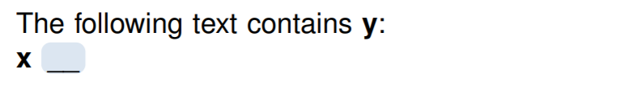
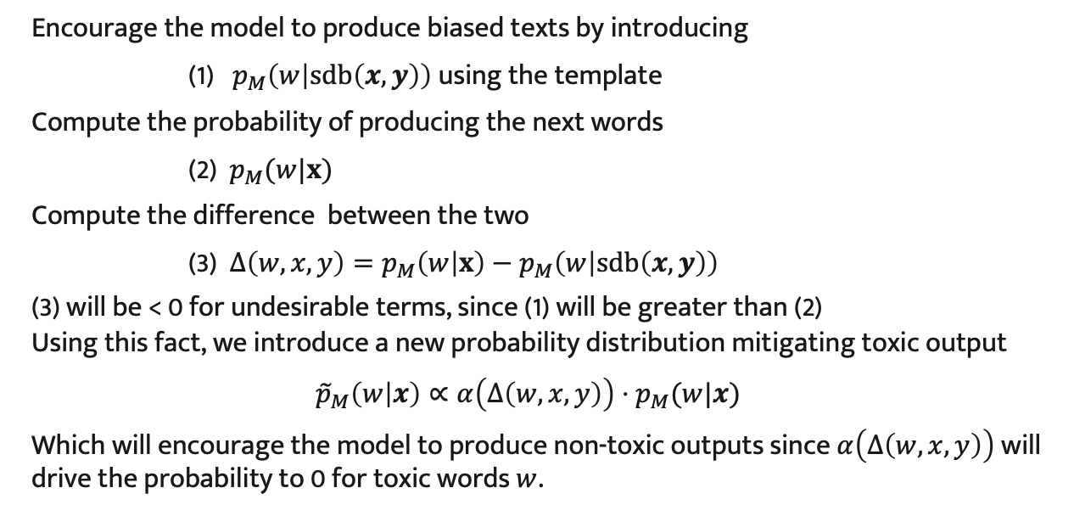
Debiasing [self-debiasing]
Encourage the model to produce biased texts by introducing
(1) $p_{M}\left(w | sdb\left(x,y\right)\right)$ using the template
Compute the probability of producing the next words
(2) $p_{M}(w|x)$
Compute the difference between the two
(3) $Δ\left(w,x,y\right)=p_{M}\left(w | x\right)−p_{M}\left(w | sdb\left(x,y\right)\right)$
(3) will be < 0 for undesirable terms, since (1) will be greater than (2)
Using this fact, we introduce a new probability distribution mitigating toxic output
$${\tilde{p}}_{M}\left(w | x\right)∝α\left(Δ\left(w,x,y\right)\right)⋅p_{M}(w|x)$$
Which will encourage the model to produce non-toxic outputs since $α\left(Δ\left(w,x,y\right)\right)$ will drive the probability to 0 for toxic words $w$.

Slide 32
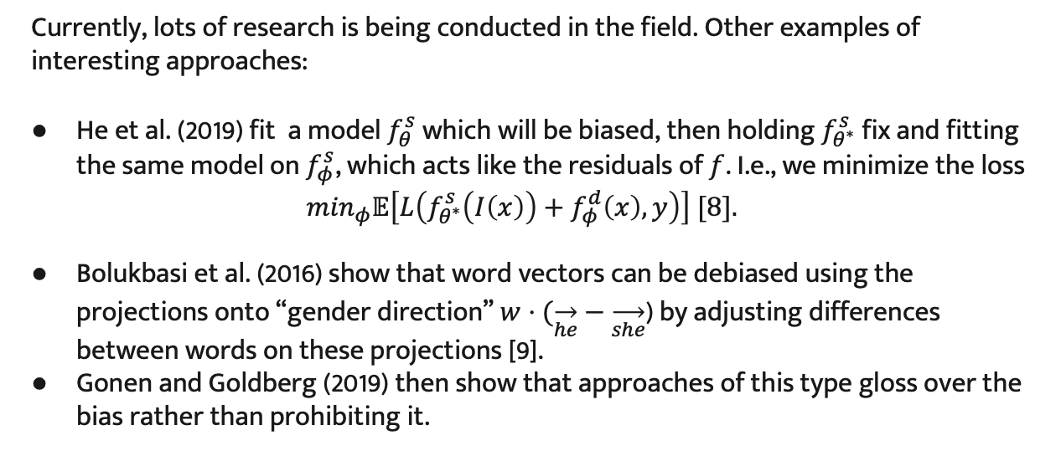
Debiasing [other ideas]
Currently, lots of research is being conducted in the field. Other examples of interesting approaches:
He et al. (2019) fit a model $f_{θ}^{s}$ which will be biased, then holding $f_{θ^{∗}}^{s}$ fix and fitting the same model on $f_{φ}^{s}$, which acts like the residuals of $f$. I.e., we minimize the loss
$$\min_{φ}𝔼\left[L\left(f_{θ^{∗}}^{s}\left(I\left(x\right)\right)+f_{φ}^{d}\left(x\right), y\right)\right] [8].$$
Bolukbasi et al. (2016) show that word vectors can be debiased using the projections onto “gender direction” $w⋅(\overset{→}{he}−\overset{→}{she}$) by adjusting differences between words on these projections [9].
Gonen and Goldberg (2019) then show that approaches of this type gloss over the bias rather than prohibiting it.

Slide 33
Ethical Implications of bias

Slide 34
Ethical Implications of bias
NLP systems can
reproduce unwanted societal biases reflected in training data
amplify unfair decisions towards certain individuals
fail for some populations (children, elderly, dialects)
➜ Mismatches can have significant consequences in critical domains such criminal justice, hiring or finance [5]
➜ It is crucial to be aware of real-world impact of NLP research and understand the relationship between ideas and its consequences, specially with a view on bias. [6]
Early ethical discussion in science first arose in the medical domain.
The Belmont Report (1979) provides some guidance with three basic principles:
1) Respect for persons 2) Beneficence and 3) Justice [7]

Slide 35
References
Powerpoint template adapted from slidesgo.com
[1] Bias. (2021, May 21). In Wikipedia. https://en.wikipedia.org/wiki/Bias
[2] Bias. (2021, May 23). In Wikipedia. https://en.wikipedia.org/wiki/Bias#Cognitive_biases
[3] Bias (statistics). (2021, May 31). In Wikipedia. https://en.wikipedia.org/wiki/Bias_(statistics))
[4] Bolukbasi, T., Chang, K. W., Zou, J., Saligrama, V., & Kalai, A. (2016). Man is to computer programmer as woman is to homemaker? debiasing word embeddings. arXiv preprint arXiv:1607.06520
[5] Gebru, T., Morgenstern, J., Vecchione, B., Vaughan, J. W., Wallach, H., Daumé III, H., & Crawford, K. (2018). Datasheets for datasets. arXiv preprint arXiv:1803.09010.
[6] Stanford CS384, Lecture 1.
[7] Sims, J. M. (2010). A brief review of the Belmont report. Dimensions of critical care nursing, 29(4), 173-174.
[8] He, H., Zha, S., & Wang, H. (2019). Unlearn dataset bias in natural language inference by fitting the residual. arXiv preprint arXiv:1908.10763.

Slide 36
References
[9] Bolukbasi, T., Chang, K. W., Zou, J., Saligrama, V., & Kalai, A. (2016). Man is to computer programmer as woman is to homemaker? debiasing word embeddings. arXiv preprint arXiv:1607.06520.
[10] Schick, T., Udupa, S., & Schütze, H. (2021). Self-diagnosis and self-debiasing: A proposal for reducing corpus-based bias in nlp. arXiv preprint arXiv:2103.00453.
[11] Geva, M., Goldberg, Y., & Berant, J. (2019). Are we modeling the task or the annotator? an investigation of annotator bias in natural language understanding datasets. arXiv preprint arXiv:1908.07898.

Slide 37
Thanks for you attention!
Let’s discuss.

Slide 38
Ethical Implications of bias [Backup]

Slide 39
Ethical Implications of bias
Gebru et al. (2020) propose a systematic approach to the creation and documentation of datasets.
Defined and iterated a set of questions around the entire dataset lifecycle:
Motivation, Composition, Collection, Pre-processing/Cleaning/Labeling, Uses
Encourage the ML community to prioritize transparency and accountability
Creators and users can make out possible biases and adjust appropriately
Motivation – why was the dataset created, how, and who are stakeholders:
How was the data associated with each instance acquired?
Who created the dataset and on behalf of which entity?

Slide 40
Ethical Implications of bias
Composition – how was data sampled, what is the data distribution:
Who was involved in the data collection processed and how were they compensated?
Does the dataset contain all possible instances or is it a sample of instances from a larger set?
Does the dataset contain data that, if viewed directly, might be offensive , insulting, threatening, or might otherwise cause anxiety?
Does that dataset contain data that might be sensitive in any way?
Does the dataset identify any subpopulations?
Collection – how was data collected, metadata, peoples’ consents:
How was the data associated with each instance acquired?
Who was involved in the data collection processed and how were they compensated?
Notes:
Motivation
Is there a grantor for the creation of the dataset?
What is the purpose of the dataset?
Composition
Is the dataset representative of the entire distribution?
Does the dataset contain information that is confidential?
Collection

