Slide 1
BERT
A presentation by Marcel Braasch

Slide 2
Tiny
BERT
A presentation by Marcel Braasch
Seminar “Neural Representation Learning”
Ludwig Maximilian University Munich
Centrum für Informations- und Sprachverarbeitung
05/21/2021

Slide 3
Contents
0 1 02 03 04 05 06 07
Motivation & Aim
Knowledge Distillation
Recap: Transformers and BERT Transformer Distillation
Two-Stage Learning
Results
Discussion / Questions

Slide 4
01
Motivation & Aim

Slide 5
Motivation
Pre-Trained Language Models (LM)
are the prevailing paradigm in state-of-the-art LMs
are extremely powerful tool for natural language understanding
require immense amounts of data
can have billions of parameters
have long inference time
are difficult to deploy in settings with limited resources
5

Slide 6
Aim
Parameters
Speed
Accuracy
Reduce number of
parameters …
… gain a significant speed-up …
… without losing too much of the model‘s expressiveness.
6

Slide 7
02
Knowledge Distillation

Slide 8
Knowledge Distillation
Origin
need to compress large ensembles
accept long training for fast inference
find a way to transfer knowledge
The main assumption
Model is evaluated by means of empirical objective function
Is only an approximation to the true risk
The real aim is to measure the generalization risk
Requires to know the real data distribution (unknown a-priori)
8

Slide 9
Knowledge Distillation
Core Idea
Assume a large model’s output inhabits generalization information
Find the best approximation of a large model using a smaller one
Use the large model’s outputs as the new target
Knowledge
distillation
9

Slide 10
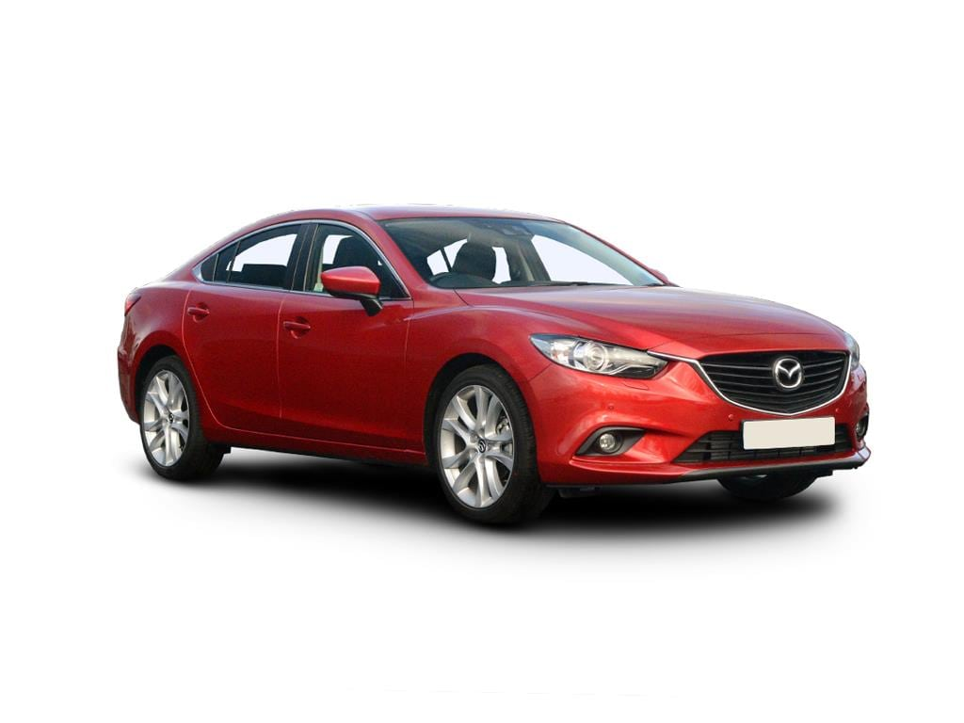


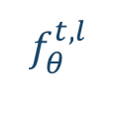
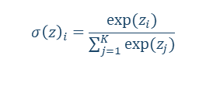
Knowledge Distillation
Assume a classifier $f_{θ}^{t}$ which is trained to predict a label ${\hat{y}}_{i}∈\left\{Banana, Truck, Car, Plan\right\}$ of an instance $x_{i}$. $f_{θ}^{t,l}$only produces the logits of the classifier (i.e., ${softmax(f}_{θ}^{t,l}(x_{i}))=f_{θ}^{t}(x_{i})$).
$$x_{i}$$
${logit}_{i}$
Probability distribution over all possible classes
$$f_{θ}^{t,l}$$
softmax
$$σ{\left(z\right)}_{i}=\frac{exp⁡(z_{i})}{\sum_{j=1}^{K}{exp⁡(z_{j})}}$$
Banana
Banana
Plane
Truck
Plane
Car
Truck
Car
10

Slide 11



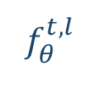
Knowledge Distillation
Assume an MNIST classifier $f_{θ}^{t}$ trying to predict 2, 3 and 7.
$$x_{i}$$
${logit}_{i}$
$$f_{θ}^{t,l}$$
softmax
3
2
7
0
1
0
7
3
2
10⁻⁶ % ratio
10⁻⁹ % ratio
11

Slide 12
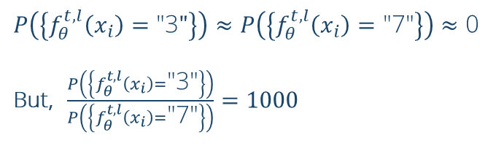

Knowledge Distillation
Assume an MNIST classifier $f_{θ}^{t}$ trying to predict 2, 3 and 7.
$$x_{i}$$
${logit}_{i}$
$P\left(\left\{f_{θ}^{t,l}\left(x_{i}\right)=\text{"3}"\right\}\right)≈P\left(\left\{f_{θ}^{t,l}\left(x_{i}\right)=\text{"7"}\right\}\right)≈$ 0
But, $\frac{P\left(\left\{f_{θ}^{t,l}\left(x_{i}\right)=\text{"3}\text{"}\right\}\right)}{P\left(\left\{f_{θ}^{t,l}\left(x_{i}\right)=\text{"7"}\right\}\right)}=1000$
$$f_{θ}^{t,l}$$
3
2
7
Much of the information about learned functions is encoded in the ratios of very small probabilities.
10⁻⁶ % ratio
10⁻⁹ % ratio
12

Slide 13
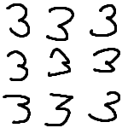
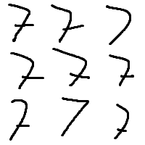
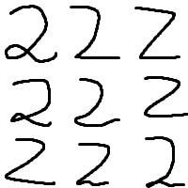
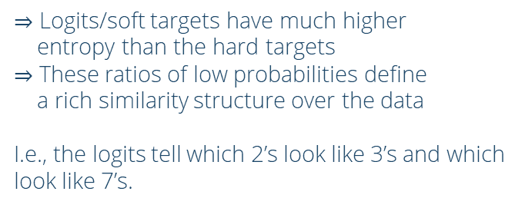
Knowledge Distillation
Assume an MNIST classifier $f_{θ}^{t}$ trying to predict 2, 3 and 7.
$$x_{i}$$
${logit}_{i}$
$⇒$ Logits/soft targets have much higher
entropy than the hard targets
$⇒$ These ratios of low probabilities define
a rich similarity structure over the data
I.e., the logits tell which 2’s look like 3’s and which look like 7’s.
$$f_{θ}^{t,l}$$
3
2
7
10⁻⁶ % ratio
$$𝒟=$$
10⁻⁹ % ratio
13

Slide 14
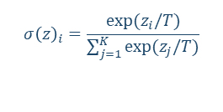
Knowledge Distillation
Assume an MNIST classifier $f_{θ}^{t}$ trying to predict 2, 3 and 7.
Question: what would be a major issue in simply using the logits of a trained teacher model as the new (soft) targets for a student model?
$$x_{i}$$
${logit}_{i}$
Answer: high entropy, indeed, but little to influence on the gradient
$$f_{θ}^{t,l}$$
softmax
3
7
$$σ{\left(z\right)}_{i}=\frac{exp⁡(z_{i}/T)}{\sum_{j=1}^{K}{exp⁡(z_{j}/T)}}$$
3
2
7
2
10⁻⁶ % ratio
10⁻⁹ % ratio
Introducing temperature retains the information encoded by the logits while keeping the properties of a PDF
14

Slide 15
Knowledge Distillation
To wrap it up
Use the large model‘s logits as the new prediction targets
Much information, little to no influence on gradients
Raise the temperature of the softmax to
retain information
receive the same classification result
get an influence on the gradient
When training temperature of both model is set equal
For inference set temperature to
15

Slide 16
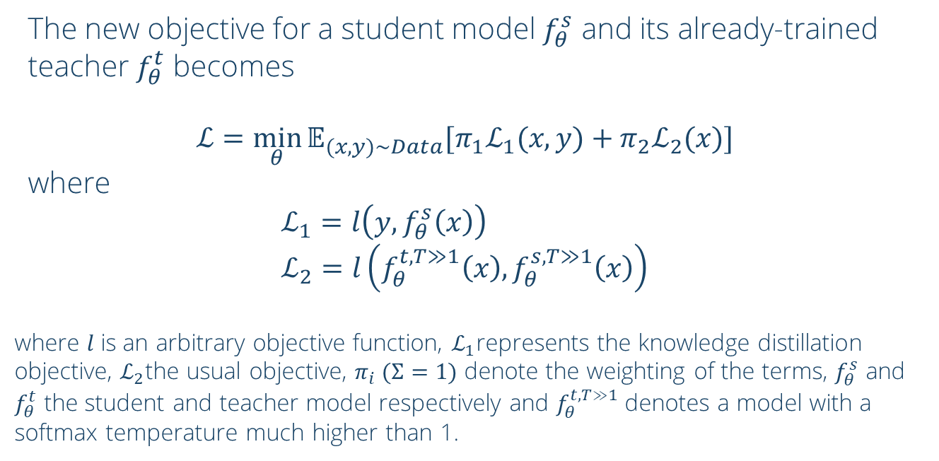
Knowledge Distillation
The new objective for a student model $f_{θ}^{s}$ and its already-trained teacher $f_{θ}^{t}$ becomes
$$ℒ=\min_{θ}{𝔼_{(x,y)\sim Data}[π_{1}ℒ_{1}(x,y)+{π_{2}ℒ}_{2}(x)]}$$
where $$ℒ_{1}=l\left(y,f_{θ}^{s}\left(x\right)\right) \\ ℒ_{2}=l\left(f_{θ}^{t,T≫1}\left(x\right),f_{θ}^{s,T≫1}\left(x\right)\right)$$
where $l$ is an arbitrary objective function, $ℒ_{1}$represents the knowledge distillation objective, $ℒ_{2}$the usual objective, $π_{i} (Σ=1)$ denote the weighting of the terms, $f_{θ}^{s}$ and $f_{θ}^{t}$ the student and teacher model respectively and $f_{θ}^{t,T≫1}$ denotes a model with a softmax temperature much higher than 1.
16

Slide 17
3 minute break
Grab a coffee,
stand up for a second,
or open the window!
Any questions so far?

Slide 18
03
Recap: Transformers and BERT

Slide 19
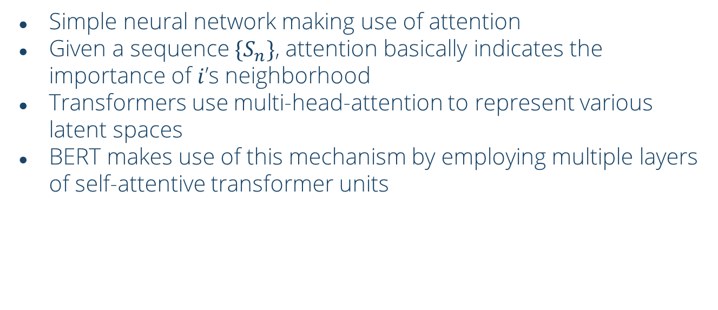
Recap:
Transformers and BERT
Simple neural network making use of attention
Given a sequence $\{S_{n}\}$, attention basically indicates the importance of $i$’s neighborhood
Transformers use multi-head-attention to represent various latent spaces
BERT makes use of this mechanism by employing multiple layers of self-attentive transformer units
19

Slide 20
Recap:
Transformers and BERT
Output
Output
Output
Output
Non-linearities
Non-linearities
Non-linearities
Concat, Add & Norm, FFN
N ×
Output
Non-linearities
Attention Head 1
Attention Head 1
Attention Head 1
MatMul
Attention Head 1
Output
Output
Output
Softmax
Non-linearities
Non-linearities
Non-linearities
Scale
h times
Attention Head 1
Attention Head 1
Attention Head 1
MatMul
Embedding
Q
K
V
Q
K
V
Q
K
V
Embedding
Embedding
Embedding
Cats are running
Embedding
Multi-head attention
Transformer Encoder Unit
BERT
20

Slide 21
04
Transformers Distillation

Slide 22








Transformers Distillation
Pre-Trained BERT
TinyBERT
Question: what’s an issue when trying to match the values of the attention matrices?
Answer: l > l’, we will have to neglect l-l’=8 layers. Thus, simply define a mapping between the layers
h = 12
d = 768
l = 12
$$ℒ=\left\{\begin{aligned}ℒ_{embd} \\ \overbrace{MSE(E^{s}W_{E},E^{t})} \\ \\ ℒ_{attn} \\ \overbrace{\sum_{i=1}^{l^{′}}{\sum_{j=i}^{h}{MSE(A_{i,j}^{s},A_{g(i),j}^{t})}}} \\ \\ ℒ_{hidn} \\ \overbrace{\sum_{i=1}^{l^{′}}{MSE(H_{i}^{s}W_{H},H_{i}^{t})}} \\ \\ ℒ_{pred} \\ \overbrace{CE(z^{s}/T,z^{t}/T)} \\ .\end{aligned}\right.$$
Attention Head_{1,1}
Attention Head_{1,2}
Attention Head_{1,L}
Embedding
Hidden
Hidden
Prediction
Non-linearities
Non-linearities
Non-linearities
$$ℒ_{embd}$$
$$ℒ_{attn}$$
$$ℒ_{hidn}$$
$$ℒ_{attn}$$
$$ℒ_{hidn}$$
$$ℒ_{attn}$$
$$ℒ_{pred}$$
Attention Head_{1,1}
Attention Head_{1,2}
Attention Head_{1,L}
Embedding
Hidden
Hidden
Prediction
Non-linearities
Non-linearities
Non-linearities
h‘ = 12
d‘ = 312
l‘ = 4
22
During pre-training, TinyBERT tries to mimic its teacher’s behavior by matching its intermediate output values.

Slide 23

Question-time
An attention head is defined by
$$attention\left(Q,K,V\right)=softmax\left(\frac{QK^{T}}{\sqrt{d_{k}}}\right)V.$$
In TinyBERT the unnormalized attention heads are distilled, i.e., for each attention head we match
$$attention_{mod}\left(Q,K,V\right)=\frac{QK^{T}V}{\sqrt{d_{k}}}.$$
What could be a reason for doing so?
Answer: higher entropy prior to normalizing, faster convergence.

Slide 24
05
Two-stage learning

Slide 25
Two-stage learning
Pre-Training
Fine-tuning
General BERT
Fine-tuned BERT
General Distillation
Task-specific Distillation
Large scale text corpus
General TinyBERT
Fine-tuned TinyBERT
Data augmentation
Task data set
Augmented data set
25

Slide 26
Two-stage learning
General Distillation
Task-specific Distillation
Large scale text corpus
General TinyBERT
Fine-tuned TinyBERT
Data augmentation
Task data set
Augmented data set
26

Slide 27
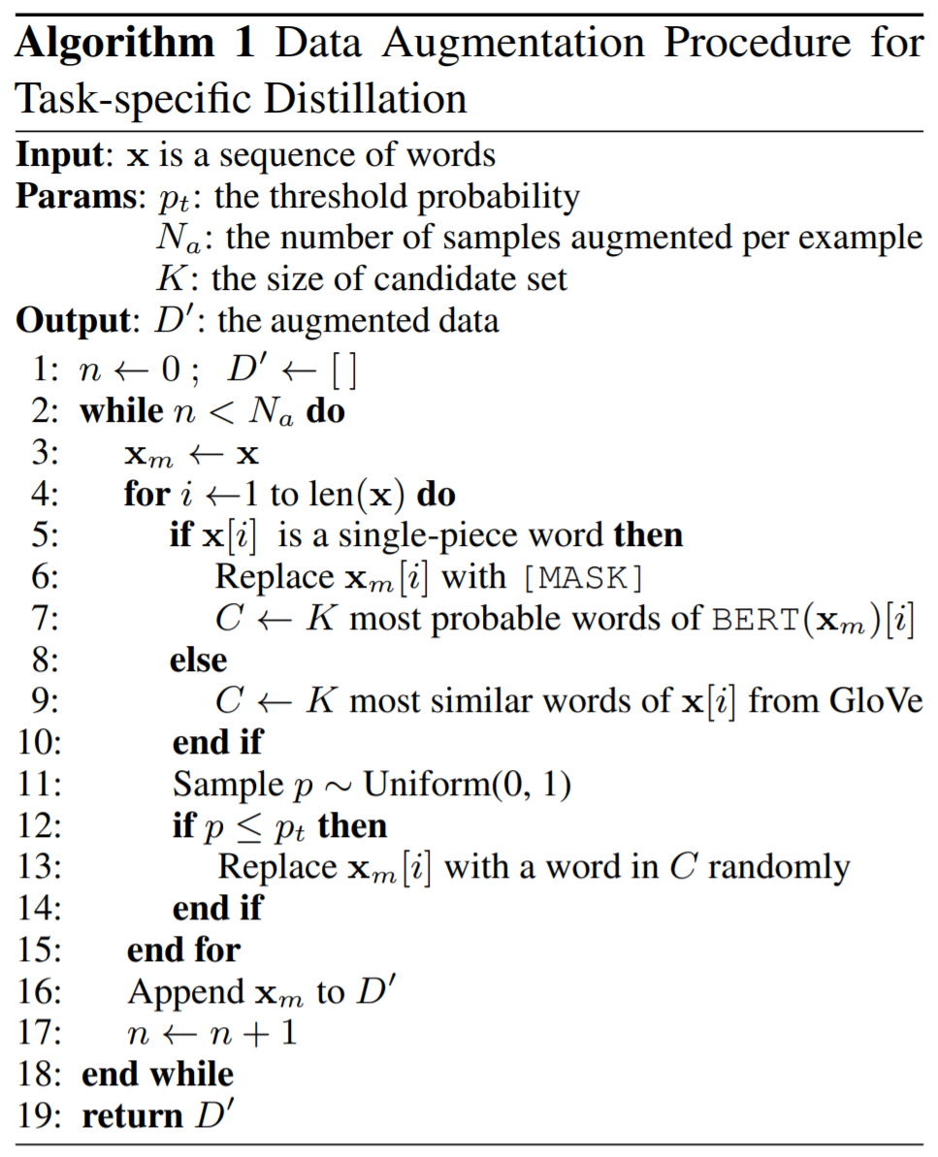

Data Augmentation
For every sentence $x$, create $N$ copies. For each copy replace each word $w$ with probability $p$ with a word uniformly drawn from a set of the $K$ most similar words to $w$.
27

Slide 28
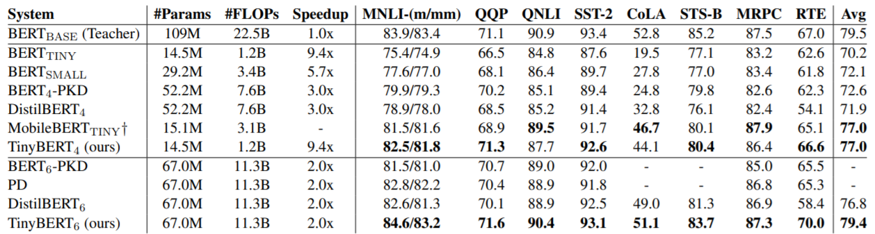
Results
TinyBERT₄ compared to BERT_{BASE}
has 96.8% of the performance
is 7.5x smaller
and 9.4x faster on inference
TinyBERT₄ compared to previous work
beats most models in most tasks
is 2-3x smaller
and 3x faster on inference
28

Slide 29
Questions
Thank you
for your attention!
Any Questions?
29

Slide 30
References
Icons from slidesgo.com
Master template adjusted from slidesgo.com
All graphics and the presentation structure are my own work
The presentation’s content and ideas are from:
[1] Bucilua, Cristian, Rich Caruana, and Alexandru Niculescu-Mizil. "Model compression." Proceedings of the 12th ACM SIGKDD international conference on Knowledge discovery and data mining. 2006.
[2] Devlin, Jacob, et al. "Bert: Pre-training of deep bidirectional transformers for language understanding." arXiv preprint arXiv:1810.04805 (2018).
[3] Hinton, Geoffrey, Oriol Vinyals, and Jeff Dean. "Distilling the knowledge in a neural network." arXiv preprint arXiv:1503.02531 (2015).
[4] Jiao, Xiaoqi, et al. "Tinybert: Distilling bert for natural language understanding." arXiv preprint arXiv:1909.10351 (2019).
[5] Vaswani, Ashish, et al. "Attention is all you need." arXiv preprint arXiv:1706.03762 (2017).
30

