Slide 1
Automatic Speech Recognition
A presentation by
Marcel Braasch
Ludwid-Maximilians Universität
Seminar Conversational AI
München, December 2nd, 2021
Hi, there my name is Ike!

Slide 2
Inhalt
Introduction
Motivation • ASR Architecture
Signal Processing
Analog signal • Digitization • Quantization • Windowing • Fourier Transform • Features
Modelling
Markov chains • HMMs • Current Architectures • LM
/a/
/s/
/r/
Hypothesis
Search
arg
max
Overview • Beam Search
2

Slide 3

Quick heads-up
This talk is technical but still rather high-level
Assumes you are familiar with basic mathematical concepts such as probability
If you are not: don’t focus too much on the formulas on the slides, look at the pretty graphics and listen , I try to make it intuitive
And please: something is unclear? Ask!
3

Slide 4
Introduction
Intro

Slide 5
Introduction: Motivation
Automatic Speech Recognition System are ubiquitous nowadays
Amazons Alexa, Apples Siri, Microsoft Cortana, etc.
User interface through natural language seems quite intuitive
Besides the post-processing NLP pipeline, we face a variety of issues
Speech is transmitted through (analog) sound waves
Computers can only process digital systems
The same sentences can sound very different
Different sentences can sound very alike
Speech-2-text pipeline can become quite complex
5

Slide 6

Introduction: ASR Architecture
Signal Processing
Modelling
Hypothesis Search
Analog audio signal
Pronunciation lexicon
Decoder
Feature extraction
Acoustic model
Digital audio signal
Language model
$$\left[\begin{matrix}22.114 & ⋯ & 1.987 \\ ⋮ & ⋱ & ⋮ \\ −9.865 & ⋯ & 3.534\end{matrix}\right]$$
6

Slide 7
Signal Processing

Slide 8

Signal Processing: Analog signal
Sound waves are essentially
variations in air pressure
Question: how do we turn this
into a digital signal?
Extracted information has to be
Robust across speakers
Robust against noise
Relatively low-dimensional
8

Slide 9
Signal Processing: Analog signal
From these continuous pressure waves discrete samples
are taken, usually by the means of a microphone
9

Slide 10
Signal Processing: Analog signal
Let’s have a (very brief) look at the inner workings of a microphone
Diaphragm
Coil
Magnet
Electric
current
10

Slide 11
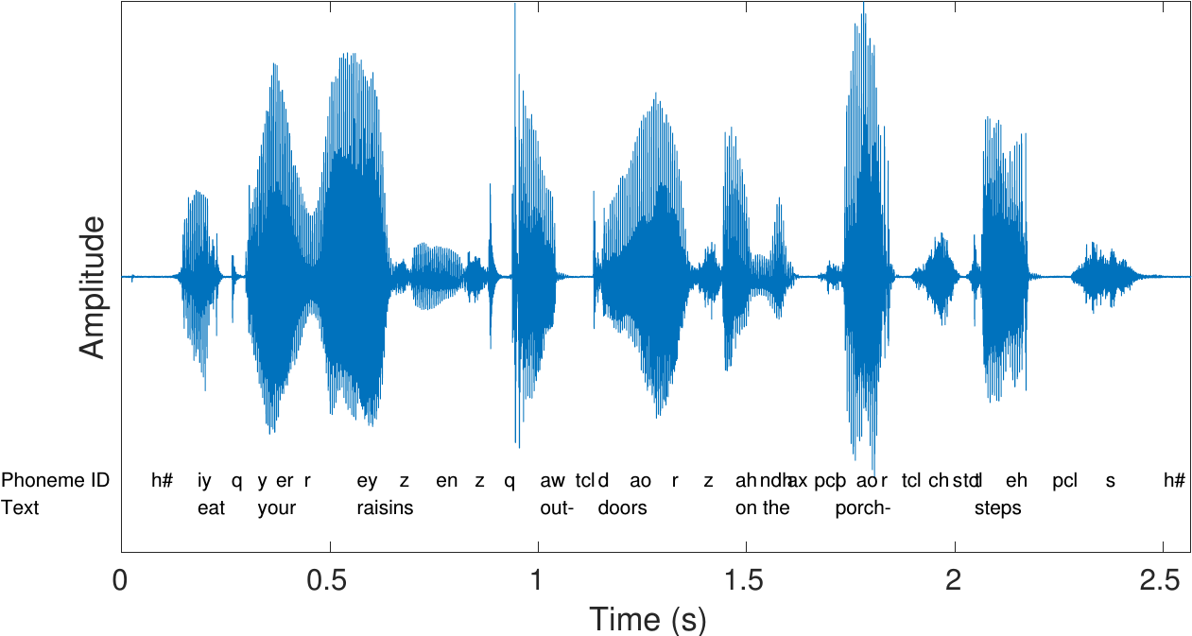
Signal Processing: Digitization
Which is turned into a
function of amplitude vs
time by sampling at
Discrete time steps.
High amplitude
= high volume
High frequency
= high pitch
11

Slide 12
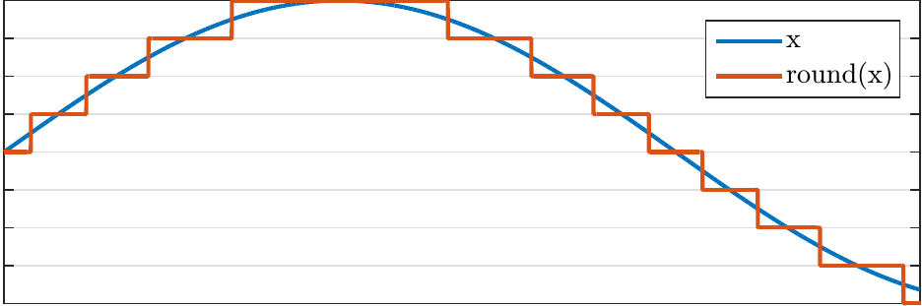
Signal Processing: Quantization
Signal is usually quantized
to the nearest bit to ensure
a consistent representation.
3 bit signal representation
7
6
5
4
3
2
1
12

Slide 13
Signal Processing: Windowing
Problem: we have a
continuous sound signal
Question: how do we find
the respective single
phonemes?
Answer: we don’t, but chunk
the signal into over-
Lapping windows
Usually around 20 – 30 ms window with 50% overlap
13

Slide 14
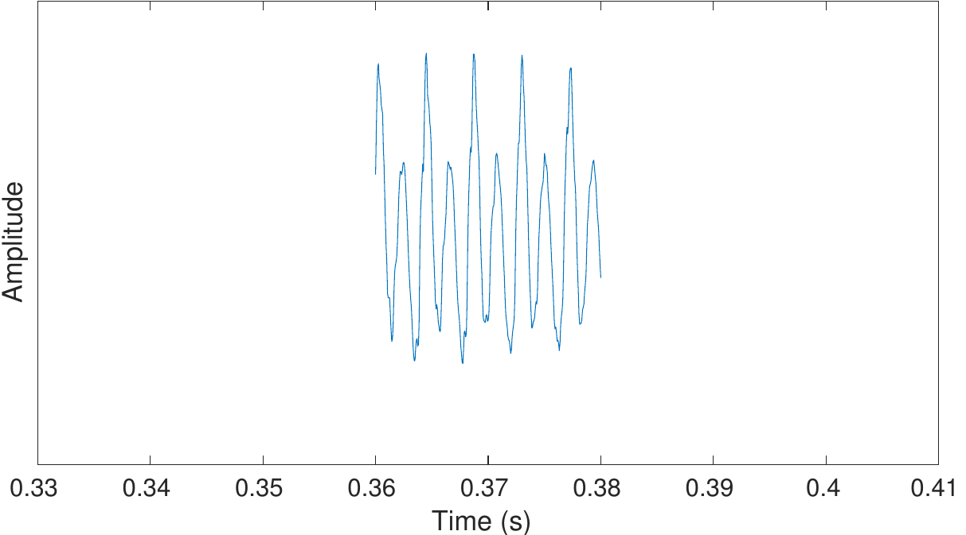
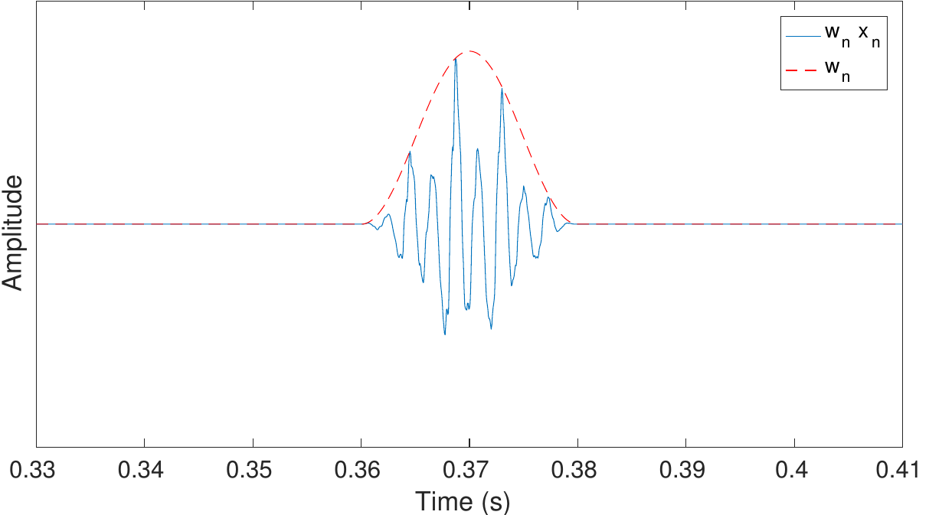
Signal Processing: Windowing
Issue: harsh cuts where start and end of window do not really correspond to true statistical properties
Solution: smooth the tails by window function (e.g., by Hann window)
14

Slide 15
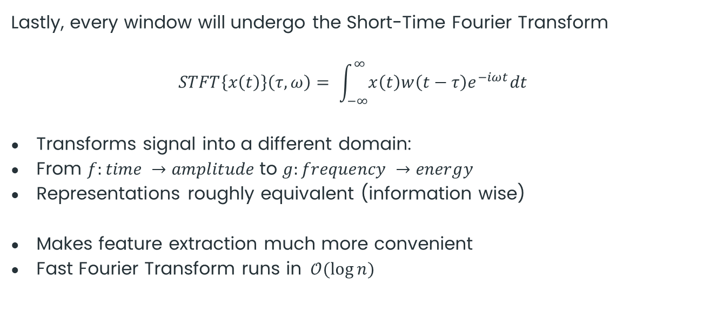
Signal Processing: STFT
Lastly, every window will undergo the Short-Time Fourier Transform
$$STFT\left\{x\left(t\right)\right\}\left(τ,ω\right)= \int_{−∞}^{∞}{x\left(t\right)w\left(t−τ\right)e^{−iωt}dt}$$
Transforms signal into a different domain:
From $f:time →amplitude$to $g:frequency →energy$
Representations roughly equivalent (information wise)
Makes feature extraction much more convenient
Fast Fourier Transform runs in $𝒪(\log{n)}$
15

Slide 16
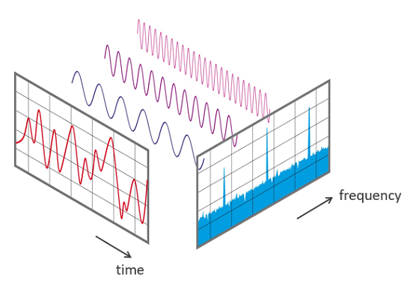
Signal Processing: STFT
From a practical point of view this is what happens
16

Slide 17
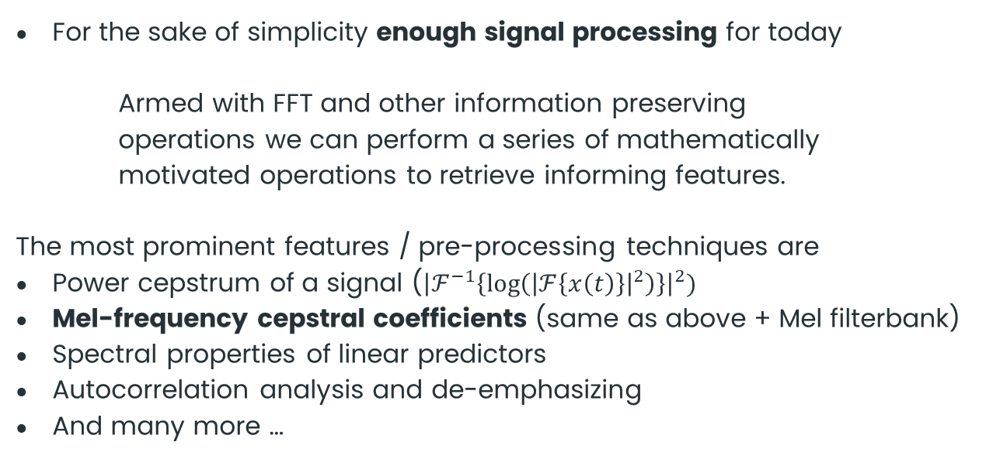
Signal Processing: STFT
For the sake of simplicity enough signal processing for today
Armed with FFT and other information preserving
operations we can perform a series of mathematically
motivated operations to retrieve informing features.
The most prominent features / pre-processing techniques are
Power cepstrum of a signal (${\left|ℱ^{−1}\left\{\log\left({\left|ℱ\left\{x\left(t\right)\right\}\right|}^{2}\right)\right\}\right|}^{2})$
Mel-frequency cepstral coefficients (same as above + Mel filterbank)
Spectral properties of linear predictors
Autocorrelation analysis and de-emphasizing
And many more …
!
17

Slide 18
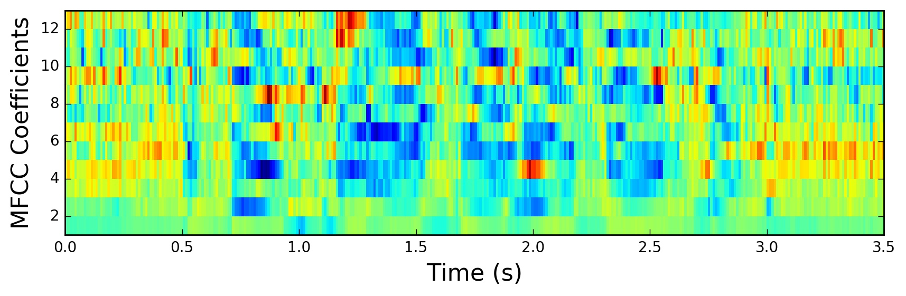
Signal Processing: MFCC
18

Slide 19
Modelling
MODEL

Slide 20
Modelling: Background
/a/
/s/
/r/
Modelling of the acoustic model quite manifold
Speech recognition active area of research ever since the 1950s
50s and 60s: first explorations of power spectra, linear predictive coding, among other speech features
70s and 80s: Increased funding and research emphasis leading to development of HMMs and applications
90s and 00s: ASR systems seeing first practical implementations in production systems (e.g., AT&T automatic routing)
10s to today: Emergence of deep learning drastically boosts ASR
HMMs are the typically the subject of modelling speech systems
Simple, powerful, flexible, combinable with arbitrary PDFs
End-to-end systems are increasingly gaining popularity
20
Notes:
DC Bias: Führt dazu, dass

Slide 21
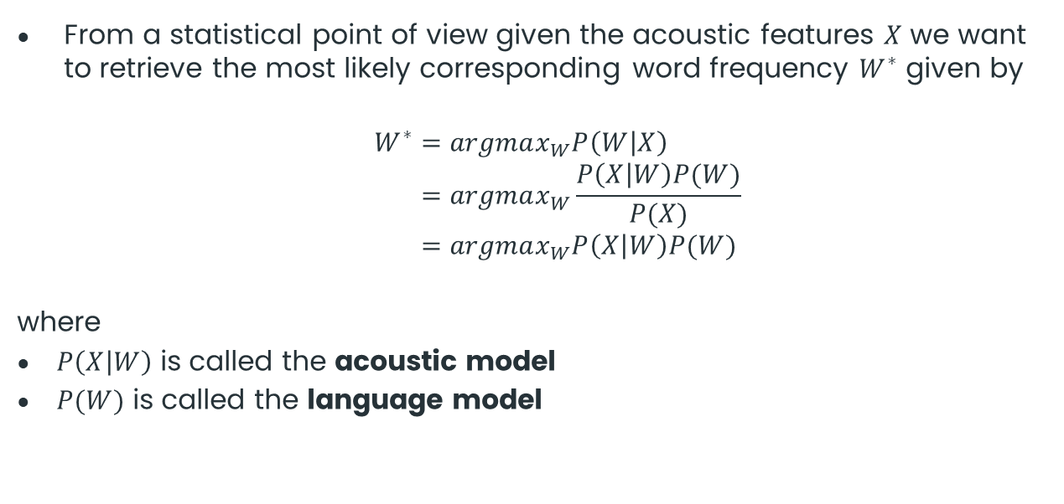
Modelling: Motivation
/a/
/s/
/r/
From a statistical point of view given the acoustic features $X$ we want to retrieve the most likely corresponding word frequency $W^{∗}$ given by
$$W^{∗}=argmax_{W}P\left(W | X\right) \\ =argmax_{W}\frac{P\left(X | W\right)P(W)}{P(X)} \\ =argmax_{W}P\left(X | W\right)P(W)$$
where
$P\left(X | W\right)$ is called the acoustic model
$P(W)$ is called the language model
21
Notes:
DC Bias: Führt dazu, dass

Slide 22

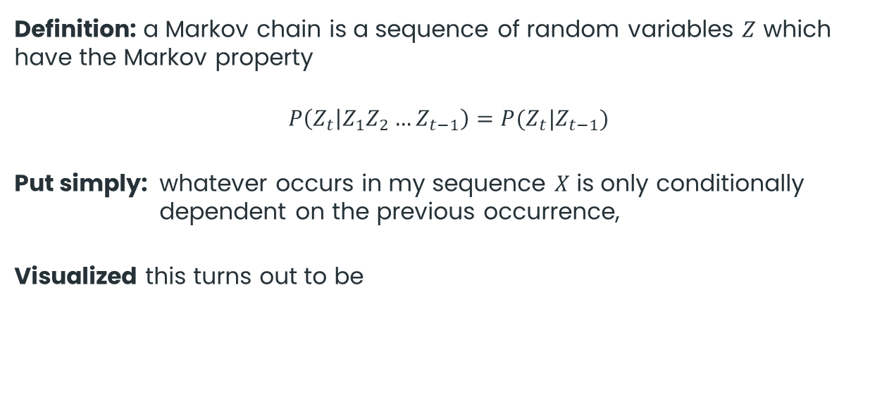




Modelling: Markov chains
/a/
/s/
/r/
Definition: a Markov chain is a sequence of random variables $Z$ which have the Markov property
$$P\left(Z_{t} | Z_{1}Z_{2}…Z_{t−1}\right)=P(Z_{t}|Z_{t−1})$$
Put simply: whatever occurs in my sequence $X$ is only conditionally dependent on the previous occurrence,
Visualized this turns out to be
$$π$$
$$Z_{1}$$
$$Z_{2}$$
$$Z_{3}$$
$$Z_{4}$$
22
Notes:
DC Bias: Führt dazu, dass

Slide 23







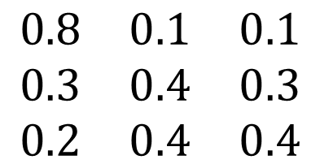






Modelling: Markov chains
/a/
/s/
/r/
$$0.4$$
Transition probabilities
$$0.8$$
$$0.1$$
$$Z_{t}$$
$$Z_{t−1}$$
$$0.2$$
$$\begin{matrix}0.8 & 0.1 & 0.1 \\ 0.3 & 0.4 & 0.3 \\ 0.2 & 0.4 & 0.4\end{matrix}$$
$$0.3$$
$$A=$$
$$0.1$$
$$0.4$$
$$0.3$$
Initial distribution
$$π=(1/3,1/3,1/3)$$
$$0.4$$
23

Slide 24

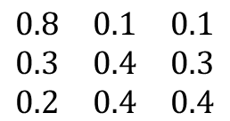
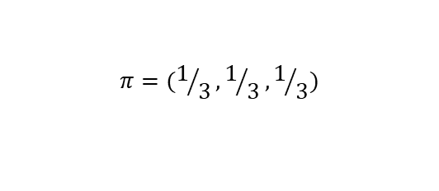
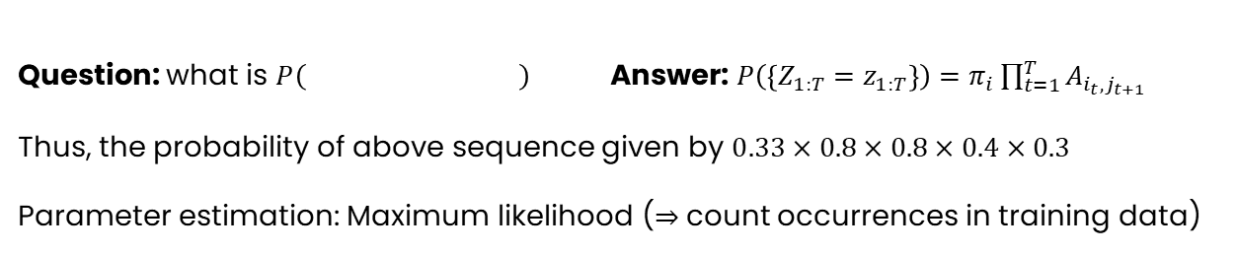


Modelling: Markov chains
/a/
/s/
/r/
Transition probabilities
Initial distribution
$$Z_{t}$$
$$Z_{t−1}$$
$$π=(1/3,1/3,1/3)$$
$$\begin{matrix}0.8 & 0.1 & 0.1 \\ 0.3 & 0.4 & 0.3 \\ 0.2 & 0.4 & 0.4\end{matrix}$$
$$A=$$
Question: what is $P\left( \right)$ Answer: $P\left(\left\{Z_{1:T}=z_{1:T}\right\}\right)=π_{i}\prod_{t=1}^{T}{A_{i_{t},j_{t+1}}}$
Thus, the probability of above sequence given by $0.33×0.8×0.8×0.4×0.3$
Parameter estimation: Maximum likelihood ($⇒$count occurrences in training data)
24

Slide 25
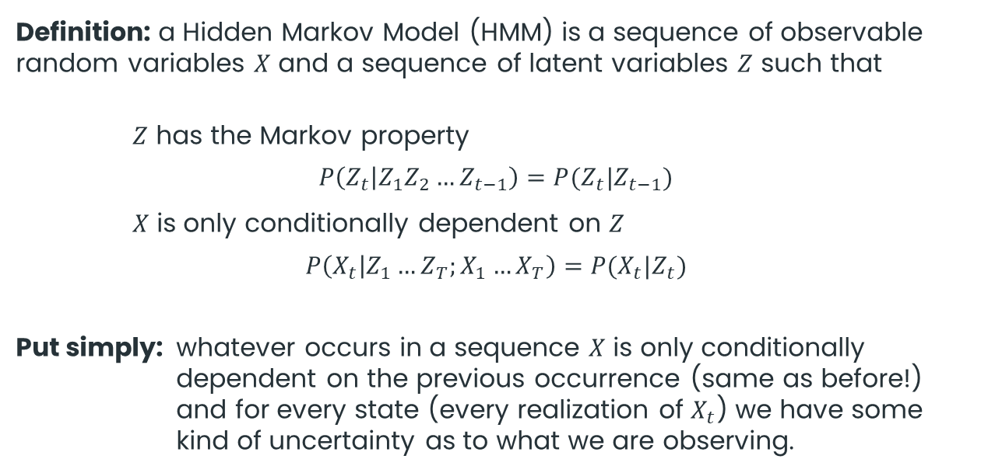
Modelling: Hidden Markov models
/a/
/s/
/r/
Definition: a Hidden Markov Model (HMM) is a sequence of observable random variables $X$ and a sequence of latent variables $Z$ such that
$Z$ has the Markov property
$$P\left(Z_{t} | Z_{1}Z_{2}…Z_{t−1}\right)=P(Z_{t}|Z_{t−1})$$
$X$ is only conditionally dependent on $Z$
$$P\left(X_{t} | Z_{1}…Z_{T};X_{1}…X_{T}\right)=P(X_{t}|Z_{t})$$
Put simply: whatever occurs in a sequence $X$ is only conditionally dependent on the previous occurrence (same as before!) and for every state (every realization of $X_{t}$) we have some kind of uncertainty as to what we are observing.
Transition probability
Emission probability
25
Notes:
DC Bias: Führt dazu, dass

Slide 26


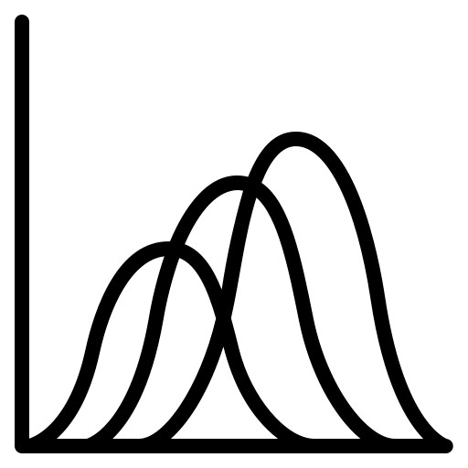
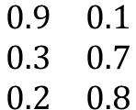
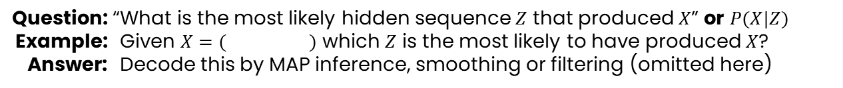

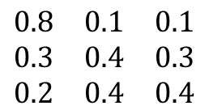



Modelling: Hidden Markov models
/a/
/s/
/r/
Transition probabilities
Emission probabilities
$$Z_{t}$$
$$X_{t}$$
$$Z_{t−1}$$
$$Z_{t}$$
$$\begin{matrix}0.8 & 0.1 & 0.1 \\ 0.3 & 0.4 & 0.3 \\ 0.2 & 0.4 & 0.4\end{matrix}$$
$$\begin{matrix}0.9 & 0.1 \\ 0.3 & 0.7 \\ 0.2 & 0.8\end{matrix}$$
$$A=$$
$$B=$$
!
Now we can ask much
more complex questions!
Question: “What is the most likely hidden sequence $Z$ that produced $X$” or $P(X|Z)$
Example: Given $X=( )$ which $Z$ is the most likely to have produced $X$?
Answer: Decode this by MAP inference, smoothing or filtering (omitted here)
*
* For a great lecture on this see references
26

Slide 27
Let’s stop talking about
weather and start talking
about speech recognition,
right?
27

Slide 28


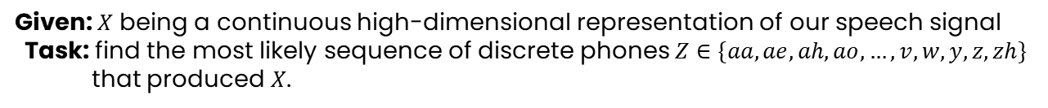








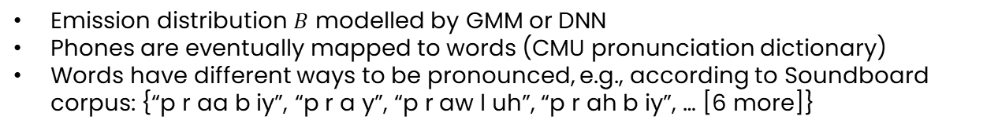
Modelling: feature-to-phone
/a/
/s/
/r/
Given: $X$ being a continuous high-dimensional representation of our speech signal
Task: find the most likely sequence of discrete phones$Z∈\{aa, ae, ah, ao, …, v, w, y, z,zh\}$
that produced $X$.
„Probably“
p
r
aa
aa
b
ax
b
l
iy
iy
$${ X}_{0}$$
$${ X}_{1}$$
$${ X}_{2}$$
$${ X}_{3}$$
$${ X}_{4}$$
$${ X}_{5}$$
$${ X}_{6}$$
$${ X}_{7}$$
$${ X}_{8}$$
$${ X}_{9}$$
Emission distribution $B$ modelled by GMM or DNN
Phones are eventually mapped to words (CMU pronunciation dictionary)
Words have different ways to be pronounced, e.g., according to Soundboard corpus: {“p r aa b iy”, “p r a y”, “p r aw l uh”, “p r ah b iy”, … [6 more]}
28

Slide 29
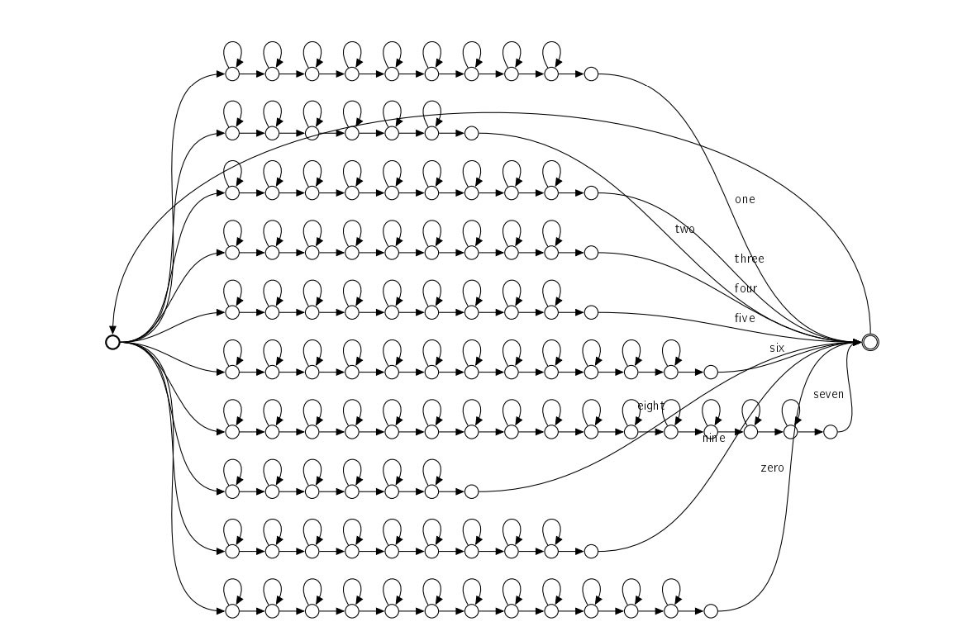
Modelling: other architectures
/a/
/s/
/r/
29

Slide 30
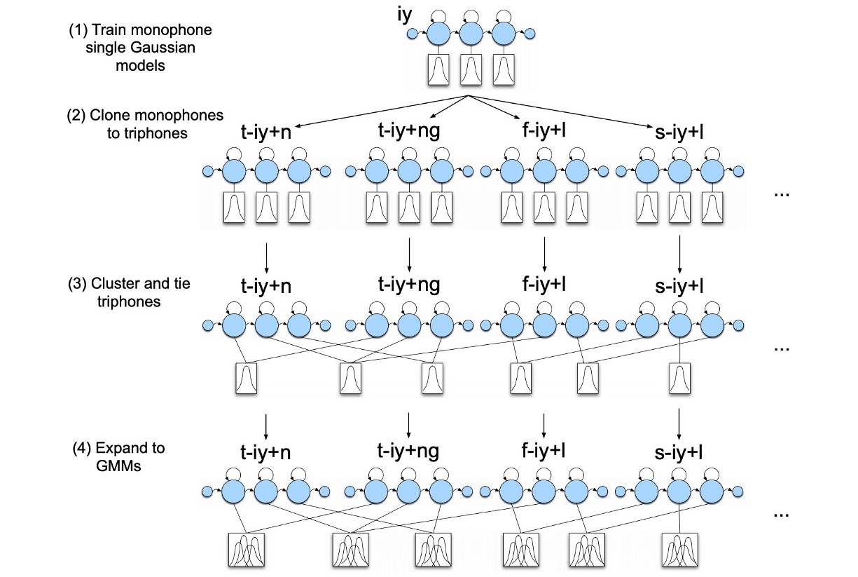
Modelling: other architectures
/a/
/s/
/r/
30

Slide 31

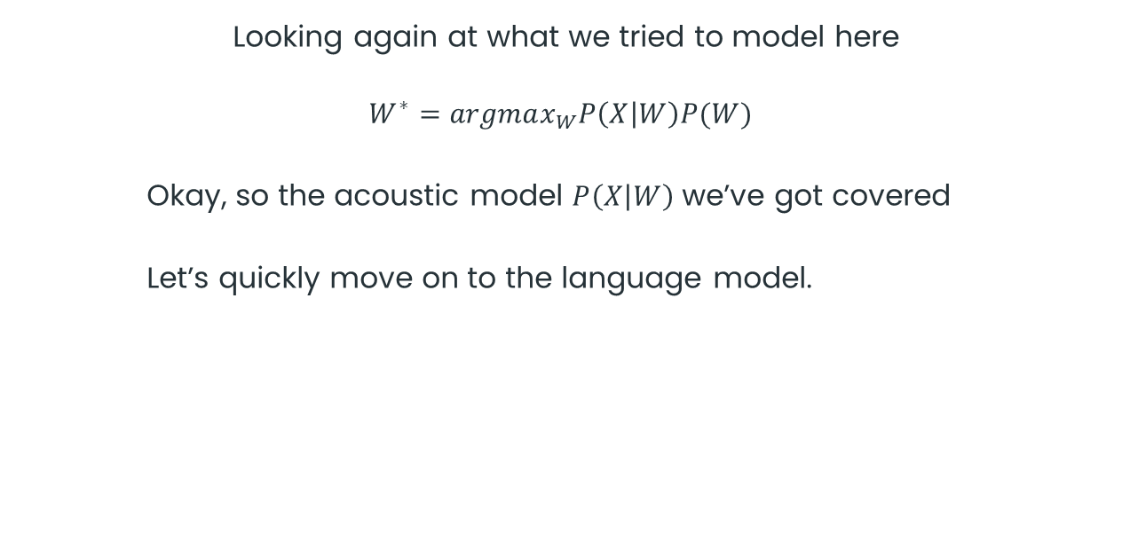
Modelling
/a/
/s/
/r/
Looking again at what we tried to model here
$$W^{∗}=argmax_{W}P\left(X | W\right)P(W)$$
Okay, so the acoustic model $P\left(X | W\right)$ we’ve got covered
Let’s quickly move on to the language model.
31
Notes:
DC Bias: Führt dazu, dass

Slide 32
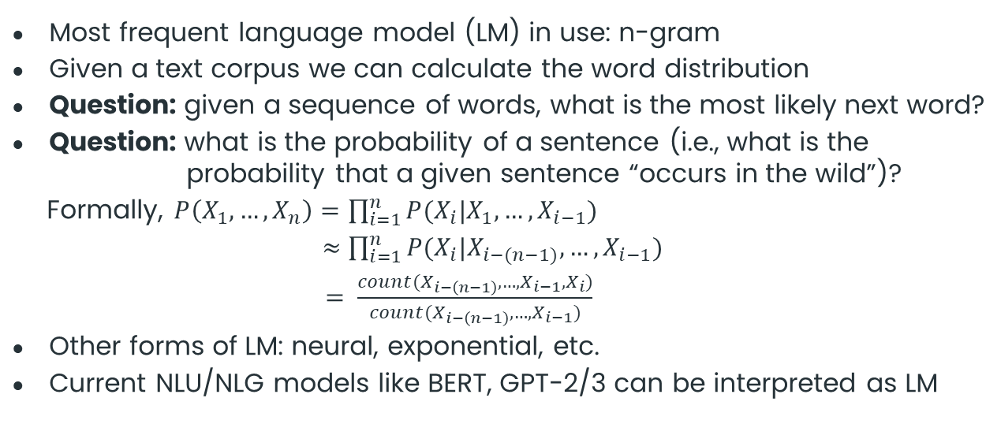
Modelling: Language modelling
/a/
/s/
/r/
Most frequent language model (LM) in use: n-gram
Given a text corpus we can calculate the word distribution
Question: given a sequence of words, what is the most likely next word?
Question: what is the probability of a sentence (i.e., what is the probability that a given sentence “occurs in the wild”)?
Formally, $P\left(X_{1},…,X_{n}\right)=\prod_{i=1}^{n}{P(X_{i}|X_{1},…,X_{i−1})}$
$≈$ $\prod_{i=1}^{n}{P(X_{i}|X_{i−(n−1)},…,X_{i−1})}$
$= \frac{count(X_{i−\left(n−1\right)},…,X_{i−1},X_{i})}{count(X_{i−\left(n−1\right)},…,X_{i−1})}$
Other forms of LM: neural, exponential, etc.
Current NLU/NLG models like BERT, GPT-2/3 can be interpreted as LM
32
Notes:
DC Bias: Führt dazu, dass

Slide 33

Modelling
/a/
/s/
/r/
Okay, so we have an acoustic and a language model at hand
$$W^{∗}=argmax_{W}P\left(X | W\right)P(W)$$
How do we find the argmax then?
?
33
Notes:
DC Bias: Führt dazu, dass

Slide 34
Hypothesis Search
?

Slide 35
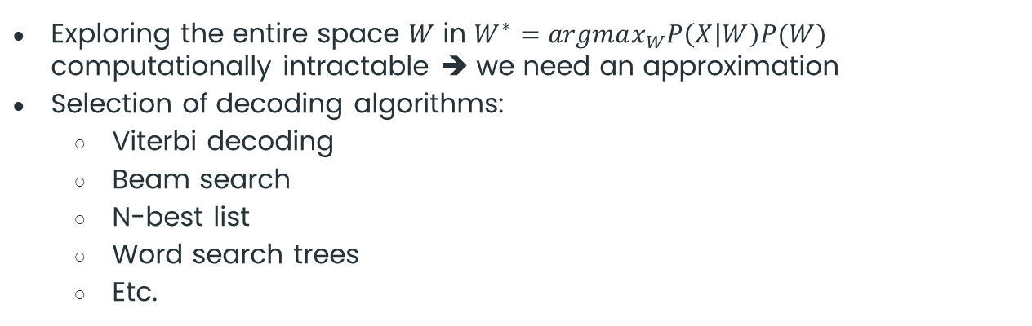
Hypothesis search: decoding
arg
max
Exploring the entire space $W$ in $W^{∗}=argmax_{W}P\left(X | W\right)P(W)$ computationally intractable ➔ we need an approximation
Selection of decoding algorithms:
Viterbi decoding
Beam search
N-best list
Word search trees
Etc.
Let’s have a quick look at beam search decoding
35
Notes:
DC Bias: Führt dazu, dass

Slide 36
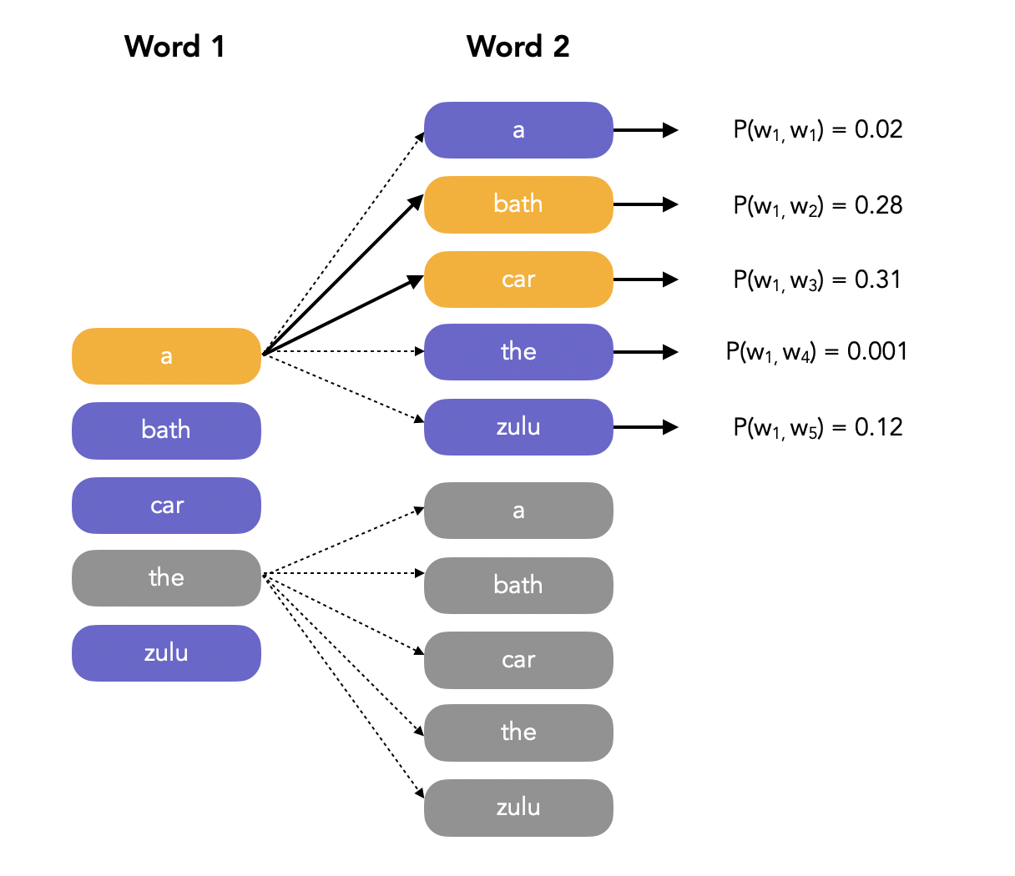
Hypothesis search: beam search
arg
max
We assume independence
between words
➔ decode word for word
Pick the k (=beam width)
most probable given the
previous ones
Iterate till the end
36
Notes:
DC Bias: Führt dazu, dass

Slide 37
Thank you
for your attention
:-)

Slide 38
References
PowerPoint / Presentation
Slides adapted from slidesgo.com
PowerPoint Master as is, is my own work
Black icons are from flaticon.com
Green icons are my own work
Big green funny looking creatures are from slidesgo.com and adapted to own purpose
Content
High-level structure
maelfabien.github.io/machinelearning/speech_reco
www.youtube.com/watch?v=q67z7PTGRi8&t=1935s&ab_channel=MicrosoftResearch
Signal Processing
wiki.aalto.fi/display/ITSP/Introduction+to+Speech+Processing
Modelling
www.in.tum.de/daml/teaching/mlgs (Section: Sequential data, entire lecture very much recommended)
Decoding
jonathan-hui.medium.com/speech-recognition-acoustic-lexicon-language-model-aacac0462639
If you want to reuse some of my stuff (I invite you to do so) please give me credits for it :-)
38

