Slide 1

And what should we hope for?
The role of the artist in the resistance
Selina Nwulu
Notes:
Summary of talk:

Slide 2
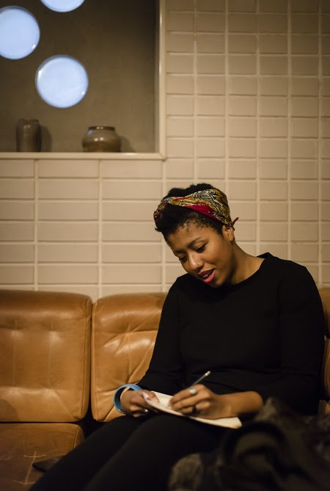
About me...
Career in two strands:
I have worked in policy, research campaigning roles in NGO sector, e.g. The Equality and Human Rights Commission, UN Women, RSA
I’m a writer and poet- I’ve performed nationally and internationally, have a poetry collection, was Young Poet Laureate for London in 2016
NGO sector: success based largely on incremental changes, favours analytical thinking. It's grounded in current state of affairs vs what could be
Writing: characterised by the fantastical, pushing boundaries and creating new ways of thinking
Notes:
Career two strands
Policy, research campaigning roles in NGO sector - EHRC, UN Women, RSA
Writer and poet – write and perform nationally and internationally, had a published collection of poems, was Young Poet Laureate for London in 2016
Though it’s not always helpful to see what I do in two distinct threads, it’s useful to understand the two different modes I operate in on a regular basis
One of reform, incremental changes compromised wins in a sector (institutionally problematic), it favours analytical thinking (sometimes) but the context is very much grounded in what is versus what could be
Another without such rigid boundaries, characterised by fantastical, pushing boundaries and creating new ways of thinking

Slide 3
Disclaimer time: What hope is not
Hope does not mean sunshine and lollypops;
From Rebecca Solnit...
“[Hope] is not the belief that everything was, is or will be fine. The evidence is all around us of tremendous suffering and destruction... It is also not a sunny everything-is-getting-better narrative, though it may be a counter to the everything-is-getting-worse one. You could call it an account of complexities and uncertainties, with openings...
Hope is an embrace of the unknown and the unknowable, an alternative to the certainty of both optimists and pessimists. Optimists think it will all be fine without our involvement; pessimists take the opposite position; both excuse themselves from acting.
It’s the belief that what we do matters even though how and when it may matter, who and what it may impact, are not things we can know beforehand. We may not, in fact, know them afterward either, but they matter all the same, and history is full of people whose influence was most powerful after they were gone.”

Slide 4
Hope is dangerous
In times of high social control (government cuts, state violence) there is less investment in artists and the philosophers.
Historically in dictatorships, unless used for propaganda, artists are highly censored, their work suppressed and at often put to jail.
Artists can critique, and question in a way that not only informs but evokes emotion. (understanding +emotion = action)
We can create a new vision, a new ways of speaking and understanding feeling
Notes:
Interesting (and terrifying) that in times of high social control, there is less investment in the artists and the philosophers.
Historically in a dictatorship, unless used for propaganda, artists are highly censored, their work suppressed and at times them put to jail.
Artists not only can critique, and question in a way that not only informs but evokes emotion. We can create a new vision, a new language, a new normality that just isn’t possible within the mindset of empirical knowledge

Slide 5
What could be? Being ‘utterly unrealistic’ in our thinking
Reminder: hope is, ‘an account of complexities and uncertainties, with openings.
Current state of affairs feels hopeless. Our elders often say little has changed.
Despite some promising shifts in black representation lately, the systemic commodification of black pain and destruction of the black body continues - either as the daily news or entertainment
Notes:
I want to come back to ths idea of what could be. And the idea of hope being, ‘an account of complexities and uncertainties, with openings.
As it stands when we look at the world as it stands, it feels like nothing really has changed. I speak to black elders who are saying we’re having the same conversations they were 30 years ago. Commodification of black pain and destruction of the black body is on loop either as the daily news either entertainment, and while there have been some amazing shifts in black representation lately, we are still facing the same struggles systemically.
I’m really inspired by writer Walidah Imarisha and the case she makes for justice movements need for creativity, hope and her genre of choice, sci-fi, which she asserts is filter through which we can explore new worlds that we can begin to build on
“When we talk about a world without prisons; a world without police violence; a world where everyone has food, clothing, shelter, quality education; a world free of white supremacy, patriarchy, capitalism, heterosexism; we are talking about a world that doesn’t currently exist.“
“visionary fiction” is literature with an emphasis the future (so often we are processing, but also reproducing our own pain – conversations around the catharsis but also harm of that)
[it] ‘encompass[es] the fantastical cross-genre creations that help us bring about those new worlds. This term reminds us to be utterly unrealistic in our organizing, because it is only through imagining the so-called impossible that we can begin to concretely build it.
- Walidah Imarisha

Slide 6
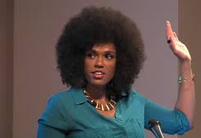
What could be? Being ‘utterly unrealistic’ in our thinking cont…
Walidah Imarisha makes the case that justice movements need creativity, hope and, her genre of choice, sci-fi, which she asserts is filter through which we can explore new worlds that we can begin to build on
“When we talk about a world without prisons; a world without police violence; a world where everyone has food, clothing, shelter, quality education; a world free of white supremacy, patriarchy, capitalism, heterosexism; we are talking about a world that doesn’t currently exist.“
“visionary fiction” is literature with an emphasis the future:
[it] ‘encompass[es] the fantastical cross-genre creations that help us bring about those new worlds. This term reminds us to be utterly unrealistic in our organizing, because it is only through imagining the so-called impossible that we can begin to concretely build it.
Notes:
I want to come back to ths idea of what could be. And the idea of hope being, ‘an account of complexities and uncertainties, with openings.
As it stands when we look at the world as it stands, it feels like nothing really has changed. I speak to black elders who are saying we’re having the same conversations they were 30 years ago. Commodification of black pain and destruction of the black body is on loop either as the daily news either entertainment, and while there have been some amazing shifts in black representation lately, we are still facing the same struggles systemically.
I’m really inspired by writer Walidah Imarisha and the case she makes for justice movements need for creativity, hope and her genre of choice, sci-fi, which she asserts is filter through which we can explore new worlds that we can begin to build on
“When we talk about a world without prisons; a world without police violence; a world where everyone has food, clothing, shelter, quality education; a world free of white supremacy, patriarchy, capitalism, heterosexism; we are talking about a world that doesn’t currently exist.“
“visionary fiction” is literature with an emphasis the future (so often we are processing, but also reproducing our own pain – conversations around the catharsis but also harm of that)
[it] ‘encompass[es] the fantastical cross-genre creations that help us bring about those new worlds. This term reminds us to be utterly unrealistic in our organizing, because it is only through imagining the so-called impossible that we can begin to concretely build it.
- Walidah Imarisha

Slide 7
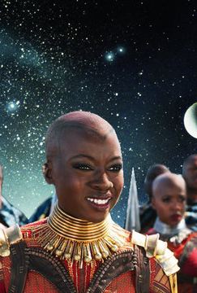
Afrofuturism
The intersection of sci-fi and ancient African traditions and black identity
Afrofuturism does not conform to a single medium. Rather, Afrofuturist artists and creators seek to celebrate black culture beyond marginalization, misogyny, transphobia, generational trauma, and other systems of oppression.
This has to be grounded in hope and the future
‘Sci fi writing is a way in which we can decolonise our imaginations’ Octavia Butler

Slide 8
Some examples of my work
The audacity of our skin – reimagining the hostile environment
Another Lens – Taking out the lens of whiteness

