Slide 1

HSRP
Hot Standby Router Protocol

Slide 2
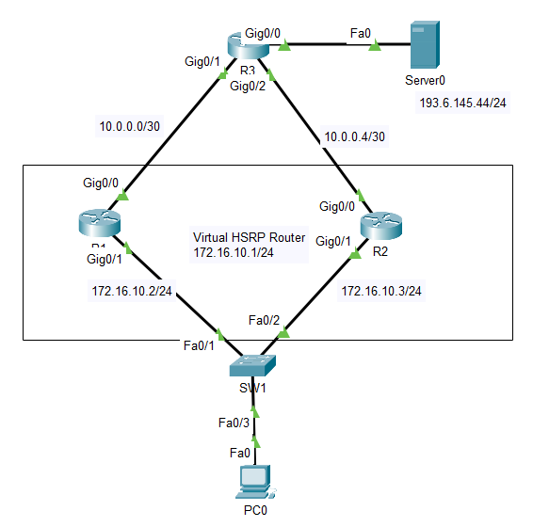
R1(config)# int g0/1
R1(config-if)# ip add 172.16.10.2 255.255.255.0
R1(config-if)# standby version 2
R1(config-if)# standby 1 ip 172.16.10.1
R1(config-if)# standby 1 priority 150
R1(config-if)# standby 1 preempt
R1(config-if)# no shut
R1(config-if)# exit

Slide 3
R1(config)# int g0/0
R1(config-if)# ip add 10.0.0.1 255.255.255.252
R1(config-if)# no shut
R1(config-if)# exit
R1(config)# router rip
R1(config-router)# version 2
R1(config-router)# net 172.16.10.0
R1(config-router)# net 10.0.0.0
R1(config-router)# end

Slide 4
R2(config)# int g0/1
R2(config-if)# ip add 172.16.10.3 255.255.255.0
R2(config-if)# standby version 2
R2(config-if)# standby 1 ip 172.16.10.1
R2(config-if)# standby 1 preempt
R2(config-if)# no shut
R2(config-if)# exit

Slide 5
R2(config)# int g0/0
R2(config-if)# ip add 10.0.0.5 255.255.255.252
R2(config-if)# no shut
R2(config-if)# exit
R2(config)# router rip
R2(config-router)# ver 2
R2(config-router)# net 172.16.10.0
R2(config-router)# net 10.0.0.4
R2(config-router)# end

Slide 6
R3(config)# int g0/1
R3(config-if)# ip add 10.0.0.2 255.255.255.252
R3(config-if)# no shut
R3(config-if)# exit
R3(config)# int g0/2
R3(config-if)# ip add 10.0.0.6 255.255.255.252
R3(config-if)# no shut
R3(config-if)# exit
R3(config)# int g0/0
R3(config-if)# ip add 193.6.145.1 255.255.255.0
R3(config-if)# no shut
R3(config-if)# exit

Slide 7
R3(config)# router rip
R3(config-router)# ver 2
R3(config-router)# net 10.0.0.0
R3(config-router)# net 10.0.0.4
R3(config-router)# net 193.6.145.0
R3(config-router)# end

Slide 8
PC
Szerver
C:\>ipconfig
FastEthernet0 Connection:(default port)
Link-local IPv6 Address.........: FE80::2E0:A3FF:FE42:5492
IP Address......................: 172.16.10.10
Subnet Mask.....................: 255.255.255.0
Default Gateway.................: 172.16.10.1
C:\>ipconfig
FastEthernet0 Connection:(default port)
Link-local IPv6 Address.........: FE80::202:4AFF:FEC3:633
IP Address......................: 193.6.145.44
Subnet Mask.....................: 255.255.255.0
Default Gateway.................: 193.6.145.1

Slide 9
C:\>ping -t 193.6.145.44
C:\>tracert 193.6.145.44
R1(config)# int g0/1
R1(config-if)# shutdown
R1# sh standby
R1# sh standby brief
R2# sh standby
R2# sh standby brief

Slide 10
R1# sh standby
GigabitEthernet0/1 - Group 1 (version 2)
State is Active
7 state changes, last state change 00:00:18
Virtual IP address is 172.16.10.1
Active virtual MAC address is 0000.0C9F.F001
Local virtual MAC address is 0000.0C9F.F001 (v2 default)
Hello time 3 sec, hold time 10 sec
Next hello sent in 2.138 secs
Preemption enabled
Active router is local
Standby router is 172.16.10.3, priority 100 (expires in 9 sec)
Priority 150 (configured 150)
Group name is hsrp-Gig0/1-1 (default)
R2# sh standby
GigabitEthernet0/1 - Group 1 (version 2)
State is Standby
9 state changes, last state change 00:00:41
Virtual IP address is 172.16.10.1
Active virtual MAC address is 0000.0C9F.F001
Local virtual MAC address is 0000.0C9F.F001 (v2 default)
Hello time 3 sec, hold time 10 sec
Next hello sent in 0.42 secs
Preemption enabled
Active router is 172.16.10.2, priority 150 (expires in 8 sec)
MAC address is 0000.0C9F.F001
Standby router is local
Priority 100 (default 100)
Group name is hsrp-Gig0/1-1 (default)

