Slide 1
Shadowhawk-Fort
Created by: Marcell Gergely Nyilas and Patrik Károly Grecz

Slide 2


Introduction
Our Name: Vanguard-Network
Company: Shadowhawk fort
Field of Expertise: Networks, systems, digital infrastructure
Goal: Building stable, secure, and cost-effective networks
Notes:
During the design, we didn't just focus on the basics; we focused on security from the very start. We built a flexible structure that can grow with the company while keeping long-term maintenance costs low.

Slide 3
Our Team
Marcell Gergely Nyilas (PM)
Task tracking, Jira
Network architecture design
Testing
Patrik Károly Grecz (PM Support)
Device configuration
Assembling project presentation
Documentation
Notes:
"Regarding the work, we made sure to check each other’s tasks constantly. While one of us was doing the configuration, the other was updating the documents and testing. This helped us avoid mistakes and create a system that is easy for anyone to understand."

Slide 4
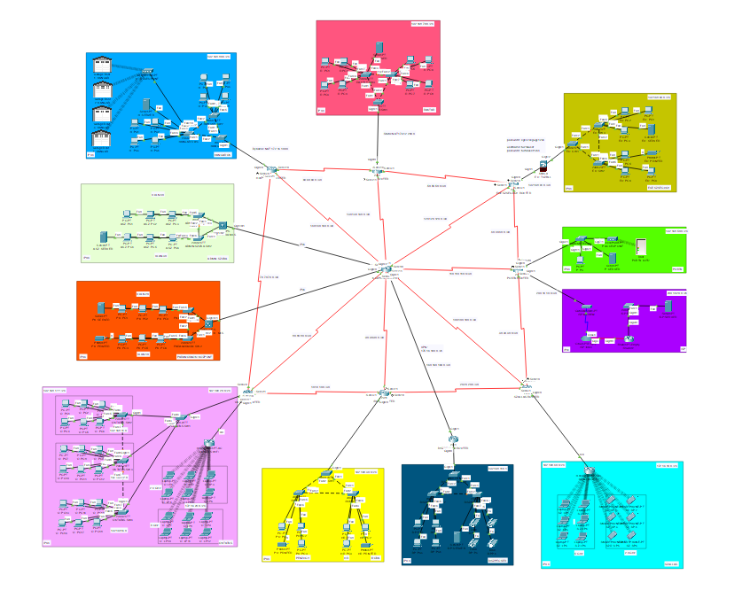
Complete Network Setup
Notes:
"We simulated the network in Cisco Packet Tracer to test everything before 'real-life' use. We used a mixed topology for maximum stability. Every device is protected with encrypted passwords. The most important part is the redundancy: if a cable or a path fails, the traffic switches to another one instantly, so users won't notice any error."

Slide 5
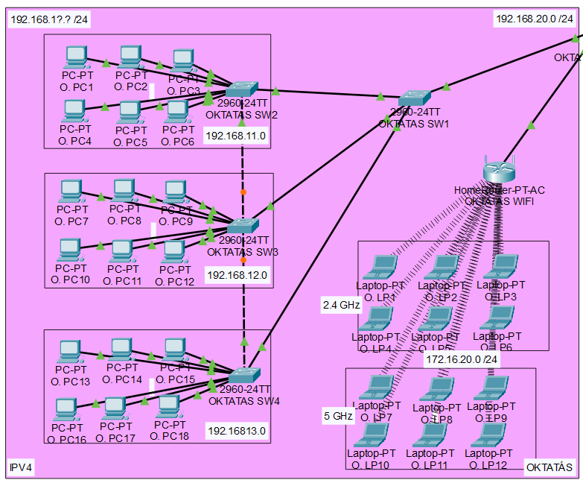
Education
IPv4
VLAN
DHCP
Wi-Fi
2,4 GHz
5 GHz
Dynamic routing
Notes:
MARCI -- "In the Education section, we use VLANs to keep the high traffic from slowing down the rest of the company. Every device gets an IP address automatically via DHCP. We used dual-band WiFi for a stable connection, and dynamic routing handles the paths automatically without us needing to fix them by hand."

Slide 6
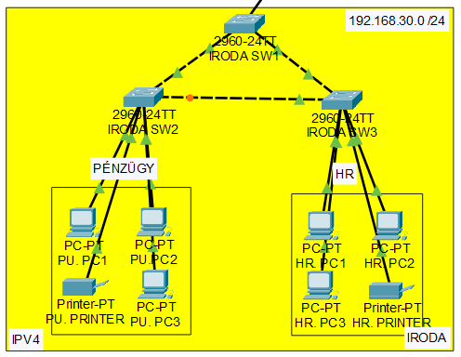
Office
Finance
IPv4
ACL
HR
IPv4
Dynamic routing
Notes:
PATRIK -- "In the Office, we used ACLs (Access Control Lists) to boost security. In practice, this means we strictly limited the Finance department's traffic so only authorized people can see sensitive data. Dynamic routing ensures that data always travels on the fastest path to the servers."

Slide 7
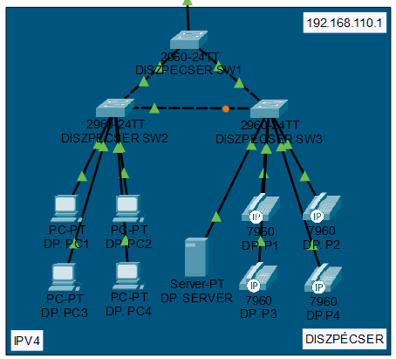
Dispatcher
IPv4
VPN
Dynamic routing
Notes:
MARCI -- "Since the Dispatch Center is physically close to other units, we used high-speed direct connections. We kept the VPN for secure remote access, so managers can check the processes safely from outside the office. This combines local speed with the flexibility of remote work."

Slide 8
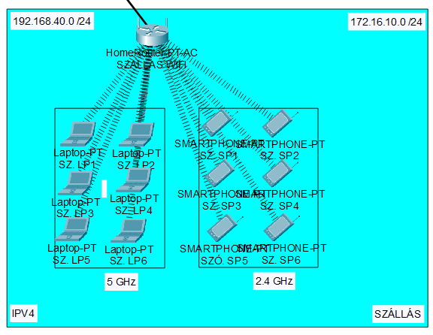
Accommodation
IPv4
DHCP
Wi-Fi
2,4 GHz
5 GHz
Dynamic routing
ACL
Notes:
PATRIK -- "For the Accommodation, the main goal was separation. Since this is a public zone, we set up a strict ACL that blocks all traffic toward our internal network. Guests can use the internet, but they cannot 'peek into' the company servers. The dual-band WiFi handles the load, but the security wall keeps the guests inside their own boundaries."

Slide 9
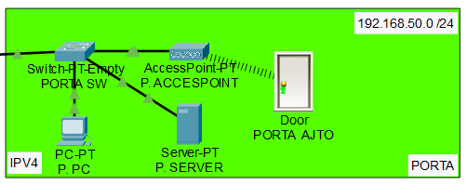
Reception
IPv4
DHCP
IoT server
IoT device
Dynamic routing
Notes:
MARCI -- "At the Entrance, we modeled modern building management using IoT (Internet of Things) devices—like a smart door and its controller. These communicate through a dedicated IoT server, so entry and monitoring can be handled centrally from a distance."

Slide 10
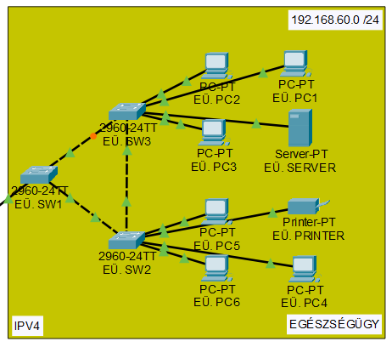
Healthcare
IPv4
Firewall
ACL
Dynamic routing
Notes:
PATRIK -- "In the Healthcare section, we applied the highest security levels because we handle sensitive data here. The firewall is set to let everything out, but it acts as a strict filter for incoming traffic: nothing gets in unless it’s a response to an internal request. We also added an ACL so that only the Admin Room can access these servers."

Slide 11
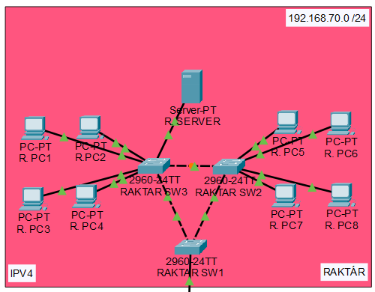
Warehouse
IPv4
Static NAT
Dynamic / Static routing
Notes:
MARCI -- "In the Warehouse, we used a mix of solutions. Internal communication uses dynamic routing to stay up-to-date. However, for the translated, fixed external addresses, we used static routing. This ensures that the warehouse system stays reachable even if other parts of the network change."

Slide 12
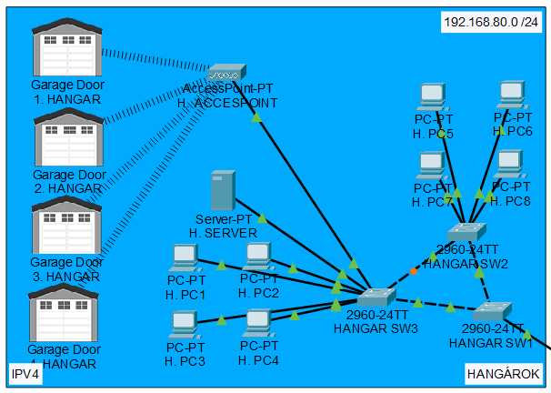
Hangars
IPv4
Dynamic NAT
IoT server
IoT devices
Dynamic / Static routing
Notes:
PATRIK -- "In the Hangars, the most visible part is the IoT integration: the garage doors are smart devices connected to the IoT server. This allows for remote, automatic control. We used the same double-routing logic here to ensure that every sensor and door reacts instantly without delay."

Slide 13
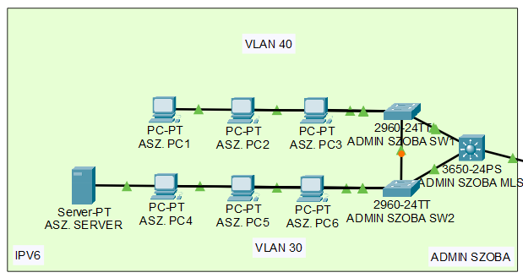
Admin Room
IPv6
VLAN
Dynamic routing
Notes:
MARCI -- "The Admin Room is the brain of our network, where we use the modern Dual Stack solution. This means our system handles both IPv4 and IPv6 addresses at the same time. The heart of the room is a Multilayer Switch, which is much smarter than a regular one: it handles high-level routing and connects all departments."

Slide 14
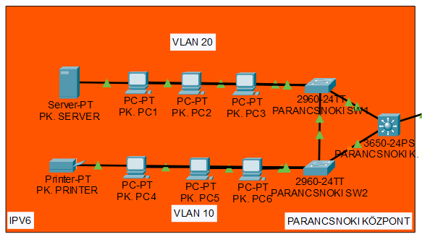
Command Center
IPv6
VLAN
Dynamic routing
Notes:
PATRIK -- "The Command Center is our other strategic point, also using Dual Stack. This allows us to communicate with both old and new devices. A Multilayer Switch ensures fast travel between VLANs and high-speed data processing so that command decisions reach their destination on the best possible path."

Slide 15
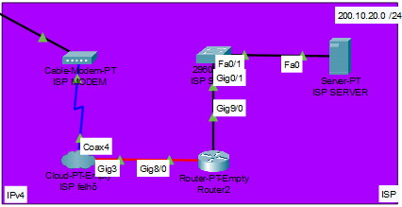
ISP
IPv4
Static routing
NAT
Notes:
PATRIK -- "In this part, we simulated the ISP that connects us to the outside world. The most important process here is NAT (Network Address Translation). This 'translates' all our private internal addresses into one single public address. This saves addresses and adds a layer of safety because our internal network is hidden from the internet."

Slide 16
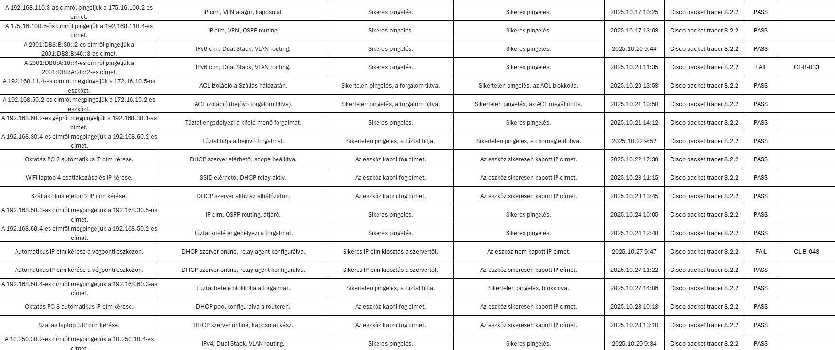
Testing
Notes:
MARCI -- "The last and most important part was systematic testing. We recorded every configuration error or bug in Jira. We didn't hide the problems; we used these 'tickets' to fix and re-test every section. This guaranteed that the final system is stable and everything works exactly as planned."

Slide 17



Jira, Scrum & GitHub
Task and Project Management
File Sharing and Version Control
Bug Tracking
Sprint Menu
Planning and Reporting
Knowledge Sharing and Documnetation
Permissions Management
Branching
Notes:
MARCI – PATRIK -- "We used Jira and the Scrum method to track our tasks. Bug tracking was key: every problem found during testing was solved step-by-step. We also used GitHub for file sharing and version control. Using 'Branches' helped us avoid overwriting each other’s work."

Slide 18


Windows and Linux Server
DHCP
DNS
IIS
Active-Directory
Printer Szerver
Backup Szerver
Group Policy Management
Notes:
MARCI – PATRIK -- "We modeled the server side in VirtualBox using Windows Server and Debian Linux. On Windows, we set up Active Directory for central user management, along with DNS and web services (IIS). We used Group Policies to keep every computer secure. Linux was used for its stability and to support DHCP functions."

Slide 19




Other Softwares and Tools
Discord: Team communication
Google Drive: Document management and storage
OBS Studio: Recording raw footage
DaVinci Resolve: Post-production and video editing
Notes:
MARCI – PATRIK -- "Finally, we used several tools to help our work. Discord was for internal chat, and Google Drive was for storing documents. We recorded our demos with OBS Studio and edited the final videos in DaVinci Resolve to make the presentation look professional."

Slide 20
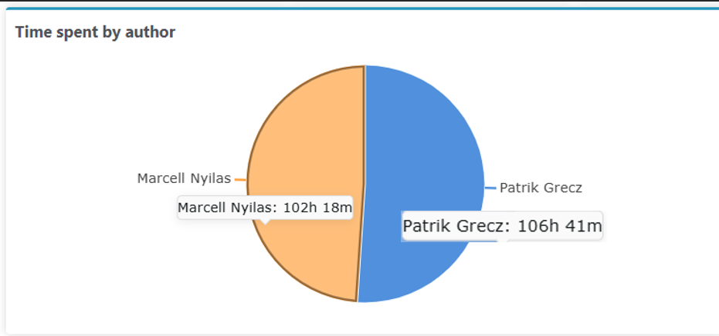
Work Distribution
Notes:
PATRIK -- "As you can see on the chart, the work was split almost perfectly 50-50 between Marcell and Patrik. The 100+ hours measured for each of us in Jira shows the amount of brainstorming and bug-fixing we did. This balanced teamwork was the key to delivering a fully tested network on time."

Slide 21
Thank you for your attention!

