Slide 1
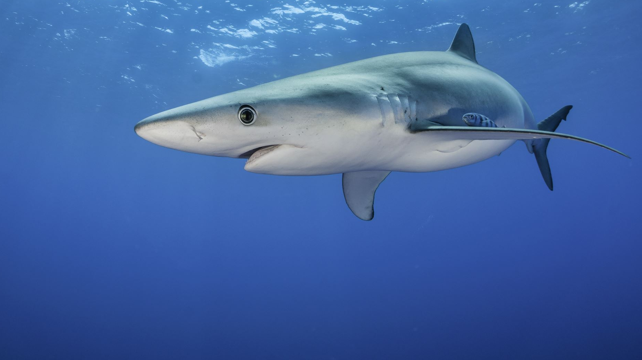


Scrum 4 Sharks

Slide 2


Team Members
Scrum Master: Anton Snizhko
Nicholas VerMulm
Aidyn Reis

Slide 3
Our Project Goals
HTML-JSP-Java Web Application
Method named createShark( ) that creates an object
Accept inputs from the user for all of the properties
Display the properties of the object returned by the createShark( ) method
XML-SOAP-Java Web Service Provider with a JSP test client
Accept inputs from the user
Pass them to a JSP page
Display all properties

Slide 4
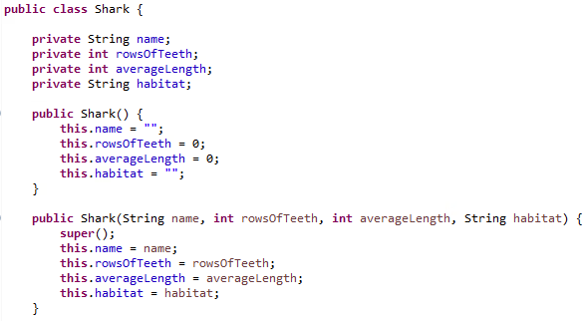
Shark.java

Slide 5

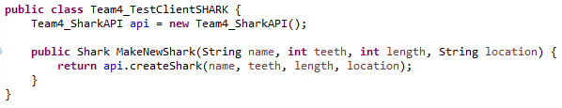
Shark API
Shark Test Client

Slide 6
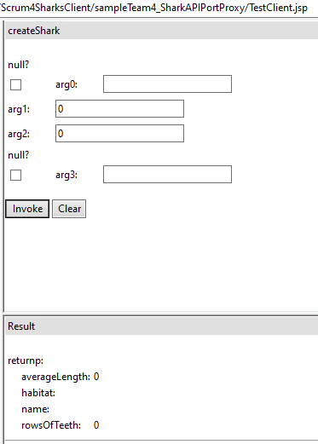
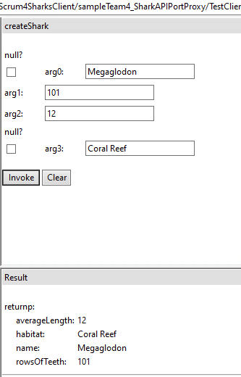
Web Service
Web Service

Slide 7
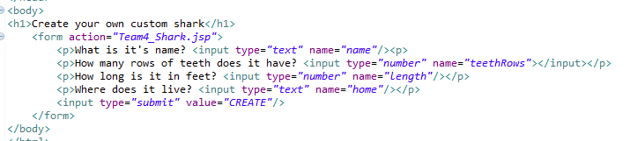
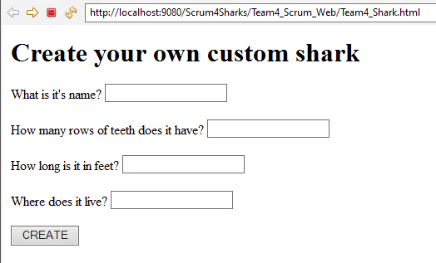
Shark HTML

Slide 8
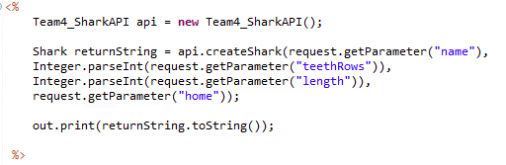
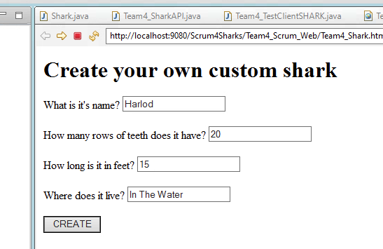
Shark JSP

Slide 9
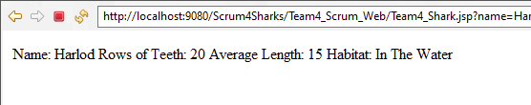
Shark Web Output

Slide 10
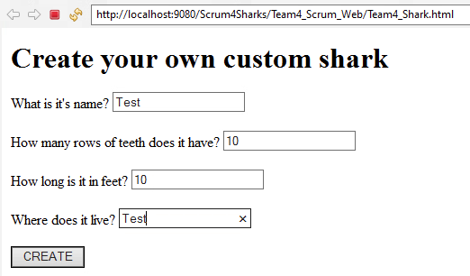
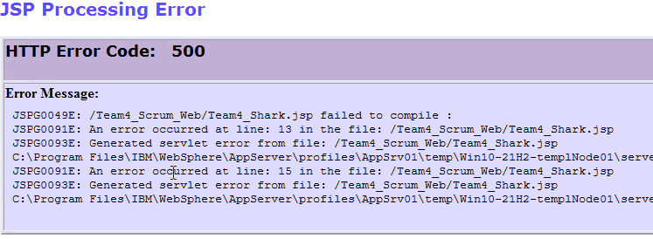
Debugging

Slide 11


The End
Questions?
Thank You

