Slide 1

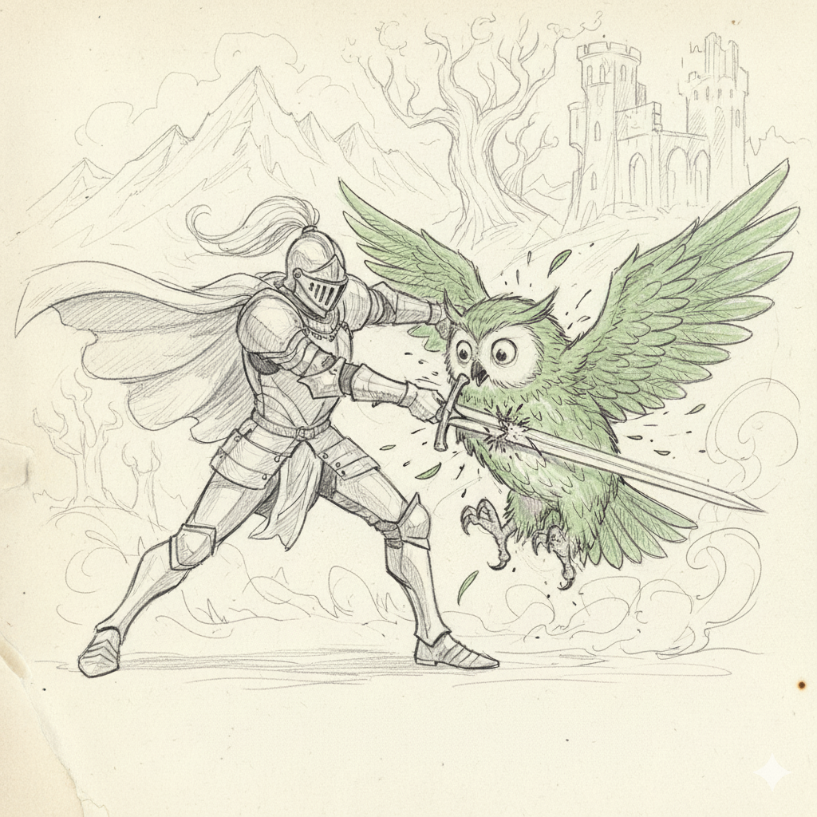
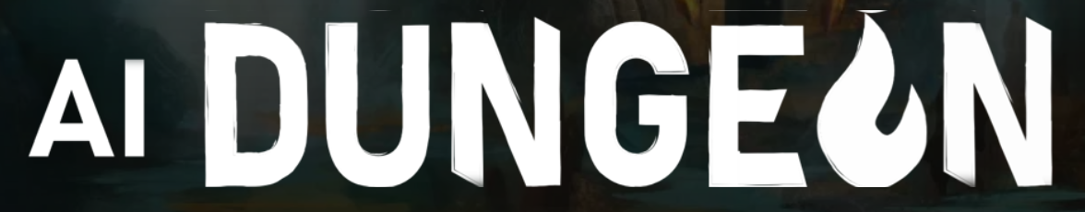
Duolingo Killer
Text-based Language Learning RPG
Based on 80s text-based adventures (Zork)
RQ: Can LLMs be tied to a persistent, progressing world?
Difficulty scaling woven into story
Text adventure with foreign word injection
Increase new:old language ratio, as the character progresses deeper into the new realm
Inspiration:

