Slide 1
Carnegie Mellon Univ.
Dept. of Computer Science
15-415 - Database Applications
C. Faloutsos
Indexing and Hashing – part I

Slide 2
General Overview - rel. model
Relational model - SQL
  Formal & commercial query languages
Functional Dependencies
Normalization
Physical Design
Indexing

Slide 3
Indexing- overview
primary / secondary indices
index-sequential (ISAM)
B - trees, B+ - trees
hashing
  static hashing
  dynamic hashing

Slide 4
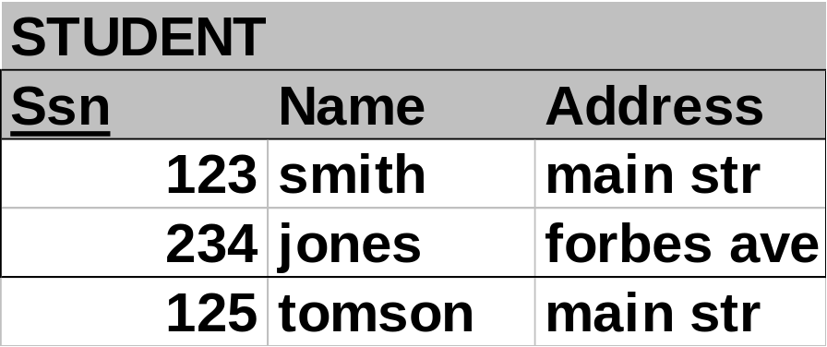
Indexing
once the records are stored in a file, how do you search efficiently? (eg., ssn=123?)

Slide 5

Indexing

Slide 6
Indexing
once the records are stored in a file, how do you search efficiently?
brute force: retrieve all records, report the qualifying ones
better: use indices (pointers) to locate the records directly

Slide 7
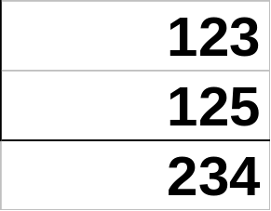
Indexing – main idea:

Slide 8
Measuring ‘goodness’
range queries?
retrieval time?
insertion / deletion?
space overhead?
reorganization?

Slide 9
Main concepts
search keys are sorted in the index file and point to the actual records
primary vs. secondary indices
Clustering (sparse) vs non-clustering (dense) indices

Slide 10
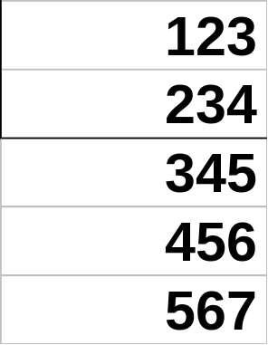
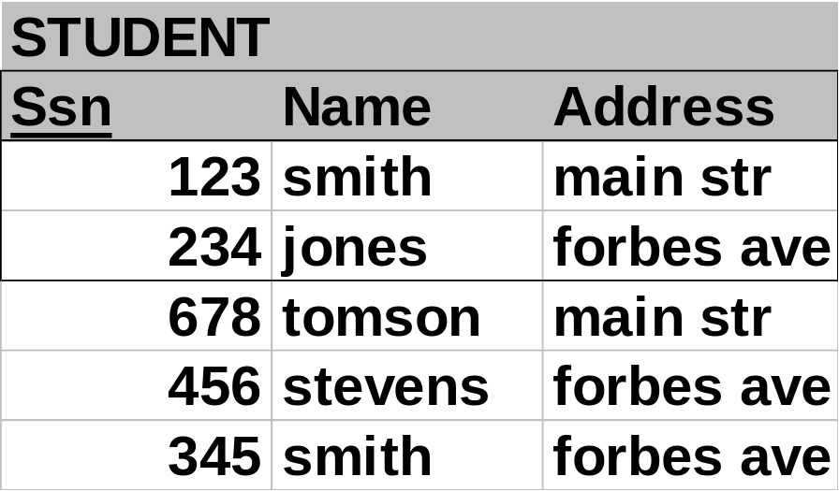
Indexing
Primary key index: on primary key (no duplicates)

Slide 11
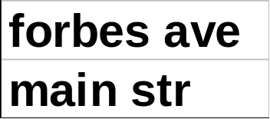
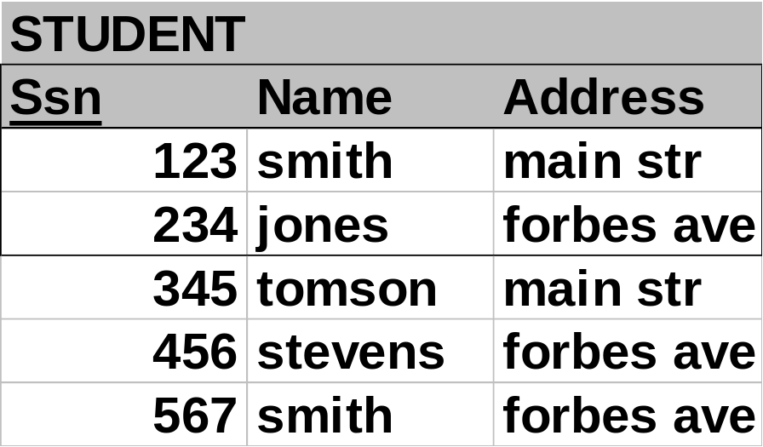
Indexing
secondary key index: duplicates may exist
Address-index

Slide 12
Indexing
secondary key index: typically, with ‘postings lists’
Postings lists

Slide 13
Main concepts – cont’d
Clustering (= sparse) index: records are physically sorted on that key (and not all key values are needed in the index)
Non-clustering (=dense) index: the opposite
E.g.:

Slide 14
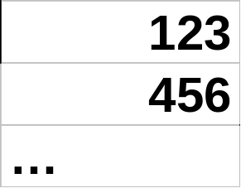
Indexing
Clustering/sparse index on ssn
>=123
>=456

Slide 15
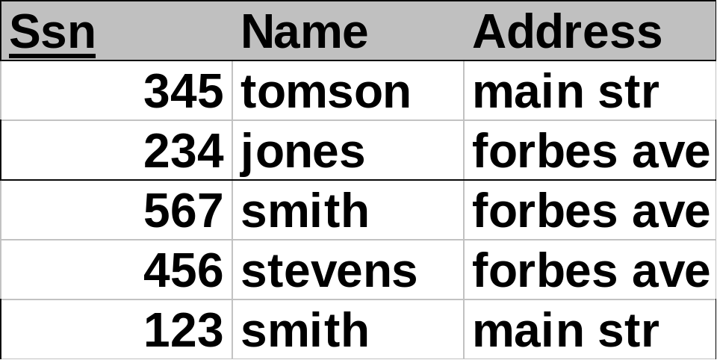
Indexing
Non-clustering / dense index

Slide 16
Summary
All combinations are possible
 | Dense | Sparse
Primary |  | usual
secondary | usual | rare
at most one sparse/clustering index
as many as desired dense indices
usually: one primary-key index (maybe clustering) and a few secondary-key indices (non-clustering)

Slide 17
Indexing- overview
primary / secondary indices
index-sequential (ISAM)
B - trees, B+ - trees
hashing
  static hashing
  dynamic hashing

Slide 18
ISAM
What if index is too large to search sequentially?

Slide 19
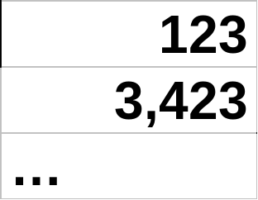
ISAM
>=123
>=456
block

Slide 20
ISAM - observations
if index is too large, store it on disk and keep index-on-the-index
usually two levels of indices, one first- level entry per disk block (why? )

Slide 21
ISAM - observations
What about insertions/deletions?
>=123
>=456
124; peterson; fifth ave.

Slide 22
ISAM - observations
What about insertions/deletions?
overflows
124; peterson; fifth ave.
Problems?

Slide 23
ISAM - observations
What about insertions/deletions?
overflows
124; peterson; fifth ave.
overflow chains may become very long - what to do?

Slide 24
ISAM - observations
What about insertions/deletions?
overflows
124; peterson; fifth ave.
overflow chains may become very long - thus:
  shut-down & reorganize
  start with ~80% utilization

Slide 25
ISAM - observations
if index is too large, store it on disk and keep index on the index (in memory)
usually two levels of indices, one first- level entry per disk block (why? )
typically, blocks: 80% full initially (why? what are potential problems / inefficiencies?)

Slide 26
So far
… indices (like ISAM) suffer in the presence of frequent updates
alternative indexing structure: B - trees

Slide 27
Overview
primary / secondary indices
multilevel (ISAM)
B - trees, B+ - trees
hashing
  static hashing
  dynamic hashing

Slide 28
B-trees
the most successful family of index schemes (B-trees, B⁺⁻trees, B*-trees)
Can be used for primary/secondary, clustering/non-clustering index.
balanced “n-way” search trees

Slide 29
B-trees
Eg., B-tree of order 3:
<6
6
9
>9
>6
<9
1
3
7
13

Slide 30
B - tree properties:
each node, in a B-tree of order n:
  Key order
  at most n pointers
  at least n/2 pointers (except root)
  all leaves at the same level
  if number of pointers is k, then node has exactly k-1 keys
  (leaves are empty)
p1
pn
v1
v2
…
v_{n-1}

Slide 31
Properties
“block aware” nodes: each node -> disk page
O(log (N)) for everything! (ins/del/search)
typically, if m = 50 - 100, then 2 - 3 levels
utilization >= 50%, guaranteed; on average 69%

Slide 32
Queries
Algo for exact match query? (eg., ssn=8?)
<6
6
9
>9
>6
<9
1
3
7
13

Slide 33
Queries
Algo for exact match query? (eg., ssn=8?)
<6
6
9
>9
>6
<9
1
3
7
13

Slide 34
Queries
Algo for exact match query? (eg., ssn=8?)
<6
6
9
>9
>6
<9
1
3
7
13

Slide 35
Queries
Algo for exact match query? (eg., ssn=8?)
<6
6
9
>9
>6
<9
1
3
7
13

Slide 36
Queries
Algo for exact match query? (eg., ssn=8?)
<6
6
9
H steps (= disk accesses)
>9
>6
<9
1
3
7
13

Slide 37
Queries
Algo for exact match query? (eg., ssn=8?)
<6
6
9
>9
>6
<9
1
3
7
13

Slide 38
Queries
what about range queries? (eg., 5<salary<8)
Proximity/ nearest neighbor searches? (eg., salary ~ 8 )

Slide 39
Queries
what about range queries? (eg., 5<salary<8)
Proximity/ nearest neighbor searches? (eg., salary ~ 8 )
<6
6
9
>9
>6
<9
1
3
7
13

Slide 40
Queries
what about range queries? (eg., 5<salary<8)
Proximity/ nearest neighbor searches? (eg., salary ~ 8 )
<6
6
9
>9
>6
<9
1
3
7
13

Slide 41
B-trees: Insertion
Insert in leaf; on overflow, push middle up (recursively)
split: preserves B - tree properties

Slide 42
B-trees
Easy case: Tree T0; insert ‘8’
<6
6
9
>9
>6
<9
1
3
7
13

Slide 43
B-trees
Tree T0; insert ‘8’
<6
6
9
>9
>6
<9
1
3
7
8
13

Slide 44
B-trees
Hardest case: Tree T0; insert ‘2’
<6
6
9
>9
>6
<9
1
3
7
13
2

Slide 45
B-trees
Hardest case: Tree T0; insert ‘2’
6
9
1
2
3
7
13
push middle up

Slide 46
B-trees
Hardest case: Tree T0; insert ‘2’
Ovf; push middle
2
6
9
2
1
3
7
13

Slide 47
B-trees
Hardest case: Tree T0; insert ‘2’
6
Final state
2
9
1
3
7
13

Slide 48
B-trees - insertion
Q: What if there are two middles? (eg, order 4)
A: either one is fine

Slide 49
B-trees: Insertion
Insert in leaf; on overflow, push middle up (recursively – ‘propagate split’)
split: preserves all B - tree properties (!!)
notice how it grows: height increases when root overflows & splits
Automatic, incremental re-organization (contrast with ISAM!)

Slide 50
Pseudo-code
INSERTION OF KEY ’K’
find the correct leaf node ’L’;
if ( ’L’ overflows ){
split ’L’, by pushing the middle key upstairs to parent node ’P’;
if (’P’ overflows){
repeat the split recursively;
}
else{
add the key ’K’ in node ’L’; /* maintaining the key order in ’L’ */
}

Slide 51
Overview
primary / secondary indices
multilevel (ISAM)
B – trees
  Dfn, Search, insertion, deletion
B+ - trees
hashing

Slide 52
Deletion
Rough outline of algo:
Delete key;
on underflow, may need to merge
In practice, some implementors just allow underflows to happen…

Slide 53
B-trees – Deletion
Easiest case: Tree T0; delete ‘3’
<6
6
9
>9
>6
<9
1
3
7
13

Slide 54
B-trees – Deletion
Easiest case: Tree T0; delete ‘3’
<6
6
9
>9
>6
<9
1
7
13

Slide 55
B-trees – Deletion
Case1: delete a key at a leaf – no underflow
Case2: delete non-leaf key – no underflow
Case3: delete leaf-key; underflow, and ‘rich sibling’
Case4: delete leaf-key; underflow, and ‘poor sibling’

Slide 56
B-trees – Deletion
Case1: delete a key at a leaf – no underflow (delete 3 from T0)
<6
6
9
>9
>6
<9
1
3
7
13

Slide 57
B-trees – Deletion
Case2: delete a key at a non-leaf – no underflow (eg., delete 6 from T0)
Delete & promote, ie:
<6
6
9
>9
>6
<9
1
3
7
13

Slide 58
B-trees – Deletion
Case2: delete a key at a non-leaf – no underflow (eg., delete 6 from T0)
Delete & promote, ie:
<6
9
>9
>6
<9
1
3
7
13

Slide 59
B-trees – Deletion
Case2: delete a key at a non-leaf – no underflow (eg., delete 6 from T0)
Delete & promote, ie:
<6
3
9
>9
>6
<9
1
7
13

Slide 60
B-trees – Deletion
Case2: delete a key at a non-leaf – no underflow (eg., delete 6 from T0)
FINAL TREE
<3
3
9
>9
>3
<9
1
7
13

Slide 61
B-trees – Deletion
Case2: delete a key at a non-leaf – no underflow (eg., delete 6 from T0)
Q: How to promote?
A: pick the largest key from the left sub-tree (or the smallest from the right sub-tree)
Observation: every deletion eventually becomes a deletion of a leaf key

Slide 62
B-trees – Deletion
Case2: delete a key at a non-leaf – no underflow (eg., delete 6 from T0)
Delete & promote, ie:
<6
3
9
>9
>6
<9
1
7
13

Slide 63
B-trees – Deletion
Case1: delete a key at a leaf – no underflow
Case2: delete non-leaf key – no underflow
Case3: delete leaf-key; underflow, and ‘rich sibling’
Case4: delete leaf-key; underflow, and ‘poor sibling’

Slide 64
B-trees – Deletion
Case3: underflow & ‘rich sibling’ (eg., delete 7 from T0)
Delete & borrow, ie:
<6
6
9
>9
>6
<9
1
3
7
13

Slide 65
B-trees – Deletion
Case3: underflow & ‘rich sibling’ (eg., delete 7 from T0)
Delete & borrow, ie:
<6
6
9
Rich sibling
>9
>6
<9
1
3
13

Slide 66
B-trees – Deletion
Case3: underflow & ‘rich sibling’
‘rich’ = can give a key, without underflowing
‘borrowing’ a key: THROUGH the PARENT!

Slide 67
B-trees – Deletion
Case3: underflow & ‘rich sibling’ (eg., delete 7 from T0)
Delete & borrow, ie:
<6
6
9
Rich sibling
>9
>6
<9
1
3
13
NO!!

Slide 68
B-trees – Deletion
Case3: underflow & ‘rich sibling’ (eg., delete 7 from T0)
Delete & borrow, ie:
<6
6
9
>9
>6
<9
1
3
13

Slide 69
B-trees – Deletion
Case3: underflow & ‘rich sibling’ (eg., delete 7 from T0)
Delete & borrow, ie:
<6
3
9
>9
>6
<9
1
6
13

Slide 70
B-trees – Deletion
Case3: underflow & ‘rich sibling’ (eg., delete 7 from T0)
FINAL TREE
Delete & borrow, through the parent
<3
3
9
>9
>3
<9
1
6
13

Slide 71
B-trees – Deletion
Case1: delete a key at a leaf – no underflow
Case2: delete non-leaf key – no underflow
Case3: delete leaf-key; underflow, and ‘rich sibling’
Case4: delete leaf-key; underflow, and ‘poor sibling’

Slide 72
B-trees – Deletion
Case4: underflow & ‘poor sibling’ (eg., delete 13 from T0)
<6
6
9
>9
>6
<9
1
3
7
13

Slide 73
B-trees – Deletion
Case4: underflow & ‘poor sibling’ (eg., delete 13 from T0)
<6
6
9
>9
>6
<9
1
3
7

Slide 74
B-trees – Deletion
Case4: underflow & ‘poor sibling’ (eg., delete 13 from T0)
6
9
A: merge w/ ‘poor’ sibling
<6
>9
>6
<9
1
3
7

Slide 75
B-trees – Deletion
Case4: underflow & ‘poor sibling’ (eg., delete 13 from T0)
Merge, by pulling a key from the parent
exact reversal from insertion: ‘split and push up’, vs. ‘merge and pull down’
Ie.:

Slide 76
B-trees – Deletion
Case4: underflow & ‘poor sibling’ (eg., delete 13 from T0)
6
A: merge w/ ‘poor’ sibling
<6
>6
1
3
7
9

Slide 77
B-trees – Deletion
Case4: underflow & ‘poor sibling’ (eg., delete 13 from T0)
FINAL TREE
<6
6
>6
1
3
7
9

Slide 78
B-trees – Deletion
Case4: underflow & ‘poor sibling’
-> ‘pull key from parent, and merge’
Q: What if the parent underflows?
A: repeat recursively

Slide 79
B-tree deletion - pseudocode
DELETION OF KEY ’K’
locate key ’K’, in node ’N’
if( ’N’ is a non-leaf node) {
delete ’K’ from ’N’;
find the immediately largest key ’K1’;
/* which is guaranteed to be on a leaf node ’L’ */
copy ’K1’ in the old position of ’K’;
invoke this DELETION routine on ’K1’ from the leaf node ’L’;
else {
/* ’N’ is a leaf node */
... (next slide..)

Slide 80
B-tree deletion - pseudocode
/* ’N’ is a leaf node */
if( ’N’ underflows ){
let ’N1’ be the sibling of ’N’;
if( ’N1’ is "rich"){ /* ie., N1 can lend us a key */
borrow a key from ’N1’ THROUGH the parent node;
}else{ /* N1 is 1 key away from underflowing */
MERGE: pull the key from the parent ’P’,
and merge it with the keys of ’N’ and ’N1’ into a new node;
if( ’P’ underflows){ repeat recursively }
}
}

Slide 81
B-trees in practice
In practice:
no empty leaves;
ptrs to records
<6
6
9
theory
>9
>6
<9
1
3
7
13

Slide 82
B-trees in practice
In practice:
no empty leaves;
ptrs to records
practice
<6
6
9
>9
>6
<9
1
3
7
13

Slide 83
B-trees in practice
In practice:
Ssn | … | …
3
7
6
9
1
<6
6
9
>9
>6
<9
1
3
7
13

Slide 84
B-trees in practice
In practice, the formats are:
leaf nodes: (v1, rp1, v2, rp2, … vn, rpn)
Non-leaf nodes: (p1, v1, rp1, p2, v2, rp2, …)
<6
6
9
>9
>6
<9
1
3
7
13

Slide 85
Overview
primary / secondary indices
multilevel (ISAM)
B – trees
B+ - trees
hashing

Slide 86
B+ trees - Motivation
B-tree – print keys in sorted order:
<6
6
9
>9
>6
<9
1
3
7
13

Slide 87
B+ trees - Motivation
B-tree needs back-tracking – how to avoid it?
<6
6
9
>9
>6
<9
1
3
7
13

Slide 88
Solution: B⁺ - trees
facilitate sequential ops
They string all leaf nodes together
AND
replicate keys from non-leaf nodes, to make sure every key appears at the leaf level

Slide 89
B+ trees
<6
6
9
>=9
>=6
<9
1
3
6
7
9
13

Slide 90
B+ tree insertion
INSERTION OF KEY ’K’
insert search-key value to ’L’ such that the keys are in order;
if ( ’L’ overflows) {
split ’L’ ;
insert (ie., COPY) smallest search-key value
of new node to parent node ’P’;
if (’P’ overflows) {
repeat the B-tree split procedure recursively;
/* Notice: the B-TREE split; NOT the B+ -tree */
}
}

Slide 91
B+-tree insertion – cont’d
/* ATTENTION:
a split at the LEAF level is handled by COPYING the middle key upstairs;
A split at a higher level is handled by PUSHING the middle key upstairs
*/

Slide 92
B+ trees - insertion
Eg., insert ‘8’
<6
6
9
>=9
>=6
<9
1
3
6
7
9
13

Slide 93
B+ trees - insertion
Eg., insert ‘8’
<6
6
9
>=9
>=6
<9
1
3
6
7
9
13
8

Slide 94
B+ trees - insertion
Eg., insert ‘8’
<6
6
9
>=9
>=6
<9
1
3
6
7
8
9
13
COPY middle upstairs

Slide 95
B+ trees - insertion
Eg., insert ‘8’
<6
6
9
>=9
>=6
<9
7
1
3
6
7
8
9
13
COPY middle upstairs

Slide 96
B+ trees - insertion
Eg., insert ‘8’
Non-leaf overflow – just PUSH the middle
<6
6
9
>=9
>=6
<9
7
1
3
6
7
8
9
13
COPY middle upstairs

Slide 97
B+ trees - insertion
7
Eg., insert ‘8’
<7
>=7
6
9
<6
<9
>=9
>=6
1
3
6
7
8
9
13
FINAL TREE

Slide 98
B*-tree
In B-trees, worst case util. = 50%, if we have just split all the pages
how to increase the utilization of B - trees?
..with B* - trees!

Slide 99
B-trees and B*-trees
Eg., Tree T0; insert ‘2’
<6
6
9
>9
>6
<9
1
3
7
13
2

Slide 100
B*-trees: deferred split!
Instead of splitting, LEND keys to sibling!
(through PARENT, of course!)
<6
6
9
>9
>6
<9
1
3
7
13
2

Slide 101
B*-trees: deferred split!
Instead of splitting, LEND keys to sibling!
(through PARENT, of course!)
FINAL TREE
<3
3
9
>9
>3
<9
1
2
6
7
13
2

Slide 102
B*-trees: deferred split!
Notice: shorter, more packed, faster tree
It’s a rare case, where space utilization and speed improve together
BUT: What if the sibling has no room for our ‘lending’?

Slide 103
B*-trees: deferred split!
BUT: What if the sibling has no room for our ‘lending’?
A: 2-to-3 split: get the keys from the sibling, pool them with ours (and a key from the parent), and split in 3.
Details: too messy (and even worse for deletion)

Slide 104
Conclusions
all B – tree variants can be used for any type of index: primary/secondary, sparse (clustering), or dense (non-clustering)
All have excellent, O(logN) worst-case performance for ins/del/search
It’s the prevailing indexing method

Slide 105
Overview
ordered indices
  primary / secondary indices
  index-sequential
  multilevel (ISAM)
B - trees, B+ - trees
hashing
  static hashing
  dynamic hashing

