Slide 1
Cis 350 Lecture 11
B/B+ Trees

Slide 2
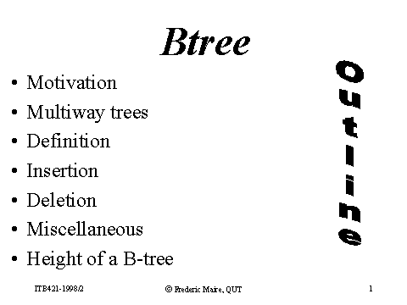

Outline

Slide 3

Motivation

Slide 4
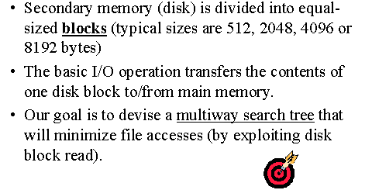
Motivation (cont.)

Slide 5
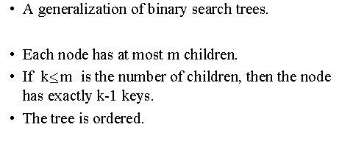
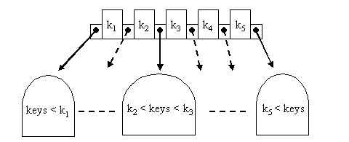
Multiway Search Trees (of order m)

Slide 6
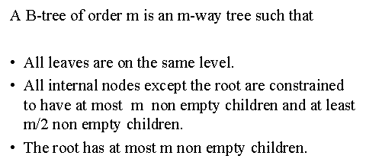
Definition of a B-Tree

Slide 7
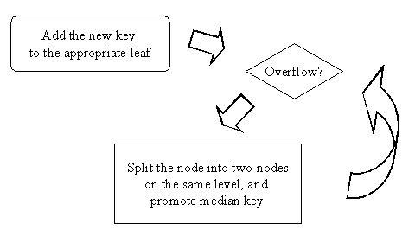
Insertion into a B-Tree

Slide 8
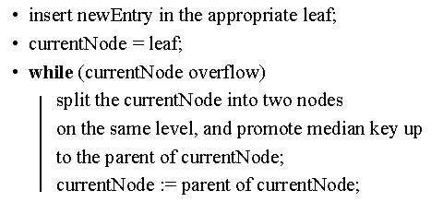
Pseudocode of Insert

Slide 9
Example Insertion

Slide 10
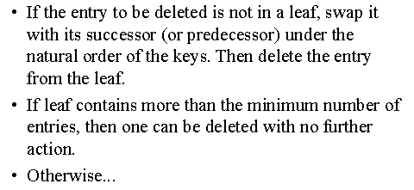
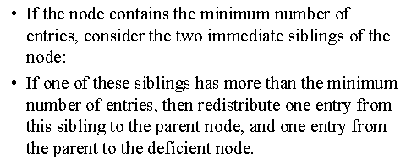
Deletion from a B-Tree

Slide 11
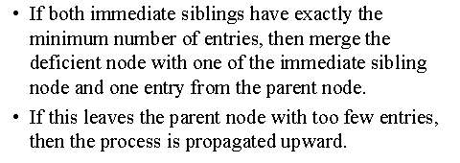
Deletion from a B-Tree (cont.)

Slide 12
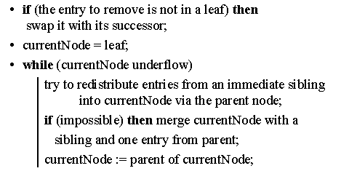
Deletion PseudoCode

Slide 13
Deletion Example

Slide 14
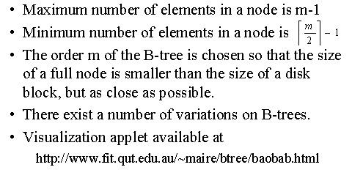
Summary

Slide 15
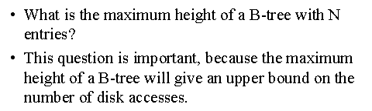
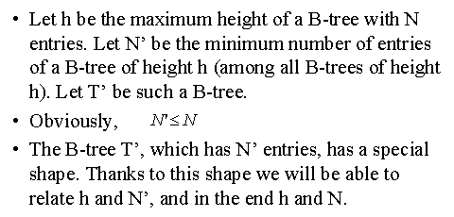
Height of a B tree

Slide 16
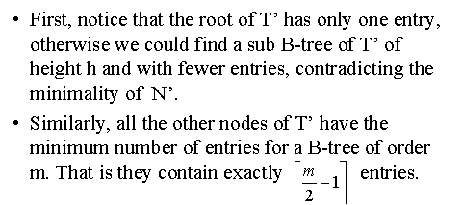
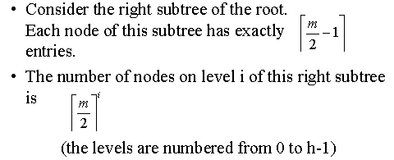
Height of a B tree (cont.)

Slide 17
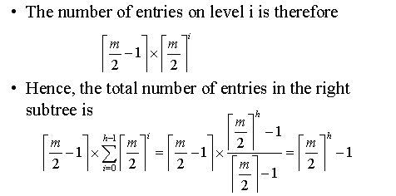
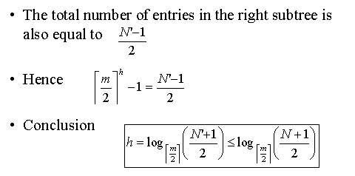
Height of a B tree (cont)

Slide 18
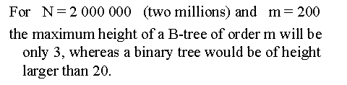
Height Example

Slide 19
B+ Trees
  The previous discussion mentioned that B-Trees are universally used to implement large-scale disk-based file systems.
  We lied. What is implemented is a variant of the B-tree called B+ tree.
  When greater efficiency is required, a slightly more complicated variant known as the B* tree is used.
  The most significant difference between a B+ and B trees is that B+ trees store records only at the leaf nodes. The internal nodes only store key values to help guide search.
  The big advantage of B+ trees is that the keys are small enough so that the top levels of the tree can remain in main memory and do not require any disk accesses.
33
18
23
48
10
12
15
18
19
20
22
23
30
31
33
45
47
48
50
52

Slide 20
B+ Trees
  The previous discussion mentioned that B-Trees are universally used to implement large-scale disk-based file systems.
  We lied. What is implemented is a variant of the B-tree called B+ tree.
  When greater efficiency is required, a slightly more complicated variant known as the B* tree is used.
  The most significant difference between a B+ and B trees is that B+ trees store records only at the leaf nodes. The internal nodes only store key values to help guide search.
  The big advantage of B+ trees is that the keys are small enough so that the top levels of the tree can remain in main memory and do not require any disk accesses.
33
B tree of order 4
18
23
48
10
12
15
18
19
20
22
23
30
31
33
45
47
48
50
52

Slide 21
B+ tree pseudocode representation
The leaf nodes are normally linked together to form a linked list
class PAIR{
void * pointer; //Record* for leaves, BPNode* for internal nodes
Key key;
}
class BPNode {
PAIR recarray[MAXREC];
int numrec;
BPNode* leftPtr, rightPtr; // each level forms a doubly linked list
Bool isLeaf();
}

Slide 22
B+ Insertion Example
Original B+ Tree containing 5 records
10
12
23
33
48
33
Add 50 to the above to get
10
12
23
33
48
50
After further insertions
18
33
48
10
12
15
18
20
21
23
31
33
45
47
48
50
52
The result of inserting 30. The 2nd leaf node splits which causes the
internal node to split in turn, creating a new root.
33
18
23
48
10
12
15
18
19
20
22
23
30
31
33
45
47
48
50
52

Slide 23
B+ Trees Deletion
First we locate the record that needs to be deleted
If it is more than half full we just delete it
We leave in place the keys that direct traffic.
33
18
23
48
10
12
15
18
19
20
22
23
30
31
33
45
47
48
50
52
Delete 18
33
18
23
48
10
12
15
19
20
22
23
30
31
33
45
47
48
50
52

Slide 24
B+ Trees Deletion₂
If deleting reduces the number of records below the minimum we either
  Look for a sibling to help We may have to revise the parents key
33
18
23
48
10
12
15
18
19
20
22
23
30
31
33
45
47
48
50
52
X
Delete 12
33
19
23
48
10
15
18
19
20
21
22
23
30
31
33
45
47
48
50
52

Slide 25
B+ Trees Deletion₃
If both siblings are at the minimum then we must merge
We remove the node on the right since the one on the left is pointed to by the next node
33
18
23
48
10
12
15
18
19
20
22
23
30
31
33
45
47
48
50
52
Delete 33 merge the 2 left most
nodes
23
18
33
10
12
15
18
19
20
22
23
30
31
45
47
48
50
52
33
47

Slide 26
Graphs
A graph G= (V,E) is a set of vertices V and a set of edges E, such that there are 2 vertices associated with each edge.
Edges are denoted in this text by the pair (i,j) which means the edge connects vertex i with vertex j.
Sometimes the edges have a direction (called directed graphs or digraphs)
2
1
1
1
5
3
2
3
2
3
6
4
4
4
Another graph
A graph
A digraph

Slide 27
Definitions
Vertices are called adjacent if there is a edge connecting them.
If an edge touches a vertex they are called incident.
1
Vertices 1 and 4 are adjacent
Vertices 2 and 4 are NOT adjacent
the edge (1,4) is incident to both
vertex 1 and vertex 4.
2
3
4
For the above
V = {1,2,3,4}
E = {(1,2),(1,3),(1,4),(2,3),(3,4)}

Slide 28
More Definitions
A loop or self-edge is a edge which is only incident to 1 vertex.
A loop
1
2
3
4
A weighted graph is a G = (V,E, W) where W is a set
of weights, each weight is associated with an edge.
A weighted digraph is called a network.

Slide 29
Applications
Path problems
  In a city with many streets, we can say each intersection is a vertex and each the streets are edges.
  A sequence of adjacent vertices is called a path. A simple path is a path in which all vertices, except possibly the first and the last are different.
1St
2St
3St
1
2
3
one
way
1Ave
1
2
3
one
way
4
5
6
2Ave
4
5
6
one
way
7
8
9
3Ave
7
8
9
one way
one way
one way

Slide 30
Spanning Trees
A graph G is called connected if there is a path between every pair of vertices in G.
If the vertices represent computers and the edges communication links, connectedness means can every computer talk to every other computer.
If it is connected can some edges be eliminated (redundant). Can more edges be added and where to make it more robust.
A graph H = (V’, E’) is a subgraph of G= (V,E) if and only if its V’ ⊆ V and E’ ⊆ E .
A cycle is a simple path with the same start and end point.
A graph with no cycles is called a tree.
A subgraph with no cycles that contains all the vertices of a graph is called a Spanning Tree.

Slide 31
Spanning Trees Picture
If the graph is weighted with weights representing costs for that link, it is often desirable to find the minimum weight spanning tree.
28
28
28
1
2
1
2
1
2
10
14
16
16
16
10
14
14
7
3
7
3
7
3
6
6
6
24
24
24
25
25
5
18
12
18
5
5
22
Spanning
Tree
cost = 100
22
4
4
4
Graph
Spanning
Tree cost = 129

