Slide 1
NetBEAMS
Architecture Proposal
Agilent Laboratories

Slide 2
Contents
Usage Context
System Block Diagram
System Components
  JDDAC Probe
  JDDAC Server
  Other Servers
Data Model
Miscellaneous

Slide 3
Usage Context
Scientists
Public
JDDAC
Software
Sensors

Slide 4





Phase 1 Block Diagram
Measurement Tier
Application Tier
Sensor Tier
DRDS
Server
OPeNDAP
Client
Met
Station
JDDAC
Probe
Measurement
Database
ADCP
JDDAC
Probe
App
Server
JDDAC
Server
CDT
JDDAC
Probe
Web
Server
Serial
Map
Server
LAN

Slide 5
System Interfaces
Measurement Tier
Application Tier
Sensor Tier
OPeNDAP/
HTTP
DRDS
Server
OPeNDAP
Client
Met
Station
Serial
JDDAC
Probe
SQL/
JDBC
XML/
HTTP
Measurement
Database
ADCP
JDDAC
Probe
SQL/
JDBC
App
Server
JDDAC
Server
CDT
JDDAC
Probe
XML/
HTTP
HTML/
HTTP
Web
Server
Map
Server
SQL

Slide 6
The Three Tiers
Sensor Tier
  Generates measurement data.
Measurement Tier
  Manages Probes
  Archives measurement data
Application Tier
  Domain specific data processing
  User visualization

Slide 7
JDDAC Probe
Responsibilities
  Polls the instrument for sensor data.
  Performs any in situ data processing and/or filtering.
  Generates self-describing measurement data.
  Performs any necessary local storage of measurement data.
  Encodes and compresses data for transmission to server and/or other probes.
  Receives messages from server and/or other probes.
Contains TEDS (Transducer Electronic Data Sheet) for the instrument.
Runs JMDI (Measurement Dataflow) and JTI (Transducer Interfacing) on J2ME. Platform TBD.
Can be mobile or fixed in place.

Slide 8


Probe Object Model Example
TIM
Transducer
Block
Function
Block
Function
Block
Transducer
Block
Function
Block
Reporter
Block
TIM

Slide 9
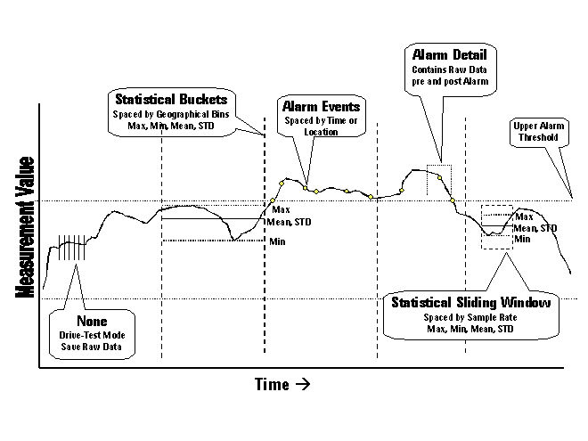
Function Block Types
Report-by-Exception
Filtering
Statistics
Alarming

Slide 10
JDDAC Server
Manages JDDAC Probes
  Probe identification and authentication
  Communicates configuration changes to probes
Manages metadata about probes and measurements.
Performs basic data processing (filtering, alarming. Etc.).
Aggregates measurement values into measurement data sets.
Archives measurement data in database.
Advertises measurement data sets.
Provides system administrative functions.
Runs JMDI (Measurement Dataflow) and JMCI (Measurement Calculus) on J2EE/Linux.
Measurement Database runs on MySQL/Linux.

Slide 11
JDDAC Server Interface
HTTP GET parameters and XML via HTTP POST commands
Authentication/Compression available for XML communications.
Allow users to
  Defines measurement policies.
  Manage probes.
  Queries measurement data and metadata.
  Perform simple data filtering.

Slide 12
Additional Servers
Map Server
  Based on open source MapServer software from U. of Minnesota.
  Serves TIGER data from Census Bureau – streets and city data.
Web Server
  Generates user visualization based on measurement data and metadata from measurement database.
DRDS Server
  Interacts with measurement database to serve OPeNDAP data sets.
Application Server
  Performs domain specific data processing.
OPeNDAP Clients
  Visualization or data processing software packages.

Slide 13
Data Model
Based on IEEE 1451.1 Data Model.
  Loosely typed, name/value pairs.
Used to represent measurement data and metadata.
Represented as ‘ArgArray’ class in Java programs.
Represented in XML for communication between JDDAC Server and clients.
Represented in JDBC binary for communication between
  JDDAC Server and Measurement Database,
  Measurement Database and DRD Server.

Slide 14
Measurement Data & Metadata
Measurement Data
Value
Actual data value
Timestamp
Time when a measurement was made
Location
Location where a measurement was made
Quality
Source of a measurement (measured, simulated, etc.)
Measurement Metadata
Unit
Measurement Unit
Uncertainty
Measurement Uncertainty
Owner
Measurement Owner

Slide 15
Data Model
Measurement Metadata
Measurement Data
Time Axis
Measurement
Dataset
Record

Slide 16
Subsystem Responsibilities
Sensor Tier – RTC, SFSU, Agilent.
Measurement Tier – Agilent, SFSU, Sun.
Application Tier – Sun, SFSU, RTC.

Slide 17
Other Collaborations
Monterey Bay Aquarium Research Institute (MBARI) Monterey Accelerated Research System (MARS) program (http://www.mbari.org/mars/)

Slide 18
Phase 2 Activities
Sensor Tier
  Replace wired connections between Probe and Server with wireless connections.
Measurement Tier
  …
Application Tier
  …

