Slide 1
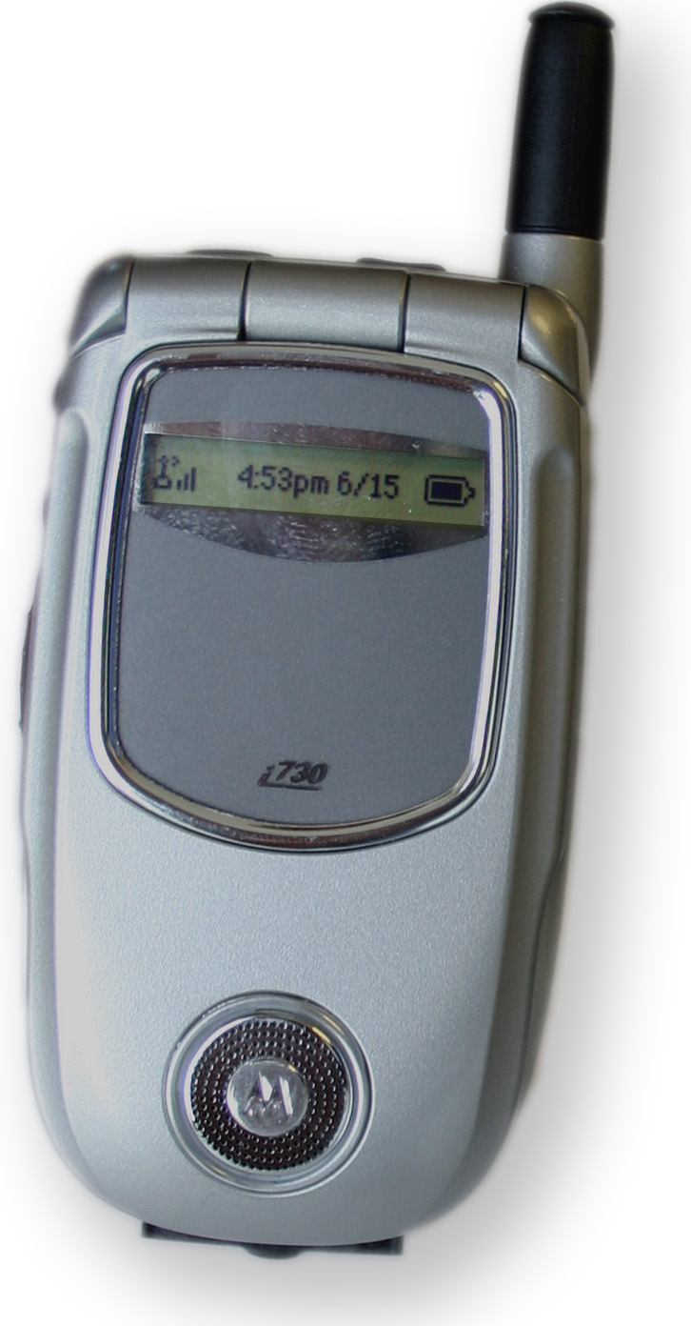
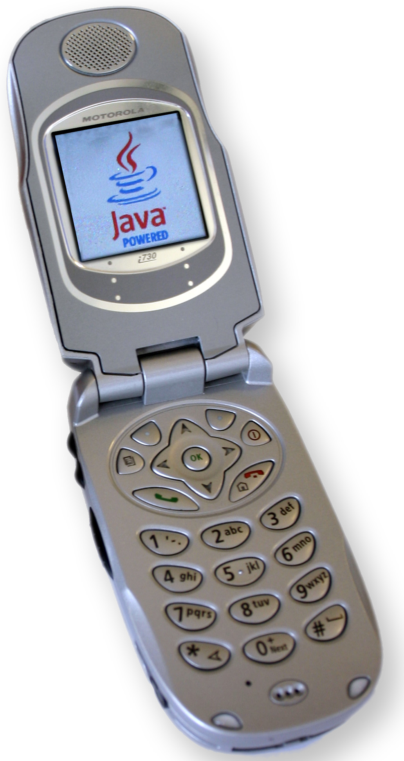
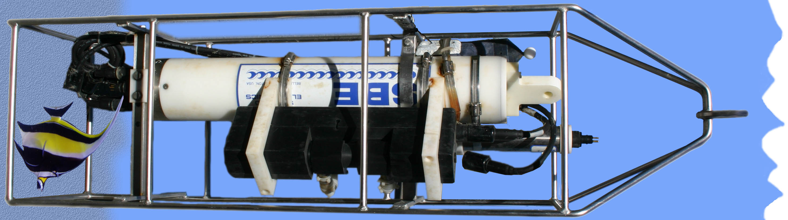
A Flexible System for Real-time Oceanographic Monitoring
Background
Real-time environmental monitoring is a field garnering an ever-increasing amount of attention. The ability for sensors to make and publish measurements to any Internet-connected devices provides researchers with a powerful tool which can ease the viewing of data, maintenance of the system and sharing of results.
Several environmental monitoring systems today rely on either satellite links or wired Internet connections for the dissemination of data. Furthermore, some systems require personal computers to automate the process of taking and publishing measurements. These solutions may provide the desired effect, but can be costly, tedious and cumbersome to own, operate and maintain. Each system is unique causing the building of a new system to be equally as much work as the first.
Requirements
The Department of Computer Science at San Francisco State University, with funding from Agilent Technologies and in collaboration with Sun Microsystems, have developed the Networked Bay Environmental Assessment Monitoring System (NetBEAMS). NetBEAMS is a generic data acquisition framework which is platform independent, easily extensible, simple to set-up and remotely configurable. This system also meets all of the requirements for today's real-time environmental monitoring system. Its design is such that it can be easily modified to support other systems with different sensor hardware.
NetBEAMS Details
Many measurement devices communicate via RS-232 connections. Cellular phones are also able to communicate using this protocol. NetBEAMS leverages this by using programmable cellular phones to act as a controller for marine sensors. The benefits of this are twofold. First, we are able to use the well-developed and well maintained infrastructure of wireless service providers as our transport mechanism. Secondly, Java 2 Micro Edition (J2ME), a stripped-down version of the Java programming language which runs on cellular phones, gives us a rich set of tools to develop control software.
NetBEAMS uses an open source data acquisition platform from Agilent Technologies called Java Distributed Data Acquisition and Control (JDDAC). JDDAC provides the infrastructure for data processing, transport, persistence and dissemination. The NetBEAMS application builds on top of this to communicate with an instrument from Seabird Electronics which measures temperature, conductivity , PAR, pressure and transmittance of sea water at the Romberg Tiburon Center in Tiburon, CA. The NetBEAMS application primarily deals with running the instrument which entails sending specific commands to take measurements and configuring the device, as well as how to process the returned results. Once a successful measurement cycle has completed (sending a command to the device and reading the result), variables in the NetBEAMS code are updated which are then made available to JDDAC for processing. At a configurable interval, JDDAC reads these variables and publishes them to a publicly viewable data server.
Typically, once a computer program is written it is difficult or impossible to change its behavior without changing the code and compiling a new application. Programs built around JDDAC are different in that they allow users to control various parts of the application while it is running. For example, there may be two channels being read at different frequencies, one every minute and the other every day. Administrators can log in to the JDDAC server and change the polling frequency of either of these channels or, if desired, completely turn them off. This is advantageous in that we can modify a running application and because we can do it remotely. Other scenarios may be changing calibration coefficients, checking for error conditions in the hardware, monitoring battery voltage of our device and
performing post-measurement data processing.
6
New commands DOWN from server
Measurement UP to server
2
Phone pulls measurements from CTD at a certain frequency using RS-232 protocol
1
Seabird CTD 16Plus

Slide 2
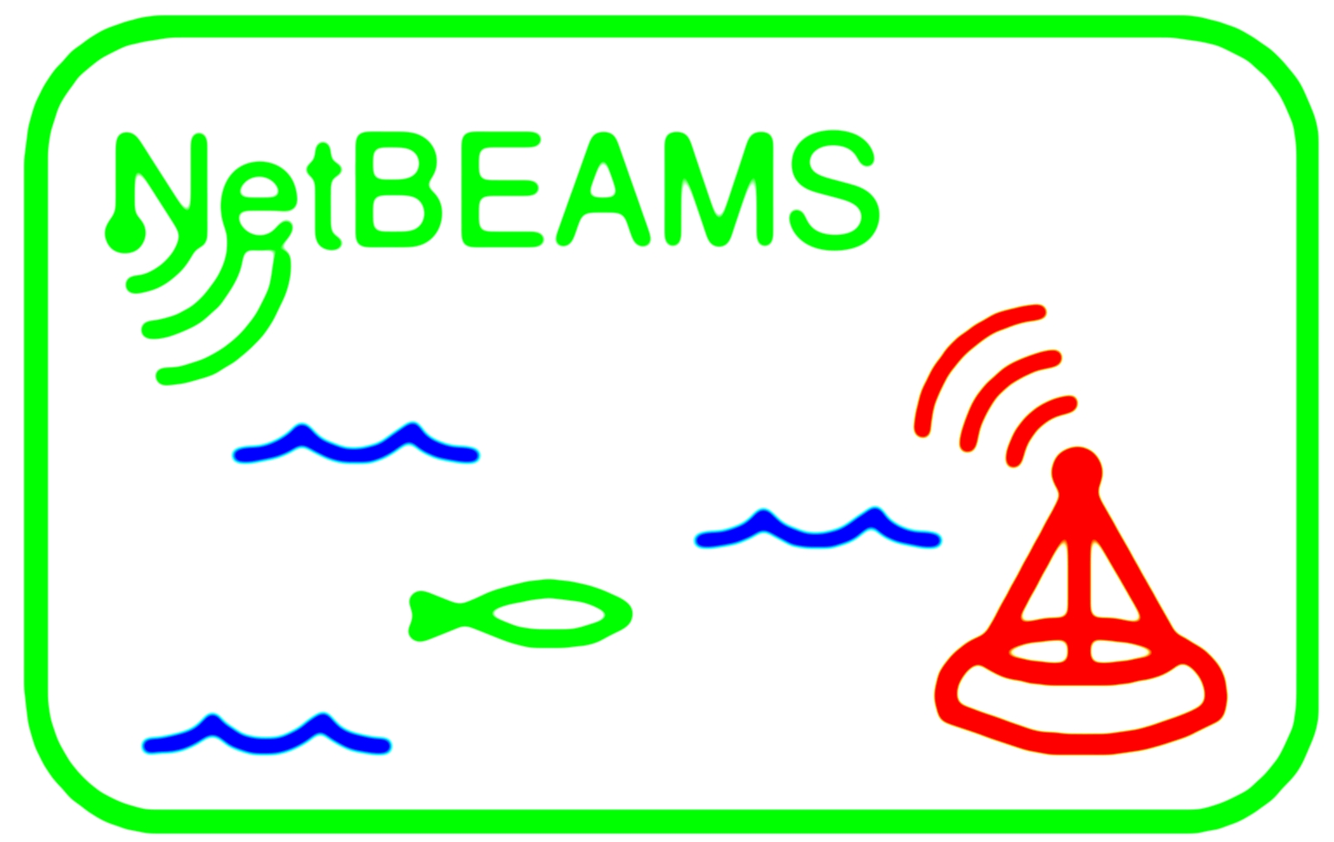

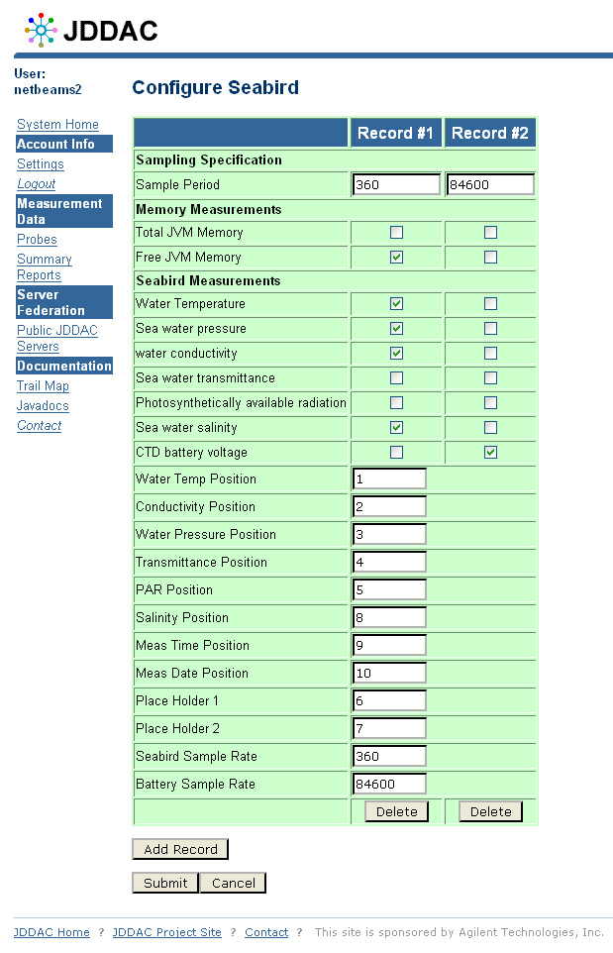
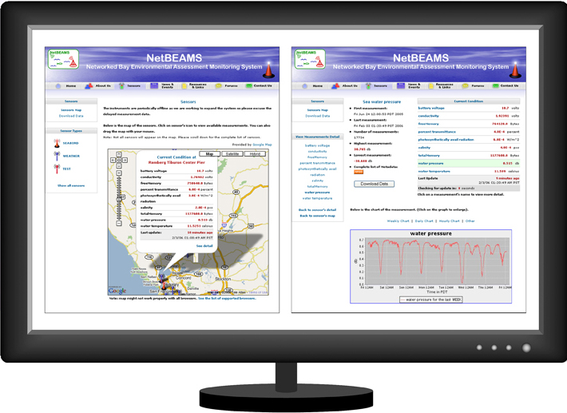
Brian Zambrano
bzambran@sfsu.edu
San Francisco State University
4
Administrators log on to the JDDAC server from any web browser and change properties of the probe. The next time the probe uploads data, the JDDAC server will gather new settings and push them down to the probe.
Internet
5
New configuration to JDDAC server and back out to phone
JDDAC Server
3
Measurements are sent to a JDDAC server and stored in database
Requests for measurement data
Any internet connected device with a web browser can view measurements in real-time as well as download historical data from http://www.netbeams.org
Project Partners
SFSU Computer Science & Romberg Tiburon Center:
  http://www.netbeams.org
Agilent Technologies (JDDAC):
  http://jddac.labs.agilent.com
Sun Microsystems (java.net):
  http://jddac.dev.java.net

