Slide 1
bp
Blueprint Planner-Agent
Plan first.
Route smarter.
Ship with agents.
$ blueprint
planner
gpt-5.5 / high reasoning
providers
OpenAI Codex · Claude Code · Gemini CLI
output
.blueprint/tasks/*.md
Terminal AI planning harness that turns vague software ideas into dependency graphs, model-routed handoffs, and validation contracts for coding agents.
github.com/marcellopps283/cli-planner-agent

Slide 2
PROBLEM
AI agents execute fast. Planning still breaks.
Context drifts across chats and tools.
Tasks overlap or miss dependencies.
Expensive models get used for cheap work.
Weak models get assigned to high-risk architecture.
Outputs are hard to audit before code changes begin.
Large AI-assisted coding projects fail when the first prompt is vague and the work is not sliced cleanly.
01 / Problem

Slide 3
SOLUTION
The planning brain before worker agents start.
Chat-first planning
Compact context
Brainstorms and fills gaps before architecture is locked.
Reads project inventory instead of dumping the entire repo.
Task graph
Worker handoffs
Creates dependency-aware work units with blocking rules.
Generates XML task prompts, model choices, and acceptance contracts.
Blueprint runs an investigative terminal chat, validates missing requirements, routes work to exact models, and writes handoffs that other agents can execute.
02 / Solution

Slide 4
WORKFLOW
One terminal surface from setup to handoff.
Onboard project, providers, models, and reasoning effort.
1
2
Brainstorm until scope, constraints, and validation are clear.
The harness keeps configuration, brainstorming, preview, and artifact generation in one flow.
3
Preview dependency graph and model assignments.
4
Generate architecture docs, XML tasks, and integration guide.
03 / Agentic workflow

Slide 5
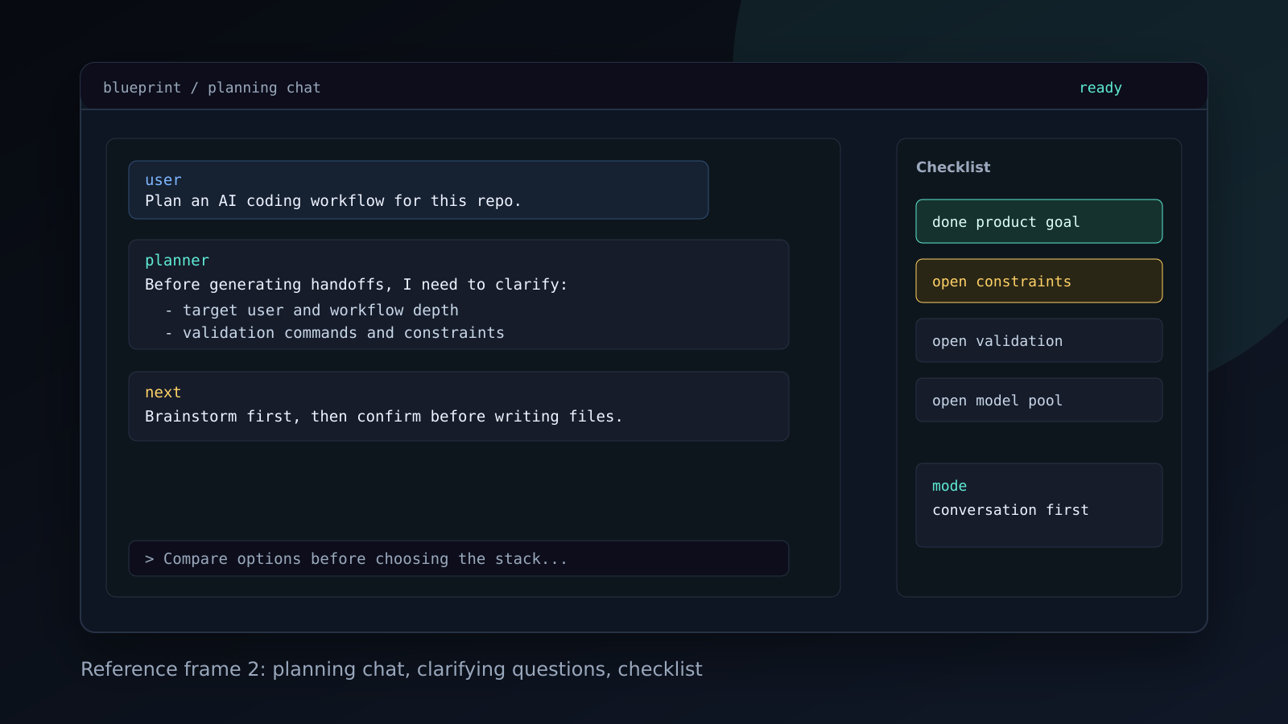
PRODUCT EXPERIENCE
Planning chat, not a rigid form.
04 / Terminal harness UX

Slide 6
MODEL ROUTING
Routes by exact model, not just provider.
Risk & Fit
Cost & Latency
Context & Effort
Architecture, security, and multi-file work require stronger reasoning.
Small documentation or formatting tasks can use cheaper, faster models.
Model context window and reasoning settings are part of routing.
preview: task -> model -> rationale
task-001
docs polish -> gemini flash-lite
task-004
routing contract -> gpt-5.5
task-006
integration validation -> gpt-5.5 or opus
05 / Model routing

Slide 7
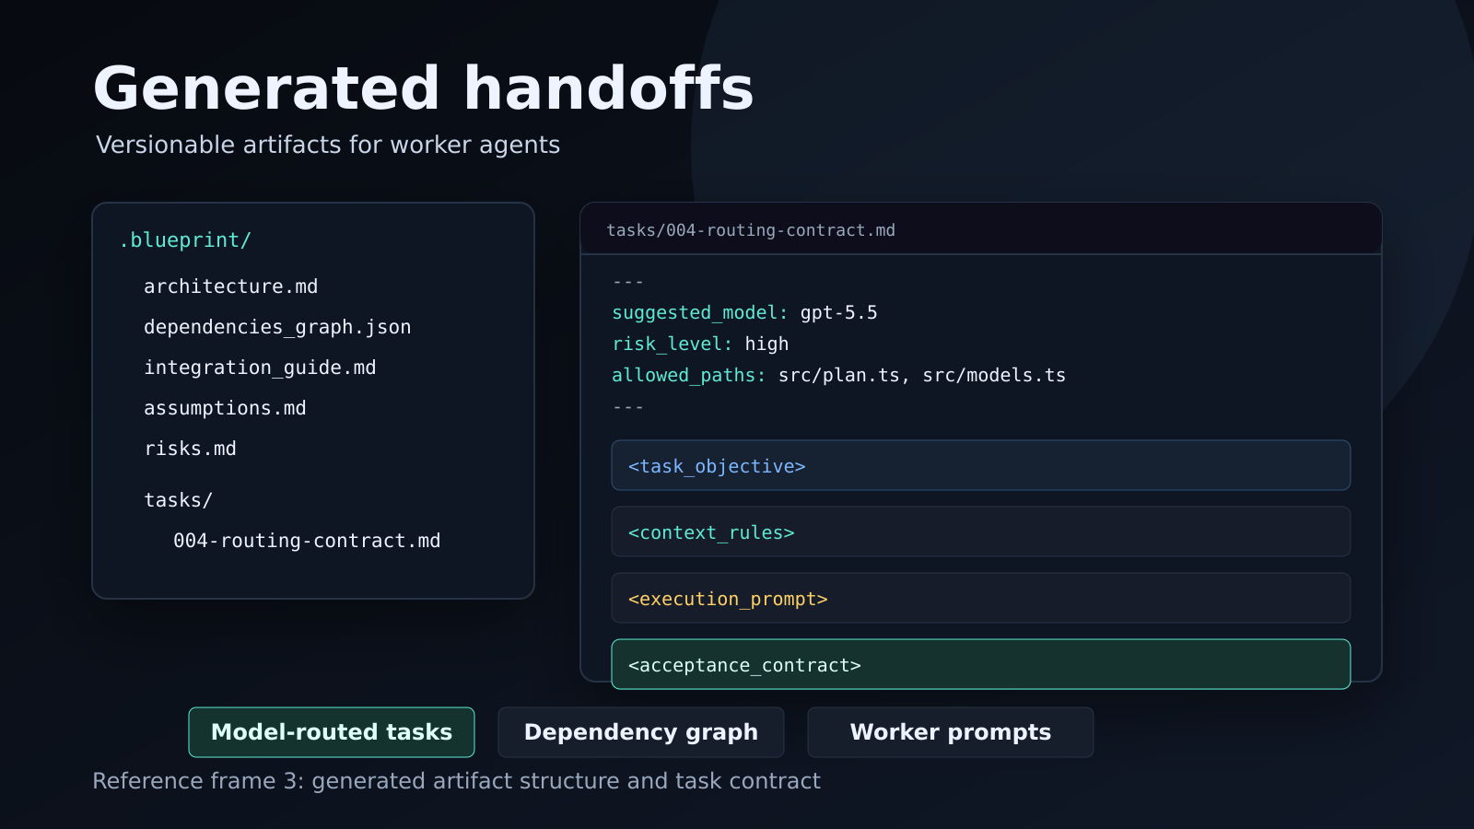
ARTIFACTS
Versionable handoffs for worker agents.
06 / Generated artifacts

Slide 8
MVP STATUS
Working planner-only harness.
TypeScript CLI/TUI with Ink and Commander.
Provider registry and selected model pool.
Deterministic and LLM planning engines.
Handoff linting, export, and smart revise.
CI passing with 111 tests.
Version 1 plans and generates rigorous handoffs for human-controlled workers. Version 2 can become the supervisor that runs those workers from the same terminal.
links
demo
marcellopps283.github.io/cli-planner-agent
repo
github.com/marcellopps283/cli-planner-agent
07 / Status and roadmap

