Slide 1

Network Science in Football
Unraveling Hidden Dynamics with Complex Networks
Marcello Russo

Slide 2
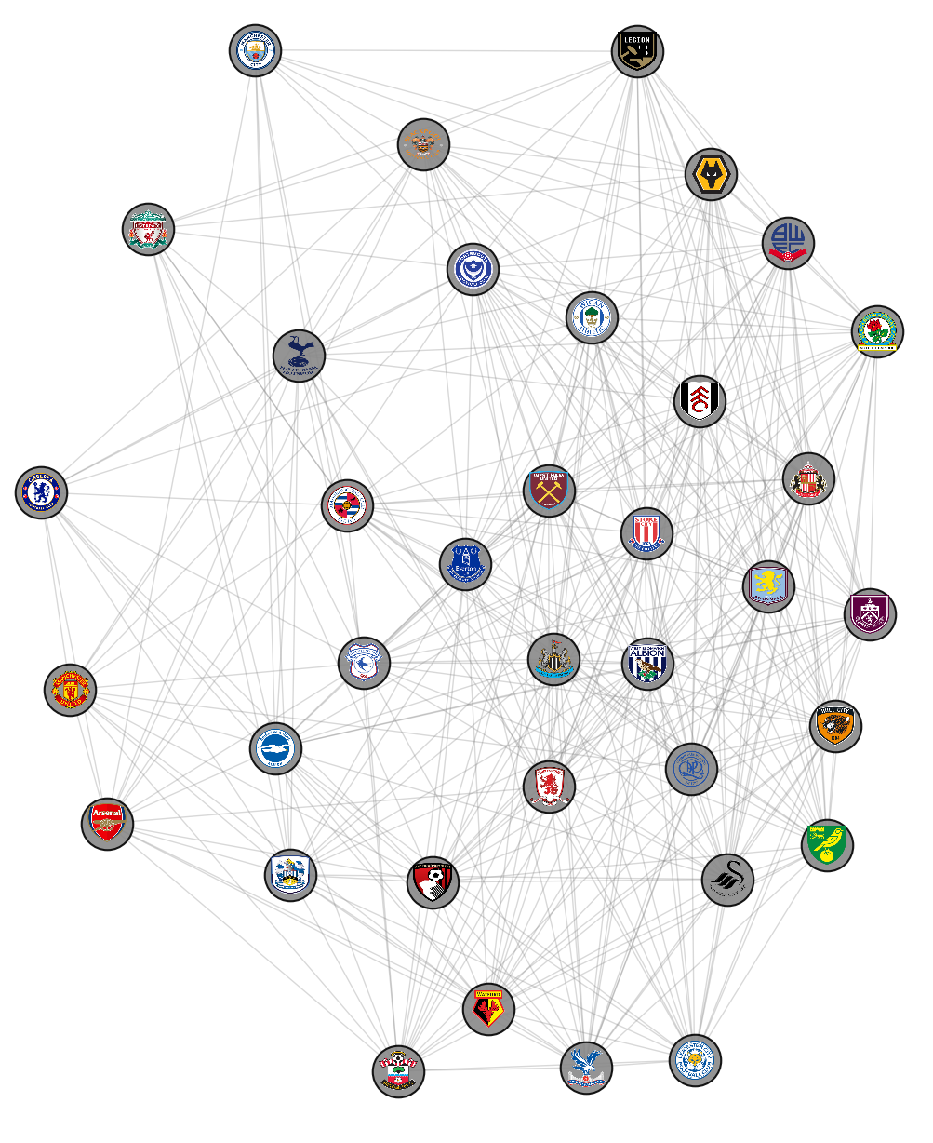
Network View of Football
Football: More than just goals and points, it's a dynamic system of team interactions.
Goal: Uncover hidden dynamics, strategies, and success factors beyond traditional statistics.
Source: The dataset was found on Kaggle and contains data from the 2000 to the 2025.
Key Data Points: Includes match dates, full-time/half-time results, goals, corners, shots, fouls, and cards.

Slide 3


Teams and Interactions
Nodes: Each Premier League team for that selected Season/s.
Edges: Represent interactions between teams based on matches played.
Edges carry detailed performance information from head-to-head encounters.

Slide 4



Teams and Interactions
The study analyzes interactions based on three key metrics of differences: - Goals: Goal scored in matches. - Aggressiveness: Fouls, yellow/red cards. - Control: Shots, corners.
Similarity between teams is achieved connecting those with minimal differences in these metrics during their games.

Slide 5
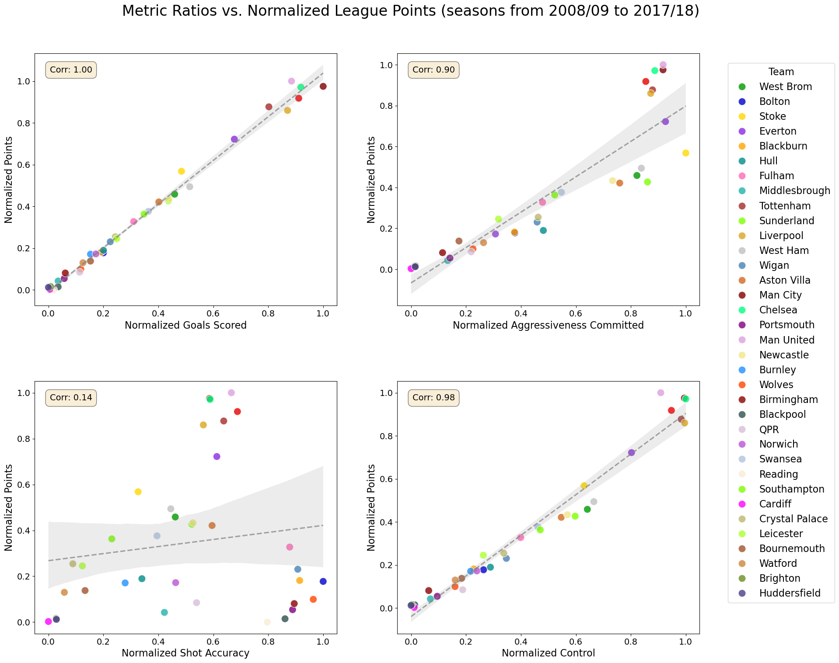
Teams and Interactions
Normalized Metrics vs Points (seasons from 2008/09 to 2017/2018)

Slide 6
Load raw EPL data
Preprocessing
Graph Creation
Edges Filtering
Centralities
Analysis
Communities Detection
The Analysis Workflow

Slide 7
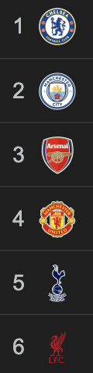
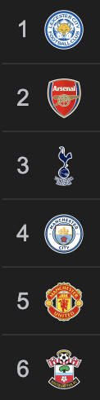
A Natural Experiment: 2014/15 vs 2015/16
2014/15 Season : Characterized by traditional Big Six dominance. - Will dominant teams form cohesive network communities?
2015/16 Season: Leicester City's unexpected title victory. - How does such an anomaly alter established network dynamics?
This comparison reveals how performance shapes network structures and team centralities for that seasons.
2014/15
2015/16

Slide 8
A Decade of Dynamics: 2008/09 - 2017/18
Extended analysis over 10 seasons to: - Mitigate the impact of single-season anomalies; - Identify stable and enduring network patterns; - Understand how similarity in performance relates to success.
This approach provides a more robust view of Premier League structural dynamics.

Slide 9
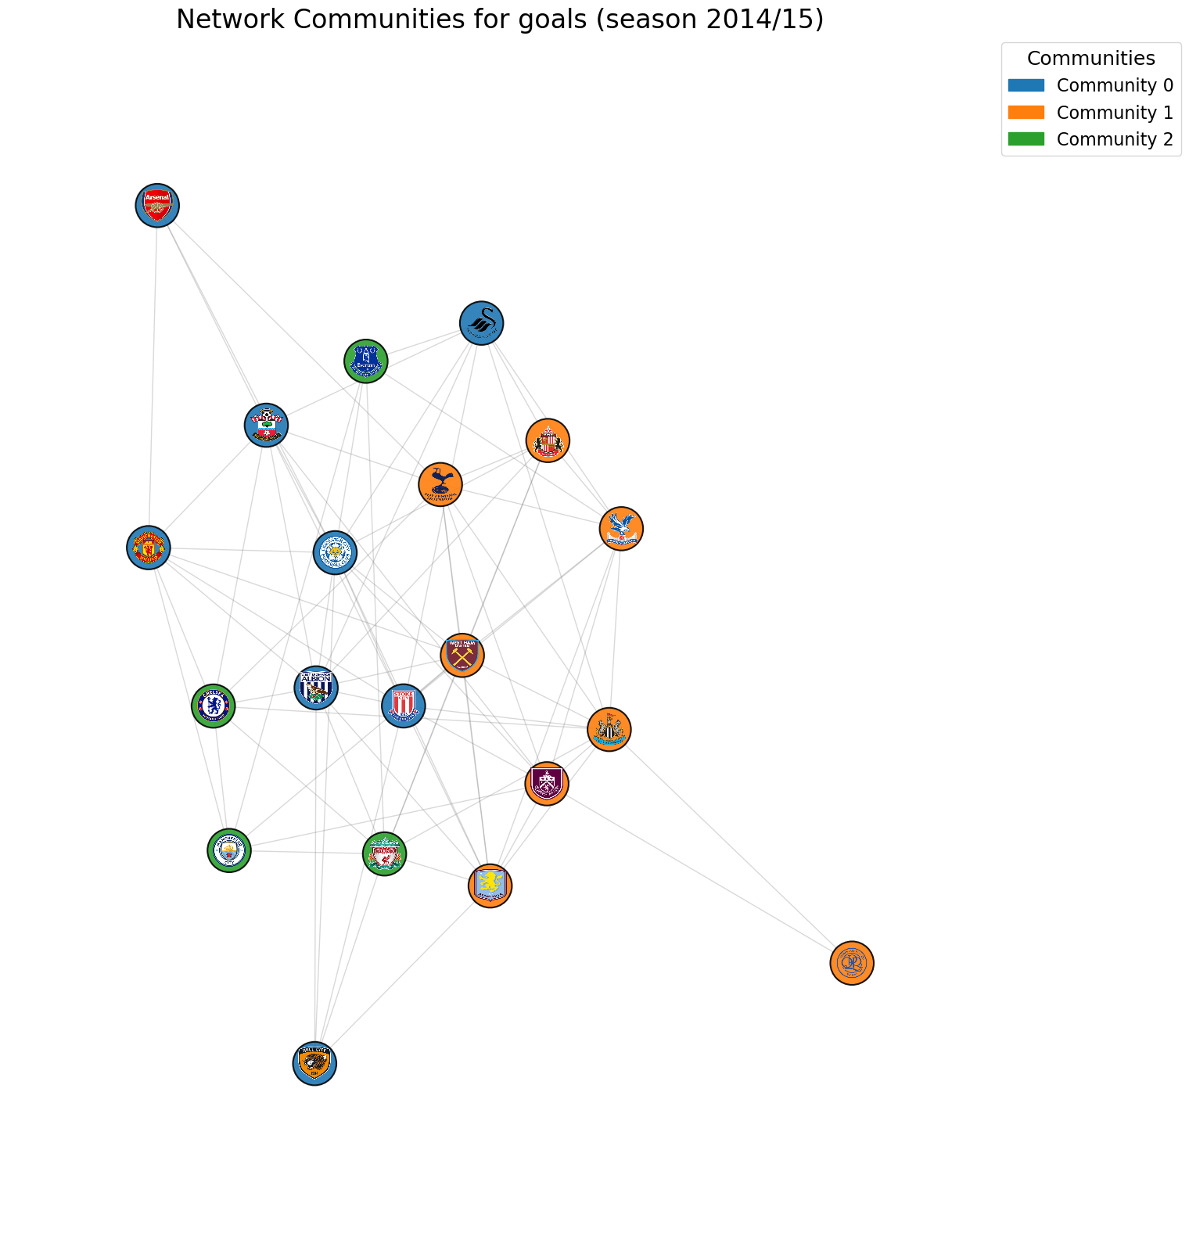
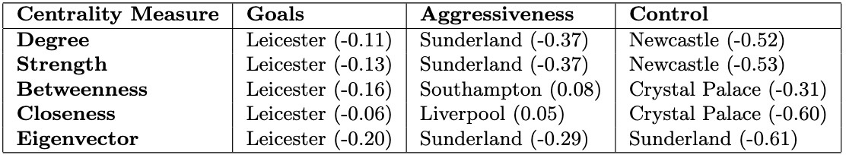
Single Seasons Insights
Centrality and Correlations: Goals and Control centralities often correlate negatively with points.
Community Dynamics: Big Six rarely form cohesive communities.
Goal Similarity Network Communities 2014/15

Slide 10
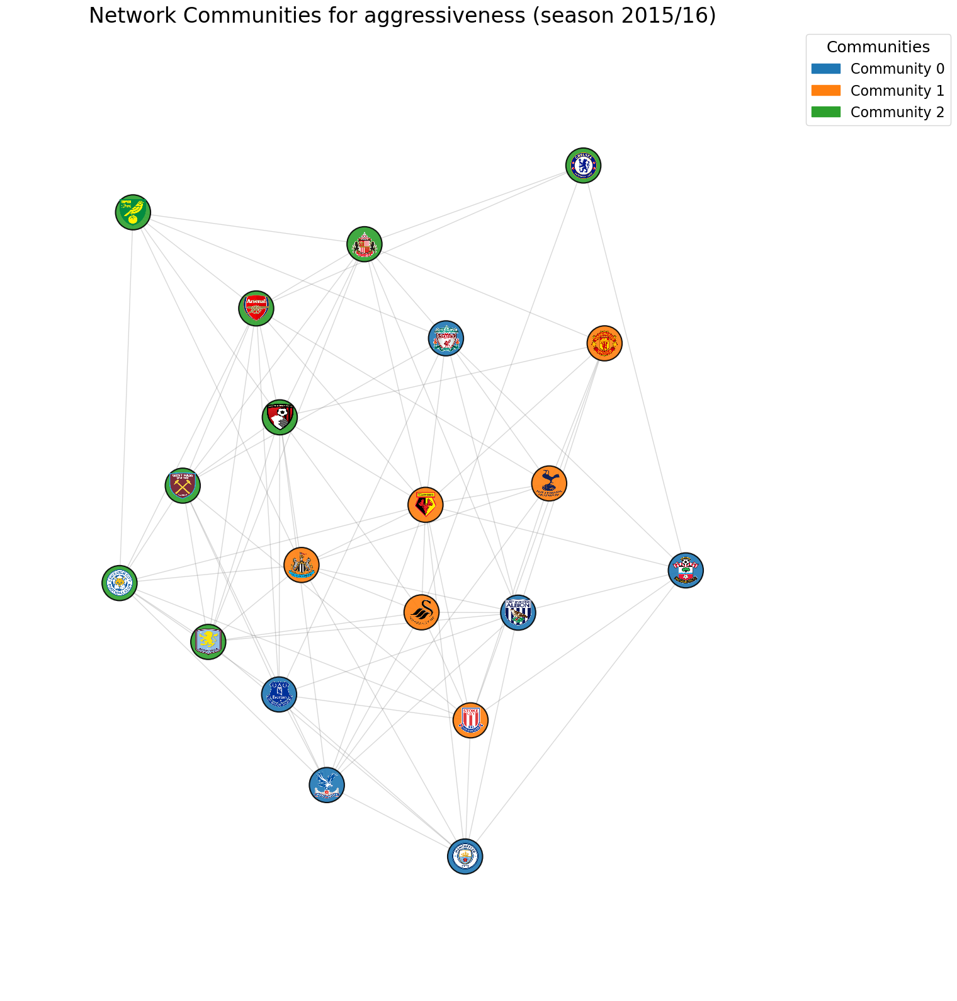
Single Seasons Insights
Leicester's Impact: Aggressiveness centrality shows strong correlation with points.
This suggests an adaptable aggression style was key to their surprising success, distinguishing them from top clubs.
Aggressivity Similarity Network Communities 2015/16

Slide 11
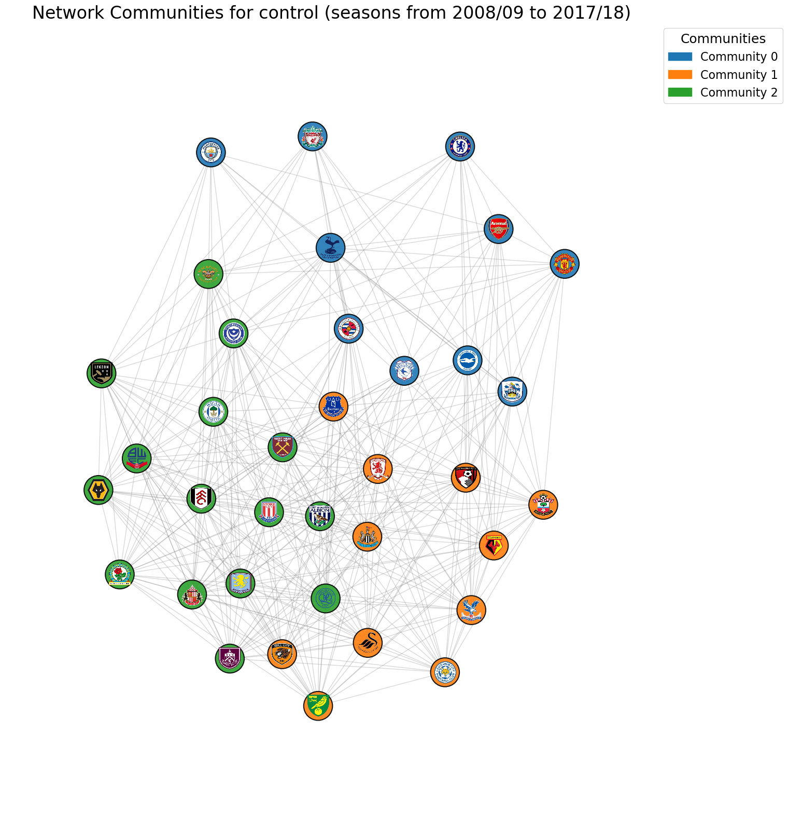
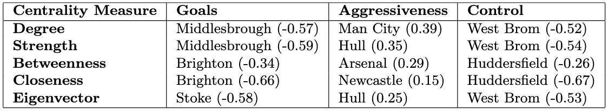
Decade-Long Pattern
Centrality and Correlations: centralities remain negatively correlated with points, but…
Community Dynamics: A clear Big Six cluster emerges, indicating shared offensive dominance.
Control Similarity Network Communities 2008/09-2017/2018

Slide 12
Limitations and Future Horizons
Current Limitations: - No data on possession in this dataset; - Season level data-aggregation; - Static network analysis; - Correlations identified, but not direct causality.
Future work: - Dynamic network models; - Multi-layer networks (transfers, coaching changes); - Integration of advanced football metrics; - Cross-league comparative studies; - Development of predictive models for team performance.

Slide 13
Thanks for your attention!
Any questions?
Marcello Russo

