Slide 1



Aviation Project
View in Power BI
Last data refresh:
10/26/2021 6:13:29 AM UTC
Downloaded at:
10/26/2021 6:15:08 AM UTC

Slide 2
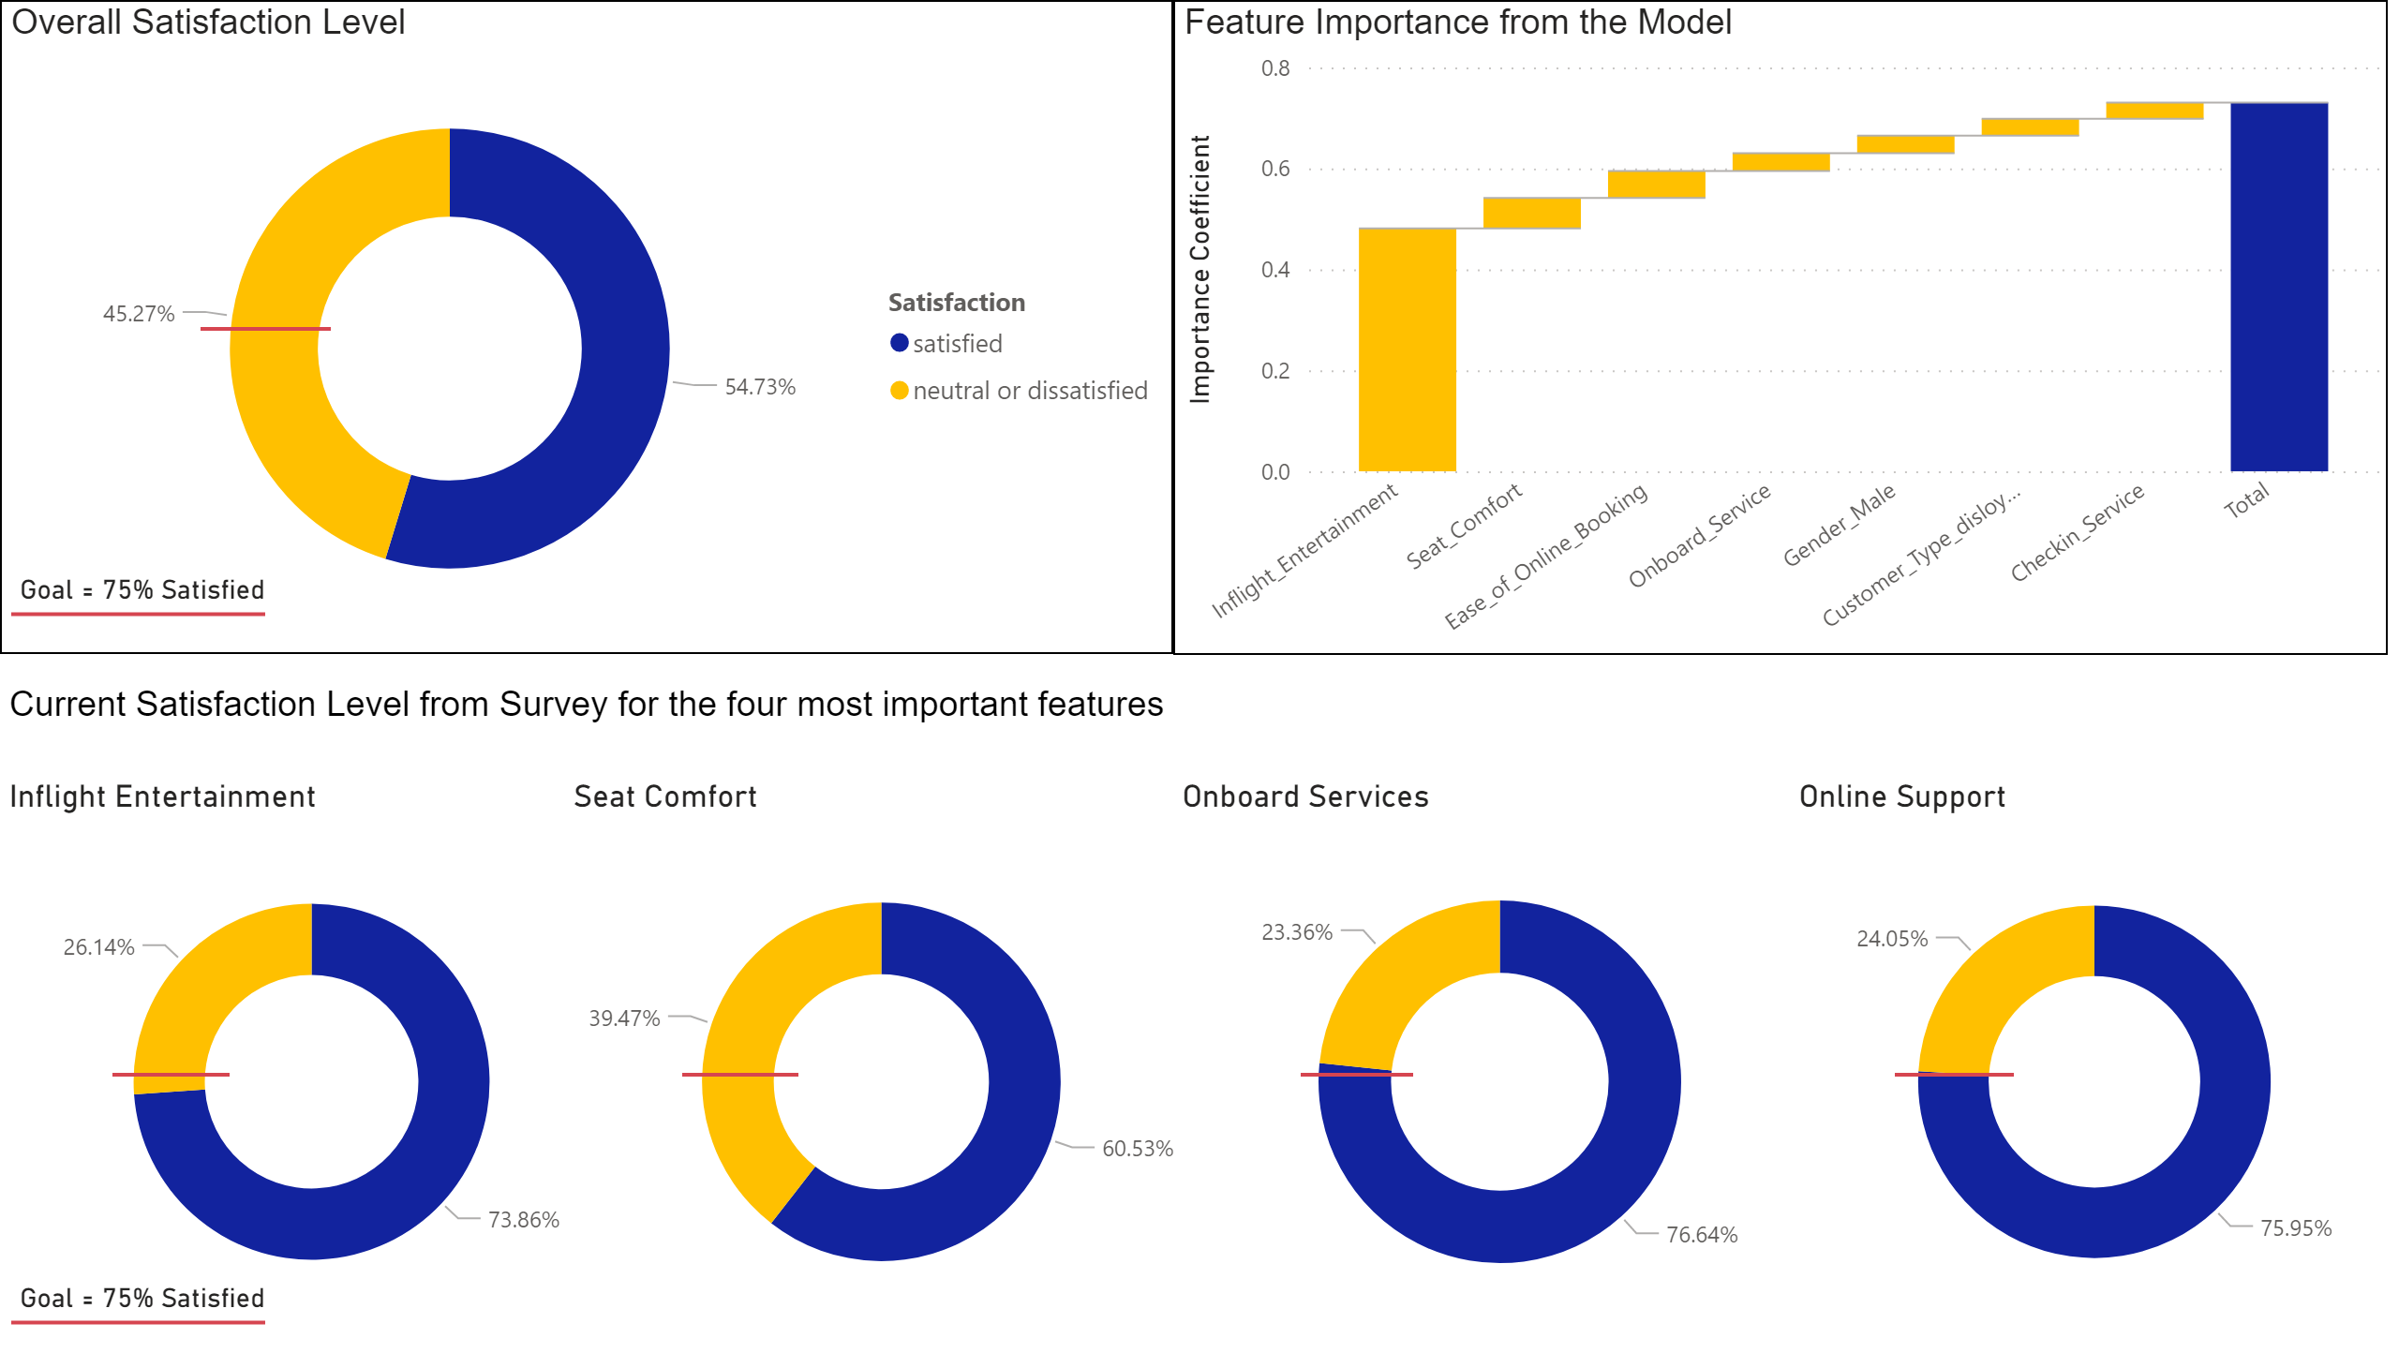
Page 1
Notes:
Overall Satisfaction Level
No alt text provided.
Feature Importance from the Model
No alt text provided.
Inflight Entertainment
No alt text provided.
Seat Comfort
No alt text provided.
Onboard Services
No alt text provided.
Online Support
No alt text provided.
shape
No alt text provided.
shape
No alt text provided.
shape
No alt text provided.
shape
No alt text provided.
Goal >75%
No alt text provided.
Goal = 75% Satisfied
No alt text provided.
Goal = 75% Satisfied
No alt text provided.
textbox
No alt text provided.

Slide 3
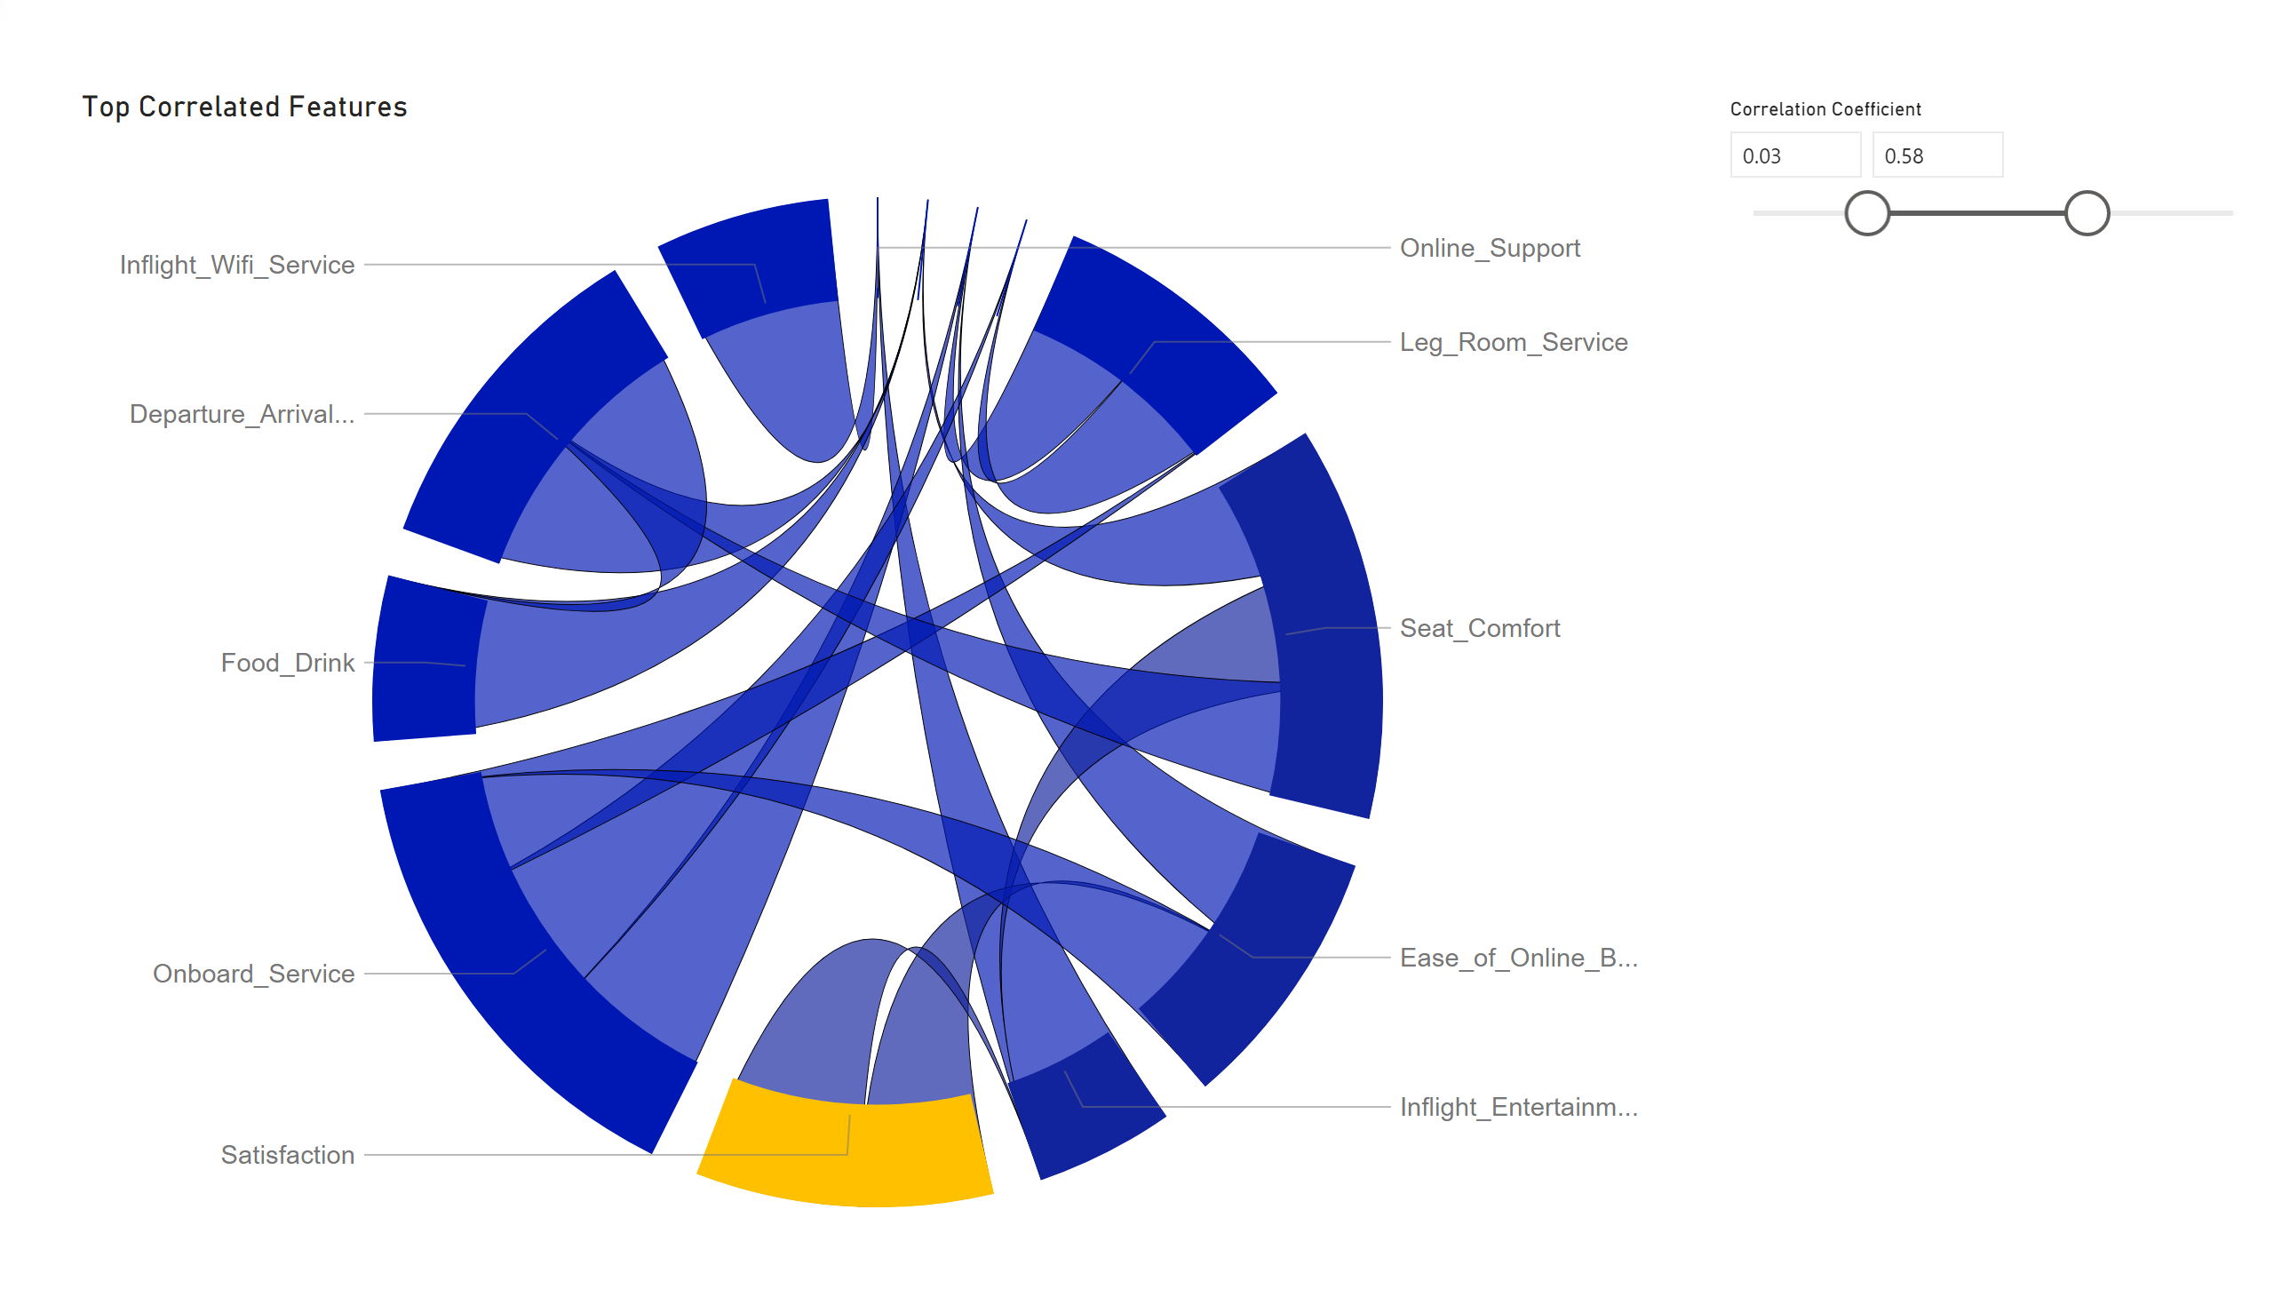
Page 3
Notes:
Top Correlated Features
No alt text provided.
slicer
No alt text provided.

