Slide 1
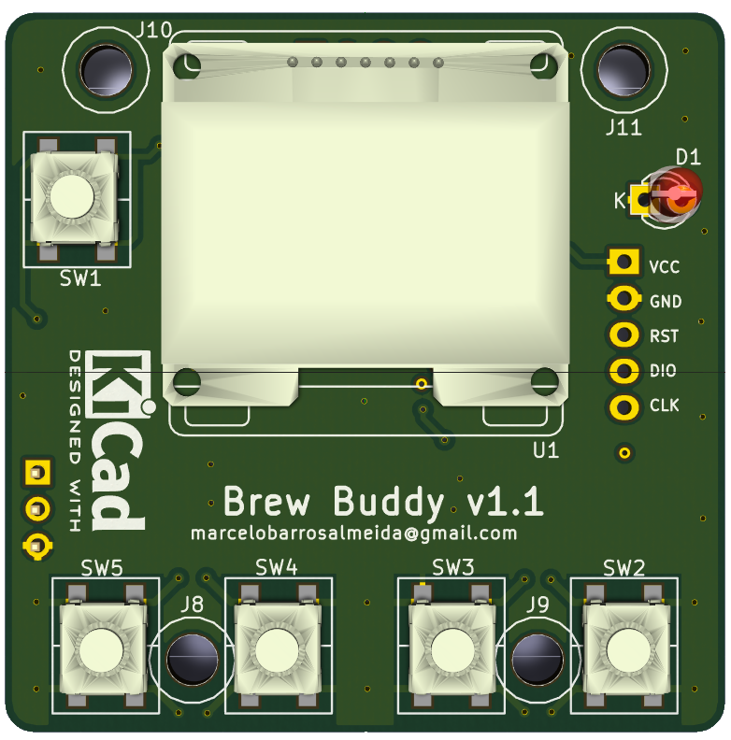
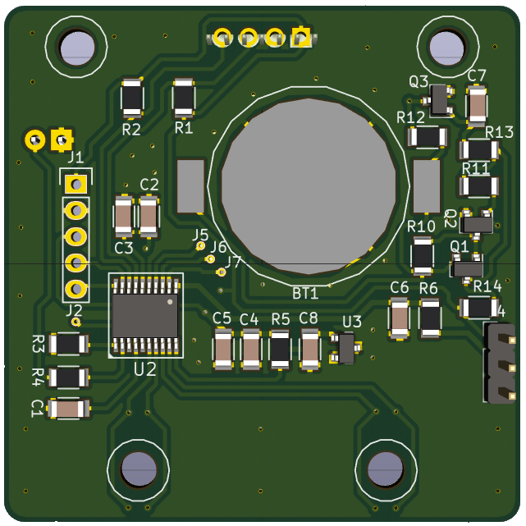
BrewBuddy: Overview
Author : Marcelo Barros de Almeida
Email : marcelobarrosalmeida@gmail.com
Project: https://hackaday.io/project/28667-brewbuddy
Code : https://github.com/marcelobarrosalmeida/brewbuddy

Slide 2
BrewBuddy: Thermometer
Author : Marcelo Barros de Almeida
Email : marcelobarrosalmeida@gmail.com
Project: https://hackaday.io/project/28667-brewbuddy
Code : https://github.com/marcelobarrosalmeida/brewbuddy

Slide 3
BrewBuddy: Moisture
Author : Marcelo Barros de Almeida
Email : marcelobarrosalmeida@gmail.com
Project: https://hackaday.io/project/28667-brewbuddy
Code : https://github.com/marcelobarrosalmeida/brewbuddy

Slide 4
BrewBuddy: Boiling/Hoping
Author : Marcelo Barros de Almeida
Email : marcelobarrosalmeida@gmail.com
Project: https://hackaday.io/project/28667-brewbuddy
Code : https://github.com/marcelobarrosalmeida/brewbuddy

Slide 5
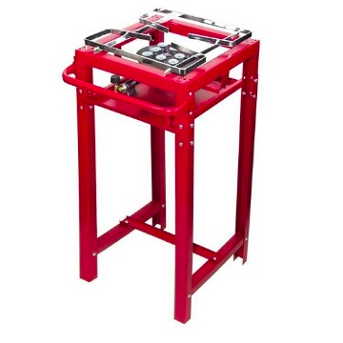
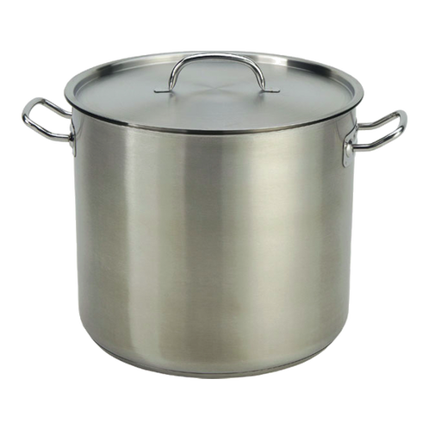
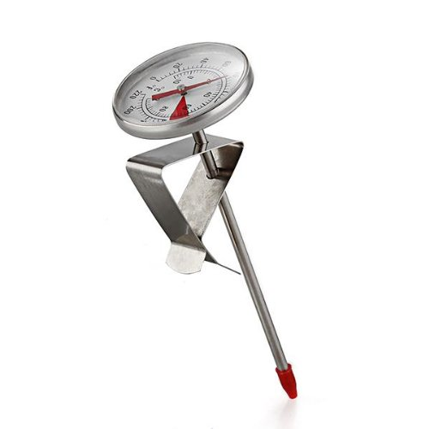
What is BrewBuddy ?
BrewBuddy is a compact device for helping homebrewers in their exhausting task of converting malts, hops and yeasts into happiness !

Slide 6
BrewBuddy Functions
  Thermometer: like an analog thermometer but aggregating time control via stopwatches (progressive and regressive).
  Step mash: You can program your temperature steps and duration when mashing. BrewBuddy will blink a led when an step is finished.
  Hop additions: When boiling, it is very easy to program your hop additions. Again, BrewBuddy will indicate when it occurs.

Slide 7
BrewBuddy Functions
  You can program up to ten mesh steps and ten hop additions.
  Your last setup is automatically saved in non volatile memory.
  BrewBuddy is powered by a CR2032 battery, working up to 20 hours.
  Menus and configurations are simple and intuitive, you will learn all function in minutes.

Slide 8
Main Components
  Microcontrolled PCB using a low cost STM32F030F4
  OLED Display 128x64
  LMT86 analog temperature sensor
  ADR5041BRTZ voltage reference (2.5V)
  Stainless steel tube for temperature measurement
  3D housing under development

Slide 9
BrewBuddy Navigation
On/off in a
single button
Indication
led
UP button
RIGHT button
DOWN button
LEFT button

Slide 10
BrewBuddy Menu
BrewBuddy
starts here !
BOILING
MOISTURE
THERMOMETER
Boiling programming (temperature and duration).
Hop additions programming (duration).
Boiling/hops follow up.
Step programming (temperature and duration).
Steps follow up.
Temperature follow up and time measurements

Slide 11
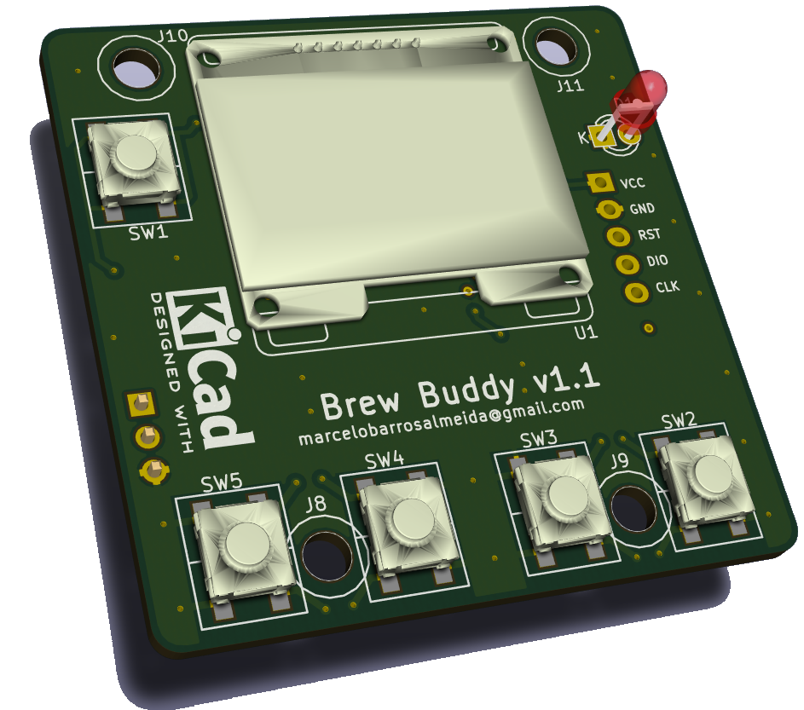
Demonstration Video
For faster demonstration, usual timer (whose unit is minute) was replaced by a timer in seconds. Moreover, temperatures were simulated.
►Demonstration mode: turn BrewBuddy on with LEFT button pressed
►Factory init mode: turn BrewBuddy on with RIGHT button pressed

