Slide 1
Workload levels
Níveis de carga
 | W₁ | … | W_{m/2} | … | W_{m}
C₁ | OP |  | OC |  | OO
…
C_{n/2} | CP |  | CC |  | CO
…
C_{n} | PP |  | PC |  | PO
 | W₁ | … | W_{m/2} | … | W_{m}
C₁ | OP |  | OC |  | OO
…
C_{n/2} | CP |  | CC |  | CO
…
C_{n} | PP |  | PC |  | PO
Capacity levels
Níveis de capacidade

Slide 2
 | W₁ | W₂ | W₃ | W₄ | W₅
C₁
C₂
C₃ | ✔ | ✔ | ✔
C₄ | ✔ | ✔ | ✔
C₅ | ✔ | ✔ | ✔
 | W₁ | W₂ | W₃ | W₄ | W₅
C₁ |  |  | ✖ | ✖ | ✖
C₂ |  |  | ✖ | ✖ | ✖
C₃ |  |  | ✖ | ✖ | ✖
C₄
C₅

Slide 3
 | W₁ | W₂ | W₃ | W₄ | W₅
C₁ | ✖ | ✖ | ✖ | ✖ | ✖
C₂ | ✔ | ✖ | ✖ | ✖ | ✖
C₃ | ✔ | ✔ | ✖ | ✖ | ✖
C₄ | ✔ | ✔ | ✔ | ✔ | ✖
C₅ | ✔ | ✔ | ✔ | ✔ | ✔
Oracle
 | W₁ | W₂ | W₃ | W₄ | W₅
C₁ | ✖¹⁷ | ✖¹⁴ | ✖¹⁰ | ✖⁰⁶ | ✖⁰¹
C₂ | ✔¹⁶ | ✖¹⁵ | ✖¹¹ | ✖⁰⁷ | ✖⁰²
C₃ | ✔¹³ | ✔¹³ | ✖¹² | ✖⁰⁸ | ✖⁰³
C₄ | ✔⁰⁹ | ✔⁰⁹ | ✔⁰⁹ | ✔⁰⁹ | ✖⁰⁴
C₅ | ✔⁰⁵ | ✔⁰⁵ | ✔⁰⁵ | ✔⁰⁵ | ✔⁰⁵
 | W₁ | W₂ | W₃ | W₄ | W₅
C₁ | ✖⁰⁷ | ✖⁰⁷ | ✖⁰¹ | ✖⁰¹ | ✖⁰¹
C₂ | ✔⁰⁶ | ✖⁰⁸ | ✖⁰¹ | ✖⁰¹ | ✖⁰¹
C₃ | ✔⁰⁶ | ✔⁰⁹ | ✖⁰¹ | ✖⁰¹ | ✖⁰¹
C₄ | ✔⁰² | ✔⁰² | ✔⁰² | ✔⁰³ | ✖⁰⁴
C₅ | ✔⁰² | ✔⁰² | ✔⁰² | ✔⁰³ | ✔⁰⁵
 | W₁ | W₂ | W₃ | W₄ | W₅
C₁ | ✖⁰⁵ | ✖⁰⁵ | ✖⁰⁵ | ✖⁰⁵ | ✖⁰⁵
C₂ | ✔⁰⁴ | ✖⁰⁹ | ✖⁰⁹ | ✖⁰⁹ | ✖⁰⁹
C₃ | ✔⁰³ | ✔⁰⁸ | ✖¹² | ✖¹² | ✖¹²
C₄ | ✔⁰² | ✔⁰⁷ | ✔¹¹ | ✔¹⁴ | ✖¹⁵
C₅ | ✔⁰¹ | ✔⁰⁶ | ✔¹⁰ | ✔¹³ | ✔¹⁶
OO
CC
PP

Slide 4
 | W₁ | W₂ | W₃ | W₄ | W₅
C₁ | ✖ | ✖ | ✖ | ✖ | ✖
C₂ | ✔ | ✖ | ✖ | ✖ | ✖
C₃ | ✔ | ✔ | ✖ | ✖ | ✖
C₄ | ✔ | ✔ | ✔ | ✔ | ✖
C₅ | ✔ | ✔ | ✔ | ✔ | ✔
Oráculo
 | W₁ | W₂ | W₃ | W₄ | W₅
C₁ | ✖¹⁷ | ✖¹⁴ | ✖¹⁰ | ✖⁰⁶ | ✖⁰¹
C₂ | ✔¹⁶ | ✖¹⁵ | ✖¹¹ | ✖⁰⁷ | ✖⁰²
C₃ | ✔¹³ | ✔¹³ | ✖¹² | ✖⁰⁸ | ✖⁰³
C₄ | ✔⁰⁹ | ✔⁰⁹ | ✔⁰⁹ | ✔⁰⁹ | ✖⁰⁴
C₅ | ✔⁰⁵ | ✔⁰⁵ | ✔⁰⁵ | ✔⁰⁵ | ✔⁰⁵
 | W₁ | W₂ | W₃ | W₄ | W₅
C₁ | ✖⁰⁷ | ✖⁰⁷ | ✖⁰¹ | ✖⁰¹ | ✖⁰¹
C₂ | ✔⁰⁶ | ✖⁰⁸ | ✖⁰¹ | ✖⁰¹ | ✖⁰¹
C₃ | ✔⁰⁶ | ✔⁰⁹ | ✖⁰¹ | ✖⁰¹ | ✖⁰¹
C₄ | ✔⁰² | ✔⁰² | ✔⁰² | ✔⁰³ | ✖⁰⁴
C₅ | ✔⁰² | ✔⁰² | ✔⁰² | ✔⁰³ | ✔⁰⁵
 | W₁ | W₂ | W₃ | W₄ | W₅
C₁ | ✖⁰⁵ | ✖⁰⁵ | ✖⁰⁵ | ✖⁰⁵ | ✖⁰⁵
C₂ | ✔⁰⁴ | ✖⁰⁹ | ✖⁰⁹ | ✖⁰⁹ | ✖⁰⁹
C₃ | ✔⁰³ | ✔⁰⁸ | ✖¹² | ✖¹² | ✖¹²
C₄ | ✔⁰² | ✔⁰⁷ | ✔¹¹ | ✔¹⁴ | ✖¹⁵
C₅ | ✔⁰¹ | ✔⁰⁶ | ✔¹⁰ | ✔¹³ | ✔¹⁶
OO
CC
PP

Slide 5
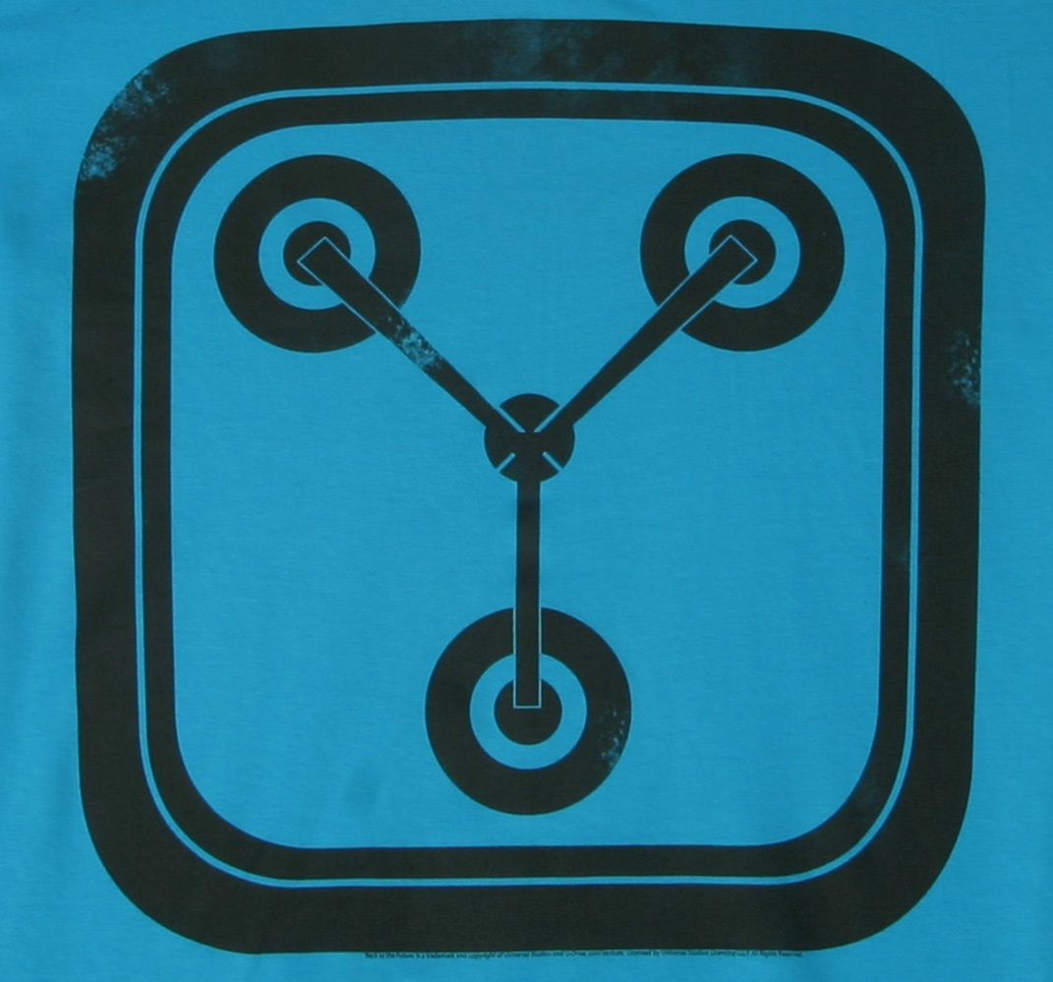
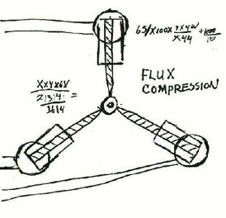
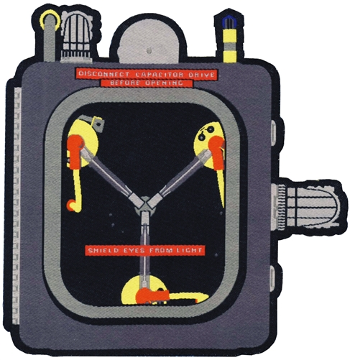

Slide 6
CloudCapacitor
CloudCapacitor
CloudCapacitor

