Slide 1
Workload levels
 | W₁ | … | W_{m/2} | … | W_{m}
C₁ | OP |  | OC |  | OO
…
C_{n/2} | CP |  | CC |  | CO
…
C_{n} | PP |  | PC |  | PO
Capacity levels

Slide 2
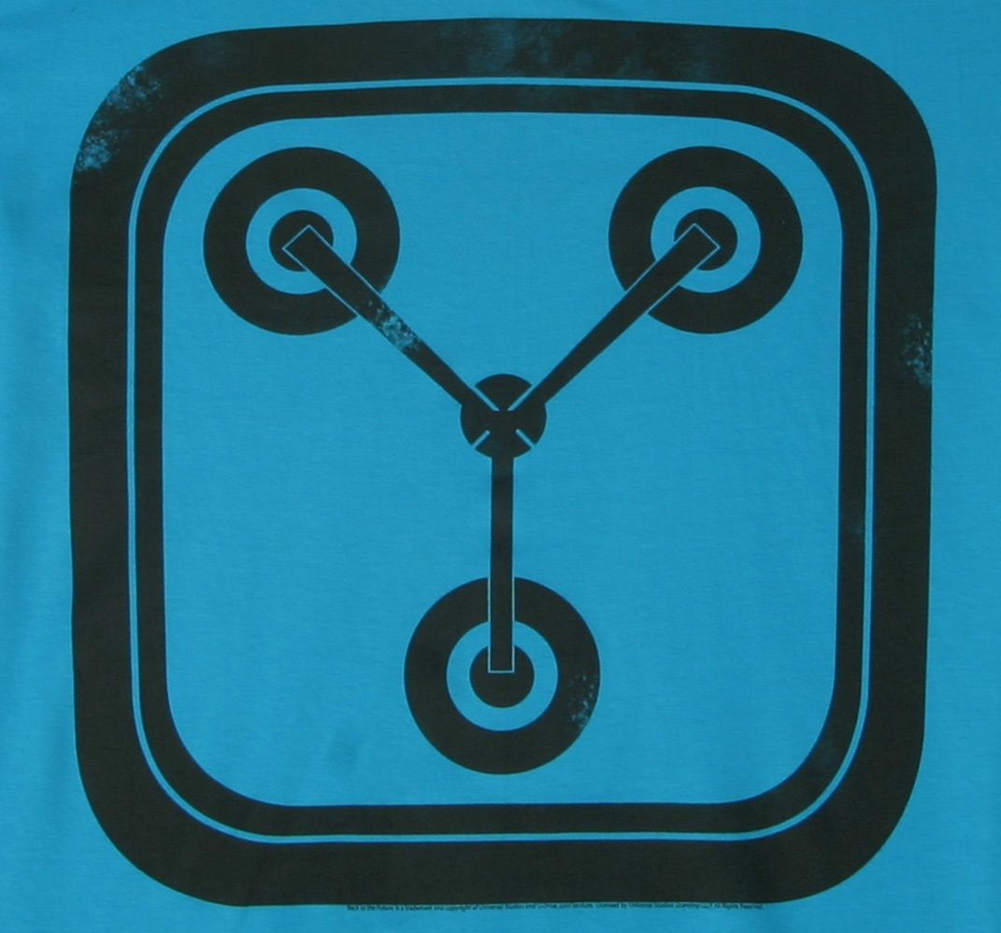
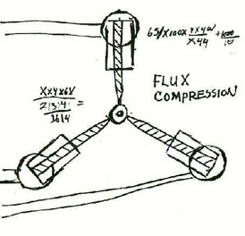
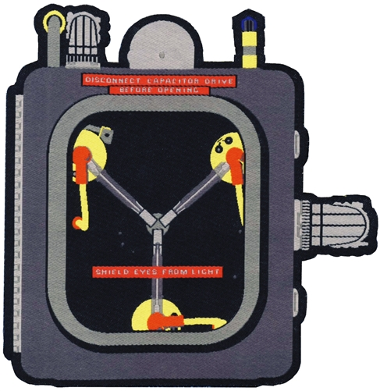

Slide 3
CloudCapacitor
CloudCapacitor
CloudCapacitor

