Slide 1
Workload levels
 | W₁ | … | W_{m/2} | … | W_{m}
C₁ | OP |  | OC |  | OO
…
C_{n/2} | CP |  | CC |  | CO
…
C_{n} | PP |  | PC |  | PO
Capacity levels

Slide 2
 | W₁ | W₂ | W₃ | W₄ | W₅
C₁
C₂
C₃ | ✔ | ✔ | ✔
C₄ | ✔ | ✔ | ✔
C₅ | ✔ | ✔ | ✔
 | W₁ | W₂ | W₃ | W₄ | W₅
C₁ |  |  | ✖ | ✖ | ✖
C₂ |  |  | ✖ | ✖ | ✖
C₃ |  |  | ✖ | ✖ | ✖
C₄
C₅

Slide 3
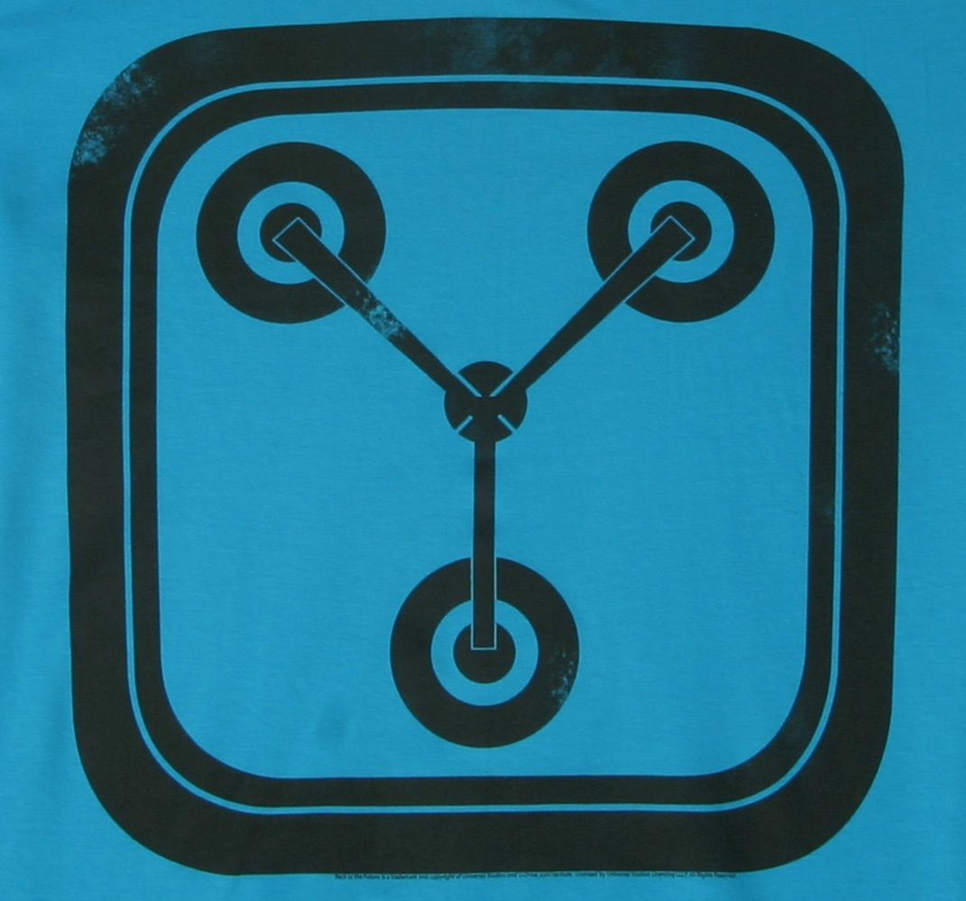
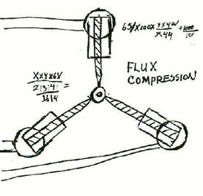
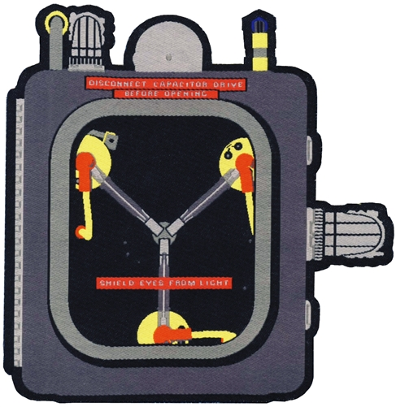

Slide 4
CloudCapacitor
CloudCapacitor
CloudCapacitor

