Slide 1
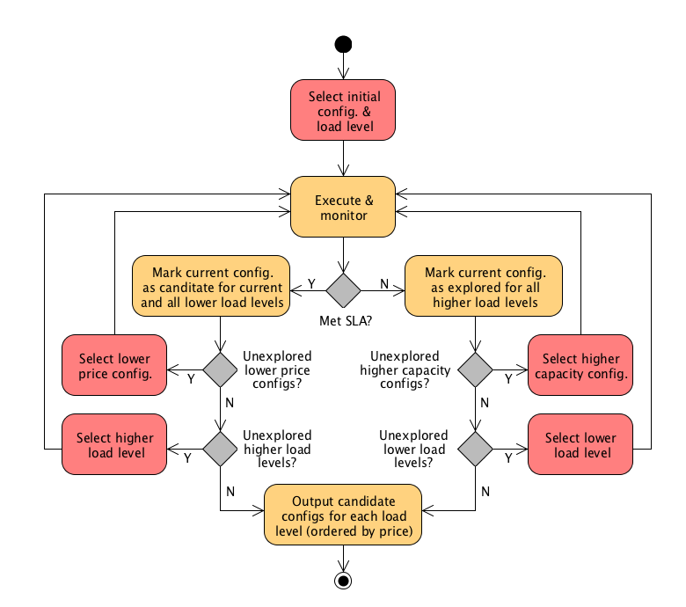

Slide 2

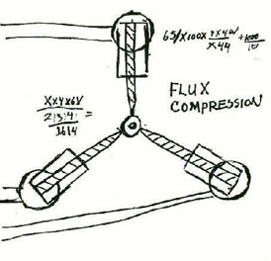
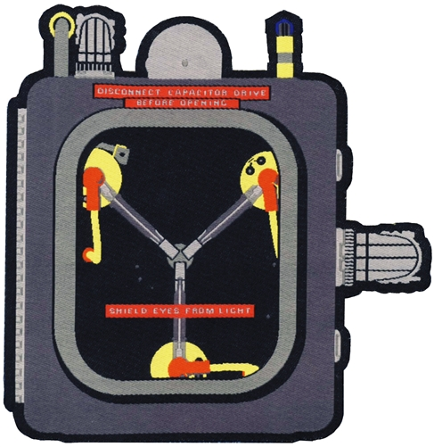

Slide 3
CloudCapacitor
CloudCapacitor
CloudCapacitor

