Slide 1
Hyperparameter Optimization of a Deep Learning-Based Channel Decoder: Comparação de Arquiteturas
Marcelo Vinícius Cysneiros Aragão
Instituto Nacional de Telecomunicações – Inatel
Santa Rita do Sapucaí – MG, 2022

Slide 2
Polar Code

Slide 3
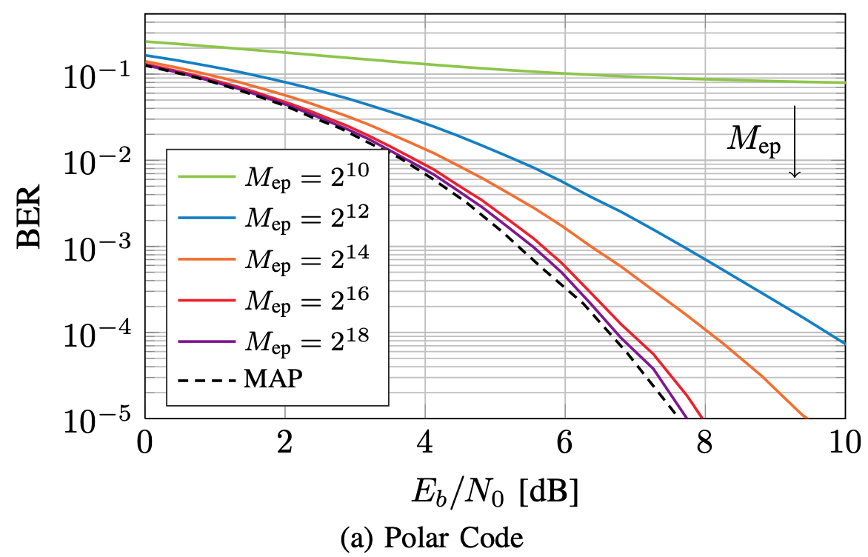
Polar code, 2^18 epochs, 1M words, 3 layers (128-64-32) (Gruber et al., 2017)

Slide 4
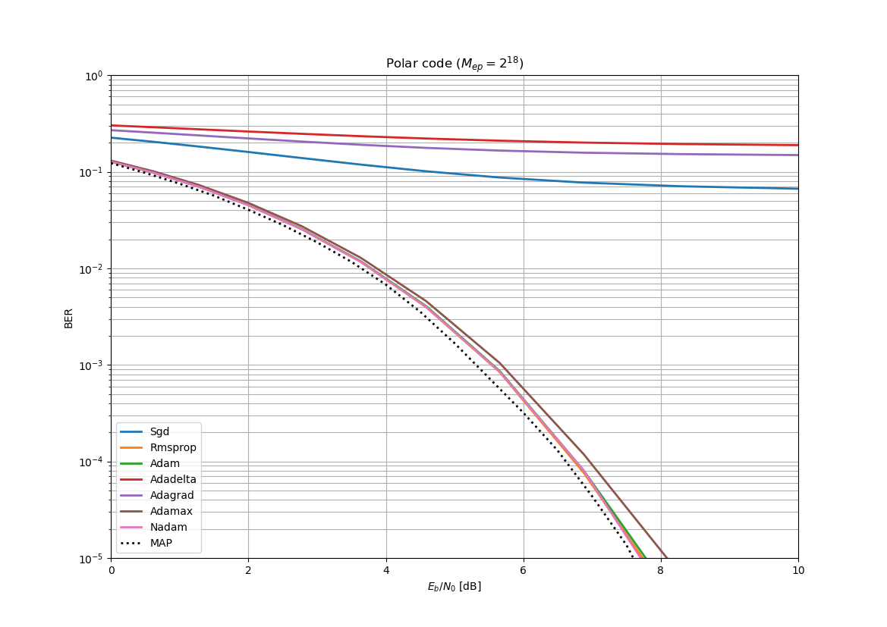
Polar code, 2^18 epochs, 1M words, 3 layers (128-64-32) (Aragão, M., 2022)

Slide 5
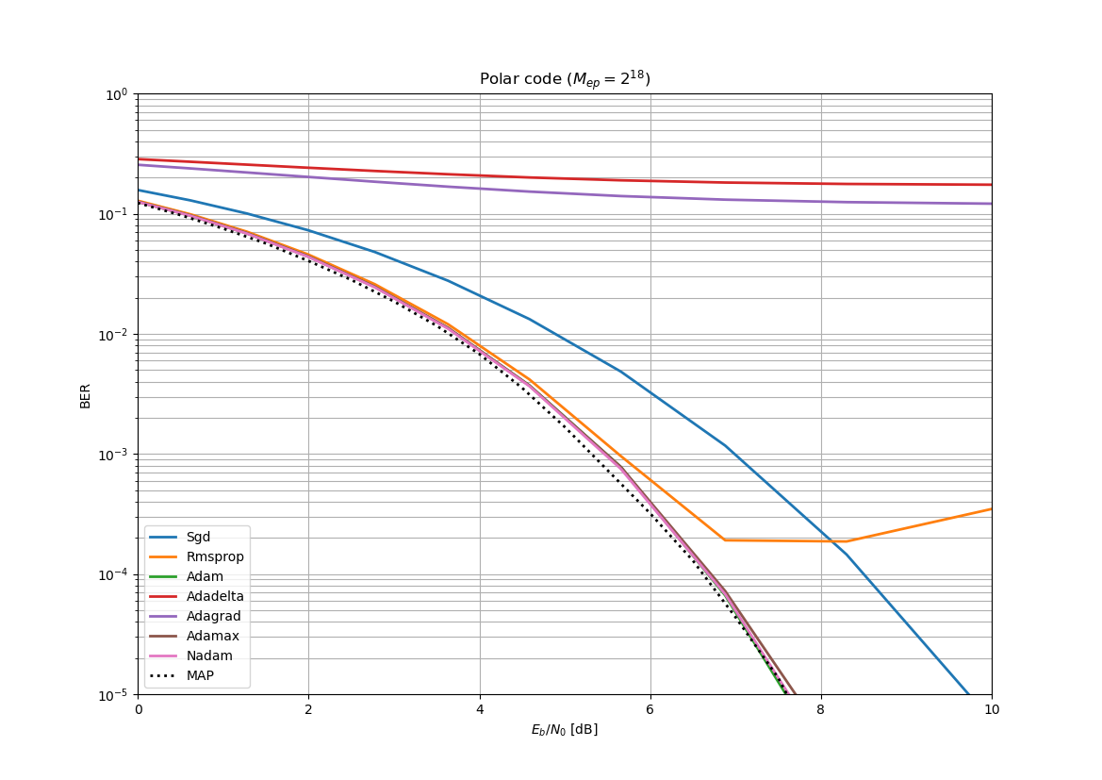
Polar code, 2^18 epochs, 1M words, 4 layers (256-128-64-32) (Aragão, M., 2022)

Slide 6
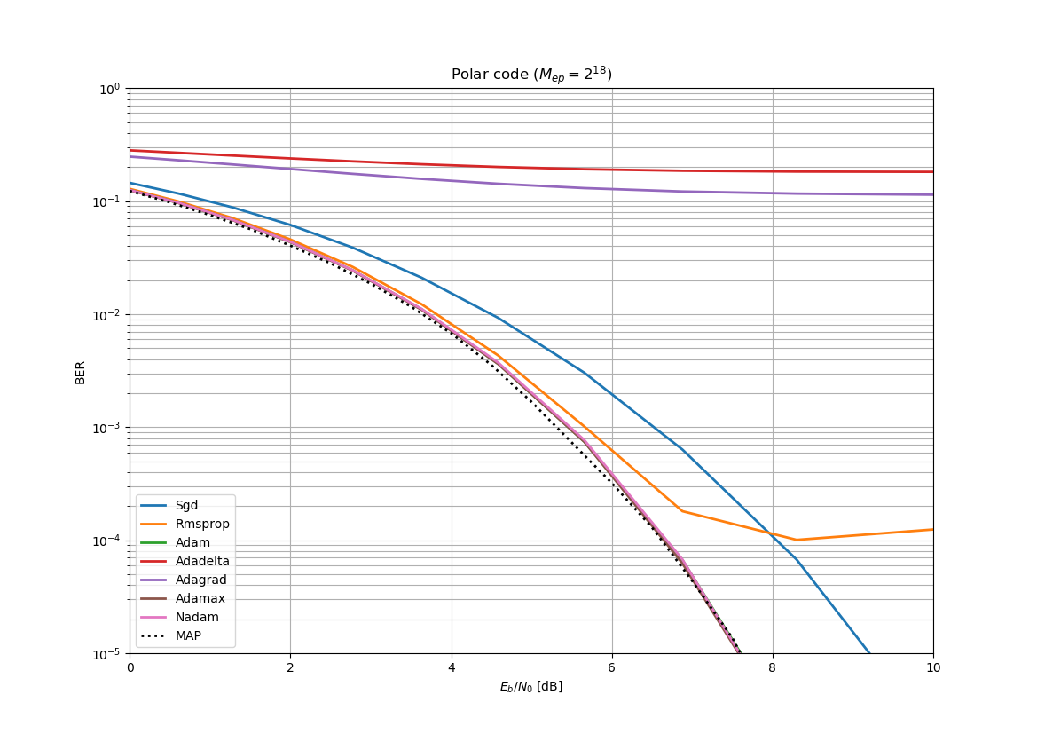
Polar code, 2^18 epochs, 1M words, 5 layers (512-256-128-64-32) (Aragão, M., 2022)

Slide 7
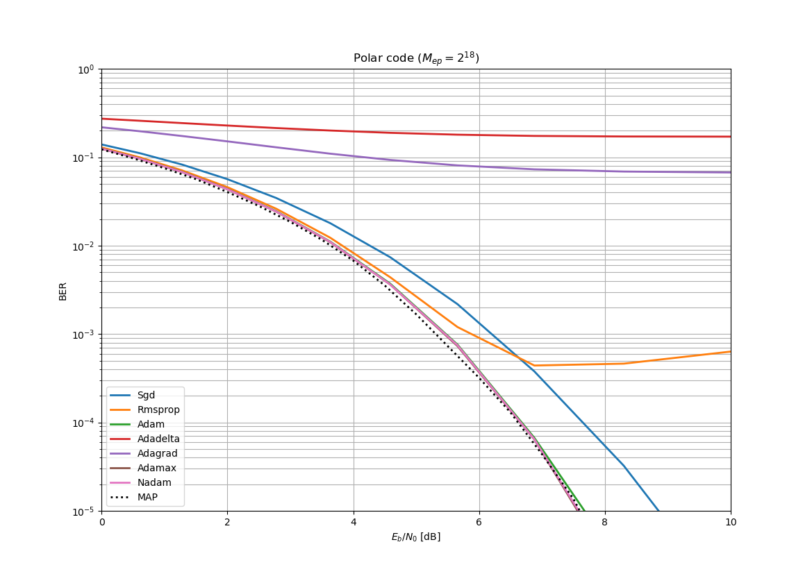
Polar code, 2^18 epochs, 1M words, 6 layers (1024-512-256-128-64-32) (Aragão, M., 2022)

Slide 8
Random Code

Slide 9
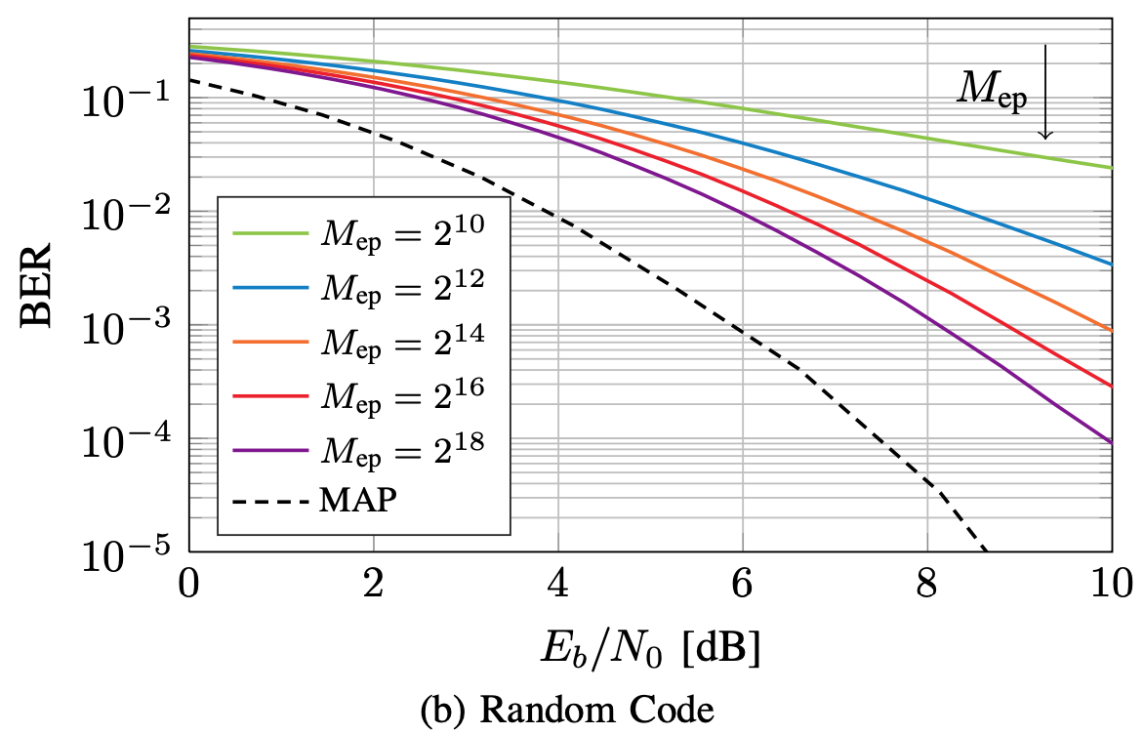
Random code, 2^18 epochs, 1M words, 3 layers (128-64-32) (Gruber et al., 2017)

Slide 10
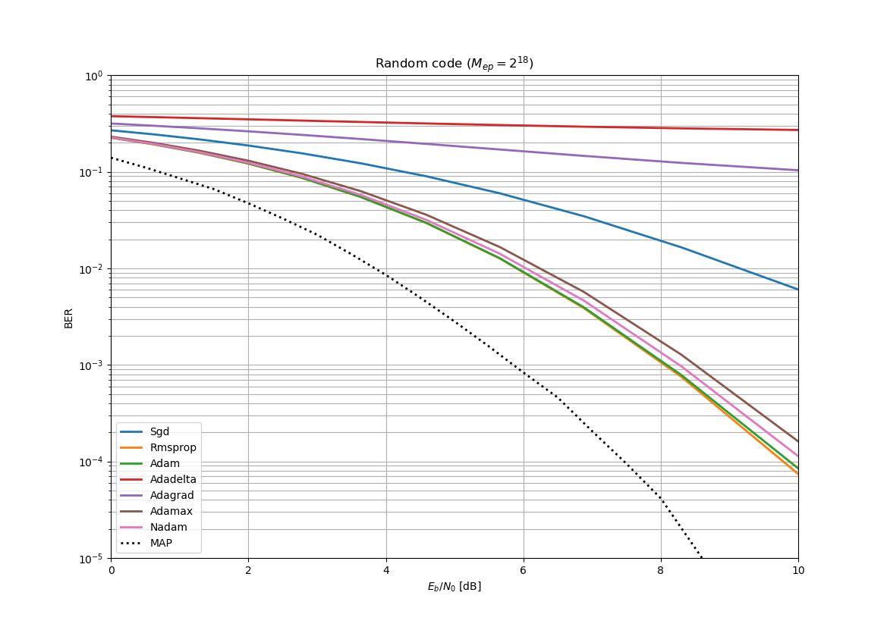
Random code, 2^18 epochs, 1M words, 3 layers (128-64-32) (Aragão, M., 2022)

Slide 11
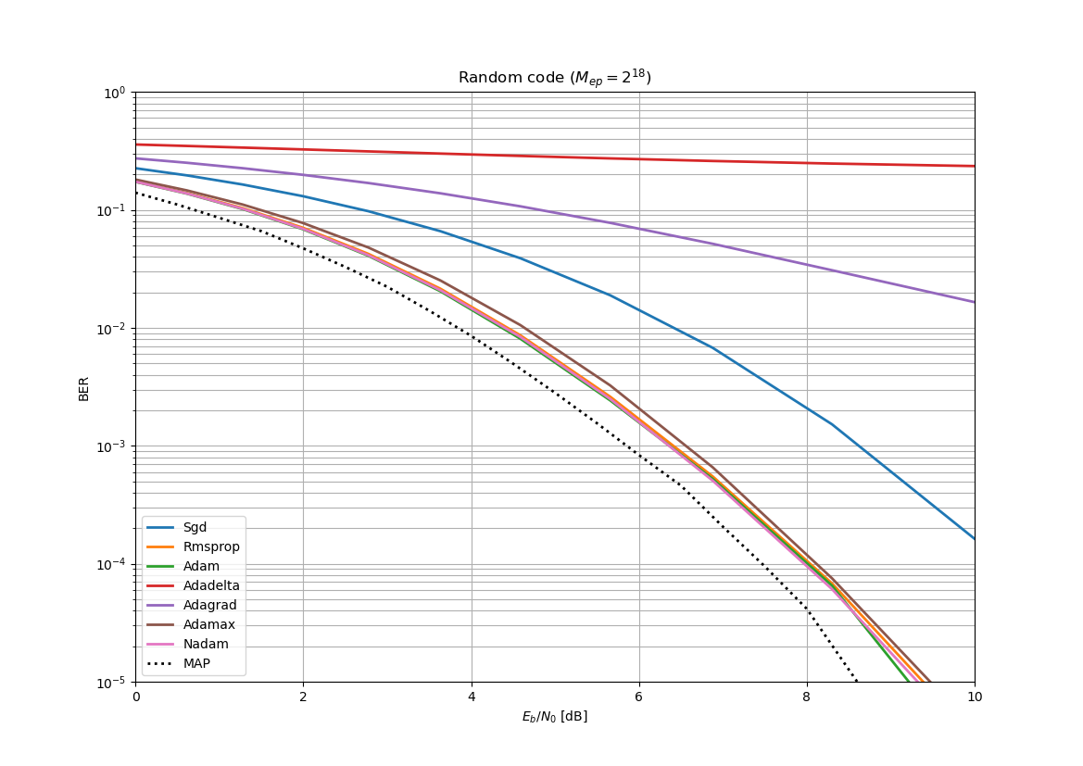
Random code, 2^18 epochs, 1M words, 4 layers (256-128-64-32) (Aragão, M., 2022)

Slide 12
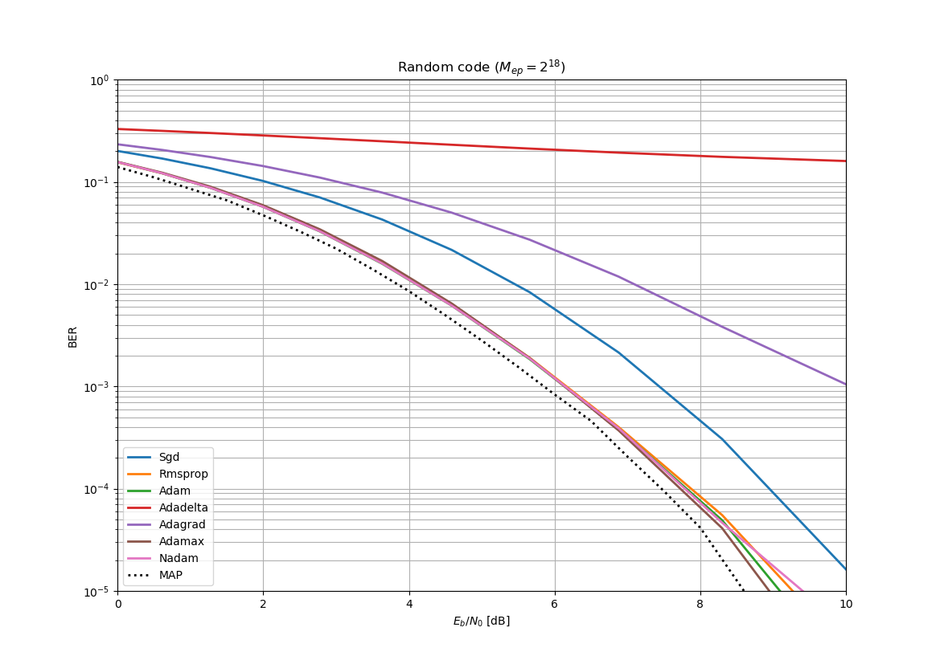
Random code, 2^18 epochs, 1M words, 5 layers (512-256-128-64-32) (Aragão, M., 2022)

Slide 13
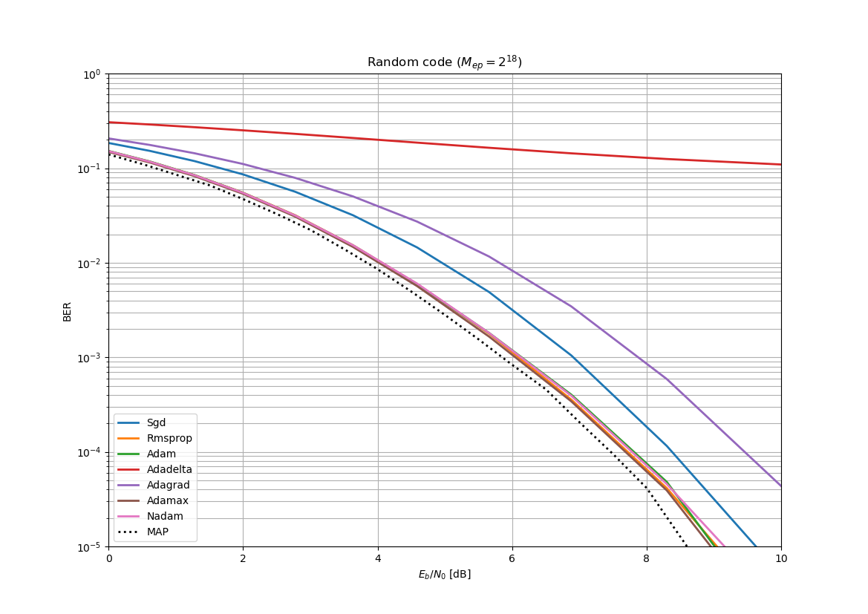
Random code, 2^18 epochs, 1M words, 6 layers (1024-512-256-128-64-32) (Aragão, M., 2022)

