Slide 1
Spring Boot

Slide 2
Agenda
What is Spring Framework
What is Spring Boot
How create a Spring Boot project
Demo
References
Notes:
Steps:
Thanks for everyone coming….
Today I will talk about…., a brief introduction about what I hope…. the main focus is present the main features about Spring Boot with a simple demo….
First, I will introduce myself…. (name, country, function, education, when started at SAP Hybris, team, experience, main goal in Software Academy)
Present the agenda (main topics, a brief description about each topic)
Before start topics in Agenda - Survey time – who here has knowledge about Spring Boot
Present the slides
In the slide “How create a Spring Boot project” demonstrate how create applications
From slide “Demo” follow the script “spring-boot-demo-script.rtf”
2

Slide 3
What is Spring Framework
Spring is a powerful open source framework for Java Platform.
Spring is a complete and modular framework for developing enterprise applications in Java.
Spring Framework can be used for all layer implementations for an application or can be used for develop a specific layer.
Notes:
3

Slide 4
Problems with Spring Framework
Spring is a large framework and its understanding can be hard.
It’s necessary a lot of steps to create an application and this can reduce the development productivity.
It’s necessary multiple configuration steps, multiple builds and deploy steps.
The injection of dependencies is realized using configuration files in XML format. The maintenance of a lot of XML files can be a hard process.
Notes:
4

Slide 5
What is Spring Boot
The project Spring Boot (or Boot simply) is more a framework the Spring ecosystem. Was launched with the Spring Framework 4.0.
Spring Boot make use of all Spring ecosystem and bring more productivity for the developer.
Spring Boot decrease the time that the developers spend to start the implementation of new projects.
Spring Boot makes easy and fast the process to create an application
Notes:
5

Slide 6
What is Spring Boot
Spring Boot is based in four principles:
Provide a getting started experience, extremely fast and direct.
Present a start view about the way to configure our projects but is completely adaptable to attend the project requirements.
Provide several no-functional requirements such as metrics, security, data access and embedded application server (Tomcat).
Reduce the code generation and the necessity of XML files.
Notes:
6

Slide 7
How create a Spring Boot project
Web Services – SPRING INITIALIZR
https://start.spring.io/
Command line
curl start.spring.io
Spring Dashboard in Eclipse
Spring Tool Suite (Eclipse)
Notes:
7

Slide 8
Demo
1: a simple Demo using Spring Script (Groovy)
2: a simple Demo using Java

Slide 9
A Simple Spring Script (Groovy)
This first demo consists in create a simple Groovy script (or a Spring Script) using Spring Boot CLI. Spring Boot CLI is a command-line abstraction that allows us to easily run Spring microservices expressed as Groovy scripts.
1. hello.groovy
A simple microservice @RestController with two methods: hello and helloUser
Notes:
9

Slide 10
A Simple Java Application
This second demo consists in create two small applications.
1. demo-spring-boot-console-web
Firstly will be create a simple spring boot application, without insert a “spring-boot-start-web” dependency. The goal here is show a simple message in the console.
After that will be create a microservice @RestController with two methods and now it’s necessary add “spring-boot-start-web” dependency.
Notes:
10

Slide 11
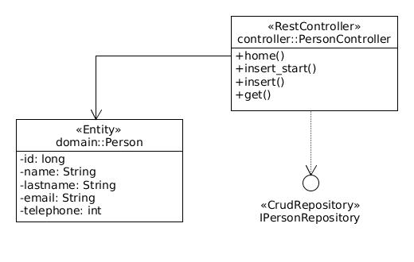
A Simple Java Application
2. demo-internal-contacts
A simple CRUD web application to add and list persons.
Notes:
11

Slide 12
A Simple Java Application
2. demo-internal-contacts
What you’ll see:
Entity class “Person”
Interface “IPersonRepository” that extends “CrudRepository”
Controller “PersonController” with CRUD methods
Use of different dependencies such as “JPA”, “HSQLDB”, “MySQL”, “Actuator” and “Security”
Providing metrics in our project using “Actuator”
Notes:
12

Slide 13
References
Getting Started with Spring Boot by Josh Long
https://www.youtube.com/watch?v=sbPSjI4tt10&t=371s
From zero to hero with Spring Boot 2.0
https://www.youtube.com/watch?v=aA4tfBGY6jY&t=264s
Spring Boot Quick Start (Course)
https://www.youtube.com/watch?v=msXL2oDexqw&list=PLqq-6Pq4lTTbx8p2oCgcAQGQyqN8XeA1x
Notes:
13

