Slide 1

3. Web App Restful API System Design
Marcelo Vitorino - Feefo Candidate
marcelogabrielvitorino@gmail.com
Recruiter: Viviane Oliveira

Slide 2
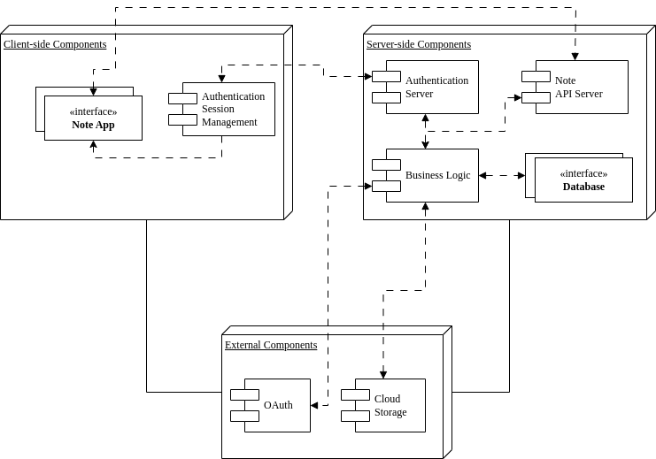
1. High level design

Slide 3
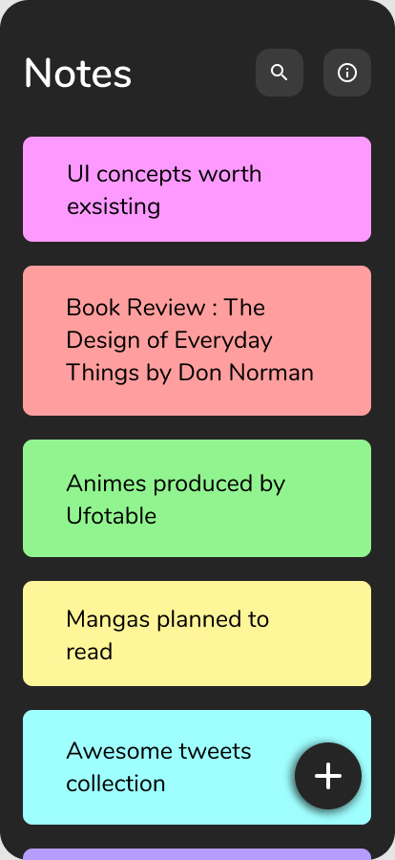
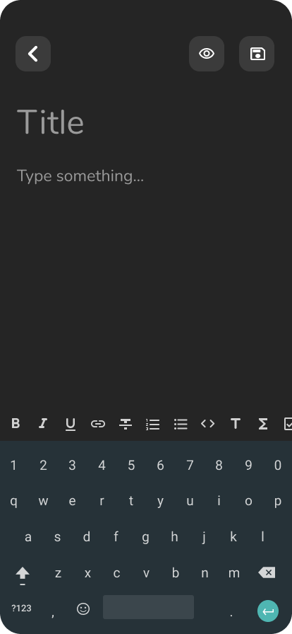

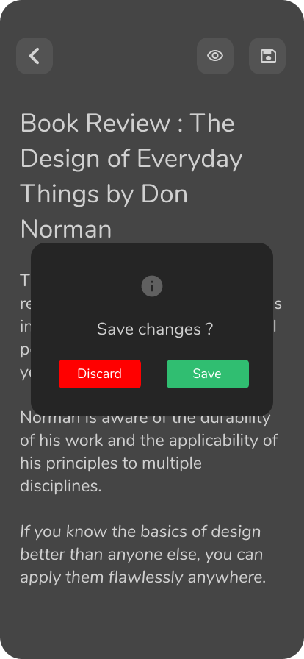
2. Web App UI

Slide 4

2. Web App UI
Empty content!

Slide 5
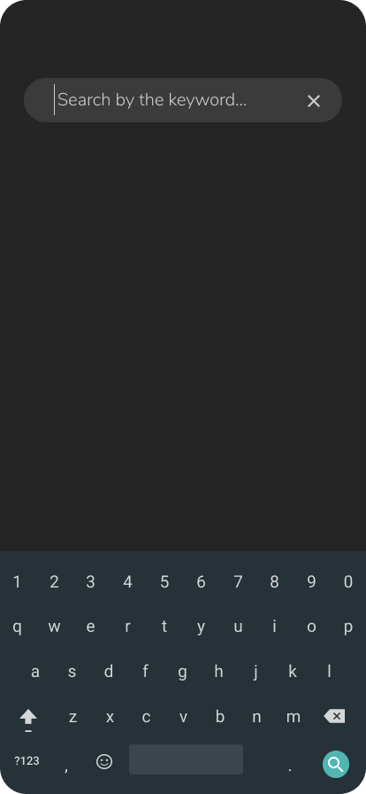
2. Web App UI

Slide 6
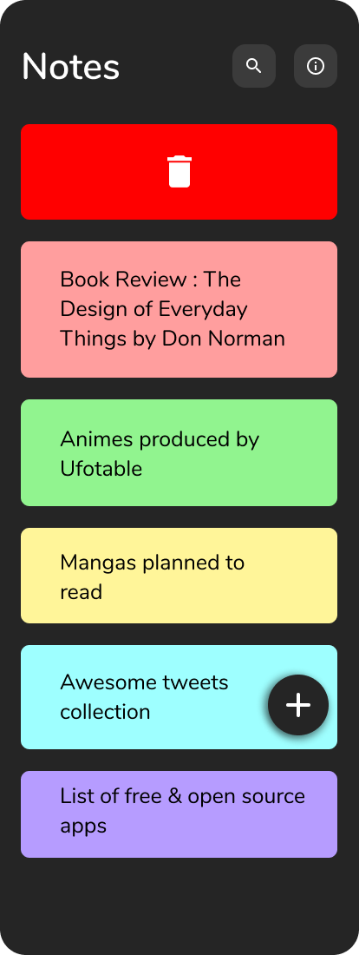
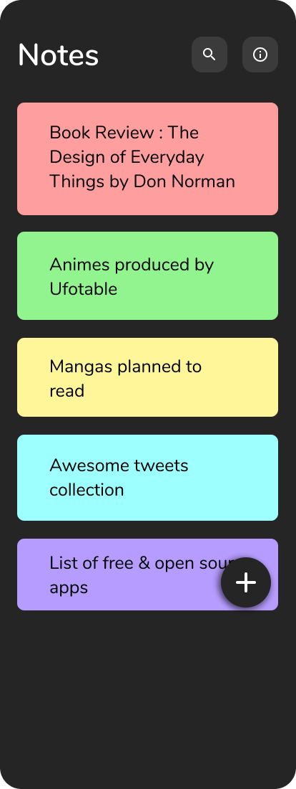
2. Web App UI

Slide 7
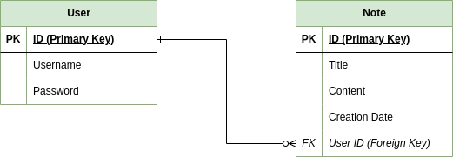
3. Data Model

Slide 8

4. RESTful API endpoints for the note web application
/notes
GET
/notes/{noteId}
GET
/notes
POST
/notes/{noteId}
DELETE

Slide 9

4. RESTful API endpoints for the note web application
/notes
GET
Description: Retrieve a list of all saved notes for the authenticated user.
Authorization: User must be logged in and authenticated.
Response: A JSON array containing objects representing each note, including their titles, contents, and creation dates.

Slide 10
4. RESTful API endpoints for the note web application
/notes/{noteId}
GET
Description: Retrieve a specific note by its ID for the authenticated user.
Authorization: User must be logged in and authenticated.
Response: A JSON object representing the requested note, including its title, content, and creation date.

Slide 11
4. RESTful API endpoints for the note web application
/notes
POST
Description: Create a new note for the authenticated user.
Authorization: User must be logged in and authenticated.
Request Body: JSON object containing the title and content of the new note.
{
"title": "Example Note Title",
"content": "This is the content of the note."
}

Slide 12
4. RESTful API endpoints for the note web application
/notes
DELETE
Description: Delete a specific note by its ID for the authenticated user.
Authorization: User must be logged in and authenticated.
Response: Status code 204 (No Content) upon successful deletion.

Slide 13
5. Java pseudo-code demonstrating web server implementation of the RESTful API
// Class representing the web server
class WebServer {
List<Note> notes = new ArrayList<>();
// Endpoint for retrieving all notes
List<Note> getAllNotes() {
return notes;
}
// Endpoint for creating a new note
Note createNote(String title, String content) {
Note newNote = new Note(notes.size() + 1, title, content);
notes.add(newNote);
return newNote;
}

Slide 14
5. Java pseudo-code demonstrating web server implementation of the RESTful API
// Endpoint for retrieving a specific note by ID
Note getNoteById(int id) {
for (Note note : notes) {
if (note.id == id) {
return note;
}
}
return null; // Note not found
}

Slide 15
5. Java pseudo-code demonstrating web server implementation of the RESTful API
// Endpoint for deleting a specific note by ID
boolean deleteNoteById(int id) {
for (Iterator<Note> iterator = notes.iterator(); iterator.hasNext(); ) {
Note note = iterator.next();
if (note.id == id) {
iterator.remove();
return true; // Note deleted
}
}
return false; // Note not found
}
}

Slide 16
5. Java pseudo-code demonstrating web server implementation of the RESTful API
// Class representing a note
class Note {
int id;
String title;
String content;
// Constructor
Note(int id, String title, String content) {
this.id = id;
this.title = title;
this.content = content;
}
}

