Slide 1
EXST 7087 Homework 9 – Time Series Analysis
Letícia Santos
Marcelo Fernandes

Slide 2
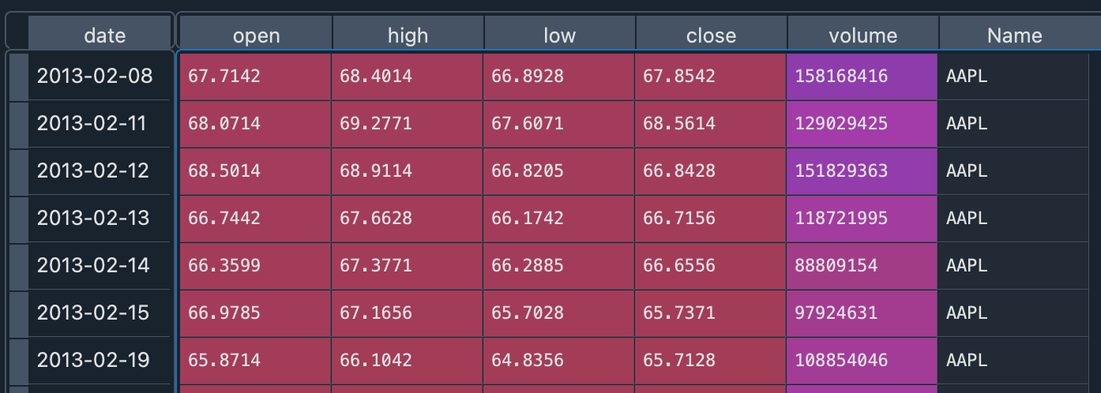
Data
Daily task 2 (Forecasting)
R
Apple Stock

Slide 3
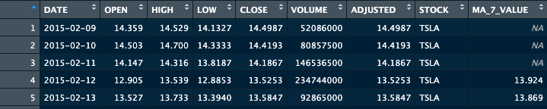
Data description

Slide 4
Analysis
Comparing Tesla and Apple prices
 | Random_Forest | Simple_Regression
count | 10 | 10
mean | 0.6424768 | 0.27926169
std | 0.12144072 | 0.05220347
min | 0.49570288 | 0.20114293
25% | 0.58179672 | 0.25170198
50% | 0.61965777 | 0.27570556
75% | 0.69342079 | 0.31623799
max | 0.91757853 | 0.36567123
0.6424768

Slide 5
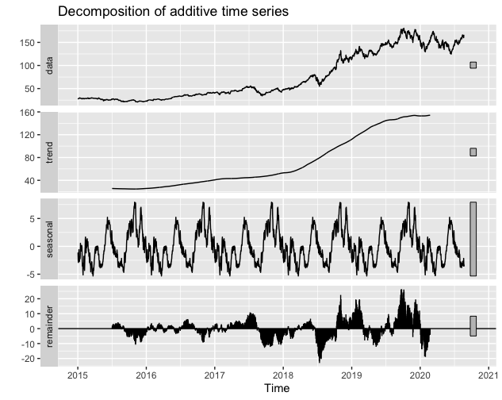
Decompose APPL

Slide 6
Correlation
Correlation between Apple and Tesla stocks: 0.9486328313, good positive correlation of the two variables
Correlation between Apple and Tesla volumes: -0.3876491261, not god negative correlation of the two variables

Slide 7
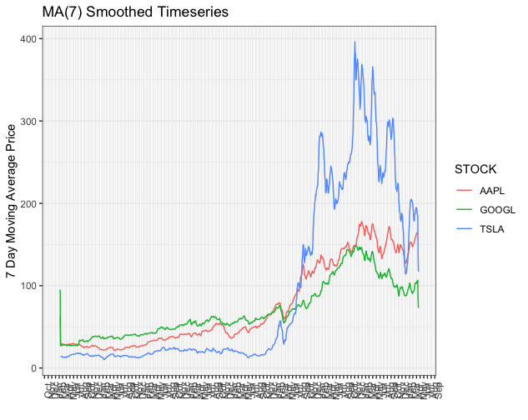
Moving average for 7 days for Apple, Google and Tesla stocks

Slide 8
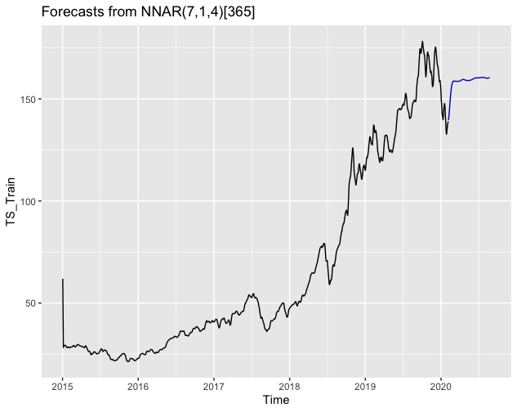
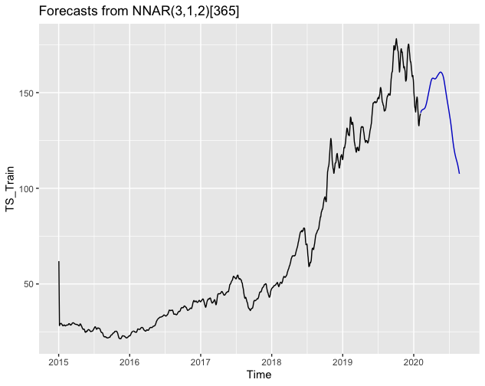
Forecast using neural networks k=200, f=365.25

Slide 9
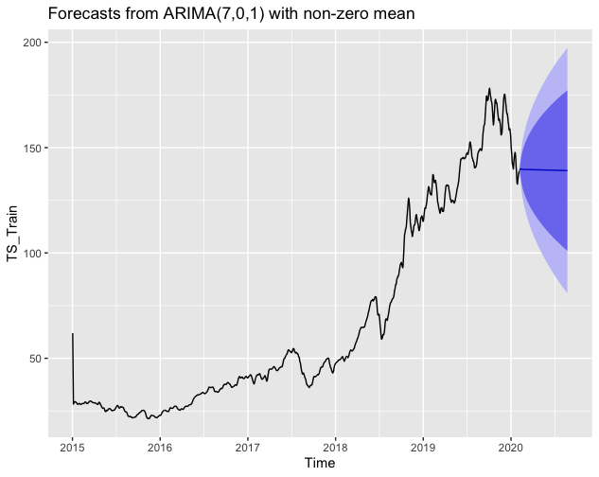
Forecasts from ARIMA with non-zero mean

Slide 10
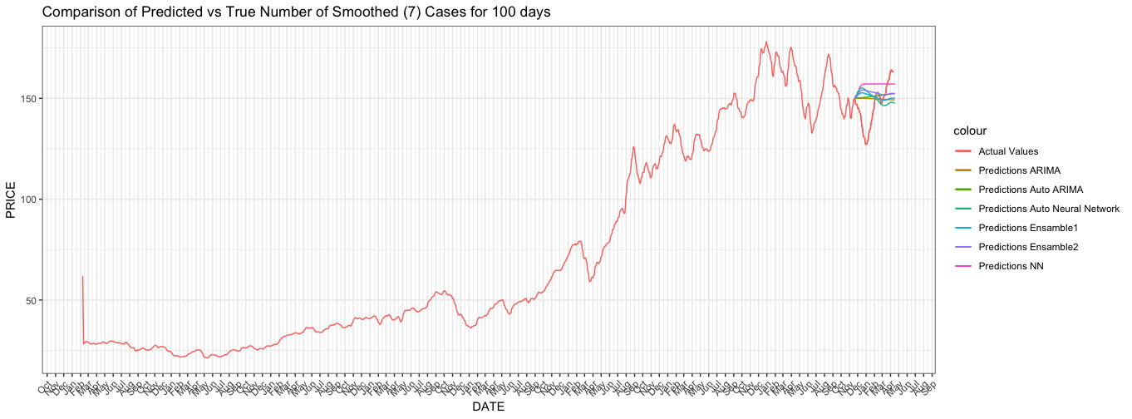

Slide 11
Zoom
None of them got close to the
True behavior

