Slide 1
EXST 7087 Homework 6 - Random Forest vs Linear Regression analysis
Letícia Santos
Marcelo Fernandes

Slide 2
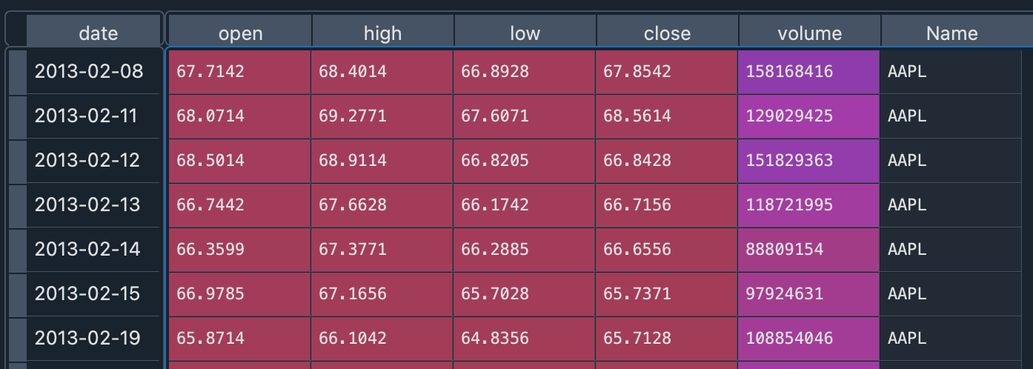
Data
https://github.com/Zeeshanahmad4/Stock-Prices-Prediction-ML-Flask-Dashboard.git
Python
Stock Price from Apple (AAPL)

Slide 3
Data description
 | close | open | high | low | volume
count | 1259 | 1259 | 1259 | 1259 | 1259
mean | 109.066698 | 109.055429 | 109.951118 | 108.141589 | 54047899.7
std | 30.5568117 | 30.54922 | 30.6861864 | 30.3762236 | 33468353.3
min | 55.7899 | 55.4242 | 57.0857 | 55.0142 | 11475922
25% | 84.83065 | 84.6478 | 85.33495 | 84.25065 | 29694376.5
50% | 109.01 | 108.97 | 110.03 | 108.05 | 45668931
75% | 127.12 | 127.335 | 128.1 | 126.29 | 68708720
max | 179.26 | 179.37 | 180.1 | 178.25 | 266833581

Slide 4
Analysis
We want to predict the close price for each day.
 | Random_Forest | Simple_Regression
count | 10 | 10
mean | 0.6424768 | 0.27926169
std | 0.12144072 | 0.05220347
min | 0.49570288 | 0.20114293
25% | 0.58179672 | 0.25170198
50% | 0.61965777 | 0.27570556
75% | 0.69342079 | 0.31623799
max | 0.91757853 | 0.36567123

Slide 5
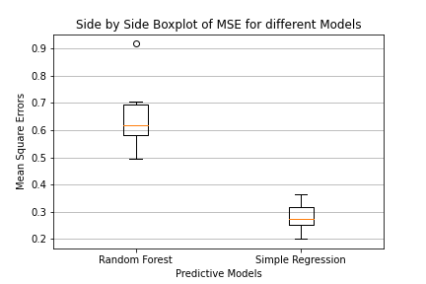
Results Simple regression obtained smaller MSE

