Slide 1
Image Stitching Feature Comparison for an Indoor Image
Marcelo Fernandes

Slide 2
Introduction
Image stitching is the process of combining multiple images with overlapping fields of view to create a larger, panoramic image. The purpose of image stitching is to create a single image that encompasses a wider field of view than can be captured with a single camera shot.
The project followed a specific procedure, which involved implementing Image Stitching in Python using the code learned in class. Initially, the code was applied to a single indoor image containing a person. The feature matching technique used was K-Nearest Neighbors (knn), which remained consistent across all images. However, different types of feature extractors were employed in the project.

Slide 3
Features extractors
SIFT (Scale-Invariant Feature Transform): SIFT is an algorithm that detects and describes distinctive features in an image, regardless of their scale or orientation. It is robust to changes in illumination, viewpoint, and partial occlusion.
ORB (Oriented FAST and Rotated BRIEF): ORB is a fast and efficient feature extraction algorithm that combines the FAST key point detector and the BRIEF descriptor. It provides rotation-invariant binary feature descriptors. And it is more used for Real Time applications.

Slide 4
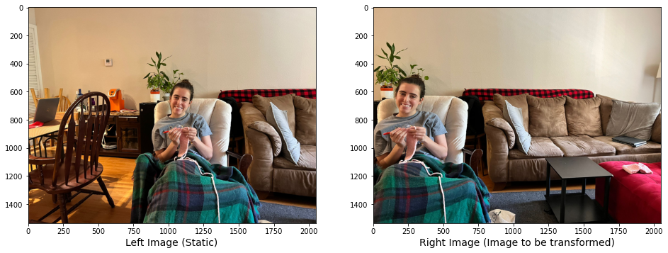
The two images that are going to be stitched using Sift method

Slide 5
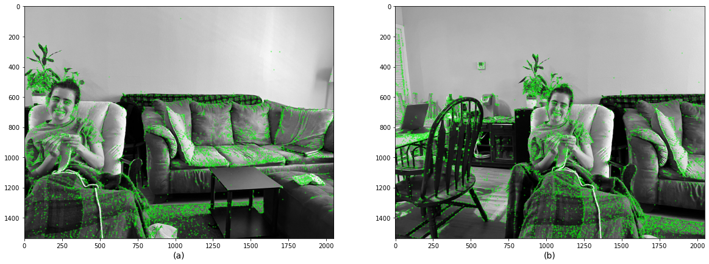
Then turns the image into a grayscale to be able to find the features

Slide 6
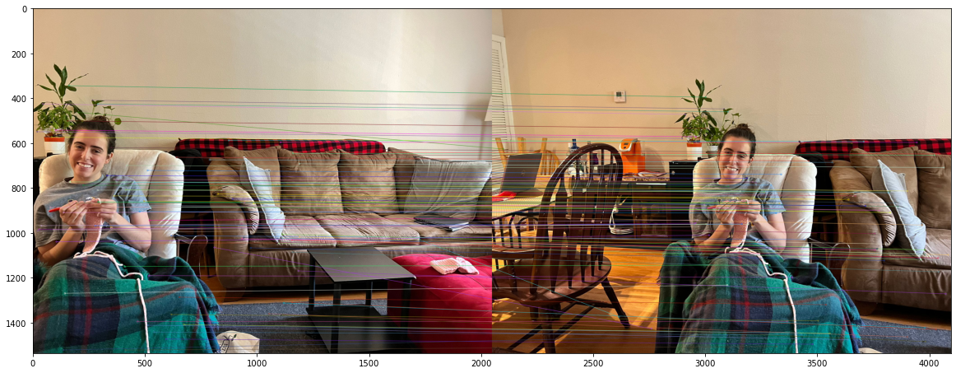
Find key points in both images and place a line showing where the two images match for different features

Slide 7
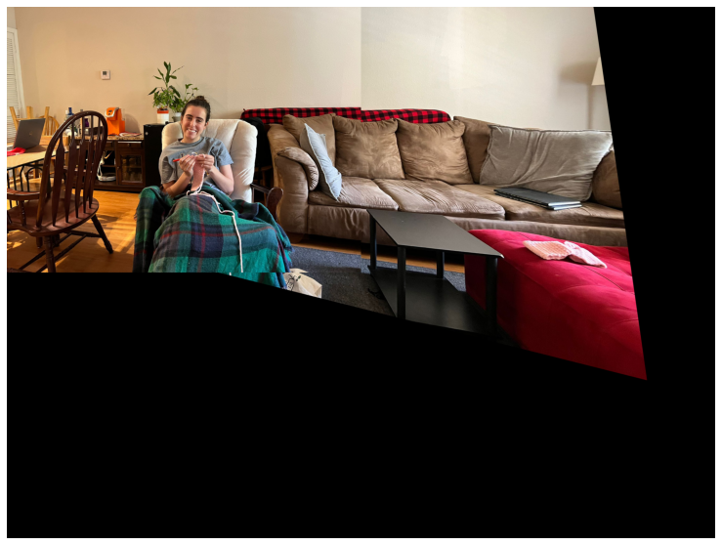
Both images together

Slide 8
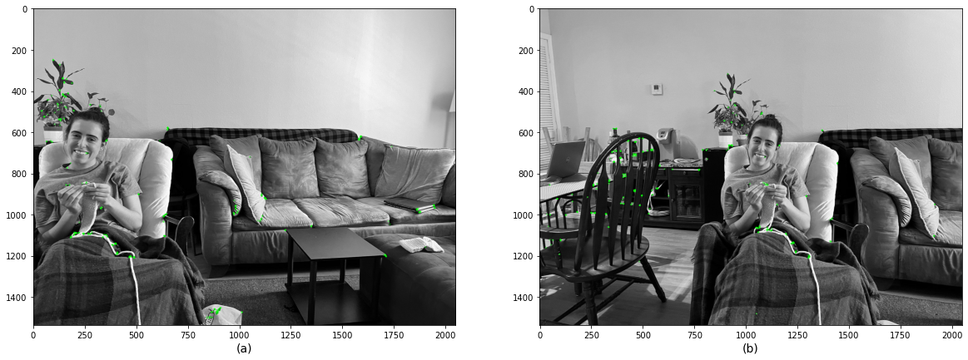
COMPARING SIFT AND ORB
Orb
Sift

Slide 9
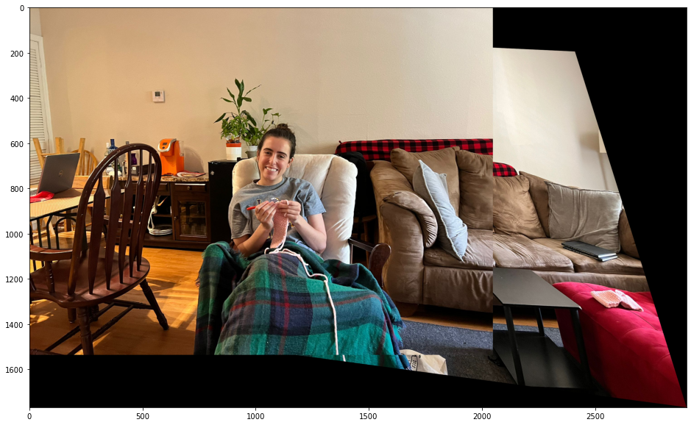
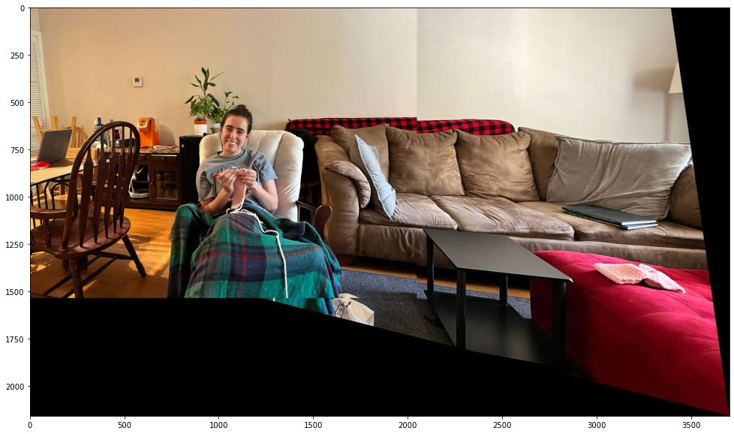
COMPARING SIFT AND ORB
Orb
Sift

Slide 10
CONCLUSION
The analysis of the image showed that the Sift method outperformed the Orb method in terms of producing a sharper final image with more feature points. Additionally, the Brisk method achieved similar results to the Sift method, generating a high number of feature points.

