Slide 1

Java Persistence API and Hibernate
Gabryella Romero
Marcel Costa

Slide 2

Agenda
JDBC
ORM
JPA
Entity Life Cycle
Mapping Entities
CRUD operation
Relationship Mapping in JPA
Cascade / Fetch
HQL / SQL

Slide 3

Who Am I?

Slide 4
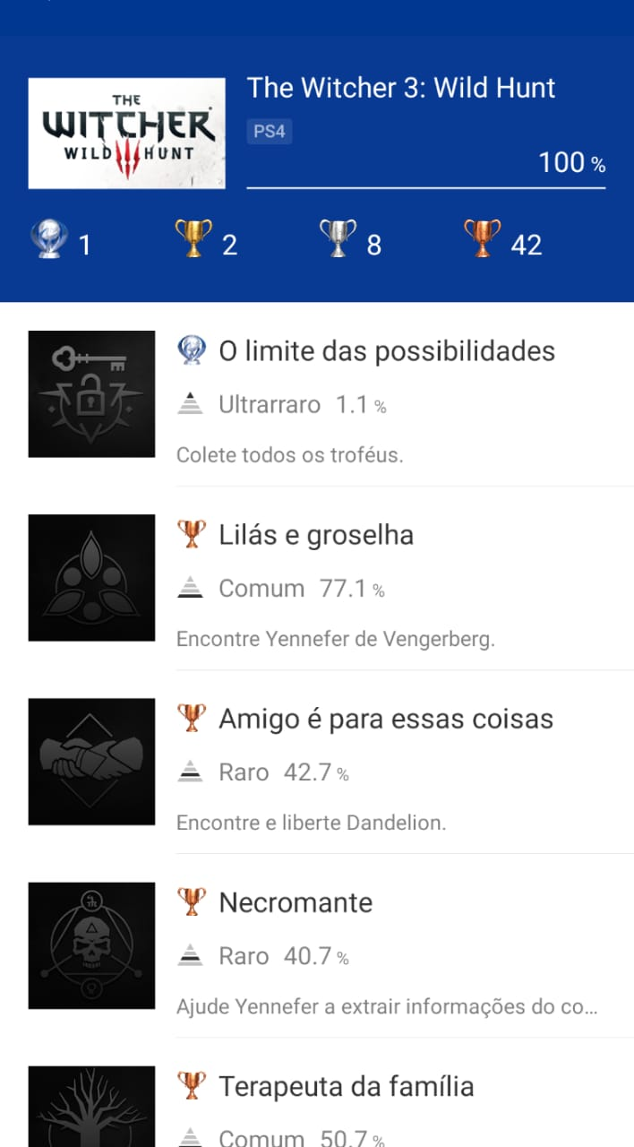
Who Am I?

Slide 5
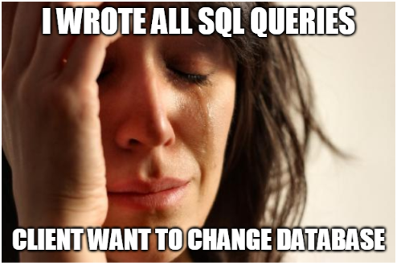
Motivation
Productivity
Notes:
Porque voces mudam a maneira de fazer algo? Porque vc usa uber e nao liga pro taxi? (eficiente, versátil, rapido)
Tempo do desenvolvedor era gasto na codificação de queries SQL
SQL tem padrao, mas mudam coisas de um fabricante para o outro. Dificil de alternar entre bancos de dados

Slide 6
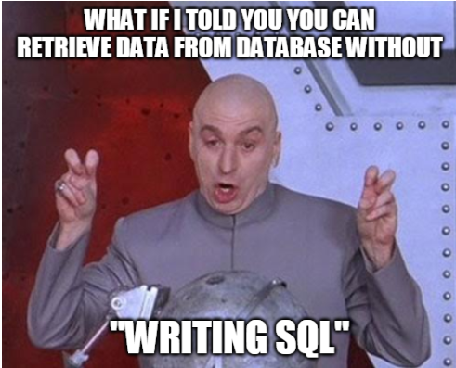
Motivation
Notes:
Mudança de paradigma: a maneira como SQL é escrito não conversa muito bem com OO

Slide 7
JDBC
Java DataBase Connectivity
API(Application Programming Interface) to enable Java code to access databases.
Each database has his own driver (mysql, sqlServer, oracle..) as a JAR file.
Let’s see an example:

Slide 8
ORM
Object relational maping
Tecnique to convert data between objects(in OO perspective) and database tables
Dont worry about SQL, the API will handle persistence activities

Slide 9
ORM
Entity1
ORM
Table1
Table2
Entity3
Entity2

Slide 10
JPA – Java Persistence API
Specification for the management of persistence and object/relational mapping with Java
Objective: provide an object/relational mapping facility for Java developers using a Java domain model and a relational database
Map Java POJOs to relational databases (which are one type of persistence)
Standardized under the Java Community Process Program with contributions from Hibernate, TopLink, JDO, and the EJB community
Hibernate: Full JPA implementation with additional “native” features, e.g.,
HQL (Hibernate Query Language) - similar to JPQL, but with some extensions
Criteria API

Slide 11
ORM and JPA
With JPA/Hibernate lots of “magic” is done under the hood, e.g., SQL-DDL is automatically generated
Know the database basics first (e.g., from a data engineering course), in order to fully understand what JPA is doing under the hood
After annotating the classes and running the application check the resulting SQL-DDL (e.g., using the database explorer in IntelliJ or Eclipse)
When executing SQL-Queries using JPA/Hibernate use the “show SQL queries” feature during development, in order to see what kind of queries are actually executed
Set <property name="hibernate.show_sql" value="true" /> in persistence.xml

Slide 12
Entity
They are POJOs (Plain Old Java Objects)
Lightweight persistent domain object
Typically represent a table in a relational database
Each entity instance corresponds to one row in that table
Have a persistent identity
May have both, persistent and transient (non-persistent) state
Simple types (primitive data types, wrappers, enums)
Composite types (e.g., Address)
Non-persistent state (using identifier transient or @Transient annotation)

Slide 13
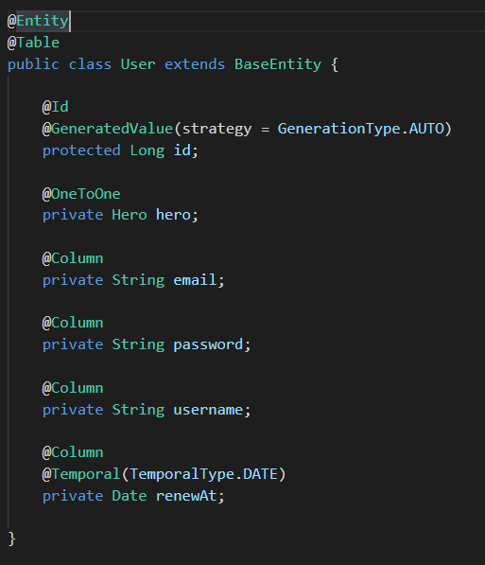
Entity

Slide 14
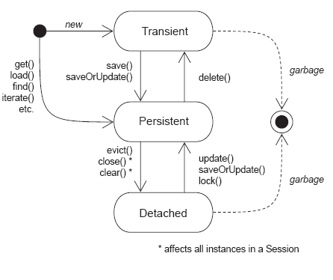
Entity Lifecycle

Slide 15
Mapping Entities
Important annotations
@Entity | Specifies that the class is an entity
@Id | Specifies the primary key of an entity
@Column | Defines the properties for a column
@Temporal | Must be specified for fields of type java.util.Date and java.util.Calendar
@Transient | Specifies that the field is not persistent

Slide 16
Mapping Entities
Important elements
@MappedSuperclass | Designates a class whose mapping information is applied to the entities that inherit from it. A mapped superclass has no separate table defined for it.
@GeneratedValue | The GeneratedValue annotation may be applied to a primary key property or field of an entity or mapped superclass in conjunction with the Id annotation

Slide 17
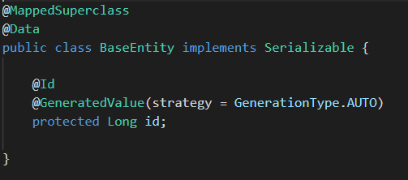
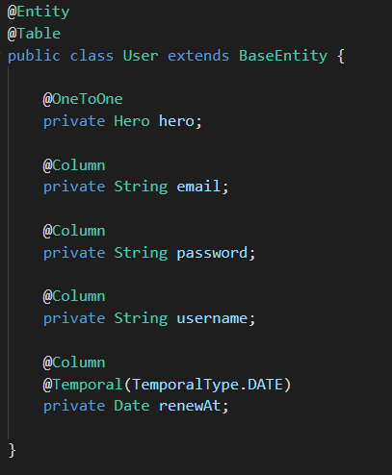
Example
BaseEntity
User

Slide 18
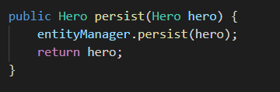
CRUD operations
Create
persist() method
Create a new entry on database
Move the object from transient to persistent state

Slide 19
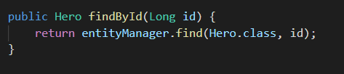
CRUD operations
Retrieve
find() method
Search on database based on primary key and return the object if present or null otherwise
Object returned is on persistent state

Slide 20
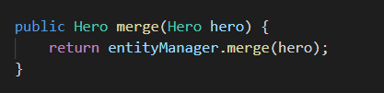
CRUD operations
Update
merge() method
Update the value on database
Keep the object at persistent state

Slide 21

CRUD operations
Delete
delete() method
Remove the object passed as parameter
Move the object from persistent to transient state

Slide 22

Relationship Mapping
Mapping Entities
Exercise 1
1.1 → map team entity
1.2 → create a persist method at TeamRepository.java
1.3 → create a merge method at TeamRepository.java
1.4 → At HibernateTrainingApplication#run
Instanciate new team
Save a new team on the database
Update the team’s name
Update the team on the database

Slide 23
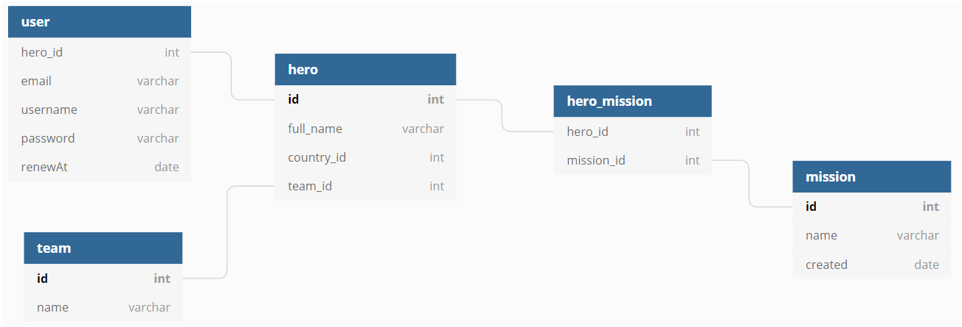
Entity relationships
One-to-One
One-to-Many
Many-to-Many
Many-to-One

Slide 24
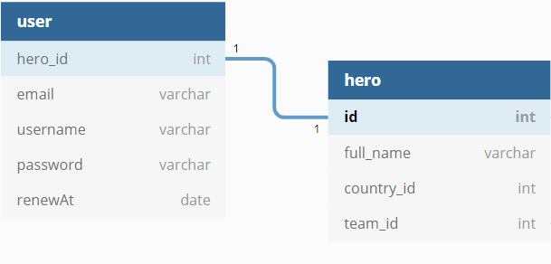
Relationship Mapping
One-to-One
Defines a single-valued association to another entity

Slide 25
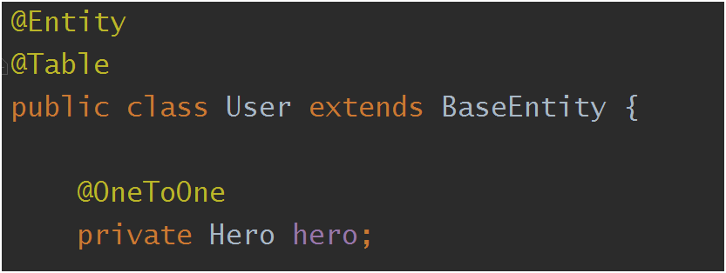
Relationship Mapping
@OneToOne
One User
to
One Hero

Slide 26
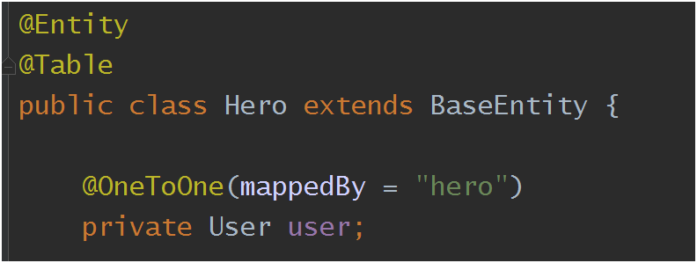
Relationship Mapping
@OneToOne
One Hero
to
One User
mappedBy → defines the owner of the relationship

Slide 27
Relationship Mapping
One-to-One
Exercise 2
2.1 → map hero entity
2.2 → map user entity
2.3 → create a new instance of hero
2.4 → persist hero on the database
2.5 → create a new instance of user
associate user to hero
2.6 → persist user on the database

Slide 28
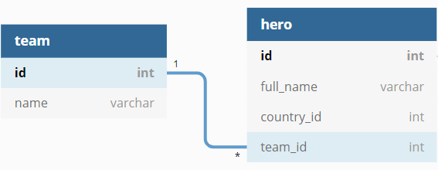
Relationship Mapping
One-to-Many

Slide 29
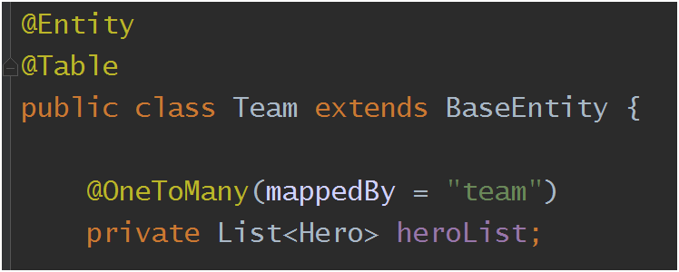
Relationship Mapping
@OneToMany
One Team
to
Many Hero
mappedBy → defines the owner of the relationship

Slide 30
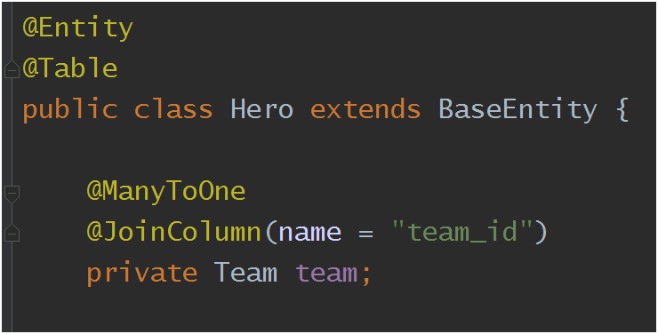
Relationship Mapping
@ManyToOne
Many Hero
to
One Team
@JoinColumn → defines the column to join the entity

Slide 31
Relationship Mapping
One-to-Many
Exercise 3
3.1 → map hero entity
3.2 → map team entity
3.3 → associate hero to team
3.4 → persist/merge team on the database

Slide 32
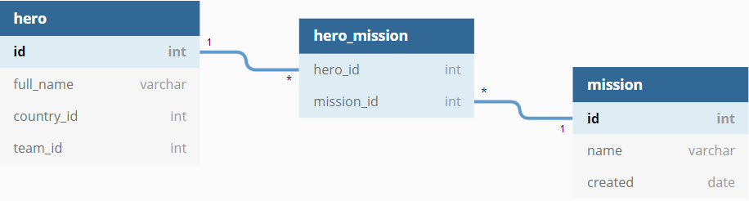
Relationship Mapping
Many-to-Many

Slide 33
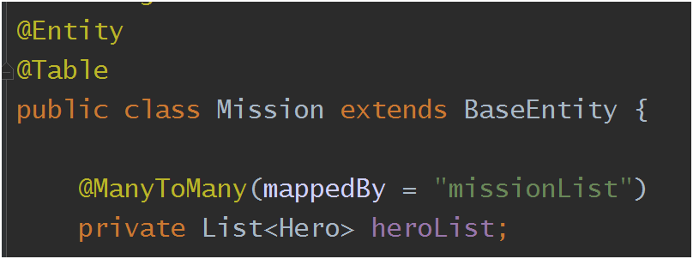
Relationship Mapping
@ManyToMany
Many Mission
to
Many Hero
mappedBy → defines the owner of the relationship

Slide 34
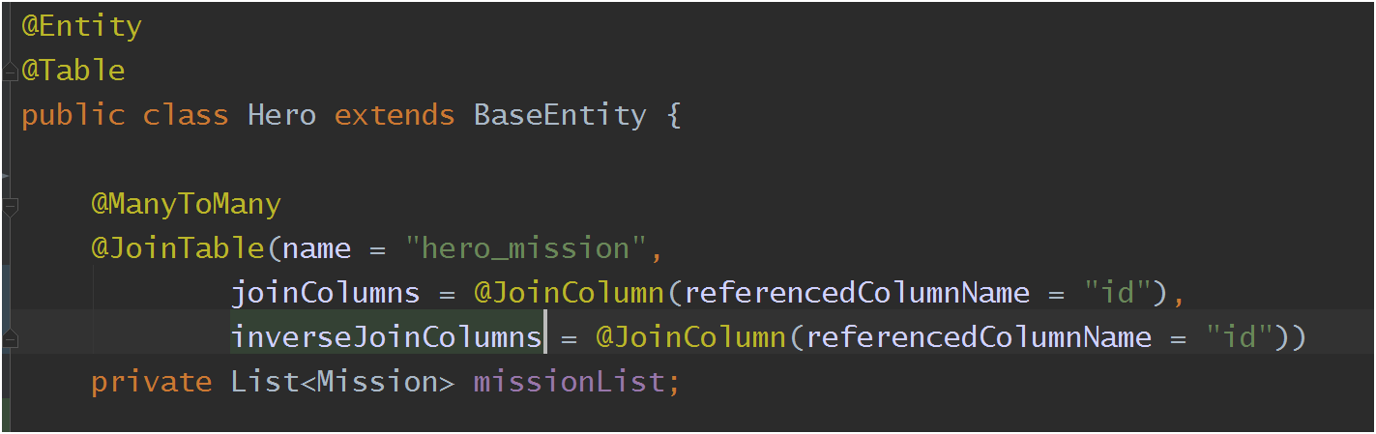
Relationship Mapping
@ManyToMany
Many Hero to Many Mission
@JoinTable → defines the table of the relationship
name: table name (junction)
joinColumns: map the owner side
inverseJoinColumns: map the inverse table
referencedColumnName: primary key (@Id) of the tables

Slide 35
Relationship Mapping
@ManyToMany
Exercise 4
4.1 → map hero entity
4.2 → map mission entity
4.3 → create a new mission
4.4 → persist mission on the database
4.5 → associate hero to the mission
4.6 → merge the hero on the database

Slide 36
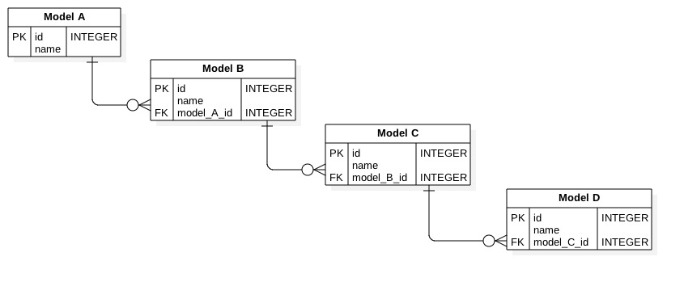
CascadeType
Does Model A need to be persisted before Model B ?

Slide 37
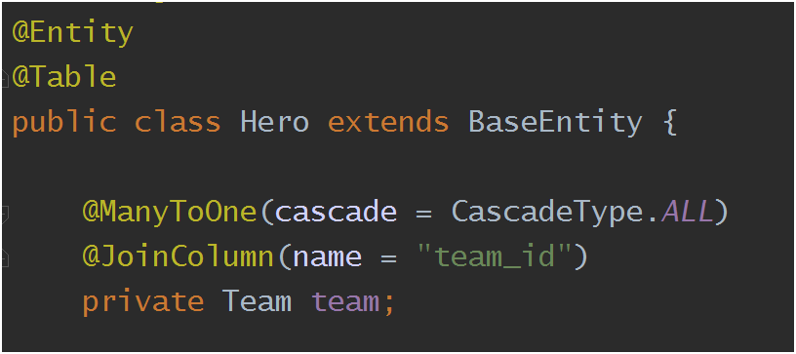
CascadeType
Operations that are propagated to the associated entity
ALL
PERSIST
MERGE
REMOVE
REFRESH
DETACH
- All relationship annotations
- Default is none

Slide 38
CascadeType
Exercise 5
5.1 → map hero entity
5.2 → create a new hero
5.3 → create a new team
5.4 → associate hero to the team
5.5 → persist hero on the database
Optional
5.5 → undo the cascade property at the hero class
5.6 → persist team on the database
5.6.1 → persist hero on the database

Slide 39


FetchType
Lazy
Eager
Load the related if needed
Load all related objects immediately

Slide 40
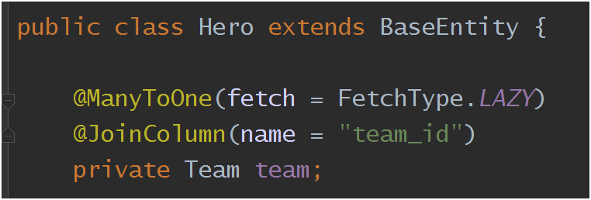
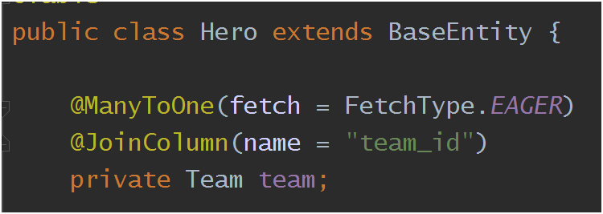
FetchType
Lazy
Eager
Default

Slide 41
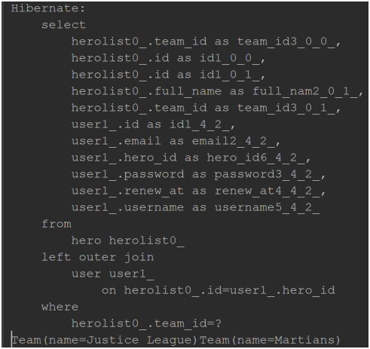
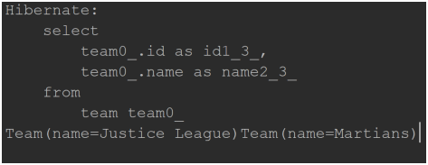
FetchType (log)
Eager
Lazy

Slide 42
FetchType
Exercise 6
6.1 → map team entity
6.2 → At the application.properties change the property spring.jpa.show-sql=true
6.3 → invoke teamRepository.findAll()

Slide 43
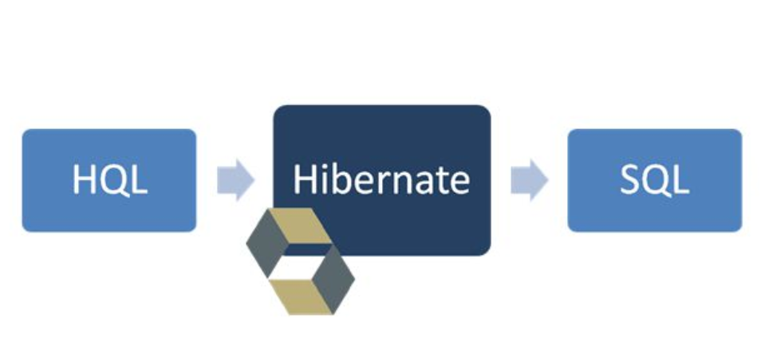
Finding Entities
HQL
Object model focused
Similar to SQL
It works as entity (not table)
Portable

Slide 44

Finding Entities
HQL
Finding all heroes

Slide 45
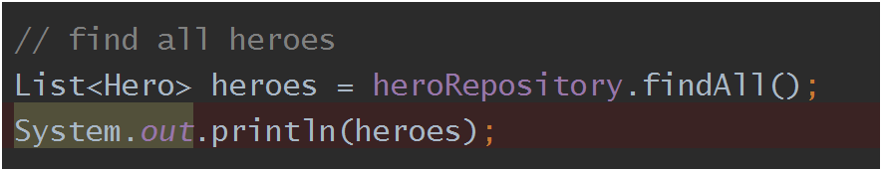
Finding Entities
Exercise 7
7.1 → write the method findAll at the class MissionRepository.java
7.2 → invoke missionRepository.findAll()

Slide 46
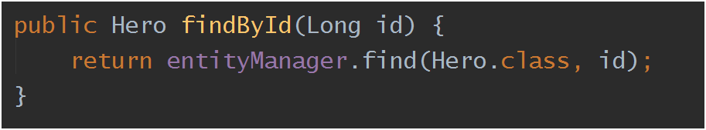
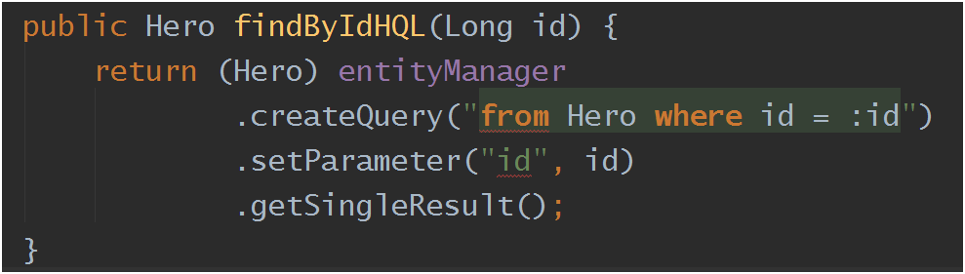
Finding Entities
HQL
Finding by ID
or

Slide 47
Finding Entities
Exercise 8
8.1 → write the method findById at the class HeroRepository.java
8.2 → invoke heroRepository.findById(heroes.get(0).getId())

Slide 48
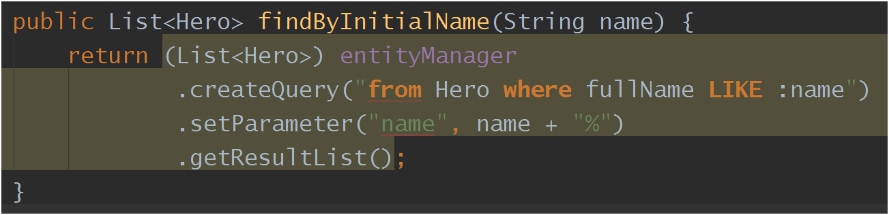
Finding Entities
HQL
Finding by initial name

Slide 49
Finding Entities
Exercise 9
9.1 → write the method findByInitialName at the class HeroRepository.java
9.2 → invoke heroRepository.findByInitialName(“M”)

Slide 50
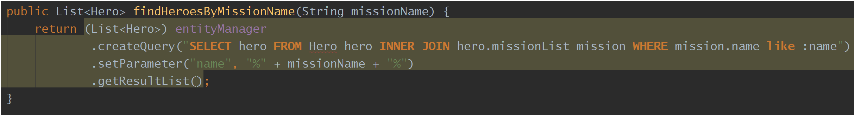
Finding Entities
Finding the heroes of a mission (contains mission’s name)
HQL
Hero: Entity
hero: alias
hero.missionList: get method at the Hero.java
mission: alias of the INNER JOIN
mission.name: get method at the Mission.java
SELECT hero FROM Hero hero
INNER JOIN hero.missionList mission
WHERE mission.name like :name

Slide 51
Finding Entities
Exercise 10
10.1 → write the method findHeroesByMissionName at the class HeroRepository.java
10.2 → invoke heroRepository. findHeroesByMissionName(“Rescue”)

Slide 52
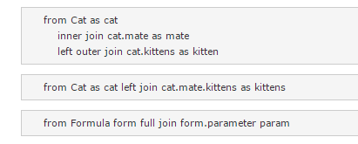
Finding Entities
Other examples

Slide 53

Finding Entities
Other examples

Slide 54
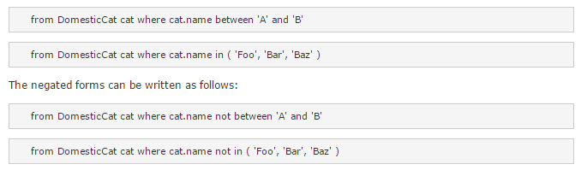
Finding Entities
Other examples

Slide 55

Questions?

Slide 56

Thank you

