Slide 1

Java Persistence API and Hibernate
Gabryella Romero
Marcel Costa

Slide 2

Agenda
JDBC
ORM
JPA
Entity Life Cycle
Mapping Entities
CRUD operation
Relationship Mapping in JPA
Cascade / Fetch
HQL / SQL

Slide 3

Relationship Mapping
Mapping Entities
Exercise 1
1.1 → map team entity
1.2 → create a persist method at TeamRepository.java
1.3 → create a merge method at TeamRepository.java
1.4 → At HibernateTrainingApplication#run
Instanciate new team
Save a new team on the database
Update the team’s name
Update the team on the database

Slide 4
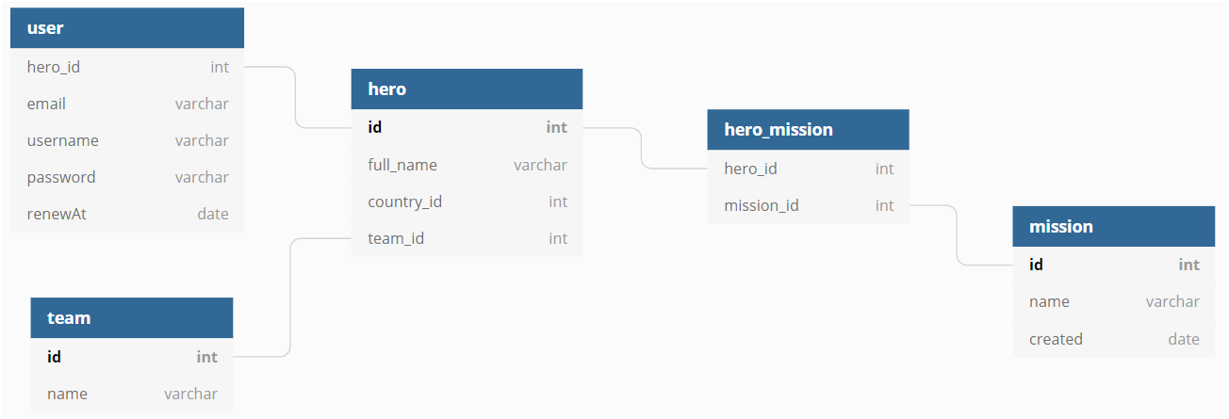
Entity relationships
One-to-One
One-to-Many
Many-to-Many
Many-to-One

Slide 5
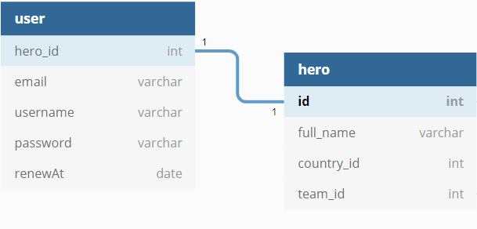
Relationship Mapping
One-to-One
Defines a single-valued association to another entity

Slide 6
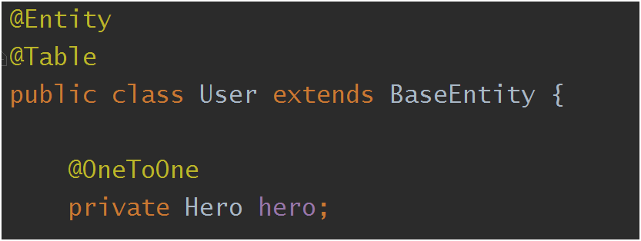
Relationship Mapping
@OneToOne
One User
to
One Hero

Slide 7
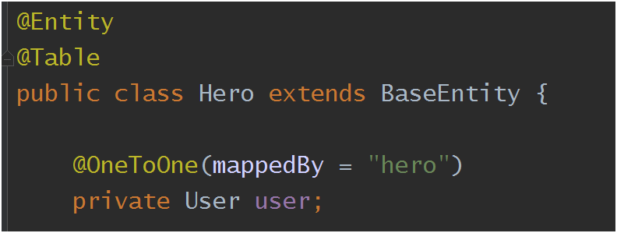
Relationship Mapping
@OneToOne
One Hero
to
One User
mappedBy → defines the owner of the relationship

Slide 8
Relationship Mapping
One-to-One
Exercise 2
2.1 → map hero entity
2.2 → map user entity
2.3 → create a new instance of hero
2.4 → persist hero on the database
2.5 → create a new instance of user
associate user to hero
2.6 → persist user on the database

Slide 9
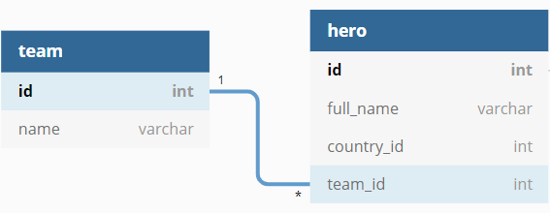
Relationship Mapping
One-to-Many

Slide 10
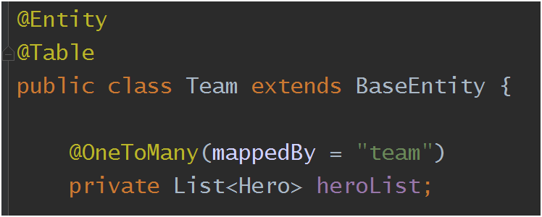
Relationship Mapping
@OneToMany
One Team
to
Many Hero
mappedBy → defines the owner of the relationship

Slide 11
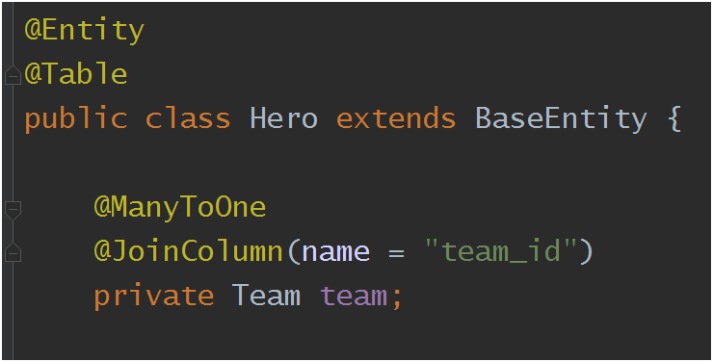
Relationship Mapping
@ManyToOne
Many Hero
to
One Team
@JoinColumn → defines the column to join the entity

Slide 12
Relationship Mapping
One-to-Many
Exercise 3
3.1 → map hero entity
3.2 → map team entity
3.3 → associate hero to team
3.4 → persist/merge team on the database

Slide 13
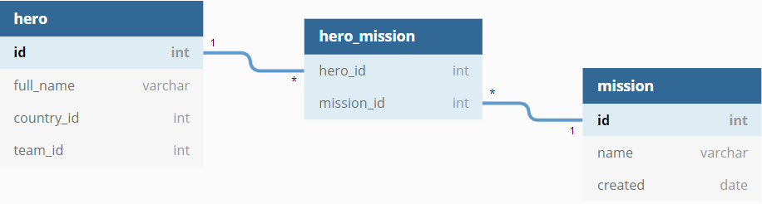
Relationship Mapping
Many-to-Many

Slide 14
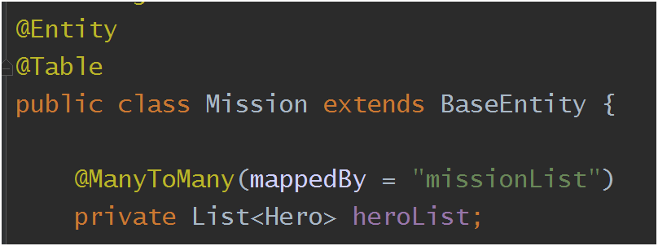
Relationship Mapping
@ManyToMany
Many Mission
to
Many Hero
mappedBy → defines the owner of the relationship

Slide 15
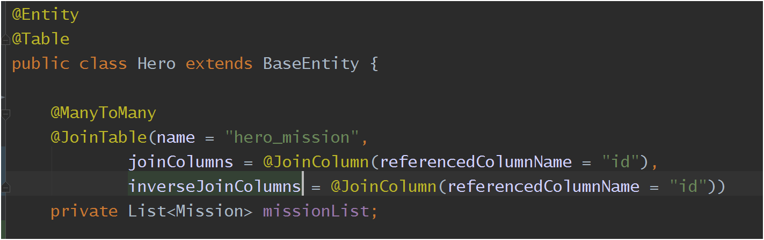
Relationship Mapping
@ManyToMany
Many Hero to Many Mission
@JoinTable → defines the table of the relationship
name: table name (junction)
joinColumns: map the owner side
inverseJoinColumns: map the inverse table
referencedColumnName: primary key (@Id) of the tables

Slide 16
Relationship Mapping
@ManyToMany
Exercise 4
4.1 → map hero entity
4.2 → map mission entity
4.3 → create a new mission
4.4 → persist mission on the database
4.5 → associate hero to the mission
4.6 → merge the hero on the database

Slide 17
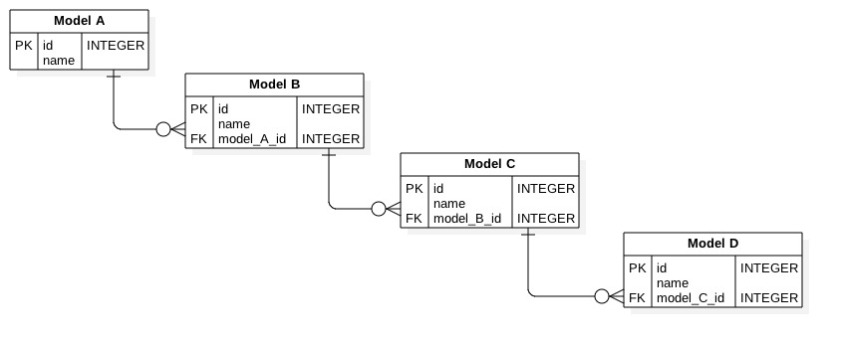
CascadeType
Does Model A need to be persisted before Model B ?

Slide 18
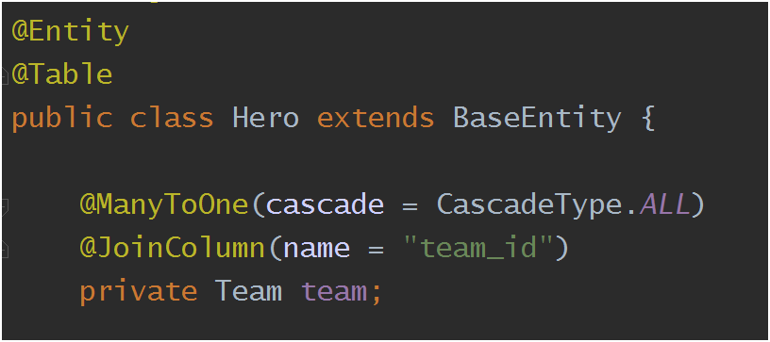
CascadeType
Operations that are propagated to the associated entity
ALL
PERSIST
MERGE
REMOVE
REFRESH
DETACH
- All relationship annotations
- Default is none

Slide 19
CascadeType
Exercise 5
5.1 → map hero entity
5.2 → create a new hero
5.3 → create a new team
5.4 → associate hero to the team
5.5 → persist hero on the database
Optional
5.5 → undo the cascade property at the hero class
5.6 → persist team on the database
5.6.1 → persist hero on the database

Slide 20


FetchType
Lazy
Eager
Load the related if needed
Load all related objects immediately

Slide 21
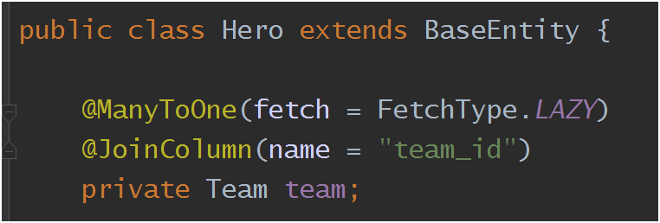
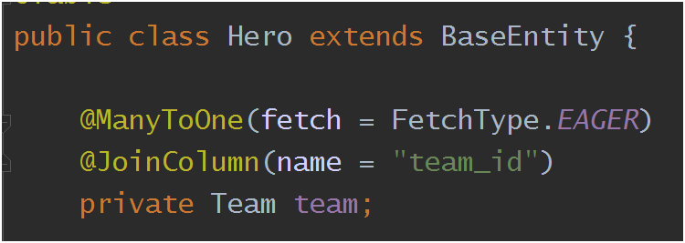
FetchType
Lazy
Eager
Default

Slide 22
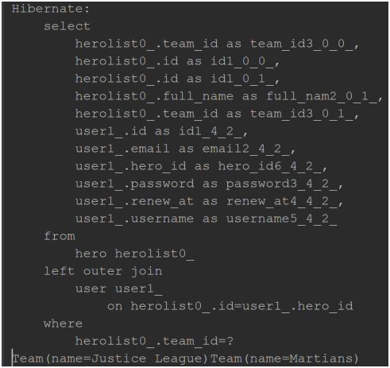
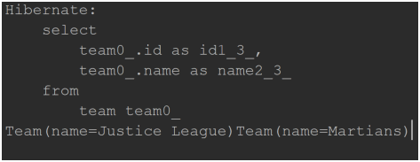
FetchType (log)
Eager
Lazy

Slide 23
FetchType
Exercise 6
6.1 → map team entity
6.2 → At the application.properties change the property spring.jpa.show-sql=true
6.3 → invoke teamRepository.findAll()

Slide 24
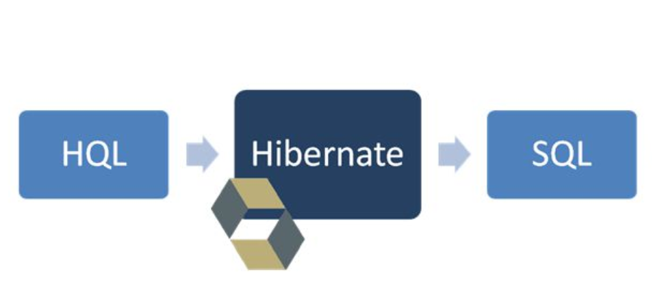
Finding Entities
HQL
Object model focused
Similar to SQL
It works as entity (not table)
Portable

Slide 25

Finding Entities
HQL
Finding all heroes

Slide 26
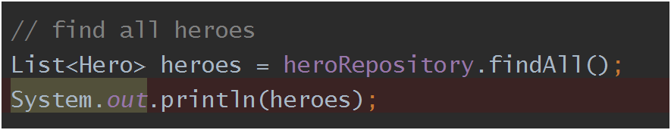
Finding Entities
Exercise 7
7.1 → write the method findAll at the class MissionRepository.java
7.2 → invoke missionRepository.findAll()

Slide 27
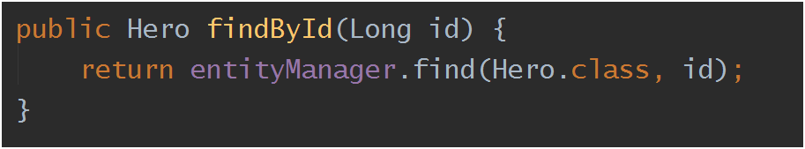
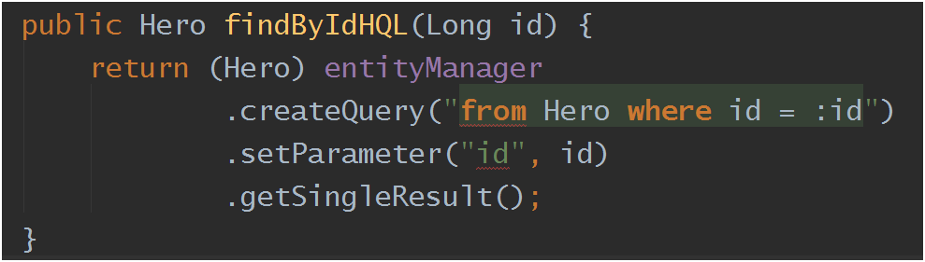
Finding Entities
HQL
Finding by ID
or

Slide 28
Finding Entities
Exercise 8
8.1 → write the method findById at the class HeroRepository.java
8.2 → invoke heroRepository.findById(heroes.get(0).getId())

Slide 29
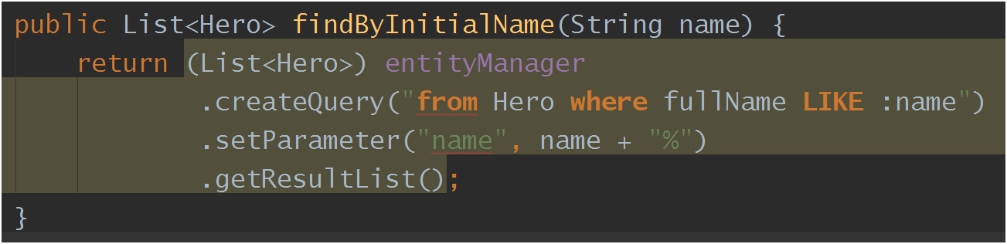
Finding Entities
HQL
Finding by initial name

Slide 30
Finding Entities
Exercise 9
9.1 → write the method findByInitialName at the class HeroRepository.java
9.2 → invoke heroRepository.findByInitialName(“M”)

Slide 31
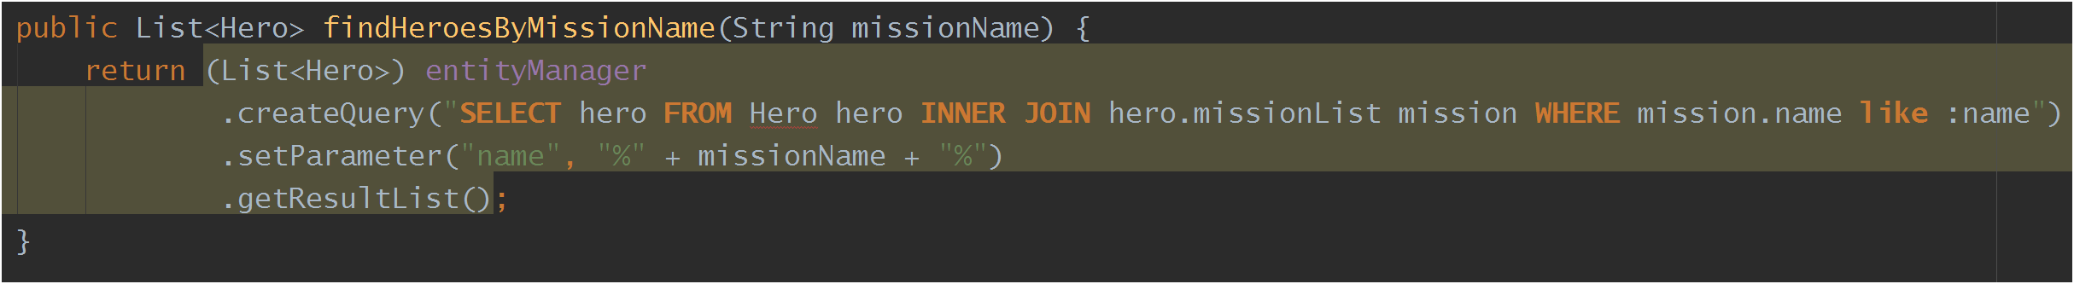
Finding Entities
Finding the heroes of a mission (contains mission’s name)
HQL
Hero: Entity
hero: alias
hero.missionList: get method at the Hero.java
mission: alias of the INNER JOIN
mission.name: get method at the Mission.java
SELECT hero FROM Hero hero
INNER JOIN hero.missionList mission
WHERE mission.name like :name

Slide 32
Finding Entities
Exercise 10
10.1 → write the method findHeroesByMissionName at the class HeroRepository.java
10.2 → invoke heroRepository. findHeroesByMissionName(“Rescue”)

Slide 33
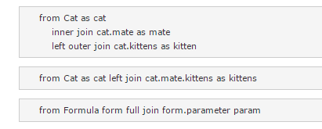
Finding Entities
Other examples

Slide 34

Finding Entities
Other examples

Slide 35
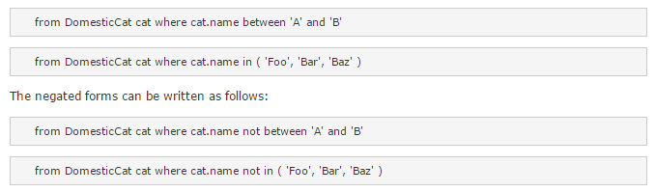
Finding Entities
Other examples

Slide 36

Questions?

Slide 37

Thank you

