Slide 1
Introduction to Maven

Slide 2
Dependency Management
Is a Java build tool
All build systems are essentially the same:
  Compile Source code
  Copy Resource
  Compile and Run Tests
  Package Project
  Deploy Project
  Cleanup

Slide 3
Repositories
Place where all jars are stored
Local (.m2 folder)
Central

Slide 4
pom.xml
Describes a project
  Name and Version
  Artifact Type
  Source Code Locations
  Dependencies
  Plugins
  Profiles (Alternate build configurations)

Slide 5
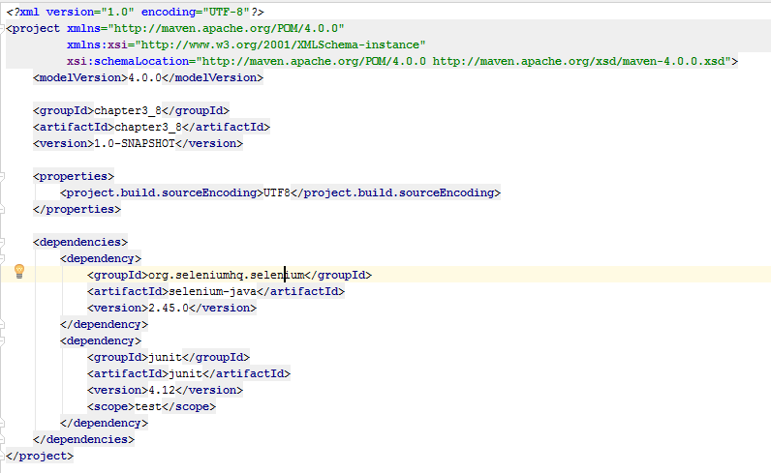
pom.xml
Identifier
Vars
Dependency Management

Slide 6
Dependency Management
3 qualifiers per dependency
  GroupId
  AritfactId
  Version
  <dependencies>
  <dependency>
  <groupId>org.seleniumhq.selenium</groupId>
  <artifactId>selenium-java</artifactId>
  <version>2.45.0</version>
  </dependency>
  <dependency>
  <groupId>junit</groupId>
  <artifactId>junit</artifactId>
  <version>4.12</version>
  <scope>test</scope>
  </dependency>
  </dependencies>

Slide 7
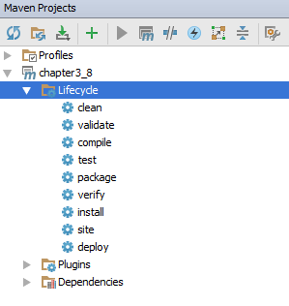
Lyfecycle

Slide 8
Introduction to
CSS Selector

Slide 9
CSS Selectors
CSS selectors are used to "find" (or select) HTML elements.
- Element
- Name
- Id
- Class
- Attribute
...

Slide 10
CSS Selectors
CSS selectors are used to "find" (or select) HTML elements.
- Element
- Name
- Id
- Class
- Attribute
...

Slide 11
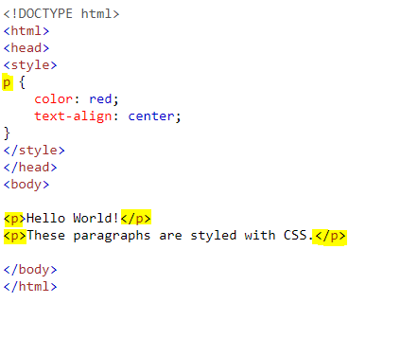
Selectors
https://www.w3schools.com/css/tryit.asp?filename=trycss_syntax1
By Element
<p>

Slide 12
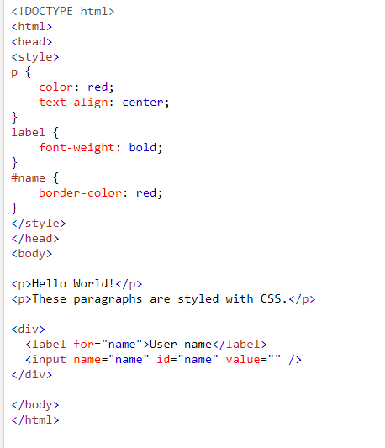
Selectors
By Element
<label>
By Id
#name

Slide 13
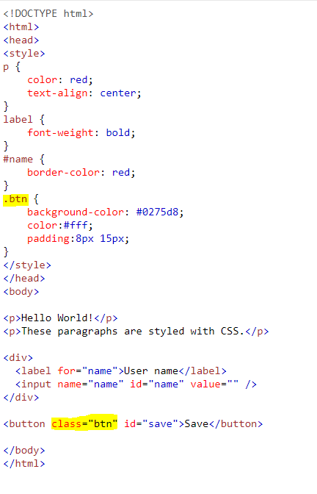
Selectors
By Class
.btn

Slide 14
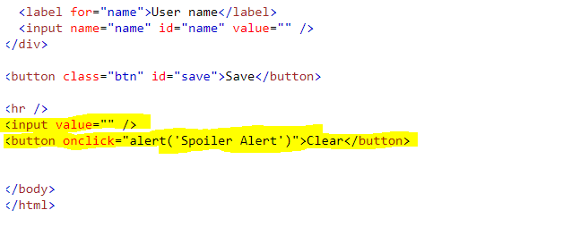
Selectors
/html/body/input
/html/body/button[2]
By XPATH
Inpect then
Select the element
Right Click / Copy / XPath

Slide 15
Introduction to
Unit Tests

Slide 16
Unit Test
Isolate a section of code
Verify its correctness
Assert
Requires @Teste

Slide 17
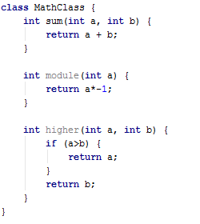
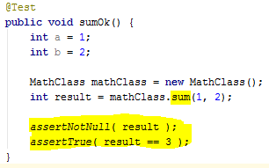
Example
>

Slide 18
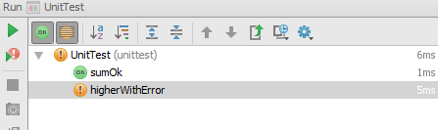

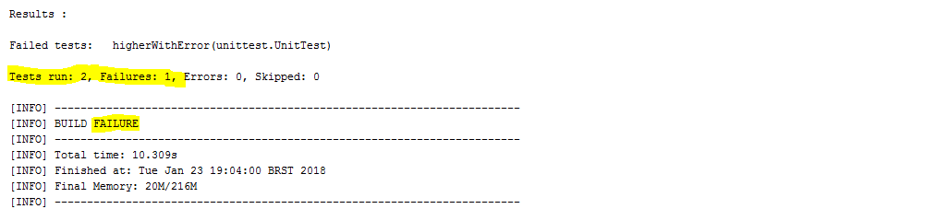
Fix

Slide 19
Introduction to
Selenium

Slide 20
Selenium
Automation Tests
Junit: Assert / Requires @Teste
Web driver (multiple browsers)
It needs a programming environment to work. Java, C#, Ruby and etc

Slide 21
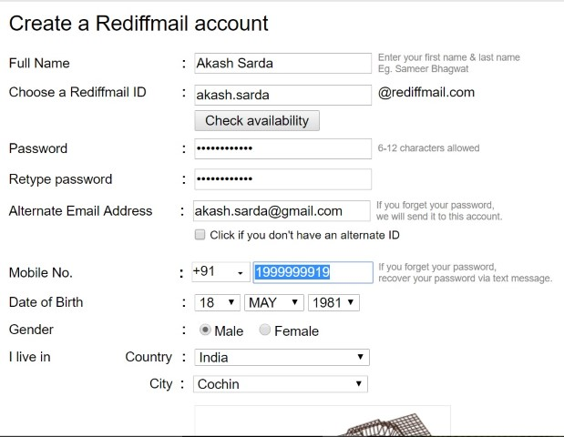
Selenium
Locators → Selectors
WebElement
(input, select, checkbox)
Given
web form
AND fill in the mandatory fields
When
Click on the Submit
Then
Validate all the fields
AND save the account

Slide 22
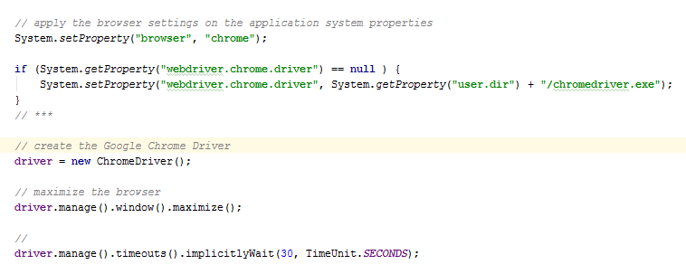
Selenium
Configuration: “Don’t worry”

Slide 23
Selenium
Moving to the URL
driver.get("https://translate.google.com/");
Closing the browser
driver.quit();
Maximize the browser
driver.manage().window().maximize();
Waiting 30 seconds
driver.manage().timeouts().implicitlyWait(30, TimeUnit.SECONDS);

Slide 24
Selenium
WebElement (classe to get the HTML elements)
method: driver.findElement
Locators
By.id(“ID”)
By.name(“name”)

Slide 25
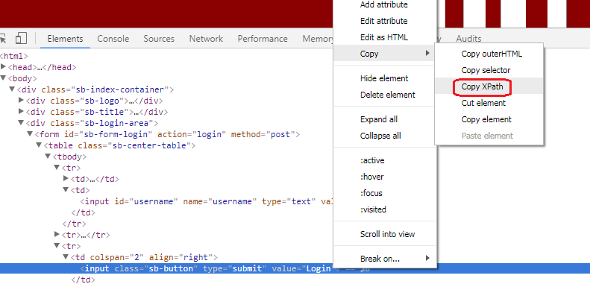
Selenium
Locators
WebElement (classe to get the HTML elements)
method: driver.findElement
By.xpath(“class”)

Slide 26
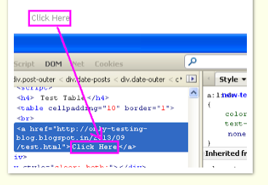
Selenium
Locators
WebElement (classe to get the HTML elements)
method: driver.findElement
By.linkText(“Click Here”)
By.partialLinkText(“Click ”)

Slide 27
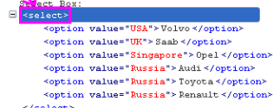
Selenium
Locators
WebElement (classe to get the HTML elements)
method: driver.findElements
By.tagName(“select”)

Slide 28
Selenium
WebElement (main methods)
click(): void
sendKeys(“”): void
getAttribute(“”): String
getText(): String
isSelected(): Boolean
getTagName(): String

Slide 29
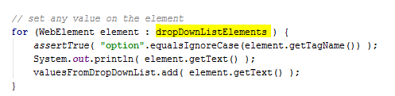
Selenium
List<WebElement>

Slide 30
Selenium
List<WebElement>

Slide 31
Selenium
Dropdownlist

Slide 32
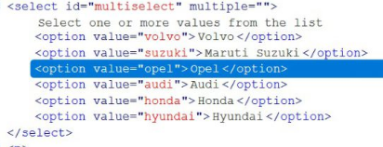
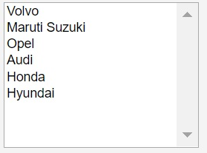
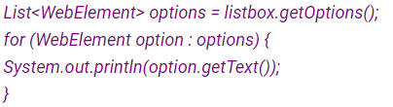
Selenium
Dropdownlist

