Slide 1
Design Patterns
University of Zielona Góra
Marcel Sawicki

Slide 2
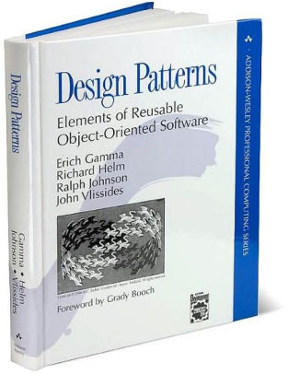
Design Patterns: Elements of Reusable Object-Oriented Software
In the year 1995 Gang of Four has published the book about design patterns.

Slide 3
Design Patterns: Elements of Reusable Object-Oriented Software
The authors of this book - Erich Gamma, Richard Helm, Ralph Johnson, and John Vlissides - described in it a number of classic software design patterns, which are a simple and elegant solution to common programming problems.
Factory, Composite, Observer, Singleton

Slide 4
Are design patterns really that important?
It saves your time. You don’t need to recreate a possible solution from nowhere and lose lots of time
Design patterns are well-known. When you say: „I used a factory to create that object” everyone will understand what you are talking about.
Most of these patterns are easy to understand. Probably your solution will be not as elegant and easy as a design pattern.

Slide 5
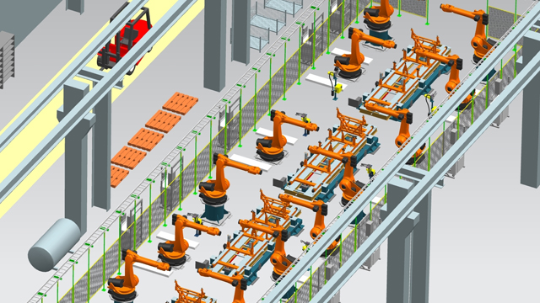
Factory
TypeScript
Factory – allows you to create families of dependent or matched objects in an abstract way, without describing specific classes.
In class-based programming, the factory method pattern is a creational pattern that uses factory methods to deal with the problem of creating objects without having to specify the exact class of the object that will be created. This is done by creating objects by calling a factory method—either specified in an interface and implemented by child classes, or implemented in a base class and optionally overridden by derived classes—rather than by calling a constructor.

Slide 6
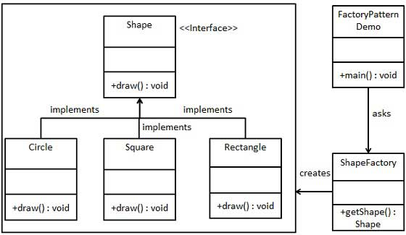
Factory
Demo: Design-Patterns\Factory\FabrykaTS

Slide 7

Strategy
Java
EmailProvider
Authentication
Strategy – the strategy pattern is a behavioral software design pattern that enables selecting an algorithm at runtime. Instead of implementing a single algorithm directly, code receives run-time instructions as to which in a family of algorithms to use.
Demo: Design-patterns\Strategy

Slide 8

Madiator
JavaScript
Mediator - the mediator pattern defines an object that encapsulates how a set of objects interact.
This pattern is considered to be a behavioral pattern due to the way it can alter the program's running behavior.
Usually a program is made up of many classes. Logic and computation are distributed among these classes. However, as more classes are added to a program, especially during maintenance and/or refactoring, the problem of communication between these classes may become more complex. This makes the program harder to read and maintain. Furthermore, it can become difficult to change the program, since any change may affect code in several other classes.
With the mediator pattern, communication between objects is encapsulated within a mediator object. Objects no longer communicate directly with each other, but instead communicate through the mediator. This reduces the dependencies between communicating objects, thereby reducing coupling.

Slide 9
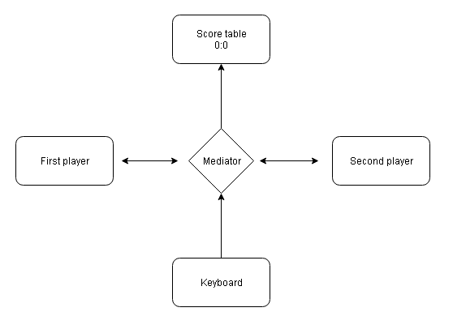
Madiator

Slide 10

Observer
C#
Observer - The observer pattern is a software design pattern in which an object, called the subject, maintains a list of its dependents, called observers, and notifies them automatically of any state changes, usually by calling one of their methods.
Demo: Design-patterns\Observer

Slide 11

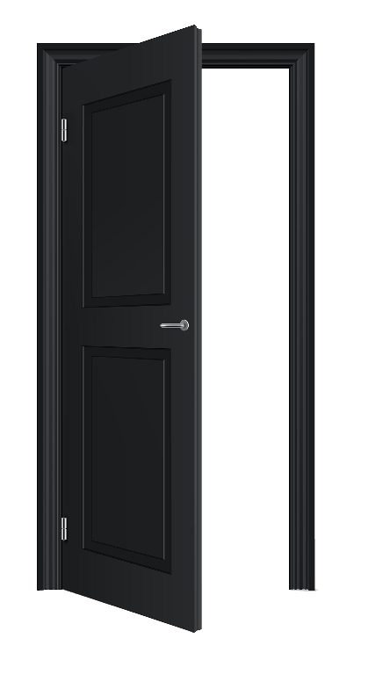
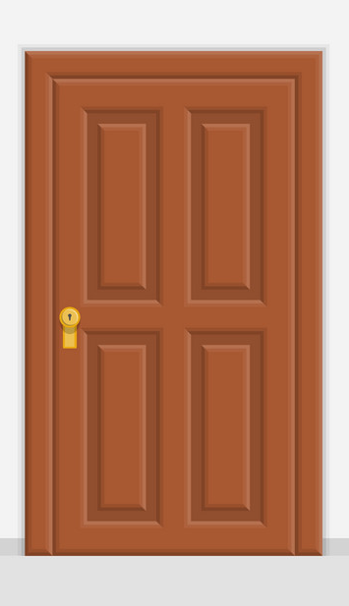
State
Closed
Open
Ajar
The state pattern is a behavioral software design pattern that allows an object to alter its behavior when its internal state changes

Slide 12
State
C#
The state pattern is set to solve two main problems:
An object should change its behavior when its internal state changes.
State-specific behavior should be defined independently. That is, adding new states should not affect the behavior of existing states.
Demo: Design-patterns\Observer

Slide 13
Thank YOU
University od Zielona Góra
Sources available on site:
http://github.com/MarcelSawicki/Design-patterns

