Slide 1
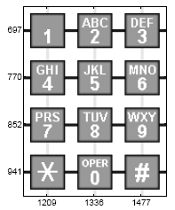
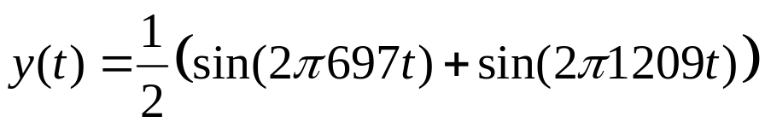

Project. Touch-tone dialing
Dual Tone Multi-Frequency (DTMF) system: the telephone dialing pad acts as a 4-by-3 matrix and associated with each row and column is a frequency.
For example, the tone generated by the button “1” is obtained by two fundamental tones with frequencies 697Hz and 1209Hz, i.e.,

Slide 2
Project. Touch-tone dialing
Assume that (a) the sampling rate fs =32768Hz, and that (b) it usually elapses around 0.5s when a button is pushed and (c) another 0.5s between the button pushing (idle).
Write a function that can generate the corresponding DTMF tones when any button is pushed.
Generate and plot the DTMF tones when the five numerical numbers of your Matric No. have been dialed. You may hear your generated tone using sound command in Matlab.
Using frequency analysis methods to analyze the signals that you generated in Step 2. Write a program to retrieve the number that the signal represents.
Write a report with descriptions of your program and explain how you achieve these tasks, together with your Matlab code in the appendix.
Upload your report in a single file with pdf or word format to IVLE by 6pm this Friday (i.e., Feb 11).

