Slide 1

Continuous Integration with Jenkins, ANT, and MXUnit
Marc Esher
CFObjective 2011
Download this presentation at wiki.mxunit.org

Slide 2
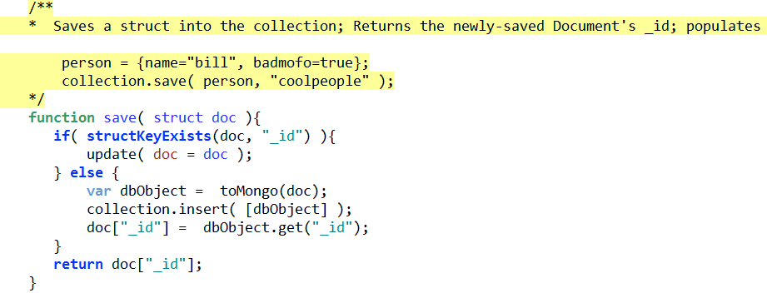
What is this?

Slide 3
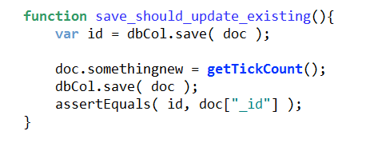
Now impress me...
What is this?

Slide 4
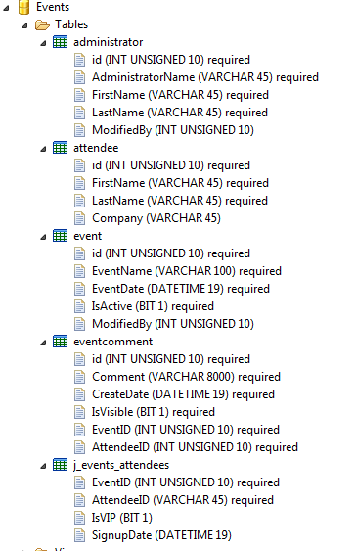
And
this?

Slide 5
Pop Quiz
Which of those 3 change?

Slide 6
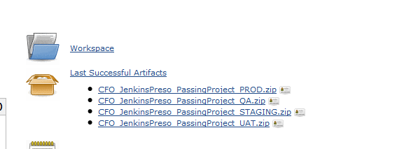
Do your projects have this?

Slide 7
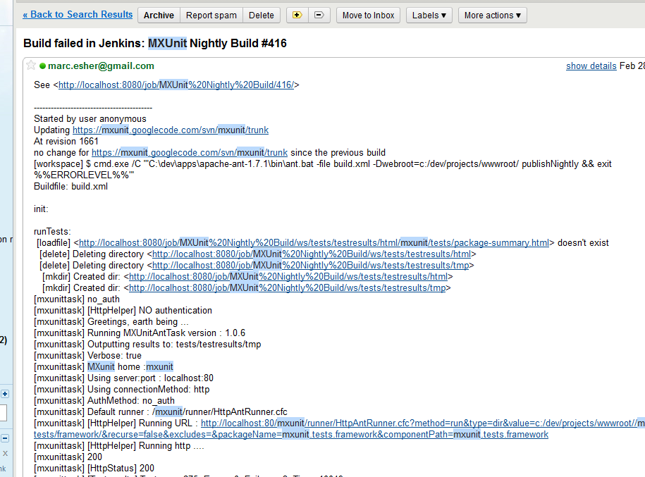
Or this?

Slide 8
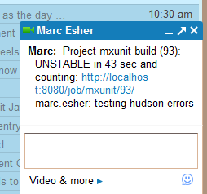
How fast do you know when something breaks?

Slide 9
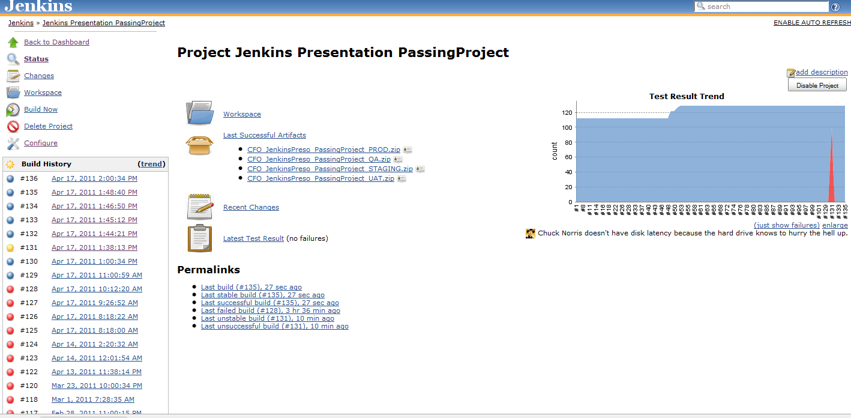
Wassssssuuppppp?

Slide 10
This Presentation is NOT:
An introduction to unit testing
A 50-minute explanation of how gull-dern geewilikers easy all of this is

Slide 11
This Presentation is:
An attempt to demonstrate how learning this stuff can:
  help you identify broken windows quicker and easier
  provide increased transparency to your projects
  enhance team communication

Slide 12
This Presentation is:
An attempt at being
*enough to get you started*
when you get back to work

Slide 13
This Presentation will:
Demystify CI

Slide 14
A Play in Three Acts
1. What Life's like with Jenkins
2. How to set it all up
3. Q & A

Slide 15
With Three Players
1. Jenkins Continuous Integration
Server (f/k/a Hudson)
2. ANT (Another neat tool)
3. MXUnit

Slide 16
What is Continuous Integration?

Slide 17
What is Continuous Integration?
What is CI for a dynamic language application?

Slide 18
What is Continuous Integration?
What is CI for a dynamic language application?
What is CI for a dynamic language application that can only run in a webserver?

Slide 19
What is CI for a dynamic language application that can only run in a webserver?
At a minimum: Always packaging your app for deployment

Slide 20
What is CI for a dynamic language application that can only run in a webserver?
At a minimum: Always packaging your app for deployment
Ideally: Always testing your app
Unit tests
Integration tests (Selenium, eg)

Slide 21
What is CI for a dynamic language application that can only run in a webserver?
At a minimum: Always packaging your app for deployment
Ideally: Always testing your app
Unit tests
Integration tests (selenium, eg)
Potentially: Always deploying your app
-- This would happen on a schedule
or a trigger (svn commit, eg) --

Slide 22
What is CI for a dynamic language application that can only run in a webserver?
The CI server can even help you do those things in a NON-Continuous manner
Click a button, deploy to Test
Click a button, deploy to Staging
Click a button, build all your deployables (zips, wars, eg)

Slide 23
What is a Continuous Integration Server?
Scheduler

Slide 24
What is a Continuous Integration Server?
Coordinator

Slide 25
What is a Continuous Integration Server?
Notifier

Slide 26
What is a Continuous Integration Server?
Artifact Aggregator

Slide 27
What is a Continuous Integration Server?
Reporter
Trends / Application Health

Slide 28
What is a Continuous Integration Server?
Auditor

Slide 29
Know This
You cannot answer
"What's broken?"

Slide 30
Know This
...Without Tests

Slide 31
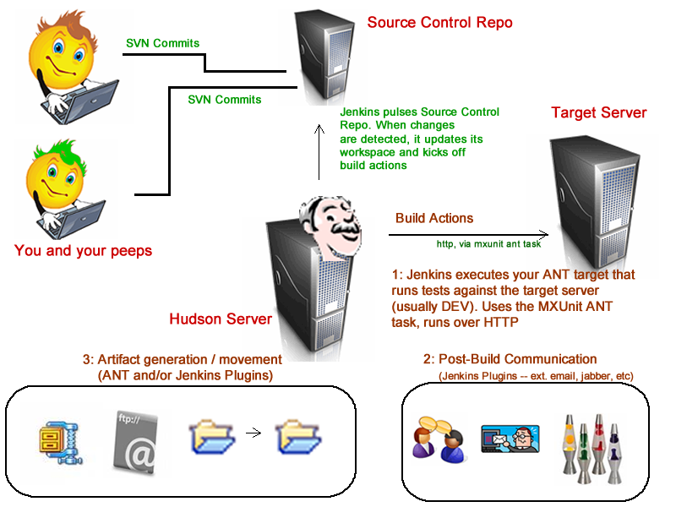
Bigass Image

Slide 32
Demo Time!
Your Life, with CI

Slide 33
3 Things You NEED to know
1. You will get the most out of CI
if you have tests
In other words, the usefulness of CI increases dramatically as your testing habits improve

Slide 34
3 Things You NEED to know
2. Resources can seem scarce*
Not as easy to find answers as, say, searching for "CFWindow"
* See the end of this deck for a list of good resources

Slide 35
3 Things You NEED to know
3. You can't avoid ANT any longer
It's the glue between Jenkins and your tests

Slide 36
If you think:
ANT is too hard
XML sucks
ANT is scary
Ooooh, great, another thing to learn
OOOH, GREAT, another annoying Java thing being pushed on me by some jerkoff who couldn't make it programming in a real language so he learned CF in 3 days and now he wants to seem like a bigshot so he's all like "Yeah, ANT rocks, you need to learn it or you should quit programming and go work at Wal-Mart because you're too stupid to be in front of a computer and speaking of which who the hell even let you have a keyboard in the first place grumble grumble grumble....

Slide 37
Stop your fretting!
CFPARAM <-- very important!
CFFUNCTION
CFINCLUDE
CFFILE
CFHTTP
CFDIRECTORY
CFOUTPUT
CFDUMP
CFZIP
#variable#

Slide 38
Stop your fretting!
CFPARAM
CFFUNCTION
CFINCLUDE
CFFILE
CFHTTP
CFDIRECTORY
CFOUTPUT
CFDUMP
CFZIP
#variable#
<property />
<target />
<import/> & <taskdef />
<copy /> <delete />, etc
<mxunit.../>
<mkdir />
<echo />
<echoproperties />
<zip />
${property}

Slide 39
Stop your fretting!
MXUnit ships with a sample ANT build file that does almost all of the work for you!
It's built to be Jenkins-friendly
/mxunit/samples/build.xml

Slide 40
Part II: How to Set it all Up
1. Install a JDK
download, install, note where you installed it, and forget about it
*As of now, it's at http://www.oracle.com/technetwork/java/javase/downloads/index.html
Simply get the JDK... no need for "bundles" (JavaEE, Netbeans, etc)

Slide 41
Part II: How to Set it all Up
2. Install ANT
download, unzip somewhere, note where you unzipped it, and forget about it
* http://ant.apache.org/bindownload.cgi

Slide 42
Part II: How to Set it all Up
3. Download Jenkins
It's a single .war file; put it somewhere sensible
(I keep a directory named "appservers", with Railo, OBD, Tomcat, etc. I keep the jenkins.war file in there.)
* http://jenkins-ci.org/

Slide 43
Part II: How to Set it all Up
You do NOT need to install Tomcat
You can install Jenkins as its own container easily, from within Jenkins itself

Slide 44
Demo Time!
Running Jenkins cmd> cd c:\dev\appservers\jenkins cmd> java -jar jenkins.war
(yes, that's it)

Slide 45
Demo Time!
Configuring Projects

Slide 46
Configuration steps
ANT/MXUnit
  Copy /mxunit/samples/HttpAntRunner.cfc into your test directory
  Copy /mxunit/ant/lib/mxunit-ant.jar into a /yourapp/lib/
  Copy /mxunit/samples/build.xml into your application's root
  Change the application.name property to the directory name of your application
  Change any other properties as necessary
  Run the runtests target to confirm ant is running your tests correctly
  Commit everything to svn
Jenkins
  Add a new Job
  Give it the Source Control URL for your project. Run a build to confirm it checked out the code
  Set up the scheduling (build triggers)
  Add a build step to run your "runtests" ANT target. Run a build to confirm it ran your tests
  Add build steps for "dist" and potentially for "svn.update" (move "svn.update" to the top)
  Archive the artifacts. They'll be in <projectname>/deploy/*.zip
  Publish JUnit test result report. They'll be in <projectname>/test/testresults/xml/*.xml
  Configure email notifications. Configure jabber (IM) notifications if you want
  Explore available plugins and have fun with CI!

Slide 47
Question: Answer, with CI:
When that code gets to your dev server, when are your tests run?
When your tests get run, what happens when something errors or fails?
Do you have metrics on how your tests are improving over time?
Is it easy for any team member to *see* the status of the build (i.e. the number of failing/passing tests)?
When the tests are run and everything is OK, is the entire project available for deployment (a zip file, for example)?
When someone checks in code to source control, how does that code get to your dev server?
Whenever you want them to
Emails, IMs, Chats... can be targeted to "culprits", as well
Yes, no extra work required
Yes. Access control is possible as well
Yes, zip via ANT and artifacts are easily archived
If you don't have that solved, CI can help

Slide 48
Where to learn more about Jenkins and CF
-- MXUnit Wiki:
http://wiki.mxunit.org/display/default/Automation+with+Jenkins+Continuous+Integration+Server
-- When you get stuck, join the MXUnit Google group and ask questions
http://groups.google.com/group/mxunit
-- Jenkins wiki:
http://wiki.jenkins-ci.org/display/JENKINS/Home
-- Jenkins Book (open source, free, work in progress)
http://www.wakaleo.com/books/continuous-integration-with-hudson-the-book

Slide 49
Where to learn more about ANT and CF
-- Jim Priest's recorded presentation on UGTV:
http://experts.acrobat.com/p53858056/
-- Go to http://carehart.org/ugtv and search for "ANT"
-- Jim Priest's ANT wiki
http://www.thecrumb.com/wiki/ant
-- My materials from 2008 CFUnited preso on ANT
(contains a LOT of example build files)
http://mxunit.s3.amazonaws.com/doc/zip/CFU2008ANT.zip

Slide 50

Thanks!
http://www.mxunit.org
Marc Esher
@marcesher on Twitter
Test
Be Happy

Slide 51
Credits
All CFML generated using Terry Ryan's Apptacular ColdFusion Builder extension
All cheesy icons from office.microsoft.com. Don't hate.
Except the Hindu god, he did not come from MS.

