Slide 1
Lean Enterprise, Principles in Practice
June, 2015
Marc Esher
@marcesher
Notes:
How many of you have:
projects start off with a lot of people and a lot of requirements?
Had an idea to build, not enough people?
Lots of you. Good. I want to tell you all a story, and based on all those hands, I suspect my story will resonate with a lot of you

Slide 2
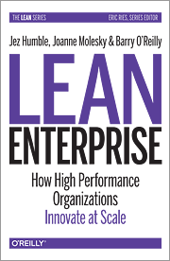
http://shop.oreilly.com/product/0636920030355.do
Notes:
About 6 months ago, I found myself in this very situation, and completely unexpectedly, that situation led us to discover and apply some of the principles of Lean software development in an enterprise setting
Specifically, the lessons in a recently published booked called “Lean Enterprise” by Jez Humble, Joanne Molesky, and Barry O’Reilly are fundamentally changing the way organizations approach software development and organize software projects

Slide 3
Standard operating procedure
Notes:
Internal customer….
Several months prior… requirements… specified MVP…. Full project pod
Developer did some POC work
Common approach
Problem: no team
My desk
Let me set the stage for our story.
An internal customer had an application they wanted built, configured, customized, and deployed to production.
A lot of the need was for developers from our internal dev and design team
Several months prior, this internal customer had done a lot of work to craft requirements around a software system they wanted to have built.
This involved using an open source data catalog software and then doing a lot of customizations around the software.
It would also have to hook into our internal authentication systems, have rigorous security controls applied, and so forth
The customer specified an MVP, and then also requirements for additional phases of development
A member of the customer team had done some local development to get an idea of what kind of work was involved in installing, configuring, and customizing the software, in vagrant.
The staffing estimate informing the request for a full team was informed a bit by this POC, and also by a fair bit of educating guessing and precedent.
This request stipulated a full project pod, including full-time back- and front-end software developers and consulting with graphic design, UX, system admins, cybersecurity,
Totalling several thousand hours of estimated work.
A common approach for us that generally works out OK.
Problem was, there were no people. They wanted a team, but a team didn’t exist
And then it landed on my desk.

Slide 4
http://giphy.com/gifs/happy-excited-M7gtacN7aPNsc
Notes:
Now that you know more about me, you know I’m a standup guy, and you’re thinking “wow, I bet when that random project request out of the blue came out, he was all excited” (cue He-man)

Slide 5

http://giphy.com/gifs/happy-excited-M7gtacN7aPNsc
Notes:
Back at it.
Now that you know more about me, you know I’m a standup guy, and you’re thinking “wow, I bet when that random project request out of the blue came out, he was all excited” (cue He-man)

Slide 6
http://rebloggy.com/post/disney-the-lion-king-disney-gif-1000-simba-emma-nala-disneyedit/78136810417
Notes:
In reality, it was more like this.
Huh? What is this?
So we didn’t know what this was, but we said OK, we’ll take 2 of our team’s devs – I was one of them – and we’ll spend a month or two doing whatever we can to help this project be successful and get into production
This kicked off a series of meetings to discuss the project, requirements, scoping, etc.
These discussions also surfaced a lot of uncertainty, and uncertainty is risk.

Slide 7

http://rebloggy.com/post/disney-the-lion-king-disney-gif-1000-simba-emma-nala-disneyedit/78136810417
Notes:
In reality, it was more like this.
Huh? What is this?
So we didn’t know what this was, but we said OK, we’ll take 2 of our team’s devs – I was one of them – and we’ll spend a month or two doing whatever we can to help this project be successful and get into production
This kicked off a series of meetings to discuss the project, requirements, scoping, etc.
These discussions also surfaced a lot of uncertainty, and uncertainty is risk.

Slide 8
Uncertainties
Installation and configuration
Security requirements
Authentication and authorization
Customization
Notes:
I bucket these uncertainties into two categories:
1. Operationalizing the application
2. Customizing the software so that the customer could get value out of it and it would be enjoyable to use

Slide 9
Confronting Ignoring Uncertainty
Repeatable installation of uncustomized software in production
Implement all security controls
Auth… No Promises
Customization Maybe later
Notes:
Now, I started off this story by talking about how this project got started, with its requirements and staffing request, and that’s our Standard operating procedure.
Well, now it was my turn to do what our team does.
See, you have to understand that my team doesn’t do a lot of feature development or customization of other people’s software for internal teams.
In fact, the reason it was so weird for this project to even show up on my desk in the first place is that we’ve never done this kind of thing before.
And since it didn’t fit the pattern, I basically approached the project by trying to make it fit into what we typically do, which is help people get their stuff configured, secured, and deployed to production
So that meant…
Go through these bullets

Slide 10
“When can we get more people?”
Notes:
We met with the customer to talk about our plan, and after a lot of talking, everyone mostly agreed.
But something was off.
The product owner was reluctant.
He said things like:
--- go through these next few slides

Slide 11
“When can we start the customizations?”

Slide 12
“… isn’t all that valuable”

Slide 13
“… Valuable”
Notes:
Valuable.
You probably see where this is going.
Now, what I wanted was to get this thing shipped and get back to all the other work we had to do.
And I had pretty much just gotten the OK, albeit tepid, to do just that

Slide 14
http://wifflegif.com/tags/69297-sarcastic-clapping-gifs
Notes:
Yay me. Congratulations.
Tell you what: I did not feel good at all. Totally unsettled

Slide 15

http://wifflegif.com/tags/69297-sarcastic-clapping-gifs
Notes:
Yay me. Congratulations.
Tell you what: I did not feel good at all. Totally unsettled

Slide 16
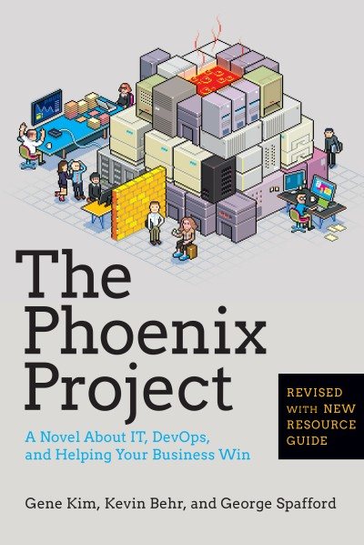
http://itrevolution.com/books/phoenix-project-devops-book/
Notes:
How many of you have read The Phoenix Project?

Slide 17

https://markmeynell.files.wordpress.com/2007/04/big-brother.jpg
Notes:
My reaction to reading TPP was “Who is this Gene Kim guy and why does he know so much about my life?”
I expected to turn around and see Gene standing behind me, snooping.

Slide 18
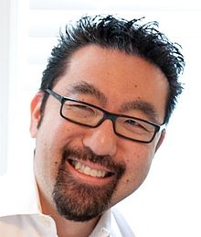
GENE KIM
http://en.wikipedia.org/wiki/Gene_Kim
Notes:
Kinda like this

Slide 19
http://shop.oreilly.com/product/0636920030355.do
Notes:
Well, that night, after that meeting, I had an experience similar to reading the phoenix project
A few weeks prior, I had just picked up Lean Enterprise, and picked through it a bit.
That night, after the meeting, I started on chapter 1 and started plowing through.

Slide 20
http://media3.giphy.com/media/feqkVgjJpYtjy/giphy.gif
Notes:
By the end of Chapter 3, I put it down, thought OMG, got to a computer and started typing.

Slide 21

http://media3.giphy.com/media/feqkVgjJpYtjy/giphy.gif
Notes:
By the end of Chapter 3, I put it down, thought OMG, got to a computer and started typing.

Slide 22
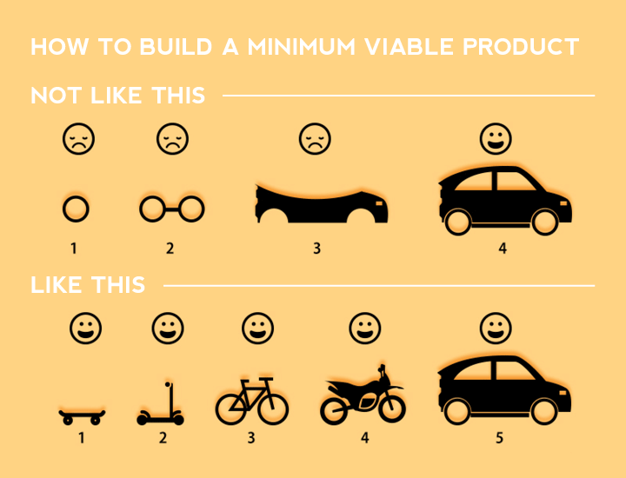
http://www.roysivan.com/best-way-develop-mvp/
Notes:
I was so unsettled about our direction because the value the customer wanted was not the value we were delivering.
Even though they had done what we typically do with speccing the project, and even though my team was doing what we always do with automating and getting into production,
We weren’t building the right thing. We weren’t delivering the right value to the right people.
So I did what everyone in DC does when they have an idea: I sent an email requesting a meeting.
I emailed my boss: We need to talk. I want to propose a pivot on this project.
See, what I came to understand was that our direction was basically like the top of this image.
My team was delivering, maybe, image #3 at the top. And although that might help us get in and out quickly, it wasn’t serving the customer.
We needed to rethink our approach to what an MVP is, and have it look more like the bottom part of the image.
So let’s talk about what that looks like in practice

Slide 23
Key Principle: Focus on Learning
Notes:
A key principle of Lean Thinking is continuous learning, and feeding that learning back into the system.
We used that principle as the foundation of our pivot.
It looked like this:

Slide 24
1. Are we building the right thing?
Notes:
Start by asking: Are we building the right thing?
This is another way of asking: “What is valuable?”

Slide 25
2. How do we know that?
Notes:
This leads the inevitable next question: How do you know that?
Edward Tufte wrote “The deepest and most probing question you can ask yourself and others is: “How do you know that?”
https://twitter.com/edwardtufte/status/300419331387428864

Slide 26
3. We need to use the software
Notes:
For us, to answer that, we knew that our users needed to use the software.
Not just the plain jane software, but enough of it customized to let them know if they were on the right track with their proposed customizations

Slide 27
4. What’s the least we can do to enable that?
Notes:
Then, on our team, we sought to determine what’s the least work we could do to enable that kind of discovery

Slide 28
Pivot proposal
Notes:
So here’s what we proposed

Slide 29
Pivot proposal: Development Approach
4-6 week discovery phase w/ small team
No production… yet
Focus on uncertainties
Leave parts of each requirement undone
Build “Just enough to use and learn”
Real users, ASAP
Notes:
Go through the bullets
For bullet #1:
I am convinced that the fact that we started out resource constrained was a blessing in disguise.
Not having a full team to throw at this project forced us to get creative and think hard about the right way to do this.
For the “undone” slide:
Part of the customization called for the addition of something like 100+ additional data fields.
But it turns out that there are really only about 7 different Types of data fields.
So my partner and I learned how to do 1 of each, which was enough to give us a sense of the kind of work involved in implementing each type of field.
We didn’t need to build all 100 fields to learn enough to reduce the uncertainty

Slide 30
Pivot proposal: Delivery
Deliver a mix of software and documentation
Staffing proposal based on discovery phase
Transition responsibility to customer team
Notes:
OK, let’s try a loaded question.
If you have a small explore team with a focus on learning
What must happen for that explore team to transition off the project and still enable the next team to take over?
Do we just write some software and then say “here you go. Good luck”?
Now start the bullets.
We were forced to think about transition planning from Day 1.
This meant that as we were learning, we had to be thinking about how to teach this to the next team.
This meant a mix of software, automations, and documentation
We had to be thinking about the types of skills required to do the remaining work
For us to transition responsibility and wean ourselves off, we had to set them up for success
Making sure it was as easy as possible to get started developing locally in vagrant
Making sure our decisions were documented
Making sure they had all the access they needed to our continuous integration and delivery system so they could take over deploy responsibility

Slide 31
Key Principle: Reduce waste
Notes:
In Lean Enterprise, Jez & co talk a lot about the lean principle of reducing waste.
So: not spending time, humans, and other resources on the wrong things.

Slide 32
1. Small, X-functional Explore Team
Notes:
The most obvious manifestation of that for us was to apply their concept of a Small, cross-functional explore team with a limited runway and focus on learning
By us spending just a few days investigating and experimenting on each of our main uncertainties, we learned something huge:
That the amount of work required to implement the customizations was likely rather less than originally thought, and required a different skill set than originally thought.
Had we staffed the project the way we’ve always done, we probably would’ve wasted a lot of people’s time.

Slide 33
2. Runway = hypotheses, not requirements
Notes:
The book has this great sentence:
“Our runway should be a list of hypotheses to test, not a list of requirements to build”
This is why, for our initial work on the project, we didn’t build any of the initial requirements fully. Just enough to reduce uncertainty and figure out what kind of skills and effort would be required to fully build, if they were even worth building at all

Slide 34
3. “Principle of Optionality”
Notes:
One example of hypotheses vs requirements was with how we were to do authentication and authorization.
Lean Enterprise talks about the Principle of Optionality, which is no fancier than it sounds. Basically: have options.
One big unknown for us was the requirements around authentication and authorization. One mechanism had been stipulated, but we had no experience with it. My boss worked with our CISO to see what other options we had, and because we knew we had options that we knew would work, we didn’t spend weeks or months going down the originally required route because our initial experiments with it were fruitless

Slide 35
Enabling the transformation

Slide 36
Enabling this transformation
Customer was a fantastic partner
Real users early
Frequent project check-ins
Unit tests and continuous integration early
Eye toward future staff
Notes:
Go through the bullets
Unit tests and CI early…. This might sound counterintuitive. Those things take time. But here’s why we did them:
Developing the customizations turned out to be kind of a hassle, and we realized early on that writing unit tests made us go a lot faster
With CI, we knew we’d have to do it anyway, and for us to make it as easy and fast as possible for users to test the system in our dev environment, obviously the friction for deployment had to be minimal

Slide 37
What didn’t go well

Slide 38
What didn’t go well
Took a while for customer to use the app
Not everyone on board with “Optionality”
Bottlenecks
Notes:
Bottlenecks: fortunately, later in the book the authors discuss Value Stream Mapping and give guidance on identifying and breaking down bottlenecks, so I’m looking forward to that learning

Slide 39
“Whenever you hear of a new IT project starting up with a large budget, teams of tens or hundreds of people, and a timeline of many months before something actually gets shipped, you can expect the project will go over time and budget and not deliver the expected value.” - Lean Enterprise
My plea: enable experimentation
Notes:
If projects are spec’d so tightly that there’s no wiggle room, you can’t experiment and learn
If you have no optionality, you can’t learn
If you’re not getting real user feedback as early as possible, it’s really hard to learn whether you’re building the right thing
I don’t care how right you’re building it. I don’t care if you’ve built a perfectly secured system, or a perfectly modularized dockerized microserviced unicorn system with 100% test coverage. If it’s not the right thing, you’ve wasted your time.
You’ve all heard the stat that something like 70% of federal IT projects fail to meet their objectives.
No one is proud of that or intends it. No one comes to work saying “Man, I can’t wait to be part of the 70%”.
No. We come to work wanting to be successful. But we’re in this together and we can’t do it alone.
Work with your leadership, your program management office, developers, and cybersecurity teams.
I’m convinced we can improve our project success rate by structuring our software projects and operating environments to enable answering: “are we building the right thing, and how do we know that?”
I’m convinced that we can improve our project success rate by moving the organization toward asking “Are we building the right thing, and how do we know that?” and structuring our software projects and operating environments to enable answering those questions.

Slide 40
Thanks!
June, 2015
Marc Esher
@marcesher

