Slide 1

Pragmatic TDD and The Cloak of Testability
  Bay Area ColdFusion Users Group
  November 19, 2008

Slide 2
Outline
QA Fundamentals
The Controversy
The Cloak of Testability
What you've been waiting for
Back at Work

Slide 3
MXUnit.org
Unit Test Framework and Eclipse Plugin for ColdFusion
Bill Shelton and Marc Esher
  Who we are: CF and Java developers who test all the freakin' time and started MXUnit to support our needs
  We also want it to work for you, that's why we're here!

Slide 4
QA Fundamentals
Why do we test anything in the first place?
  Seems like an obvious question, but think about it.
  When we test, what are we looking for?
  Tiers or layers – Tesing should examine different aspects (db, cfc/service, UI, integration)‏
When do we test?
  Do we test before, during, or after we write production code?

Slide 5
The Controversy
”Uncle” Bob Martin (ObjectMentor)‏
  ”...my thesis is that it has become infeasible ... for a software developer to consider himself professional if he does not practice test driven development.”
  ”...a test driven developer does not write a line of production code until he has written a failing unit test, and no production code can be written until there is a failing unit test.”
http://www.infoq.com/interviews/coplien-martin-tdd

Slide 6
The Controversy (cont.)‏
Cedric Beust (TestNG)‏
  ”Don't you feel a bit dirty? What with all those books ... telling you you should be doing TDD, and otherwise you are not professional?Is it just me? I try to do it... sometimes it feels right, sometimes it doesn't..."Need citation!
  ”I especially dislike the efforts of TDD extremists who are trying to make developers feel bad whenever they don't use TDD, or lead them to think that something is wrong with the way they write their software. ”

Slide 7
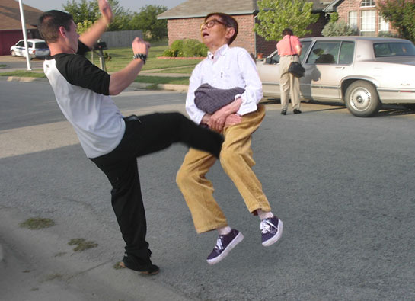
Who's Right?

Slide 8
What Bill and Marc Say
Just write your damn tests and make sure code is testable.
TDD License - How about Test Focused Development (TFD) : Write tests as much as possible and whenever it makes sense.
Testability naturally leads to clean code and a clear design
Agility – Testable code is also agile, allowing for quicker changes

Slide 9
What you've been waiting for
WTF does MXUnit look like?
What does untestable code look like?
What does testable code look like?
Mmmmm .... Code

Slide 10
Back at Work
When you get back to work ...
  Download and install MXUnit and go through docs
  Get involved! http://groups.google.com/group/mxunit
  Testing is as just hard as writing code, but your code will be better if well-tested
  Your code is only as good as the tests that execute it.

Slide 11

Test and be happy

Slide 12
References
InfoQ : Coplien and Martin Debate
  http://www.infoq.com/interviews/coplien-martin-tdd
InfoQ: Design for Testability (Cedric Beust)‏
  http://www.infoq.com/interviews/beust-designing-testability
The Flawed Theory Behind Unit Testing (Michael Feathers)‏
  http://michaelfeathers.typepad.com/michael_feathers_blog/2008/06/the-flawed-theo.html

