Slide 1
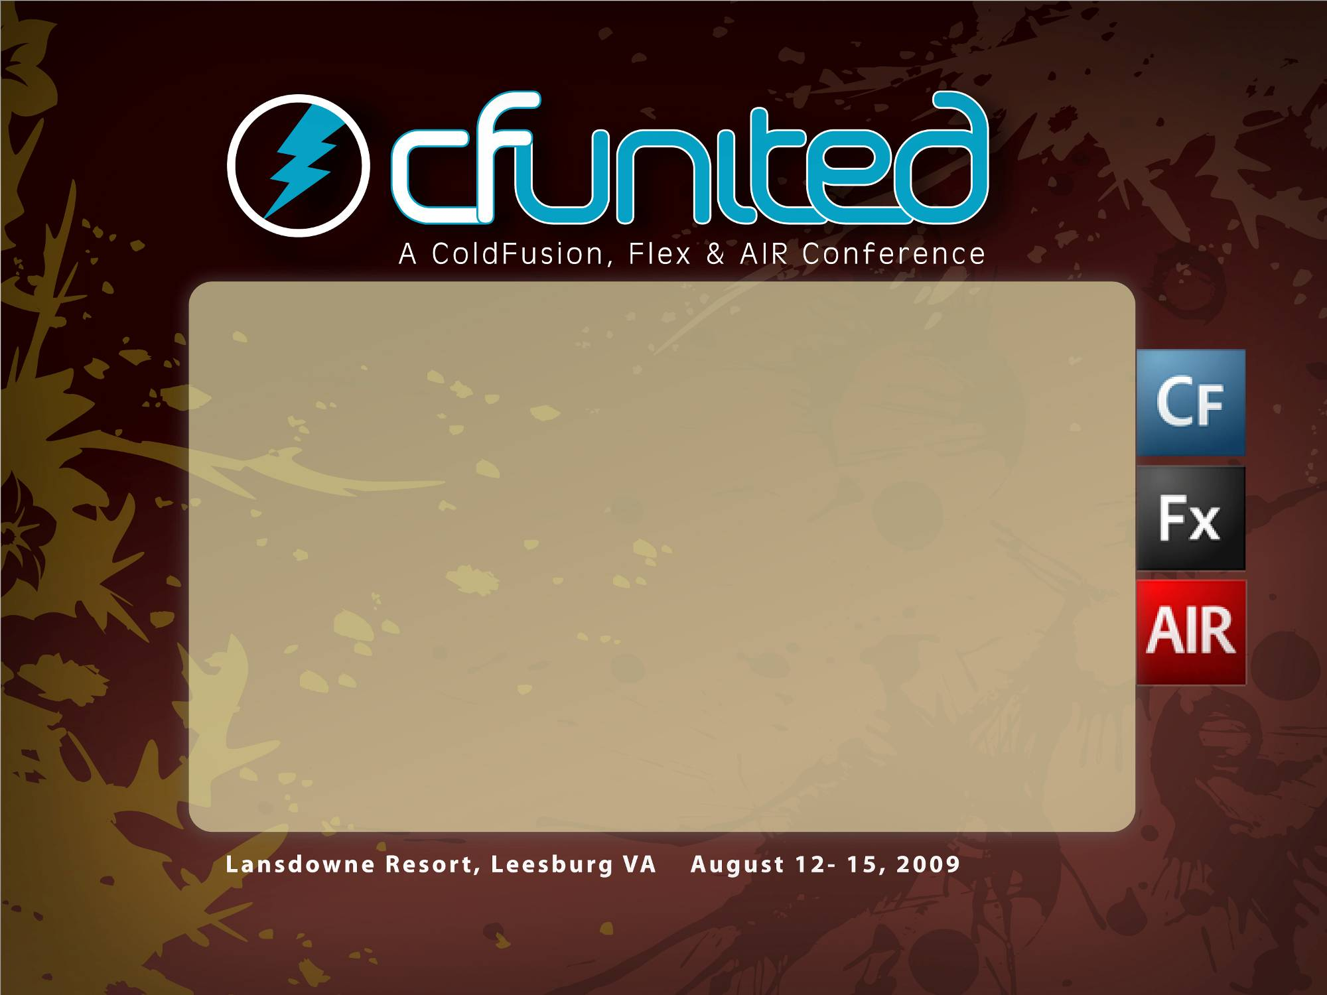
Automate Like a Rock Star!
Marc Esher
MXUnit.org
(You can download this presentation from MXUnit.org
after the show)

Slide 2

What this presentation
is “About”
Notes:
This is not a deep dive into one or two automation mechanisms that are going to completely robot-ize your office, save you months of time each year, and otherwise make you a king.
This is an introduction to habits and tools that can, over time, save you significant time so you can do more of what you like to do.

Slide 3
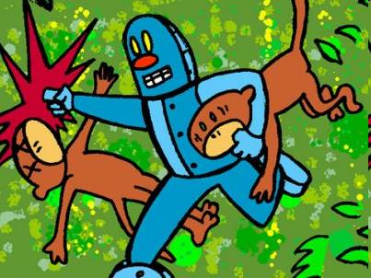
http://www.swervepictures.com/pics/monkey2.jpg
Notes:
Above all, this presentation is about developing a vigorous revulsion to “Monkey Work”. It’s about being a master of your processes, not a slave to them

Slide 4
Are you in the
right room?
Notes:
If this doesn’t appeal to you, please feel free to leave… I don’t want you to listen for an hour to something that doesn’t sound interesting.

Slide 5
Given a choice between spending an hour doing a task manually, or spending three hours writing a program to do it automatically... a geek will write the program, every single time. And, if not given the choice, if explicitly ordered to do the job manually, we'll disobey and write the program anyway.
--Catherine Devlin
http://catherinedevlin.blogspot.com/2009/06/how-to-tell-geek.html
Notes:
You’re in the right room if this quote speaks to you, even just a little. If it intrigues you, piques your interest, you’re in the right room.
If you’re interested in starting to develop – at a cellular level – an intense dislike of doing monkey work, you’re in the right room

Slide 6
But…
Why?
We’ll get to that later…
Notes:
In general, a good presentation starts off with a problem, then presents solutions to that problem.
I’m going to turn this on its head, because it’s Friday. Instead, I’m going to start with the Hows, not the Whys. I want to save the Whys till the end, because I think that by the end, the whys may become obvious. And if they don’t, I want them to be a surprise.
Plus, I think what you’ll find over the next 40 minutes is that the Hows really aren’t too tough. If you come away with even just a little bit of “yeah, I can do that!”, then the Whys will matter more.

Slide 7

Personal
Productivity

Slide 8
Batch
Files

Slide 9
In Windows, these end with “.bat”
They make calls to system commands and other executables
They save time by reducing keystrokes and mouse clicks and by combining multiple commands into a single ‘action’
NET START "Macromedia JRun CFusion Server"
NET START "Macromedia JRun Admin Server"

Slide 10
Keyboard
Launchers

Slide 11
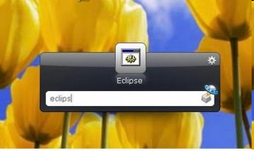
Keyboard launchers can start programs, bat files, etc
Advanced launchers can simulate mouseclicks and keystrokes
They save time by eliminating mouseclicks and significantly reducing keystrokes

Slide 12

This thing is
killing you
Notes:
Or at the very least, is slowing you down

Slide 13
Code
Snippets

Slide 14
Most IDEs have a “snippet” or “macro” feature
Pre-recorded snippets of commonly used code
Often can ‘invoke’ with a key sequence
Save time by reducing keystrokes, avoiding mistakes, and contending with ‘the memory problem’
If you type it more than once, put it in a snippet

Slide 15
Systems
Automation

Slide 16
Apache ANT
(for moving, copying, zipping, starting, stopping, svn-ing, and lots of other -ings)

Slide 17
Extremely powerful application for completely automating your build and deployment process
Also very useful for routine file system and system command task automation
You can execute ANT from the command line and bat files, which means you can schedule tasks easily
Limited only by your imagination

Slide 18
Apache JMeter
(for pounding on web pages)

Slide 19
Start it with a bat file
Create Test Plans with “Thread Groups”. These are http requests
Control number of concurrent users and how many times they run
Full-fledged load-testing application, but extremely useful as a simple tool for pounding on things
Perfect for those situations where you wish you had 100 of you to click links

Slide 20
Again…
Why?

Slide 21

Thanks!
http://www.mxunit.org
Marc Esher
@marcesher on Twitter
Test
Be Happy

Slide 22
Resources
In the Download of this presentation, you’ll find examples where appropriate.
These are additional links:
Batch Files:
Google it for a gazillion hits, but here are two useful ones:
http://www.computerhope.com/msdos.htm
http://support.microsoft.com/kb/173529
Launchy:
http://www.launchy.net/
http://blog.mxunit.org/search/label/launchy
Other Key Launchers: http://www.autohotkey.com/,
FARR (http://www.donationcoder.com/Software/Mouser/findrun/index.html)
Snippets:
http://blog.mxunit.org/2009/04/timesavers-cfeclipse-snippets.html
http://blog.mxunit.org/2008/08/mxunit-102-now-available.html

Slide 23
Resources
ANT
http://ant.apache.org/
http://mxunit.org/doc/zip/DDT218_Automating%20the%20build-deploy%20process%20with%20ANT.zip (a zip file with lots of ANT example files)
http://www.thecrumb.com/wiki/ant
http://www.carehart.org/ugtv/list.cfm?search=ant
http://www.alagad.com/blog/post.cfm/ant4cf-released-andndash-run-build-files-remotely-and-interact-with-coldfusion-services-from-ant-scripts
JMeter
http://jakarta.apache.org/jmeter/
http://alagad.com/blog/post.cfm/site-testing-with-apache-s-jakarta-jmeter
http://alagad.com/blog/post.cfm/apache-s-jmeter-part-ii-recording-a-test-script-with-the-proxy-component
General
http://productiveprogrammer.com/wiki/index.php/Main_Page

