Slide 1
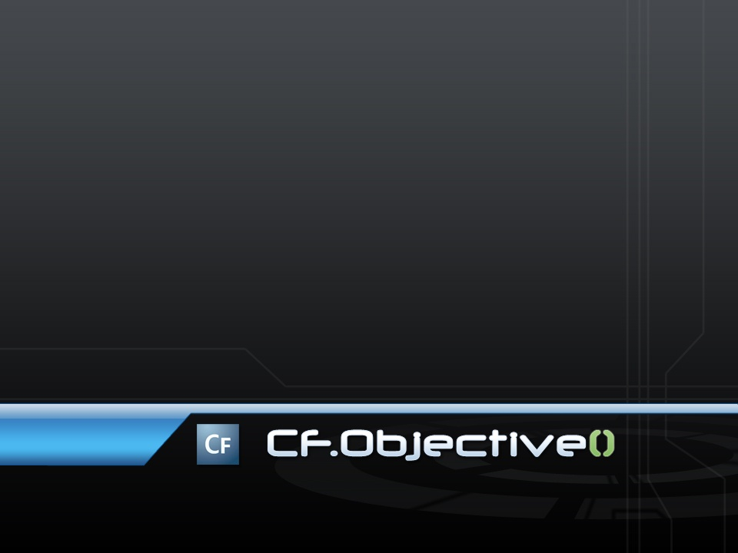
Writing Testable Code:
Real-World TDD
Easy-To-Test
VDD
Marc Esher
http://www.mxunit.org

Slide 2
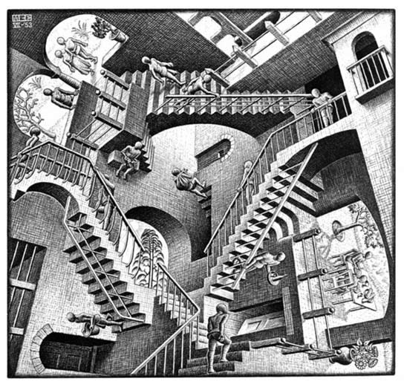
Am I in the Right Room?
Notes:
Beginning of a series of quick slides for “If this talk doesn’t sound like it’s for you, it’s A-OK to leave”.

Slide 3
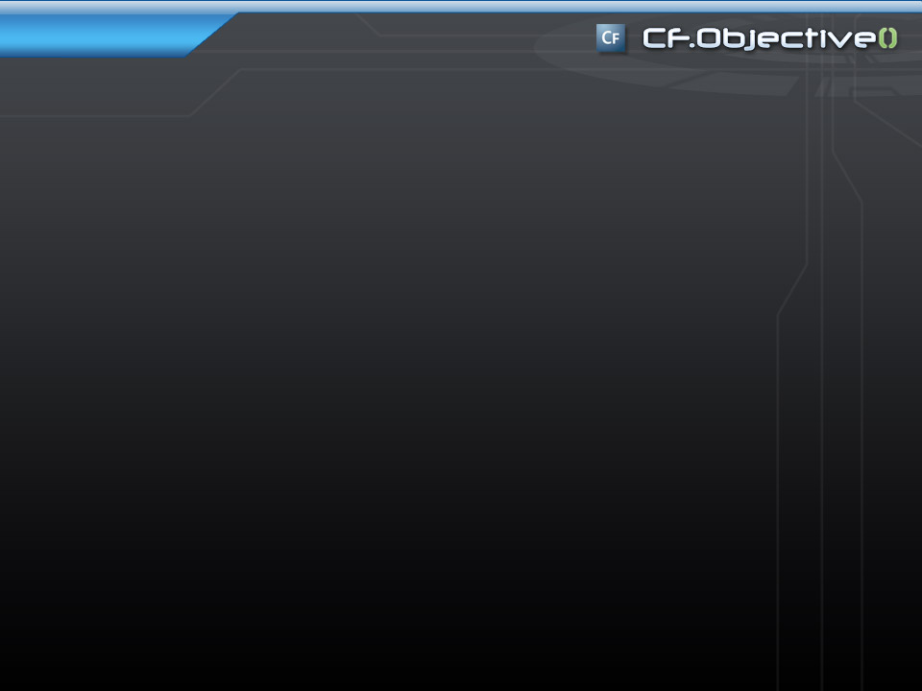
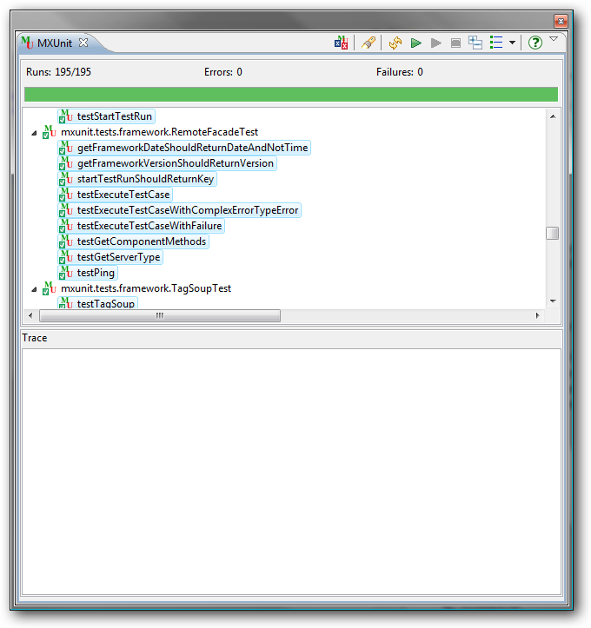
Stay here if
You want to
Write code that is
Easier To Test
Notes:
This really is the whole point of the session.
Though this is not an introduction to unit testing session, nor is it a “how do I test my DAOs” session.

Slide 4
<cfcomponent extends=“InTheRightRoomIf">
  <cffunction name="whyElse">
    <cfset YOU = createObject("component",
    "CFObjectiveAttendee")
    .wantTo()
    .writeBetter_ObjectOriented_Code()>
  </cffunction>
</cfcomponent>
Notes:
Testable code and the principles of OO go hand in hand

Slide 5

And Especially If
You have:
  Piles O’ Cash
  Cases of Chimay
  Bottles of Dalwhinnie
  Boxes of Cohibas
To give to a:
  Short, Bald
  CF & Java Programmer
  Who’s been coding for a while,
  Writing and Researching Testing for a while,
  Contributing to a CF Test framework,
  Slaving away for the man in a cube farm just tryin’ to get by in this cold hard world

Slide 6

I’m the
Good Code Pixie!
Notes:
When you leave this world, you’re going to leave a legacy. Much of it will be personal. Some will be professional. Some will be represented in the code you’ve left behind. We’re all here because we write code. Some of us are farther along in our journey than others. And that’s a beautiful thing because all of us here have different contexts and vantage points, different experiences. So let’s do some crowd sourcing (cuz that’s so web 2.0).
Let’s make a list of what it is that we value in the code we write.
In other words, when people say “that’s good code”, what do they mean?

Slide 7

And yet…
…We stray
Notes:
It just so happens that the opposite of the values we came up with is precisely what makes testing difficult.
Let me repeat that: When you write code that doesn’t reflect these values of good software design, the code is probably hard to test
When you write code that manifests these values, it’s probably easy to test.
THUS: there’s an inherent link between quality code and easy testability

Slide 8
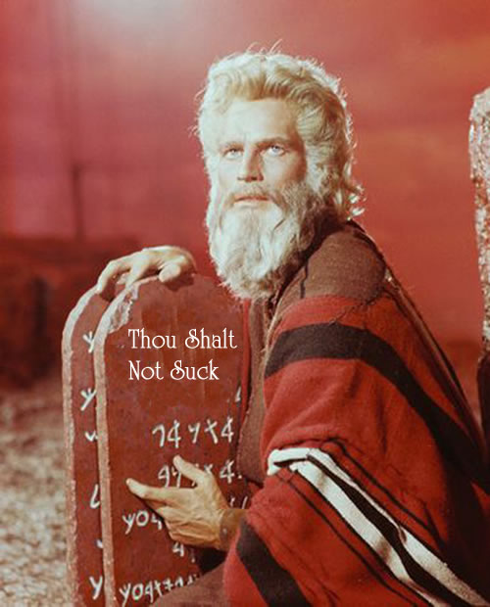
Only the pure of heart, and the Green of Test, shall enter…
Notes:
So why do we need tests? Tests help us stay on the path. They help keep us true to principles of good software design in the face of the various and sundry temptresses that lean on us every day to do things a little bit lazier

Slide 9

VDD
TDD
Notes:
In other words, tests are like little angels sitting on our shoulder, whispering in our ear, encouraging us to write better code. Tests do not “drive” anything. Behaviors and requirements and helping users kick ass drives us. Tests are but one of the many armies we marshal in that crusade

Slide 10
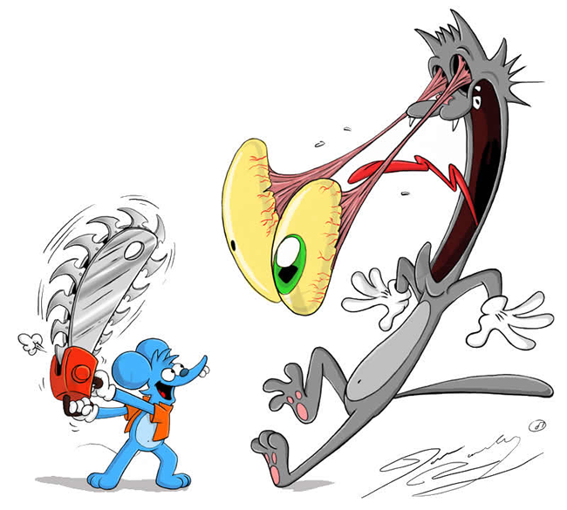
Let’s Build some Instincts!
Notes:
Getting better at designing code that is easier to test starts with developing instincts for the patterns of “ick” that make testing difficult. So we’re going to look at archetypal examples of stuff that makes testing hard
These are all just dependencies of some variety

Slide 11
A look at hard-to-test code

Slide 12

The things you can’t control
Make testing hard
“Wave Slides” are the new bullet point

Slide 13
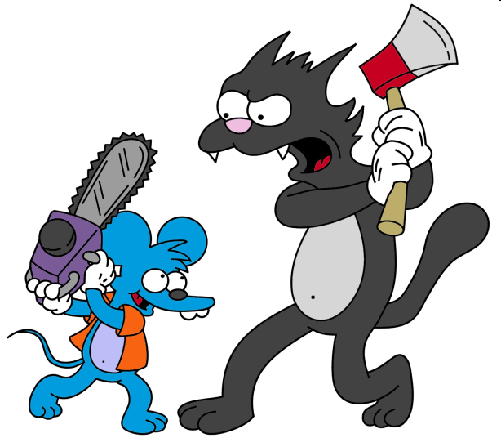
To Control… Refactor
Notes:
You refactor to cordon off the uncontrollable stuff into its own little place, thus enabling you to control it through mocks and other such devices

Slide 14
Let’s Refactor!

Slide 15
If you can EXTRACT it
….
</cfloop>
<cfset sendNotifications(deletedFiles=results.deletedfiles,….)>
<cfreturn results> ….
  ….
  </cftry>
</cfloop>
<cfmail from="directorycleaner@myco.com" to="#emailRecipients#" ….>
<p>#ArrayLen(results.deletedFiles)#files deleted.</p>
these errors were encountered:
<cfdump var="#results.errors#">
</cfmail>
<cfreturn results>…..

Slide 16
If you can ABSTRACT it
<cffunction name="deleteFile" …>
<cfargument name="fileToDelete“ …>
<cffile action="delete" file="#fileToDelete#">
</cffunction>

Slide 17
If you can INJECT it
<cffunction name="setFileSystemUtility">
<cfargument name="FileSystemUtility">
<cfset variables.fsu = arguments.FileSystemUtility>
</cffunction>

Slide 18

Can Control It
YOU

Slide 19

Thanks!
http://www.mxunit.org
Marc Esher
@marcesher on Twitter
Test
Be Happy

Slide 20
Photo Credits
http://obamicon.me
http://mathcentral.uregina.ca/beyond/articles/Art/relativity.jpg
http://fc67.deviantart.com/fs20/f/2007/260/0/8/The_Itchy_and_Scratchy_Show_by_Morpheus306.jpg
http://oneparticularwave.files.wordpress.com/2006/11/escher.gif
http://i8.photobucket.com/albums/a7/gclubaton/Breadcrumbs/Parting-of-The-Red-Sea-web.jpg
http://wallpapers.free-review.net/wallpapers/42/Big_wave.jpg
http://michaelscomments.files.wordpress.com/2006/04/CharltonHestonTheTenCommandmentsC101021021.jpg
http://img.vayatele.com/itchy_y_scratchy.gif
http://obamicon.me
http://mathcentral.uregina.ca/beyond/articles/Art/relativity.jpg
http://fc67.deviantart.com/fs20/f/2007/260/0/8/The_Itchy_and_Scratchy_Show_by_Morpheus306.jpg
http://i8.photobucket.com/albums/a7/gclubaton/Breadcrumbs/Parting-of-The-Red-Sea-web.jpg
http://wallpapers.free-review.net/wallpapers/42/Big_wave.jpg
http://michaelscomments.files.wordpress.com/2006/04/CharltonHestonTheTenCommandmentsC101021021.jpg
http://img.vayatele.com/itchy_y_scratchy.gif

Slide 21
The thing you print
Dependencies make testing hard
Undesired behaviors make testing hard
Unpredictable / uncontrollable state makes testing hard
The more things a function does, the harder it is to adequately test
If you can:
Easily control state at test time
Easily control dependencies at test time
“neuter” undesirable behavior at test time
Control the uncontrollable at test time
Reduce the # of things a function does
Then Testing becomes Easy

Slide 22
How?
Isolate the behaviors that create state from the behaviors that act on state
Provide for state and state providers to be passed in rather than created internally (i.e. dependency injection)
Abstract uncontrollable state like Time into separate functions instead of using them directly

Slide 23
When you do all of this in isolation, you can mock the isolated state and behaviors at test time
You can create your desired state at will by creating private functions in your unit tests
You then override your real functions with these test-time stand-ins using MXUnit’s injectMethod() or or with the functions provided by mocking frameworks

Slide 24
To design for easy testability, think…
What about the behavior I need to test will make testing more difficult?
  What state will I require as inputs?
  What will change as a result of this method’s behavior?
  How will I assess the change?
  Could I run this component’s functions in relative isolation, or does it require access to external scopes like application, session, request, form, url, etc?
  What different scenarios will I have to create as a result of all the conditionals in my function?
This leads you to:
  Isolate the state or allow state providers to be injected
  To the degree possible, provide outputs or other means of assessing what changed
  Reduce complexity in a function to make it easier to contend with conditionals

Slide 25
By thinking this way
Functions tend to do fewer things
  You start to write really small, single-responsibility functions
The smaller functions become, the more potential for reuse they incur
The more reusable functions become, the more they can be pulled out of their original component and into libraries that can be used in other applications
Thus, by thinking about how to make things easier to test, you help achieve the promises of Object-Oriented design

