Slide 1
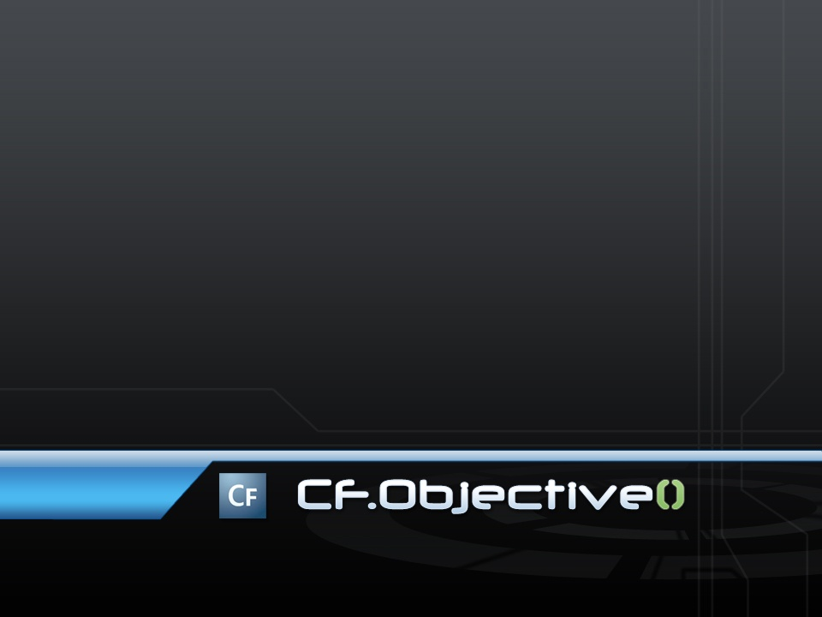
Writing Testable Code:
Real-World TDD
Easy-To-Test
VDD
Marc Esher
http://www.mxunit.org

Slide 2
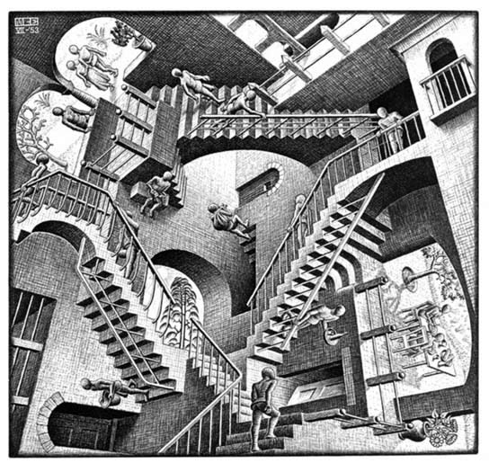
Am I in the Right Room?
Notes:
Beginning of a series of quick slides for “If this talk doesn’t sound like it’s for you, it’s A-OK to leave”.

Slide 3
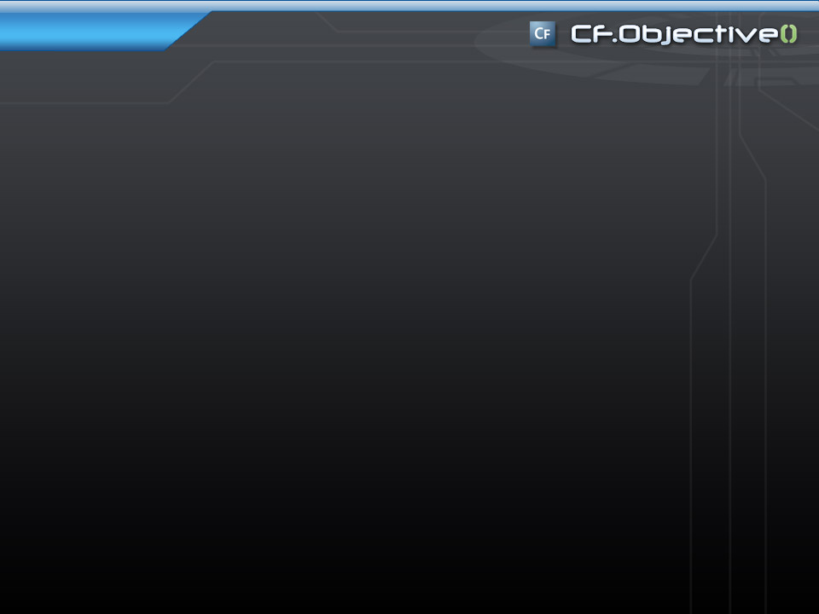
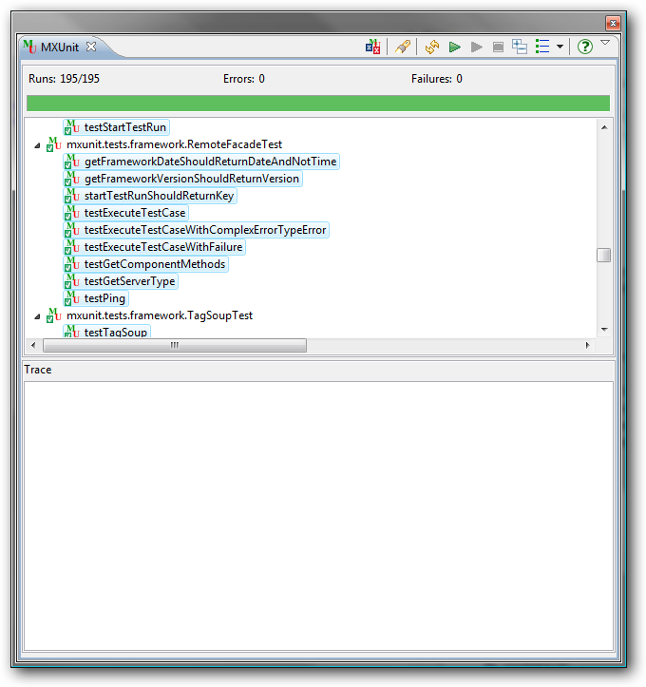
Stay here if
You want to
Write code that is
Easier To Test
Notes:
This really is the whole point of the session.

Slide 4
<cfcomponent extends=“InTheRightRoomIf">
  <cffunction name="whyElse">
    <cfset YOU = createObject("component",
    "CFObjectiveAttendee")
    .wantTo()
    .writeBetter_ObjectOriented_Code()>
  </cffunction>
</cfcomponent>
Notes:
Testable code and the principles of OO go hand in hand

Slide 5
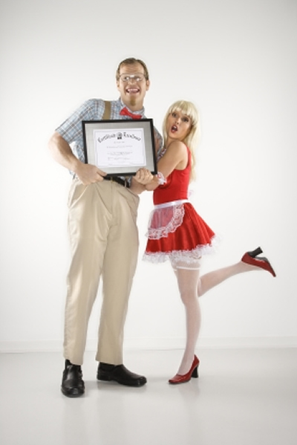
Real Men…
…don’t write
1000-line functions
Notes:
You want to write code that manifests your values, or the principles of good object oriented design

Slide 6

And Especially If
You have:
  Piles O’ Cash
  Cases of Chimay
  Bottles of Dalwhinnie
  Boxes of Cohibas
To give to a:
  Short, Bald
  CF & Java Programmer
  Who’s been coding for a while,
  Writing and Researching Testing for a while,
  Contributing to a CF Test framework,
  Slaving away for the man in a cube farm just tryin’ to get by in this cold hard world
Notes:
This is essentially the About The Speaker slide. It’s a funny transition to lighten the mood, because I want them to participate in the next slide.

Slide 7

I’m the
Good Code Pixie!
Notes:
When you leave this world, you’re going to leave a legacy. Much of it will be personal. Some will be professional. Some will be represented in the code you’ve left behind. We’re all here because we write code. Some of us are farther along in our journey than others. And that’s a beautiful thing because all of us here have different contexts and vantage points, different experiences. So let’s do some crowd sourcing (cuz that’s so web 2.0).
Let’s make a list of what it is that we value in the code we write.
In other words, when people say “that’s good code”, what do they mean?

Slide 8

And yet…
…We stray
Notes:
It just so happens that the oppose of the values we came up with is precisely what makes testing difficult.
Let me repeat that: When you write code that doesn’t reflect these values of good software design, the code is probably hard to test
When you write code that manifests these values, it’s probably easy to test.
THUS: there’s an inherent link between quality code and easy testability

Slide 9

VDD
TDD
Notes:
I have to give a 2-3 minute talk on what my title slide “VDD” means. This is a short discourse on why I don’t like the phrase “Test-Driven Development” and why, for the remainder of the talk, I’ll be talking about “Values Driven Development”. It’s not an official phrase or a new movement. It’s simply a way to frame the conversation so that we don’t think of testing as the master – it’s not – but instead see it as a guide, a helper to assist us in staying true to our code values.

Slide 10
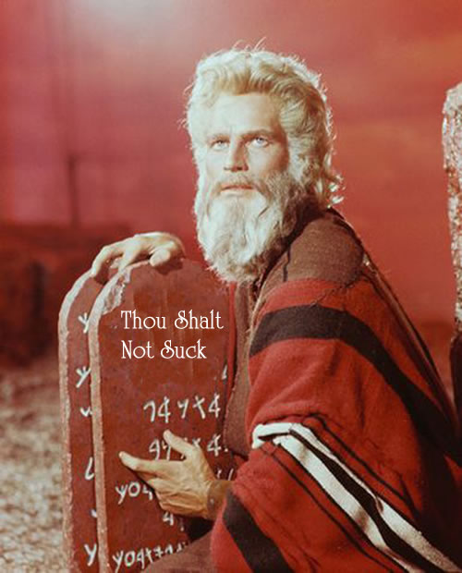
Only the pure of heart, and the Green of Test, shall enter…
Notes:
So why do we need tests? Tests help us stay on the path. They help keep us true to principles of good software design in the face of the various and sundry temptresses that lean on us every day to do things a little bit lazier

Slide 11
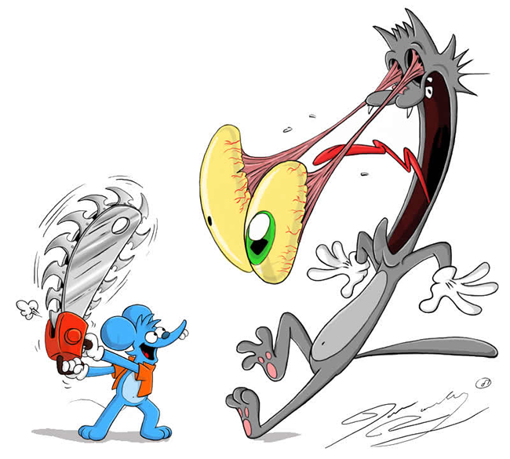
Let’s Build some Instincts!

Slide 12
A look at hard-to-test code

Slide 13
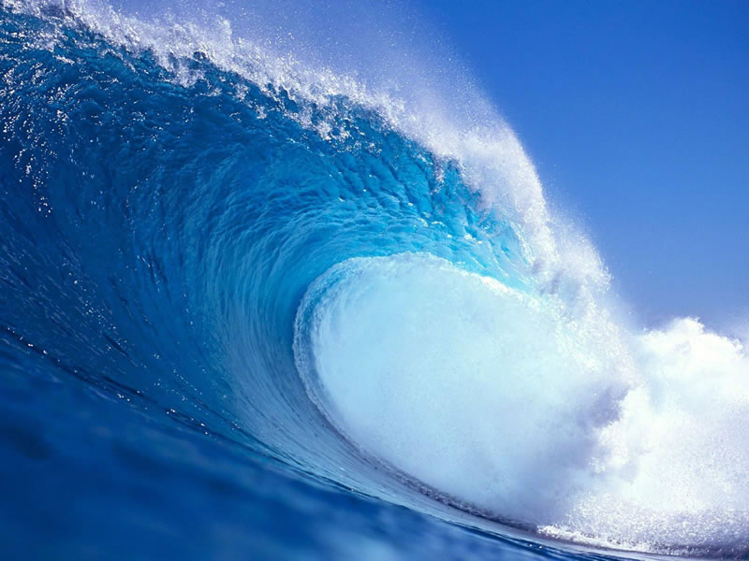
The things you can’t control
Make testing hard

Slide 14
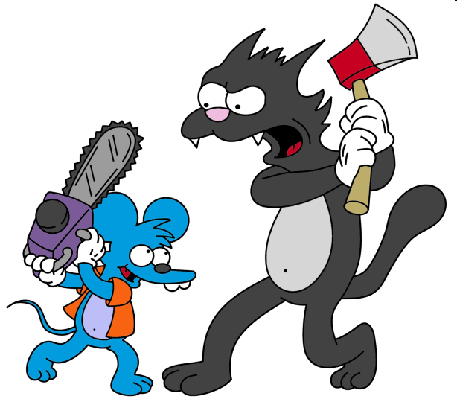
To Control… Refactor

Slide 15
Let’s Refactor!

Slide 16
If you can EXTRACT it
….
</cfloop>
<cfset sendNotifications(deletedFiles=results.deletedfiles,….)>
<cfreturn results> ….
  ….
  </cftry>
</cfloop>
<cfmail from="directorycleaner@myco.com" to="#emailRecipients#" ….>
<p>#ArrayLen(results.deletedFiles)#files deleted.</p>
these errors were encountered:
<cfdump var="#results.errors#">
</cfmail>
<cfreturn results>…..

Slide 17
If you can ABSTRACT it
<cffunction name="deleteFile" …>
<cfargument name="fileToDelete“ …>
<cffile action="delete" file="#fileToDelete#">
</cffunction>

Slide 18
If you can INJECT it
<cffunction name="setFileSystemUtility">
<cfargument name="FileSystemUtility">
<cfset variables.fsu = arguments.FileSystemUtility>
</cffunction>

Slide 19
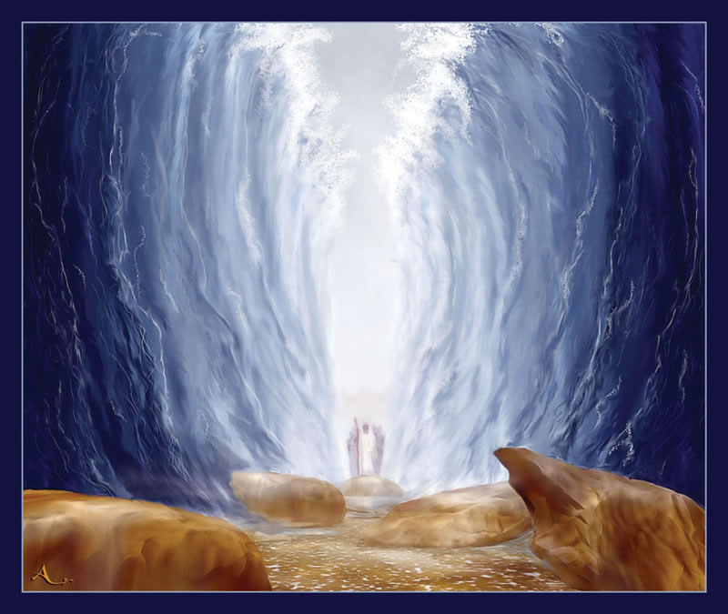
Can Control It
YOU

Slide 20
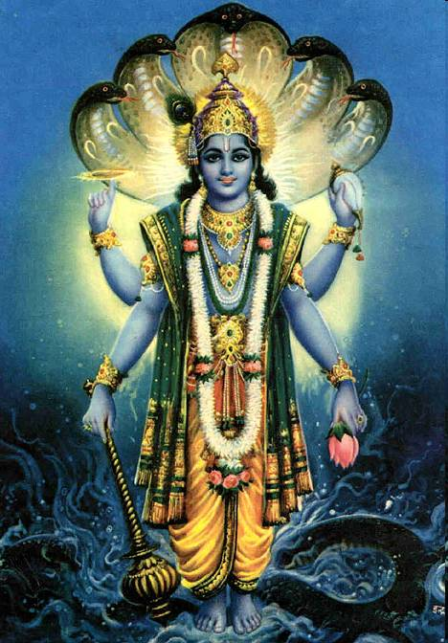
Thanks!
http://www.mxunit.org
Marc Esher
@marcesher on Twitter
Test
Be Happy

Slide 21
Photo Credits
http://obamicon.me
http://mathcentral.uregina.ca/beyond/articles/Art/relativity.jpg
http://fc67.deviantart.com/fs20/f/2007/260/0/8/The_Itchy_and_Scratchy_Show_by_Morpheus306.jpg
http://oneparticularwave.files.wordpress.com/2006/11/escher.gif
http://i8.photobucket.com/albums/a7/gclubaton/Breadcrumbs/Parting-of-The-Red-Sea-web.jpg
http://wallpapers.free-review.net/wallpapers/42/Big_wave.jpg
http://michaelscomments.files.wordpress.com/2006/04/CharltonHestonTheTenCommandmentsC101021021.jpg
http://img.vayatele.com/itchy_y_scratchy.gif
http://obamicon.me
http://mathcentral.uregina.ca/beyond/articles/Art/relativity.jpg
http://fc67.deviantart.com/fs20/f/2007/260/0/8/The_Itchy_and_Scratchy_Show_by_Morpheus306.jpg
http://i8.photobucket.com/albums/a7/gclubaton/Breadcrumbs/Parting-of-The-Red-Sea-web.jpg
http://wallpapers.free-review.net/wallpapers/42/Big_wave.jpg
http://michaelscomments.files.wordpress.com/2006/04/CharltonHestonTheTenCommandmentsC101021021.jpg
http://img.vayatele.com/itchy_y_scratchy.gif

