Slide 1
ORM Zen
Marc Esher
cf.Objective() 2011
http://bit.ly/cformzen

Slide 2
Announcements
Get this presentation at http://bit.ly/cformzen
There’s a short Appendix at the end
SQL Logging
ORMReload
Lots of links at the end, too
This is NOT an Intro to ORM presentation

Slide 3

http://www.flickr.com/photos/50235987@N00/3386446442

Slide 4

http://www.visualparadox.com/wallpapers/zen.htm

Slide 5

I’m an ORM King! Eaassssyyy!

Slide 6

http://severity1.wordpress.com/2009/11/01/my-first-zen-wallpaper/strength_zen_naturallaw-2/
OKOKOK… W. T. F.?

Slide 7
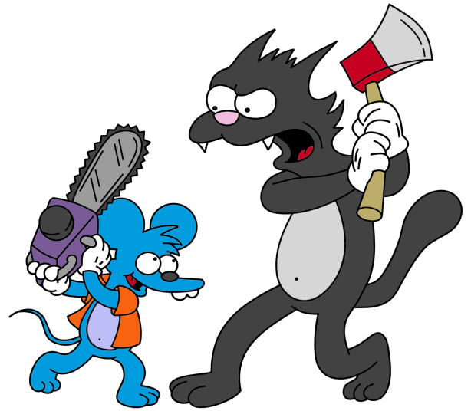
ME
ORM
http://simpsons.wikia.com/wiki/The_Itchy_%26_Scratchy_Show

Slide 8
Say Hello to my Leetle Friends
“Why won’t you delete?”
“Why won’t you save?”
“Why DID you save?”
“Why did you delete 800 records… … and then insert 801?”
“Why did you insert into MyTable … And then update MyTable ?”

Slide 9
And their less-attractive cousins…
“object references an unsaved transient instance - save the transient instance before flushing”
“Cannot insert null into <SomePrimaryKey>…”
“java.util.ConcurrentModificationException”
“failed to lazily initialize a collection of role: xxx, no session or session was closed ”
“a different object with the same identifier value was already associated with the session”

Slide 10

ORM
(In Marc’s “ORM is the Devil” mindset)
http://www.akomic.net/mechanical.html

Slide 11
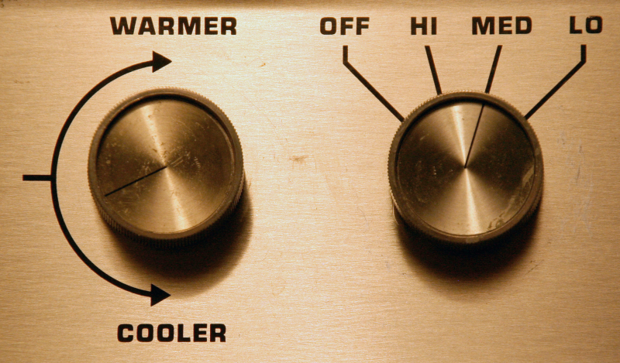
http://just-a-blip.blogspot.com/2009/07/modern-bed-warmer.html

Slide 12
This is my story
From Suffering

Slide 13
This is my story
From Suffering
Toward
Enlightenment

Slide 14
Enlightenment, In One Slide
Don’t let CF auto-flush the Hibernate session
always use transactions
Use one-to-many sparingly; I try to use them only when I need to save relationships through them
Inverse=true is essential on bi-di relationships
Not setting “cascade” on one-to-many relationships will cause collection members not to save or delete
Deleting from one-to-many is simply not simple
“linktable” is rarely useful… often you need a “join entity”
Don’t store ORM objects in the session scope. Ever.

Slide 15
Agenda
ORM Settings -- Control the Session Flush
Many-to-One Relationships
One-to-Many Intro: Bidirectional relationships
One-to-Many: Adding to Collections
One-to-Many: inverse and “relationship owner”
One-to-Many: Deleting from Collections
Hibernate Session and the ColdFusion Session scope

Slide 16
Introducing, Our App
Demo Time – Let’s meet
The Application’s Concept
Our Database Tables
Our Components
Our “workflow”

Slide 17
The Application’s Concept
An ‘Event Registration' system
‘Administrator' Can create and modify events
Create and modify attendees
Attendees can "register" for Events
Eventually Attendees will be able to comment on Events

Slide 18
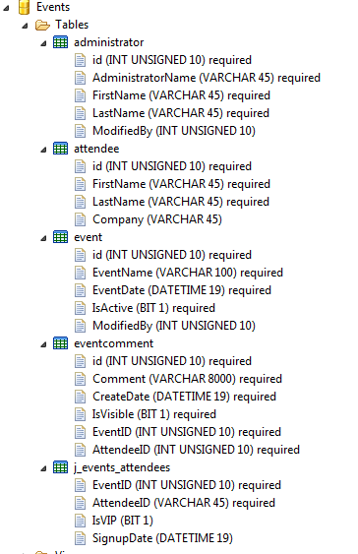

Slide 19
Intro Demo
Show The Intro Code

Slide 20
Agenda
ORM Settings -- Control the Session Flush
Many-to-One Relationships
One-to-Many Intro: Bidirectional relationships
One-to-Many: Adding to Collections
One-to-Many: inverse and “relationship owner”
One-to-Many: Deleting from Collections
Hibernate Session and the ColdFusion Session scope

Slide 21
Suffering – The Early Days
Why are objects updating even when I don’t call entitySave()?

Slide 22
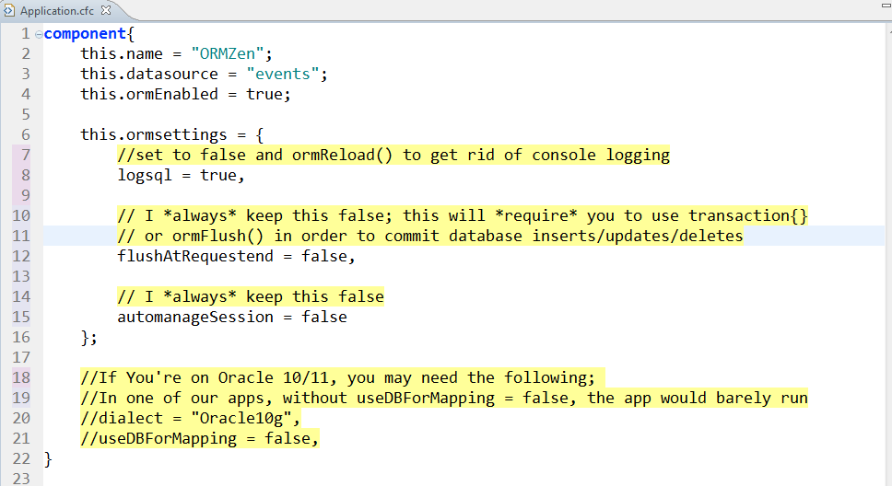
Essential ORM Settings
*Many props to Dan Vega for useDBForMapping = false tip

Slide 23
Essential ORM Settings: Session Control
autoManageSession = false
flushAtRequestEnd = false
This means that you have to wrap entitySave() and entityDelete() in transactions
or use ormFlush()
(Some would say you should wrap ALL state mutation in a transaction)

Slide 24
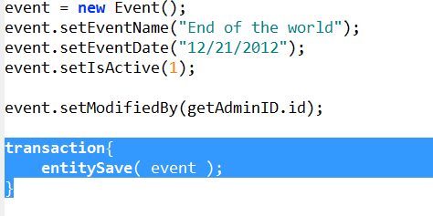
ORM Essentials: Wrap in Transaction

Slide 25
Early Enlightenment
Why are objects updating even when I don’t call entitySave()?
this.ormSettings.autoManageSession = false
this.ormSettings.flushAtRequestEnd = false
Wrap entitySave() and entityDelete() in transaction{} to control the session flush

Slide 26
Agenda
ORM Settings -- Control the Session Flush
Many-to-One Relationships
One-to-Many Intro: Bidirectional relationships
One-to-Many: Adding to Collections
One-to-Many: inverse and “relationship owner”
One-to-Many: Deleting from Collections
Hibernate Session and the ColdFusion Session scope

Slide 27
Suffering
What does “The value for property java.lang.String cannot be retrieved from object of type id” mean?
How do I unset a many-to-one relationship?
CFDump just got reaaal slow. Why?
Happens when a many-to-one object has, itself, a big one-to-many relationship
How do I entityLoad() and filter on a property when that property is now an object?

Slide 28
Many-to-One
The Simplest Relationship
This is your typical Foreign Key Relationship
E.g. Event has a “ModifiedBy” column, which is a relationship with the “Administrator” table’s “id”
Think: “MANY events can have ONE current modifiedBy”
Three Knobs
fieldtype = “many-to-one”
fkcolumn = Column Name in THIS Table
cfc = CFC Name Of Related Entity

Slide 29
Many-to-One Demo
Demo

Slide 30
Many-to-One
many-to-one: Many Events can have this one Administrator;
many-to-one properties are ALWAYS a single object, not a collection.
“The value for property java.lang.String cannot be retrieved from object of type id. Expected object type is XXX.”
often indicates you have a many-to-one property but are setting a simple value into that property

Slide 31
Enlightenment
What does “The value for property java.lang.String cannot be retrieved from object of type id” mean?
You probably changed a simple property to a many-to-one but didn’t update the code that calls the setters
You’re setting a simple value when it expects an object
How do I unset a many-to-one value?
setMyM2OProperty( javacast(“null”, “”) );

Slide 32
Enlightenment
CFDump just got reaaal slow. Why?
ALWAYS use “top” when cfdumping an ORM object
writeDump(var=object, top=“3”);
In MXUnit tests:
debug(var=object, top=“3”);
How do I entityLoad() and filter on a property when that property is now an object?
You must pass that object as the filter criteria

Slide 33
Agenda
ORM Settings -- Control the Session Flush
Many-to-One Relationships
One-to-Many Intro: Bidirectional relationships
One-to-Many: Adding to Collections
One-to-Many: inverse and “relationship owner”
One-to-Many: Deleting from Collections
Hibernate Session and the ColdFusion Session scope

Slide 34
Suffering: one-to-many Gluttony
I’m gonna have properties for every relationship I can think of and never write SQL Again!
If( arrayLen(myOneToMany) GT 0 )
Why is this so slow?

Slide 35
Bidirectional Relationships
Bi-di --- “many-to-one” on one side, and “one-to-many” on the other
Database schemas have no concept of uni-di; bi-di only
Express bi-di with SQL (often with joins)
“ select * from event where ModifiedBy = ? ”
Think: “this ONE Administrator will have MANY modified events”
Four Knobs:
fieldtype = “one-to-many”
fkcolumn = Foreign key column in the RELATED object’s table for this property
cfc = CFC Name of the related entity
singularName = how to refer to single members of this collection
And one devil knob named ‘inverse’ to be discussed later

Slide 36
One-to-Many Demo
Demo simple one-to-many property

Slide 37
Enlightenment: Bidirectional is…
Sometimes very useful
Usually in the context of JOIN tables
E.g. linking an Attendee to Events
When you DO need them… more knobs!
Sometimes not useful and a cause of performance problems on the one-to-many side
Do you really need a property of “Adminstered Events”?
Red Flag: properties that simply take the place of “select * from some table where id = :myid”

Slide 38
Agenda
ORM Settings -- Control the Session Flush
Many-to-One Relationships
One-to-Many Intro: Bidirectional relationships
One-to-Many: Adding to Collections
One-to-Many: inverse and “relationship owner”
One-to-Many: Deleting from Collections
Hibernate Session and the ColdFusion Session scope

Slide 39
Suffering
When I add an object to a one-to-many collection, it won’t save
When I delete an object from a one-to-many collection, I get “null” errors
My join table (linktable) has more data than just two Foreign Keys… can I still use “linktable”?

Slide 40
Demo: Whither cascade?
Demo one-to-many saves with and without cascade

Slide 41
Enlightenment: Cascade and linktable
When I add an object to a one-to-many collection, it won’t save
Need cascade=“all” on the one-to-many property
When I delete an object from a one-to-many collection, I get “null” errors
Need cascade=“all-delete-orphan” on the one-to-many property
My join table (linktable) has more data than just two Foreign Keys… can I still use “linktable”?
Nope. Need a “Join Entity” which comprises both of the Foreign Key entities plus the additional data you wish to store
Then, you simply one-to-many on that Join Entity
Your “Join Entity” will comprise TWO many-to-one relationships

Slide 42
Agenda
ORM Settings -- Control the Session Flush
Many-to-One Relationships
One-to-Many Intro: Bidirectional relationships
One-to-Many: Adding to Collections
One-to-Many: inverse and “relationship owner”
One-to-Many: Deleting from Collections
Hibernate Session and the ColdFusion Session scope

Slide 43
Suffering
When I call object1.addObject2( object2 ), I see a SELECT, then an INSERT, then an UPDATE
When I call object1.removeObject2( object2 ), I get “Cannot insert NULL into XXX”

Slide 44
Demo: The Devil Knob
There oughtta be a support group for sufferers of this knob

Slide 45
Enlightenment: inverse=true
In bi-di relationships
You need inverse=true
Always
No Exceptions
It means, “the object on the other side is the relationship owner”

Slide 46
Agenda
ORM Settings -- Control the Session Flush
Many-to-One Relationships
One-to-Many Intro: Bidirectional relationships
One-to-Many: Adding to Collections
One-to-Many: inverse and “relationship owner”
One-to-Many: Deleting from Collections
Hibernate Session and the ColdFusion Session scope

Slide 47
Suffering
If I loop over a collection and try to remove elements from that collection, I get “ConcurrentModificationException”

Slide 48
Demo: Deleting from a Collection
This is not an ORM error… it’s just an error

Slide 49
Enlightenment: Deleting from a Collection
Don’t use for( item in Array ) syntax when deleting
Use plain old index loops
If you use entityDelete() on a collection item and get “entity would be resaved…”, you must also remove that item from the collection via removeXXX(XXX) or arrayDeleteAt(…)

Slide 50
Agenda
ORM Settings -- Control the Session Flush
Many-to-One Relationships
One-to-Many Intro: Bidirectional relationships
One-to-Many: Adding to Collections
One-to-Many: inverse and “relationship owner”
One-to-Many: Deleting from Collections
Hibernate Session and the ColdFusion Session scope

Slide 51
Suffering
When I store my user object in the session, and then change it and entitySave(), I get weirdo Hibernate errors

Slide 52
Enlightenment: Persistent objects and CF Session Scope
Just don’t do it (How’s that for Zen!)
Store simple values (userID) in session scope, then entityLoadByPK(“User”, session.userID) when you need that object
The second you type “EntityMerge()”, you’re travelling down the trail of suffering

Slide 53
Thanks to my teachers
I learned most of this stuff from
Bob Silverberg
Brian Kotek
Joe Rinehart
Mark Mandel
Barney Boisvert
Dan Vega
32 bottles of Dalwhinnie 15 year Scotch
Hours upon hours of suffering

Slide 54

Thanks to you!
Marc Esher
@marcesher on Twitter
Test
Be Happy

Slide 55
Resources
http://www.barneyb.com/barneyblog/category/orm/ -- transactions, inverse, one-to-many, domain model integrity, etc
http://www.silverwareconsulting.com/index.cfm/CF-ORM-Integration -- every darn thing
http://www.compoundtheory.com/?action=displayPost&ID=419 – Hibernate Sessions and Object State
http://www.briankotek.com/blog/index.cfm/ObjectRelational-Mapping -- Bidi relationships, HQL
http://www.mkyong.com/hibernate/inverse-true-example-and-explanation/ -- inverse=“true” and “relationship owner”
http://www.aliaspooryorik.com/blog/index.cfm/category/hibernate-25 -- lots of useful tips on HQL, collections, logging, nested-set model, etc.

Slide 56
Appendix
SQL Logging
ORMReload()

Slide 57
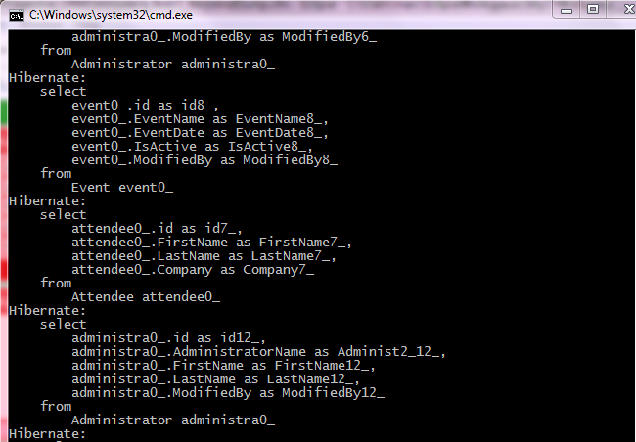
Essential ORM Settings: Logging
logSQL = true

Slide 58
Viewing SQL logging in Tail View
This works in ColdFusion Builder or CFEclipse with the Adobe 8.0.1 Extensions
Add the xxxxx-out.log file to the tail view
Rejoice

Slide 59
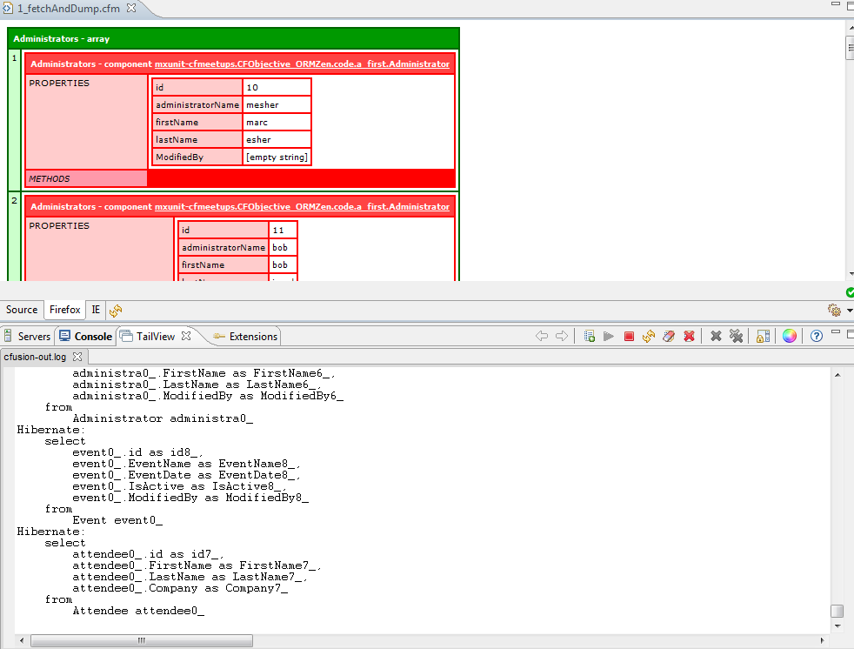
Viewing SQL logging in Tail View

Slide 60
ORM Essentials: Parameter Logging
If you *need* to see the parameters for the SQL statements, turn it on
WEB-INF/cfusion/lib/log4j.properties
Uncomment this line:
### Also log the parameter binding to the prepared statements.
#log4j.logger.org.hibernate.type=DEBUG
This will get extremely noisy, so use with care

Slide 61
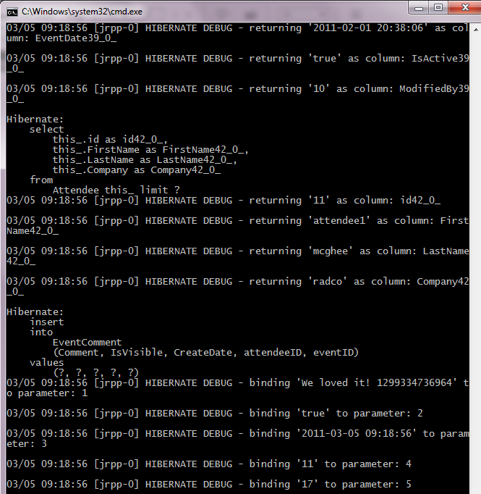

Slide 62
ORM Essentials: ormReload()
ANY changes to ORM components require ormReload()
Sometimes, ORM will lose its mind and you’ll need to restart CF (It’s not often, but don’t be surprised by it)
Usually control with a URL flag in onRequestStart()
Don’t forget them in your MXUnit tests!
Use beforeTests() for best performance

Slide 63
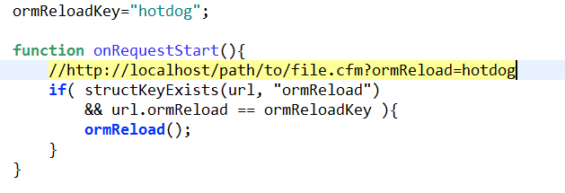
ORM Essentials: ormReload()
*For this presentation, I’ll include ormReload() at the top of each page so I don’t forget to do it

