Slide 1
ORM Zen
Marc Esher
cf.Objective() 2011
http://bit.ly/cformzen

Slide 2
Announcements
Get this presentation and all code at http://bit.ly/cformzen
There’s a short Appendix at the end
SQL Logging
ORMReload
Lots of links at the end, too

Slide 3

http://www.flickr.com/photos/50235987@N00/3386446442

Slide 4

http://www.visualparadox.com/wallpapers/zen.htm

Slide 5

I’m an ORM King! Eaassssyyy!

Slide 6
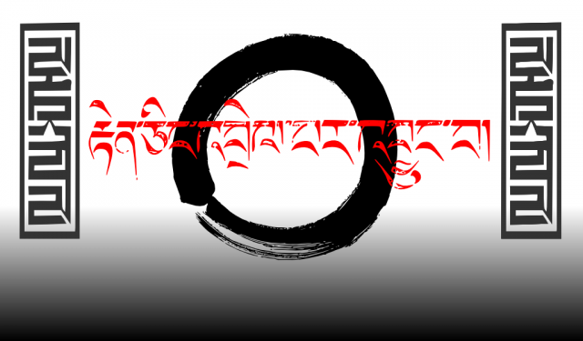
http://severity1.wordpress.com/2009/11/01/my-first-zen-wallpaper/strength_zen_naturallaw-2/
OKOKOK… W. T. F.?

Slide 7
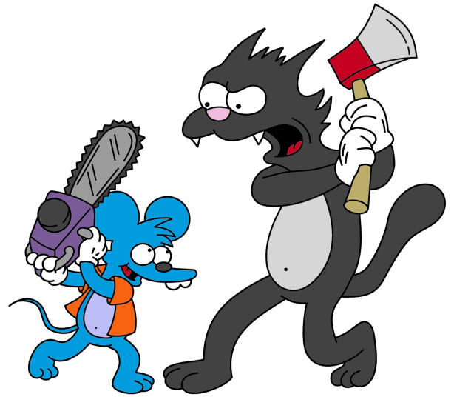
ME
ORM
http://simpsons.wikia.com/wiki/The_Itchy_%26_Scratchy_Show

Slide 8
Say Hello to my Leetle Friends
“Why won’t you save relationships?”
“Why won’t you delete relationships?”
“Why DID you save anything at all?”
“Why did you insert into MyTable … And then update MyTable ?”

Slide 9
And their less-attractive cousins…
“object references an unsaved transient instance - save the transient instance before flushing”
“Cannot insert null into <SomePrimaryKey>…”
“java.util.ConcurrentModificationException”
“failed to lazily initialize a collection of role: xxx, no session or session was closed ”
“a different object with the same identifier value was already associated with the session”

Slide 10

ORM
(In Marc’s “ORM is the Devil” mindset)
http://www.akomic.net/mechanical.html

Slide 11
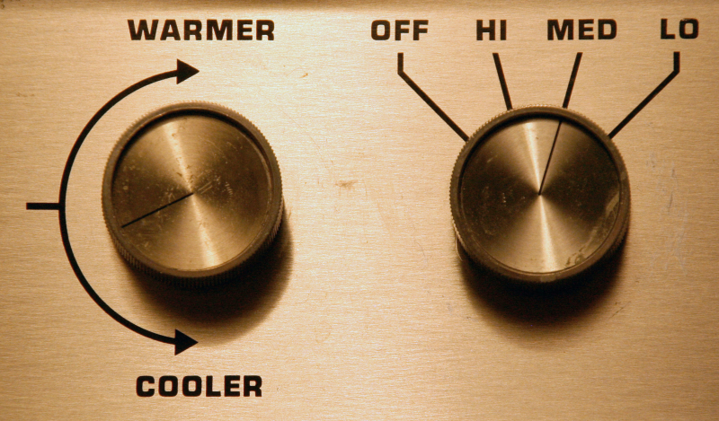
http://just-a-blip.blogspot.com/2009/07/modern-bed-warmer.html

Slide 12
This is my story
From Suffering

Slide 13
This is my story
From Suffering
Toward
Enlightenment

Slide 14
Agenda
ORM Settings -- Control the Session Flush
Many-to-One Relationships
One-to-Many Relationships
One-to-Many: inverse and “relationship owner”
One-to-Many: Adding to Collections
One-to-Many: Deleting from Collections
Hibernate Session and the ColdFusion Session scope

Slide 15
The Application’s Concept
An ‘Event Registration' system
Administrator can create and modify events
Attendees can "register" for Events
Attendees can comment on Events

Slide 16
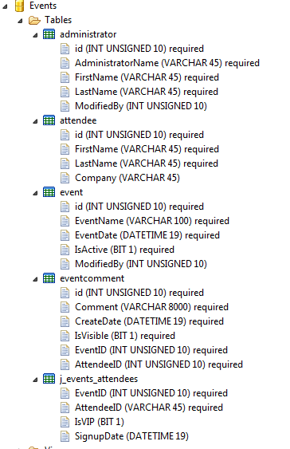

Slide 17
Agenda
ORM Settings -- Control the Session Flush
Many-to-One Relationships
One-to-Many Relationships
One-to-Many: inverse and “relationship owner”
One-to-Many: Adding to Collections
One-to-Many: Deleting from Collections
Hibernate Session and the ColdFusion Session scope

Slide 18
Suffering – The Early Days
Why are objects updating even when I don’t call entitySave()?

Slide 19
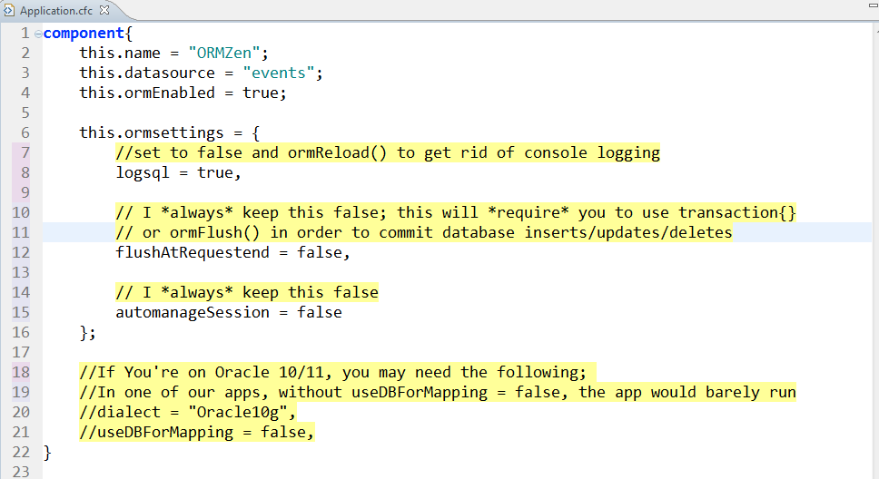
Essential ORM Settings
*Many props to Dan Vega for useDBForMapping = false tip

Slide 20
Essential ORM Settings: Session Control
autoManageSession = false
flushAtRequestEnd = false
Consequence: use transaction{}
or use ormFlush()
(Some would say you should wrap ALL state mutation in a transaction)

Slide 21
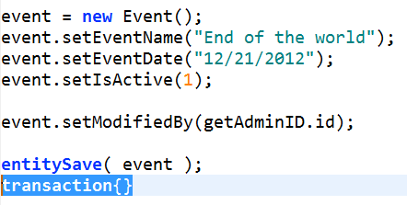
ORM Essentials: Use Transactions to flush

Slide 22
Agenda
ORM Settings -- Control the Session Flush
Many-to-One Relationships
One-to-Many Relationships
One-to-Many: inverse and “relationship owner”
One-to-Many: Adding to Collections
One-to-Many: Deleting from Collections
Hibernate Session and the ColdFusion Session scope

Slide 23
Suffering
What does “The value for property java.lang.String cannot be retrieved from object of type id” mean?
How do I unset a many-to-one relationship?
CFDump just got reaaal slow. Why?
Happens when a many-to-one object has, itself, a big one-to-many relationship
How do I entityLoad() and filter on a property when that property is now an object?

Slide 24
Many-to-One
The Simplest Relationship
This is your typical Foreign Key Relationship
E.g. Event has a “ModifiedBy” column, which is a relationship with the “Administrator” table’s “id”
Think: “MANY events can have ONE current modifiedBy”
Three Knobs
fieldtype = “many-to-one”
fkcolumn = Column Name in THIS Table
cfc = CFC Name Of Related Entity

Slide 25
Many-to-One Demo
Demo

Slide 26
Enlightenment
What does “The value for property java.lang.String cannot be retrieved from object of type id” mean?
You probably changed a simple property to a many-to-one but didn’t update the code that calls the setters
You’re setting a simple value when it expects an object
How do I unset a many-to-one value?
setMyM2OProperty( javacast(“null”, “”) );

Slide 27
Enlightenment
CFDump just got reaaal slow. Why?
ALWAYS use “top” when cfdumping an ORM object
writeDump(var=object, top=“3”);
In MXUnit tests:
debug(var=object, top=“3”);
How do I entityLoad() and filter on a property when that property is now an object?
You must pass that object as the filter criteria

Slide 28
Agenda
ORM Settings -- Control the Session Flush
Many-to-One Relationships
One-to-Many Relationships
One-to-Many: Adding to Collections
One-to-Many: inverse and “relationship owner”
One-to-Many: Deleting from Collections
Hibernate Session and the ColdFusion Session scope

Slide 29
Suffering: one-to-many Gluttony
I’m gonna have properties for every relationship I can think of and never write SQL Again!
If( arrayLen(myOneToMany) GT 0 )
Why is this so slow?
Wait… is it really doing a separate query for EVERY row? WTF?!

Slide 30
One-to-Many Relationships
Think: “this ONE Administrator will have MANY modified events”
Four Knobs:
fieldtype = “one-to-many”
fkcolumn = Foreign key column in the RELATED object’s table for this property
cfc = CFC Name of the related entity
singularName = how to refer to single members of this collection
And one devil knob named ‘inverse’ to be discussed later

Slide 31
One-to-Many Demo
Demo simple one-to-many property

Slide 32
Enlightenment: One-to-Many…
For me, most useful when saving relationships through them
E.g. linking an Attendee to Events
Discourage use for “listing things”
Do you really need a property of “Adminstered Events”?
Prefer HQL or SQL instead
Read up on the N+1 Selects problem
Learn about lazy=“extra”
Red Flag: properties that simply take the place of “select * from some table where id = :myid”

Slide 33
Agenda
ORM Settings -- Control the Session Flush
Many-to-One Relationships
One-to-Many Relationships
One-to-Many: inverse and “relationship owner”
One-to-Many: Adding to Collections
One-to-Many: Deleting from Collections
Hibernate Session and the ColdFusion Session scope

Slide 34
Suffering
When I call object1.addObject2( object2 ), I get “Object references an unsaved transient instance”
When I call object1.addObject2( object2 ), I see a SELECT, then an INSERT, then an UPDATE

Slide 35
Demo: The Devil Knob
There oughtta be a support group for sufferers of this knob

Slide 36
Enlightenment: inverse=true
Bi-Directional: many-to-one on one side, and one-to-many on the other (they link back and forth)
In bi-directional relationships
You need inverse=true
Always
No Exceptions
It means, “the object on the other side is the relationship owner”

Slide 37
Enlightenment: set Both sides
Always set both sides of the relationships
comment.setEvent( event );
event.addComment( comment );

Slide 38
Enlightenment: set Both sides
Preferably encapsulate this in One of the objects:
component name=“Event” {
function addComment( comment ){
arrayAppend( comments, comment );
event.addComment( this );
}
}

Slide 39
Agenda
ORM Settings -- Control the Session Flush
Many-to-One Relationships
One-to-Many Relationships
One-to-Many: inverse and “relationship owner”
One-to-Many: Adding to Collections
One-to-Many: Deleting from Collections
Hibernate Session and the ColdFusion Session scope

Slide 40
Suffering
When I add a new object to a one-to-many collection,
it won’t save

Slide 41
Demo: Whither cascade?
Demo one-to-many saves with and without cascade

Slide 42
Enlightenment: Cascade
When I add an object to a one-to-many collection, it won’t save the relationship
Need cascade=“all” on the one-to-many property

Slide 43
Agenda
ORM Settings -- Control the Session Flush
Many-to-One Relationships
One-to-Many Relationships
One-to-Many: inverse and “relationship owner”
One-to-Many: Adding to Collections
One-to-Many: Deleting from Collections
Hibernate Session and the ColdFusion Session scope

Slide 44
Suffering
When I delete an object from a one-to-many collection, I get “null” errors
If I loop over a collection and try to remove elements from that collection, I get “ConcurrentModificationException”

Slide 45
Demo: Deleting from a Collection
1 is an ORM error
1 is not

Slide 46
Enlightenment: Deleting from a Collection
When I delete an object from a one-to-many collection, I get “null” errors
Need cascade=“all-delete-orphan” on the one-to-many property
If you get “entity would be resaved” Errors
You need to un-set BOTH sides of the relationship

Slide 47
Enlightenment: Deleting from a Collection
Don’t use for( item in Array ) syntax when deleting
Use plain old index loops
I loop backwards!

Slide 48
Agenda
ORM Settings -- Control the Session Flush
Many-to-One Relationships
One-to-Many Relationships
One-to-Many: inverse and “relationship owner”
One-to-Many: Adding to Collections
One-to-Many: Deleting from Collections
Hibernate Session and the ColdFusion Session scope

Slide 49
Suffering
When I store my user object in the ColdFusion session scope,
and then change it and save,
I get weirdo Hibernate errors

Slide 50
Enlightenment: Persistent objects and CF Session Scope
Just don’t do it (How’s that for Zen!)
Store simple values (userID) in session scope, then entityLoadByPK(“User”, session.userID) when you need that object
The second you type “EntityMerge()”, you’re travelling down the trail of suffering

Slide 51
Enlightenment, In One Slide
Don’t let CF auto-flush the Hibernate session
always use transactions
Use one-to-many sparingly; I try to use them only when I need to save relationships through them
Not setting “cascade” on one-to-many relationships will cause collection members not to save or delete
Inverse=true is mandatory on bi-di relationships
Deleting from one-to-many is simply not simple
“linktable” is rarely useful… often you need a “join entity”
Don’t store ORM objects in the session scope. Ever.

Slide 52
Thanks to my teachers
I learned most of this stuff from
Bob Silverberg
Brian Kotek
Joe Rinehart
Mark Mandel
Barney Boisvert
Dan Vega
32 bottles of Dalwhinnie 15 year Scotch
Hours upon hours of suffering

Slide 53
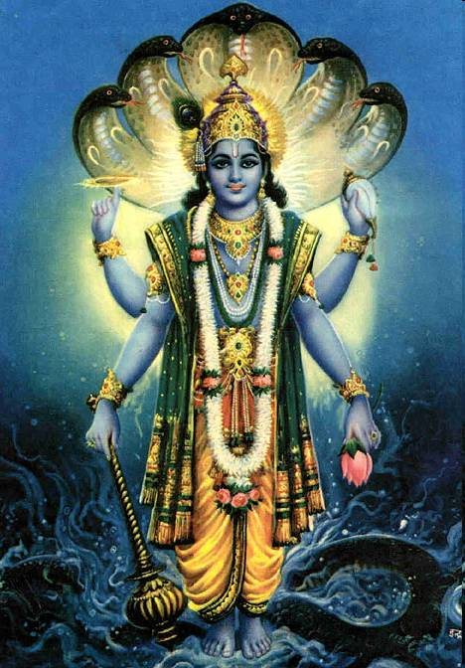
Thanks to you!
Marc Esher
@marcesher on Twitter
Test
Be Happy

Slide 54
Resources
http://www.barneyb.com/barneyblog/category/orm/ -- transactions, inverse, one-to-many, domain model integrity, etc
http://www.silverwareconsulting.com/index.cfm/CF-ORM-Integration -- every darn thing
http://www.compoundtheory.com/?action=displayPost&ID=419 – Hibernate Sessions and Object State
http://www.briankotek.com/blog/index.cfm/ObjectRelational-Mapping -- Bidi relationships, HQL
http://www.mkyong.com/hibernate/inverse-true-example-and-explanation/ -- inverse=“true” and “relationship owner”
http://www.aliaspooryorik.com/blog/index.cfm/category/hibernate-25 -- lots of useful tips on HQL, collections, logging, nested-set model, etc.

Slide 55
Appendix
SQL Logging
ORMReload()

Slide 56
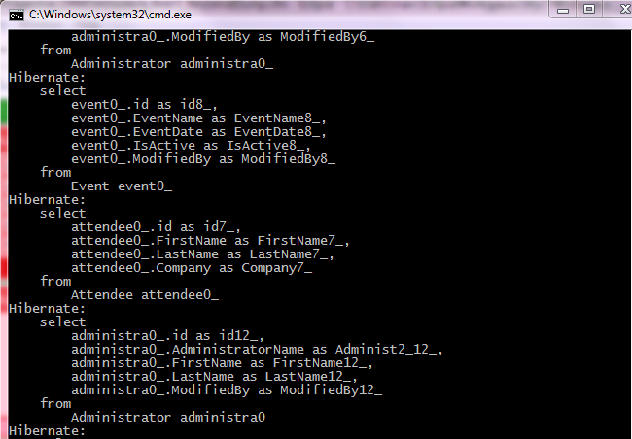
Essential ORM Settings: Logging
logSQL = true

Slide 57
Viewing SQL logging in Tail View
This works in ColdFusion Builder or CFEclipse with the Adobe 8.0.1 Extensions
Add the xxxxx-out.log file to the tail view
Rejoice

Slide 58
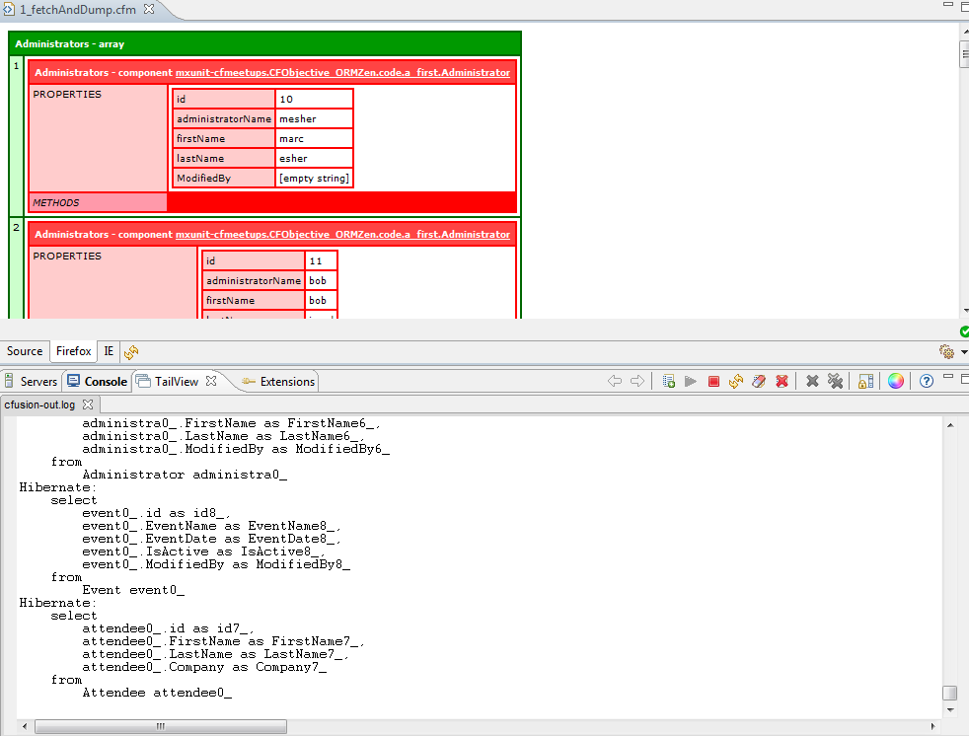
Viewing SQL logging in Tail View

Slide 59
ORM Essentials: Parameter Logging
If you *need* to see the parameters for the SQL statements, turn it on
WEB-INF/cfusion/lib/log4j.properties
Uncomment this line:
### Also log the parameter binding to the prepared statements.
#log4j.logger.org.hibernate.type=DEBUG
This will get extremely noisy, so use with care

Slide 60
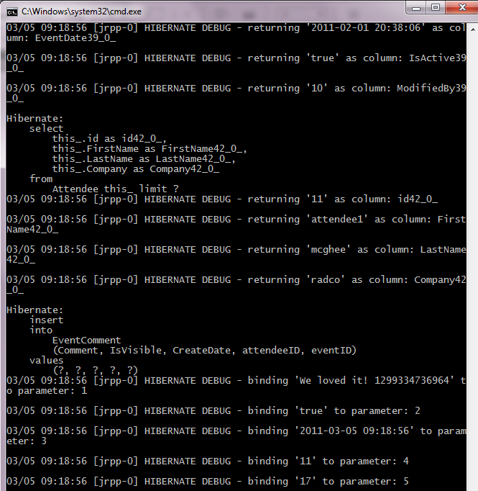

Slide 61
ORM Essentials: ormReload()
ANY changes to ORM components require ormReload()
Sometimes, ORM will lose its mind and you’ll need to restart CF (It’s not often, but don’t be surprised by it)
Usually control with a URL flag in onRequestStart()
Don’t forget them in your MXUnit tests!
Use beforeTests() for best performance

Slide 62
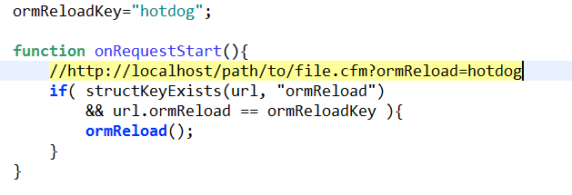
ORM Essentials: ormReload()
*For this presentation, I’ll include ormReload() at the top of each page so I don’t forget to do it

