Slide 1
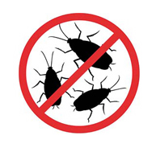
Better Living through Testing
An Introduction to Unit Testing with MXUnit
Marc Esher & Bill Shelton from MXunit.org
Notes:
Warm up. Introductions

Slide 2

About Us
Front-line CF and Java Programmers
40+ years combined experience
We built MXUnit to suit our own testing needs
http://mxunit.org
Marc, Bill, Mike, Raj, and Amir.
Bill can’t count very well.

Slide 3


What I love
My Girls
Not why I do what I do
Notes:
Quick demo run of an automated test suite. Articulate approx level of coverage

Slide 4
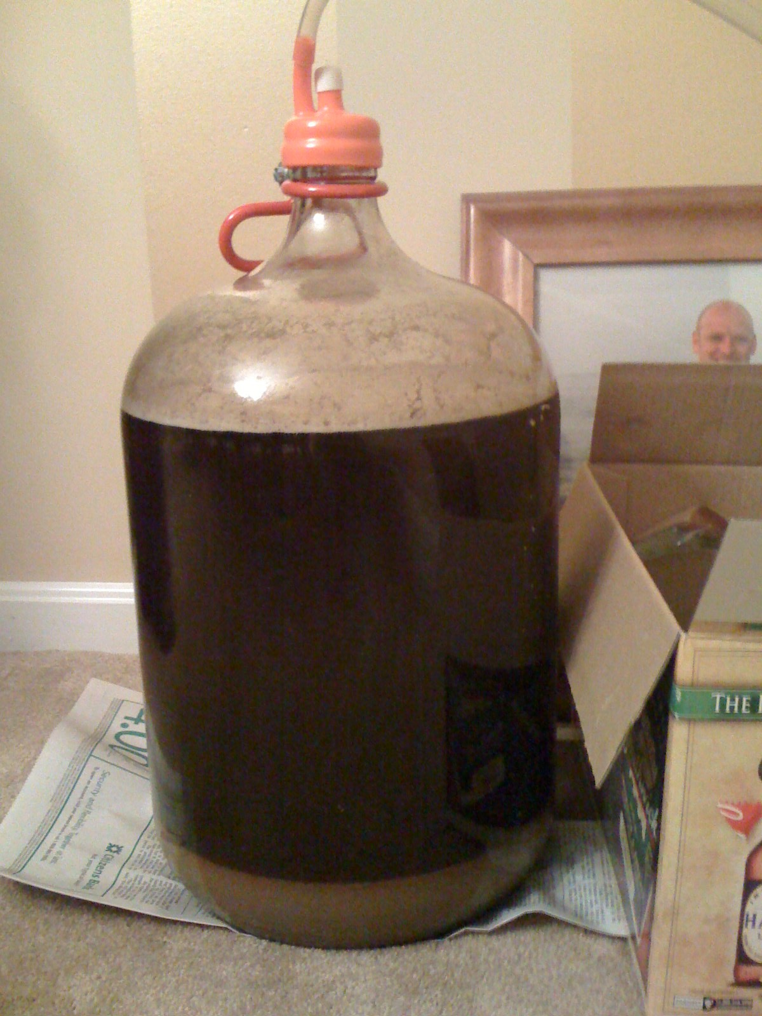
Craftsmanship
A Double IPA of my own design
Brewing is craftsmanship… just like coding

Slide 5


Team
A guy named Ken
This guy has to use my code!

Slide 6



Customers
Helping these people kick ass (or, at least, get their work done)
*Pictures shamelessly taken from the internets

Slide 7
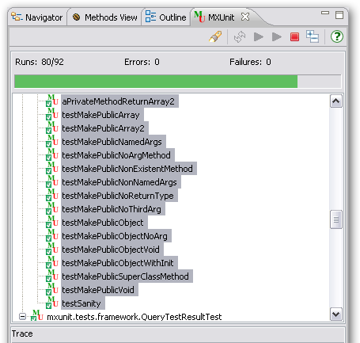
Back to Green
Green = passing tests
High “Runs” means I’m writing lots of tests

Slide 8
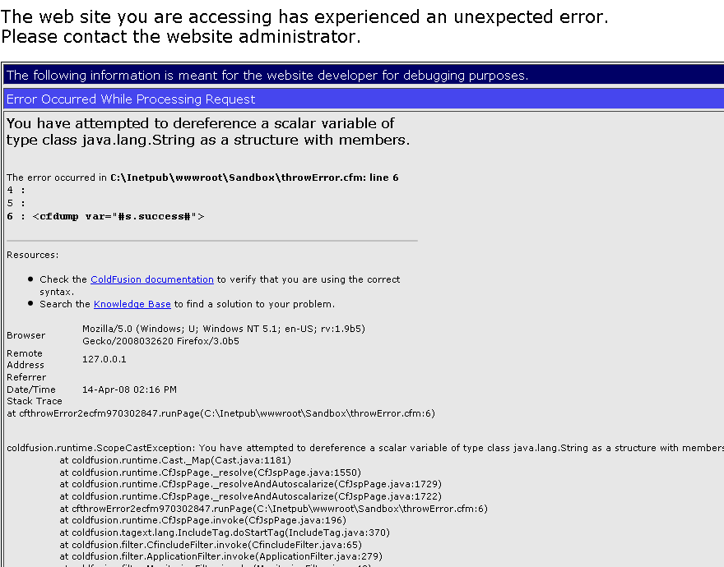
Things I don’t like
CF Error Screen

Slide 9
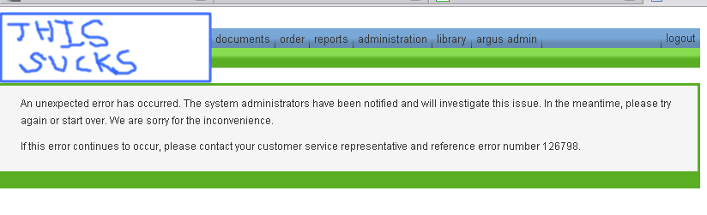
When the user sees this
“custom” error template

Slide 10

Guy, 2 seconds later
User after seeing the custom error screen
Mark Metcalf, Twisted Sister “I wanna rock” video

Slide 11
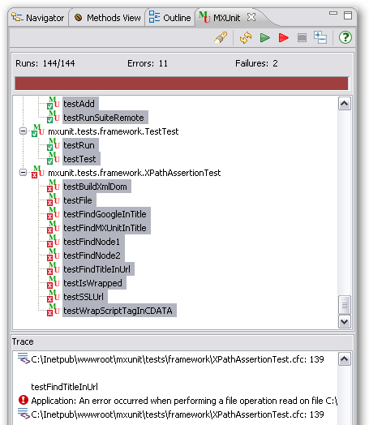
Red again
Red = failing tests
But at least I know what to fix!

Slide 12
Code Time!
If you had to guess, what’s the name of the CFC we’re testing?
What does that CFC do?
What are some of the validation rules?
Would “password” pass?
What about “PasswOrd1!”?
Would “?” pass? Why don’t you know?

Slide 13
Big Code Question
How does PasswordValidator do what it does?

Slide 14
Back to your corner
We read no docs
Looked at no API; no component explorer
Didn’t open PasswordValidator.cfc
You can prove, ad infinitum, “?” will fail, and if it stops failing, you know right away
Easy-to-test components are also often Easy to Use!

Slide 15
Jive Turkey (Lingo matters)
TestSuite = collection of TestCases
TestCase = collection of tests
Test = collection of Assertions
Assertion = demonstrate expected behavior

Slide 16
More Jive
setUp = special function that runs before each test
  Useful for initializing objects and other “shared” data
tearDown = special function that runs after each test
  Useful for deleting rows from databases, cleaning up file system resources
Repeat after me: these run with every test, not every TestCase!

Slide 17
To Shiv or Shank? (Names matter)
Most unit test frameworks:
  1) TestCases = SomethingTest.cfc or TestSomething.cfc
  2) testSomeBehavior()
MXUnit does not honor #2; any public function is seen as a test.
If you don’t want MXUnit to run a function as a test, make it private or package

Slide 18
How You Test
F5; cfabort; cfdump
tst_XXX.cfm (rock stars)

Slide 19
Unit Test Frameworks
Provide assertions
  assertTrue(), assertEquals(), etc
Provide means to run tests
  Browser, eclipse(?), Flex app
Provide means of grouping tests (TestSuite)
Usually some means of automating with ANT

Slide 20
MXUnit (nkotb)
Function-at-a-time testing
Able to see your output (cfdump, cfoutput)
See your CFCatch dumps
Eclipse plugin with integrated help
ANT and JUnitReport integration
Assertion Plugins
Actively maintained and supported
Growing user base
Get it at http://mxunit.org (the plugin, too)

Slide 21
Writing tests (6 simple rules)
SomethingTest.cfc
Extends mxunit.framework.TestCase
Keep tests short
Only a few assertions per test
Error or failed assertion stops the test
Use setUp and tearDown for common start/end stuff

Slide 22
Running Tests
Run CFC directly in browser
  http://localhost/mytest.cfc?method=runtestremote
In Eclipse
In a .cfm file using DirectoryTestSuite
In a TestSuite (with runtestremote)
With ANT

Slide 23
Why I test
Less of this…

Slide 24

Why I love to test
… and More of this

Slide 25
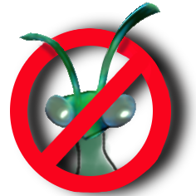
Thanks!

