Slide 1
ORM Zen
Marc Esher
cf.Objective() 2011

Slide 2
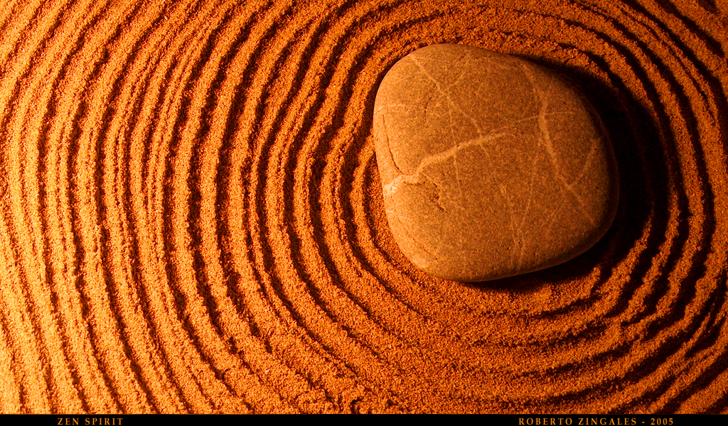
http://www.flickr.com/photos/50235987@N00/3386446442

Slide 3

http://www.visualparadox.com/wallpapers/zen.htm

Slide 4

I’m an ORM King! Eaassssyyy!

Slide 5
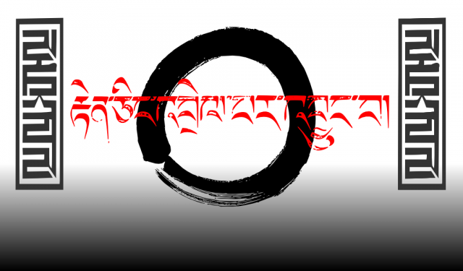
http://severity1.wordpress.com/2009/11/01/my-first-zen-wallpaper/strength_zen_naturallaw-2/
OKOKOK… W. T. F.?

Slide 6
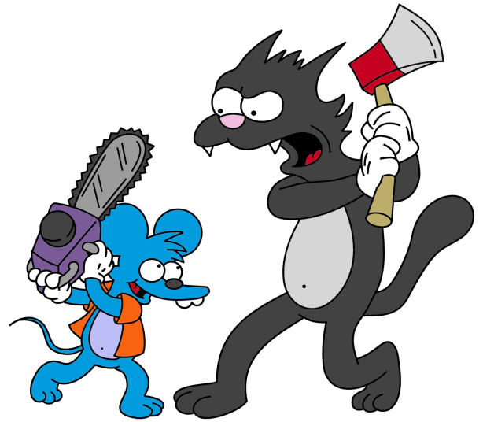
ME
ORM
http://simpsons.wikia.com/wiki/The_Itchy_%26_Scratchy_Show

Slide 7
Say Hello to my Leetle Friends
“Why won’t you delete?”
“Why won’t you save?”
“Why did you delete 800 records and then insert 801?”
“Why did you insert into MyTable … And then update MyTable ?”

Slide 8
And their less-attractive cousins…
“object references an unsaved transient instance - save the transient instance before flushing”
“Cannot insert null into <SomePrimaryKey>…”
“java.util.ConcurrentModificationException”
“failed to lazily initialize a collection of role: xxx, no session or session was closed ”
“a different object with the same identifier value was already associated with the session:”

Slide 9

ORM
(In Marc’s “ORM is the Devil” mindset)
http://www.akomic.net/mechanical.html

Slide 10
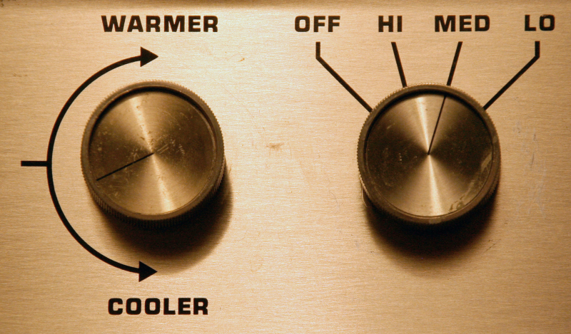
http://just-a-blip.blogspot.com/2009/07/modern-bed-warmer.html

Slide 11
This is my story
From Suffering

Slide 12
This is my story
From Suffering
Toward
Enlightenment

