Slide 1


Approaches to Automated Security Testing
Bill Shelton
MXUnit.org

Slide 2
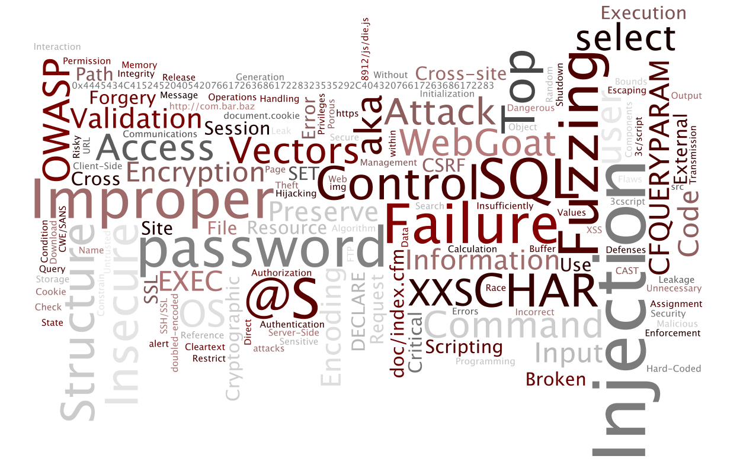

Slide 3
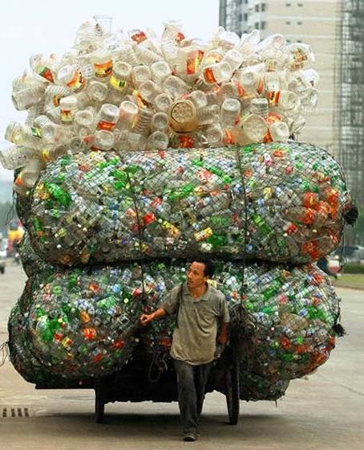
One
Big
Ass Problem!

Slide 4

Programmer
Security guy

Slide 5

Programmer
Security guy

Slide 6



Notes:
2 primary types of testing – black box and white box

Slide 7
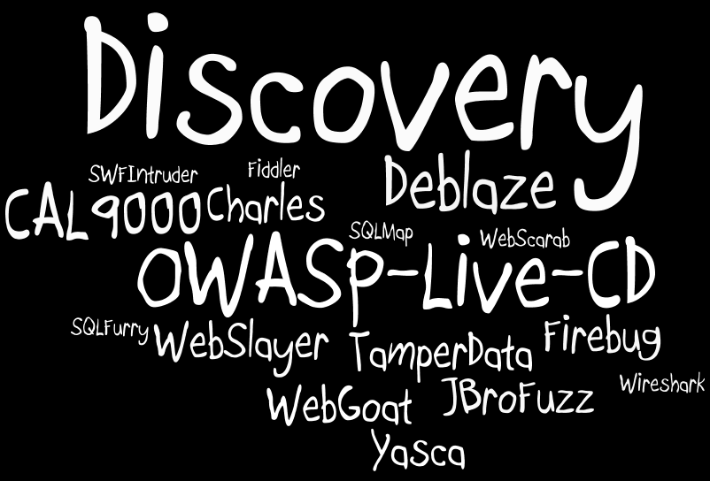

Slide 8


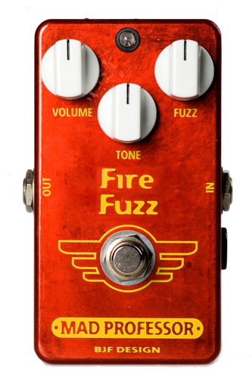
+ Webdriver + + ==

Slide 9
Ok … Now what?

Slide 10
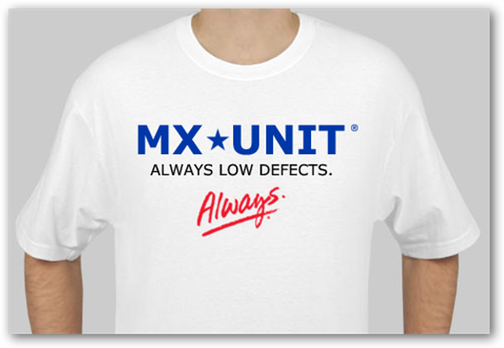
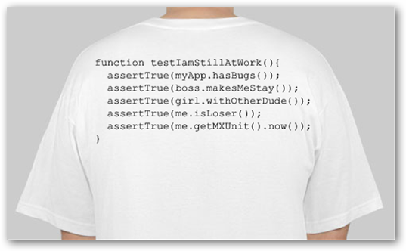
It’s T-shirt time!
What’s wrong with the following code?

Slide 11
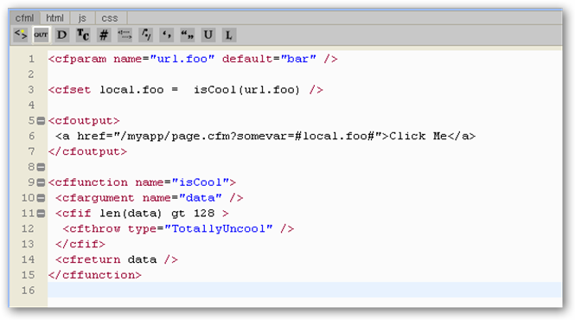


Slide 12

Static
Analysis

Slide 13
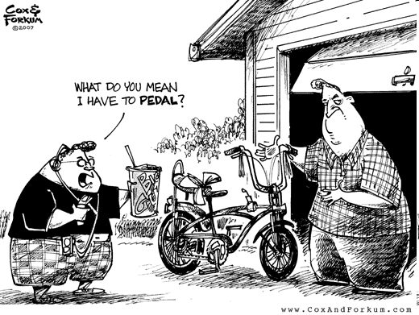

Slide 14

Trust
Boundary

Slide 15
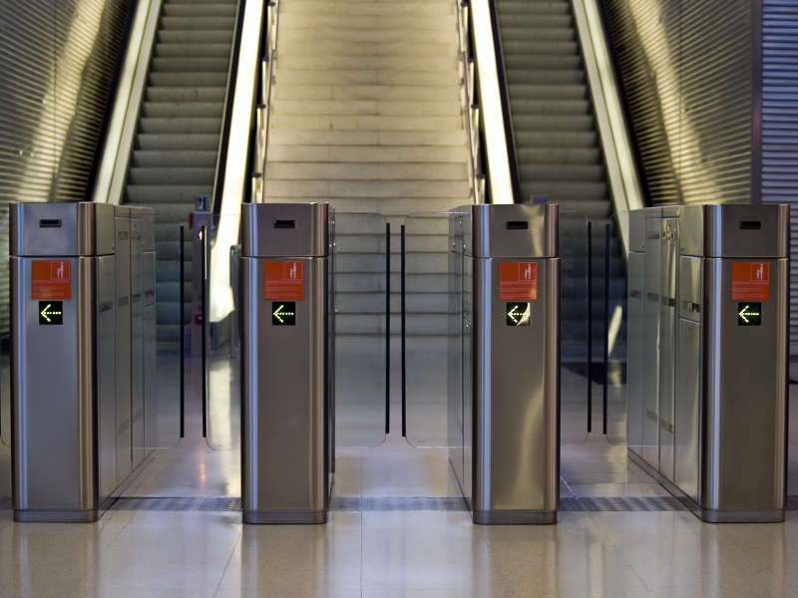
Validation

Slide 16

Output
Encoding

Slide 17
White List
Black List

Slide 18
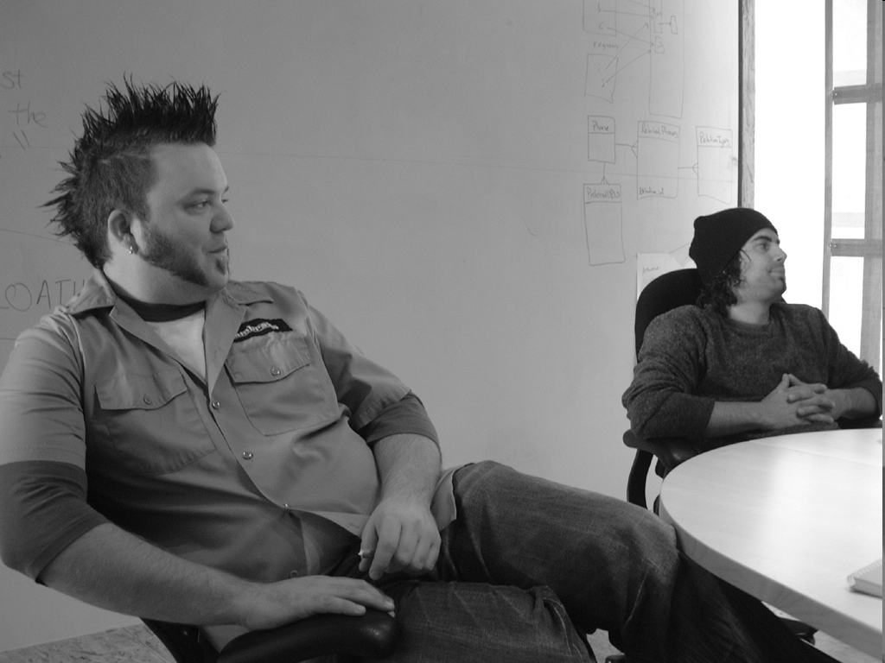
Validate this, punk …
Notes:
What to Validate
Http Requests
Http Sessions
Http Cookies
Data from all untrusted sources including databases!

Slide 19
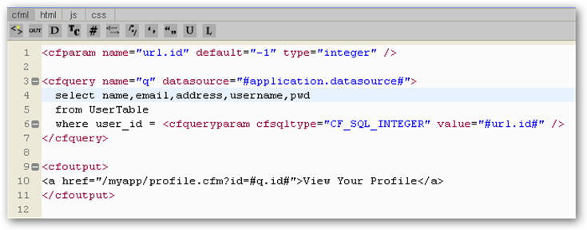

Slide 20
http://foo.com/myapp/profile.cfm?id=123
Direct Object Reference

Slide 21
http://foo.com/myapp/profile.cfm?id=123
Direct Object Reference
Direct Object Reference

Slide 22

Indirect
Object
Reference

Slide 23
Take Away
No Silver Bullet
It’s up to you to fix it
Think securely from the first line of code
Use tools to help find vulnerabilities
Use your knowledge to find more and fix them
Learn the trust boundaries
Validate and encode correctly

Slide 24

Test
Be Happy

Slide 25
Stuff to read
OWASP - http://www.owasp.org/index.php/Main_Page
Secure Programming with Static Analysis – Brian Chess & Jacob West
Software Security: Building Security In – Gary McGraw
Exploiting Software: How to Break Code – Gary McGraw

