Slide 2

Learn Unit Testing and
Improve Sexual Performance bacfug
11.19.08
MXUnit.org
Notes:
The title slide will be intentionally distracting while we introduce ourselves. MXUnit, where we're from
Our first job is writing software.
We are hardcore testers
Bill – US Treasury off-duty, just in case I’m being followed … fuck you … ear-wax
What’s so funny?
Ajax is sexy, right?
But, did you know that even though JQuery and ExtJs are sexy, Unit Testing is Hot. Really …

Slide 3

“Just wait will ya? I’m in the middle of running a test suite!”
Notes:
This is Jan, a guy recently mentored by Marc Esher

Slide 4

“Continuous Integration
so totally
r0x0r!”
Notes:
A Ed and Tammy who met on the mxunit google group

Slide 5

We test because we don't trust.
Why test?
Notes:
Soap box talk about why testing is important then we’ll show the cool toys and tools to play with.
Seems like an obvious question, but really consider it …
Why don’t we just write our code and ship it?
Why are automated tests better?
Yet, we test all the time in life.

Slide 6
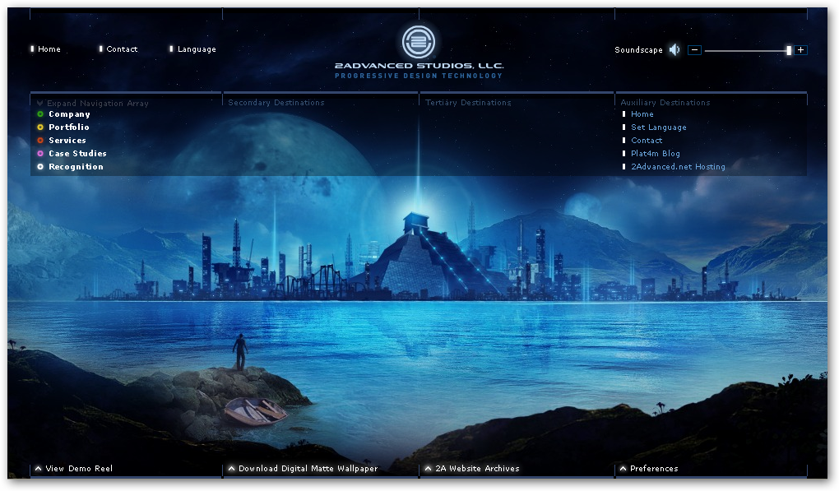
Trust This?
Notes:
Nice UI! Not beating up at all on this. It’s really slick. But we don’t know what we’re getting into.
Many organizations only value what they can see and what they can get out the door. Now what's under the hood.
Yeah it looks good, but how quickly can we change it? Are there any defects? How is it tested?
Many companies see the UI look slick, or the output/end result is what they want, but when they need changes done quickly and you say, well, that’s going to take some time …

Slide 7

“I hope that was hours and not days, Tim.”

Slide 8
Testable apps are agile.
Notes:
Testing is more important to developers and smart organizations.
Why? Your tests are automated and touch many parts of your application. They are also fast. So, when making changes, you can run your test suite and get immediate feedback.

Slide 9

“I like agile, Timmy …”
Notes:
Dream on, code monkey …

Slide 10

“You’re lucky to still have your job, douche bag.”
Notes:
Ah, this is more like it. This is my boss.

Slide 11
Good designs are testable.
Notes:
Testability naturally leads to good designs.

Slide 12
Simplify

Slide 13

Feedback
Notes:
Many organizations only value what they can see.
Testing is more important to developers and smart organizations.
Many companies see the UI look slick, or the output/end result is what they want, but when they need changes done quickly and you say, well, that’s going to take some time …

Slide 14
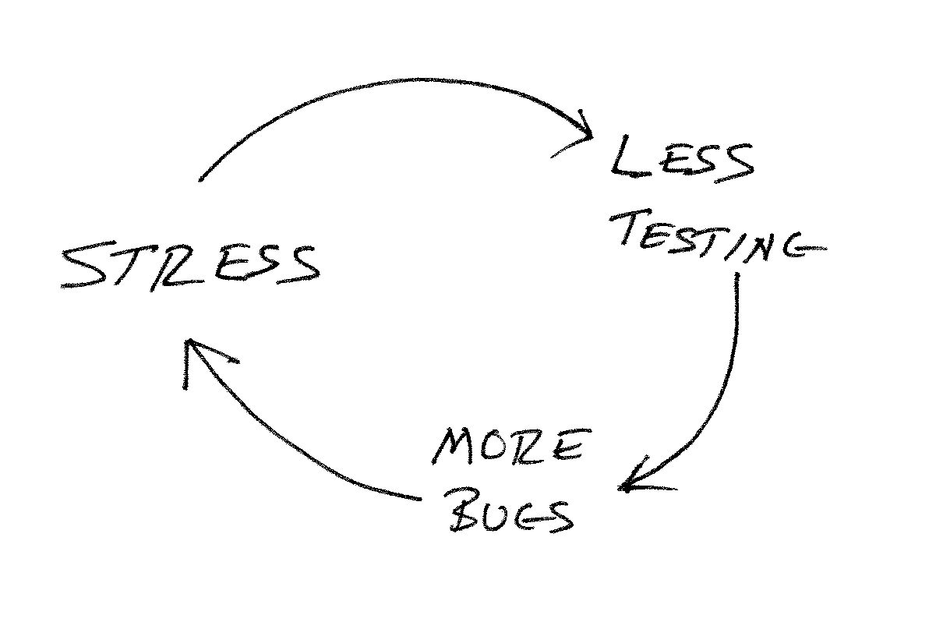
Bad

Slide 15
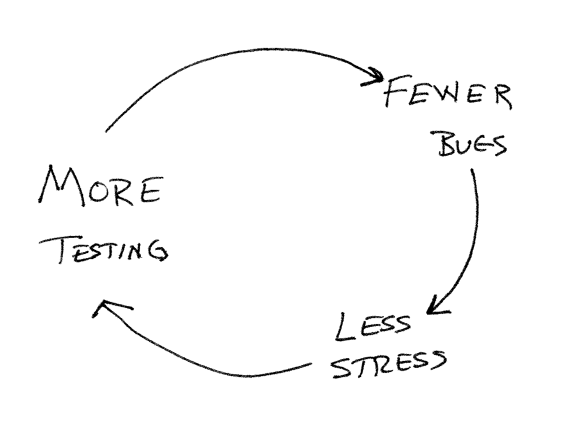
Good

Slide 16
TDD Controversy

Slide 17
  ”... it has become infeasible ... for a software developer to consider himself professional if he does not practice test driven development.”
-”Uncle” Bob Martin
ObjectMentor

Slide 18
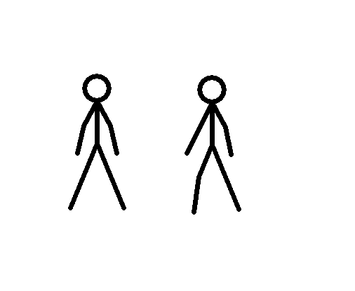

Slide 19
”Don't you feel a bit dirty? What with all those books ... telling you you should be doing TDD, and otherwise you are not professional?Is it just me? I try to do it... sometimes it feels right, sometimes it doesn't..."
-Cedric Beust
TestNG

Slide 20
Just Test
Notes:
Many organizations only value what they can see.
Testing is more important to developers and smart organizations.
Many companies see the UI look slick, or the output/end result is what they want, but when they need changes done quickly and you say, well, that’s going to take some time …

Slide 21

Use the right tools
Notes:
Cut out the crap. Refactor.

Slide 22
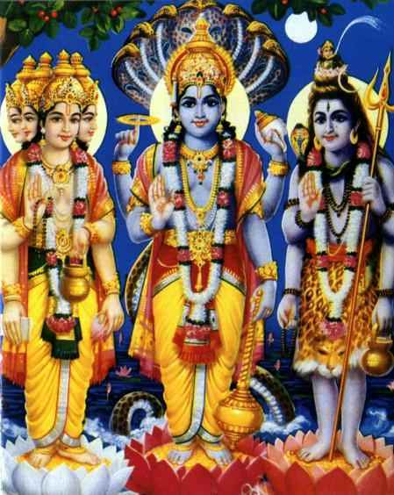
Test
And
Be
Happy
http://mxunit.org

Slide 23
Resources
InfoQ : Coplien and Martin Debate
  http://www.infoq.com/interviews/coplien-martin-tdd
InfoQ: Design for Testability (Cedric Beust)‏
  http://www.infoq.com/interviews/beust-designing-testability
The Flawed Theory Behind Unit Testing (Michael Feathers)‏
  http://michaelfeathers.typepad.com/michael_feathers_blog/2008/06/the-flawed-theo.html
  MXUnit
  http://mxunit.org

