Slide 1
Concurrency Zen
Marc Esher
cf.Objective() 2012
http://bit.ly/cfconcurrencyzen

Slide 2
This Presentation is NOT About
Twitter-scale message busses
NASDAQ-scale stock exchanges

Slide 3
This Presentation is NOT About
Replacing CFThread for “fire-and-forget” operations
Using Scala, Clojure, or other JVM languages

Slide 4
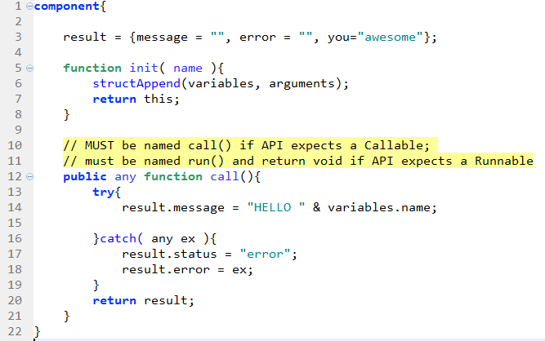
If you can write this:

Slide 5
If you can write this:

Slide 6
If you can write this:

Slide 7
If you can write this:

Slide 8
If you can write this:
YOUR Code Here

Slide 9
You can achieve:
Responsible
Safe
Testable
Manageable
Production-worthy Concurrency

Slide 10
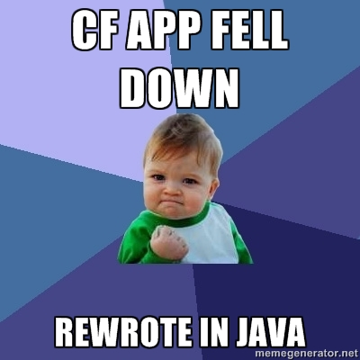
Notes:
At a previous job, I had much success converting older, brittle ColdFusion applications into multi-threaded Java applications. It was during that time that I learned all about concurrency.
True story, In 2004 I wrote my first Java program that used concurrency. My first “concurrent” program didn’t use threads. Instead, I was firing up brand new JVM instances and passing command line arguments to it… from another java program.
I was stupid! I’ve learned a lot since then, and that’s what I’m here to talk about.
My hope is that now that we have proper concurrency in ColdFusion, you will not find yourself in a position where rewriting in Java is the best solution

Slide 11
history.start()

Slide 12
1995
Cold Fusion 1.0

Slide 13
1996
JDK 1.0 Released
Threads from the start
Notes:
Born from the Oak programming language, originally intended for programming smart appliances
http://en.wikipedia.org/wiki/Oak_(programming_language)

Slide 14
1998 (CF 3.1 / CF 4.0)
util.concurrent 1.0 Released
-- Doug Lea
Foundations of the JCF

Slide 15

1999 (CF 4.5)
Season 1

Slide 16
2002 (CF MX 6.0)
JSR 166 Expert Group Formation
Birth of java.util.concurrent
Notes:
2.3 What need of the Java community will be addressed by the proposed specification?
Low level threading primitives, such as synchronized blocks, Object.wait and Object.notify, are insufficient for many programming tasks. As a result, application programmers are often forced to implement their own higher level concurrency facilities. This results in enormous duplication of effort. Further, such facilities are notoriously hard to get right and even more difficult to optimize. The concurrency facilities written by application programmers are often incorrect or inefficient. Offering a standard set of concurrency utilities will ease the task of writing a wide variety of multithreaded applications and generally improve the quality of the applications that use them.
2.4 Why isn't this need met by existing specifications?
Currently, developers can use only the concurrency control constructs provided in the Java language itself. These are too low level for some applications, and are incomplete for others.
http://jcp.org/en/jsr/detail?id=166

Slide 17
2004 (CF MX 6.1)
J2sE 5.0 Released
Java Concurrency Framework (JCF) Introduced

Slide 18
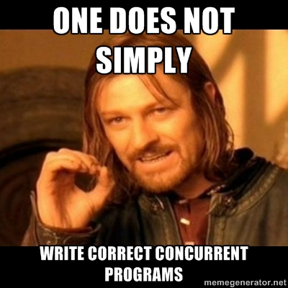

Slide 19
2006 (CF 7.0.2)
“Java Concurrency in Practice” Published
--Brian Goetz
“Writing correct programs is hard; writing correct concurrent programs is harder.”
Notes:
First sentence of Brian Goetz’s “Java Concurrency in Practice”, the seminal work on the topic

Slide 20
What’s the meaning of this?
13 years after CF 1.0
12 years after JDK 1.0
10 years after the birth of modern concurrency on the JVM
4 years after JCF introduced
2 years after JCiP demonstrates the difficulties of concurrency
……

Slide 21
2008
ColdFusion 8 Released
CFThread Introduced
Notes:
CFThread is the only concurrency abstraction available in ColdFusion. It is the lowest-level abstraction available. Threads are nearly universally shunned as too difficult to program directly; no sane programmer on the JVM would think of using threads, given the other options available

Slide 22
2012
14 Years Ago!
Java programmers knew Threads were too low-level

Slide 23
Why are concurrent programs hard to write correctly?
Shared Mutable State demands that you reason about:
Locks / synchronization
Deadlocks
Race Conditions
Data flow, visibility of changes
Unintentional publication of objects and data

Slide 24
Why are concurrent programs hard to write correctly?
“Exploitable Parallelism” isn’t always clear
“Threads”, as a mechanism, do not encourage reasoning about task boundaries

Slide 25
ColdFusion Concurrency
But CFThread is…
EASY!

Slide 26
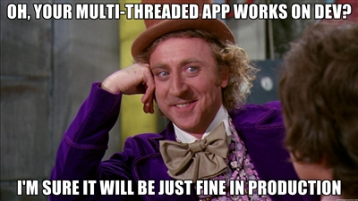

Slide 27
CFThread …
Deep-copies everything you pass into it
Provides no mechanism for retrieving results
Encourages brittle data sharing schemes
Provides no producer/consumer mechanism
Provides no “scheduling” mechanism for heartbeat / daemon style tasks
Limits your thread pool size at the server level
Provides no pool shutdown mechanism

Slide 28
CFThread is…
Hard to monitor
Hard to unit test
Hard to debug
Virtually Impossible to sanely post-process
Keyword: “sane”

Slide 29
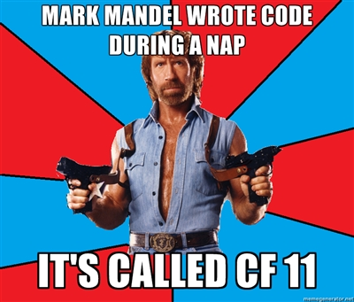
Notes:
But I don’t want to spend 45 minutes depressing you with sky-is-falling talk of how hard threads are for real-world problems.
I want to show you how to be awesome.
And when you talk about awesome and coldfusion, you have to start with Mark Mandel.

Slide 30
java.util.concurrent – in CF!
June 21, 2011
Mark Mandel commits JavaLoader patch
Enabling use of java.util.concurrent in ColdFusion

Slide 31
Ommmmmmmm
Introducing:
Enlightened Concurrency in ColdFusion

Slide 32
Java Concurrency Framework (java.util.concurrent)
Thread-Safe Datatypes
--AtomicLong, AtomicInteger, etc
Thread-Safe Collections
--Queues, Deques, Maps, etc

Slide 33
Java Concurrency Framework
Executors
-- Classes that manage concurrency for you
Result-returning Tasks (Callable, Future)
--The code you write!

Slide 34
Executors: 30k-foot View
ExecutorService
Task 1
Task 1.get()
Work Queue
Max Size
Task 2
Task 2.get()
Task 3
Task 3.get()
N Threads
Pool
Task X
Task X.get()

Slide 35
From the Inside-out
1. We’ll start with the code you write that
does the work of your program (tasks)
2. Then we’ll see how the JCF runs your code
3. Finally, we’ll fetch the results

Slide 36
Tasks
The JCF is based on the concept of “Tasks”
Implement the “Callable” interface – has a call() method
In our case, a Task is a CFC instance
Tasks don’t share data (except that which is thread-safe)
Tasks “do stuff” and return a result
Tasks know nothing about concurrency – they know nothing about *how* they will be called
An “executor” runs your task
You can wait for the result, or fetch it later
You can invoke groups of tasks and wait for their cumulative completion

Slide 37
A Task CFC

Slide 38
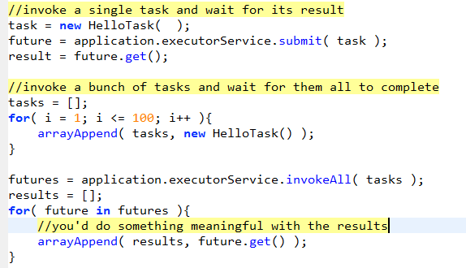
Sneak Peak: Executing Tasks

Slide 39
Sneak Peak: Executing Tasks

Slide 40
Sneak Peak: Executing Tasks
Remember your Task cfc?

Slide 41
Executor Overview
Configurable Thread Pool
Configurable “Work Queue”
Executes tasks
returns results if you need them

Slide 42
Different Types of “Executors”
“ExecutorService”
Run 1 or more tasks
Fire-and-forget
Fire-and-wait

Slide 43
Different Types of “Executors”
“ScheduledThreadPoolExecutor”
Schedule a task to run periodically
Heartbeats / Daemons
Nanosecond granularity

Slide 44
Different Types of “Executors”
“ScheduledThreadPoolExecutor”
Often used for finding work to submit to other Executors!

Slide 45
Different Types of “Executors”
“ExecutorCompletionService”
Producer / Consumer
Many “work” tasks;
Single “completion” task

Slide 46
Different Types of “Executors”
“ExecutorCompletionService”
Task → Work Queue
Task Executes
Result → Completion Queue

Slide 47
Different Types of “Executors”
“ExecutorCompletionService”
“Completion Task” is scheduled to periodically process the Completion Queue

Slide 48
Different Types of “Executors”
“ForkJoinPool”
Tasks recursively create subtasks
Pool uses work-stealing
Results are “join()”ed at the end
“Divide and Conquer”

Slide 49
Introducing CFConcurrent
Library that more easily exposes the JCF
Wraps up the common idioms / boilerplate
Provides lifecycle methods:
Start
Pause
Stop
Provides full access to all Java objects
Easy to use, easy to extend

Slide 50
Introducing CFConcurrent
github.com/marcesher/cfconcurrent
ZOMG Documentation
Example-PALOOZA
Notes:
Originally, I was going to show you how to do all of this with the java objects directly; however, while developing the presentation and all the examples, patterns emerged and it was obvious that a library needed to be written to kind of lube the friction between CF and Java.
Very important to know though that it’s not a “wrapper” library… I’m not hiding Java from you… just making it a bit easier to contend with.
And if you don’t want to use it but want to work with Java directly, you can either look at cfconcurrent’s code, or look in the code samples that you can download with this presentation

Slide 51
ExecutorService Overview
1. Construct an app-scoped service
2. Submit tasks using API methods:
service.submit( task )
service.invokeAll( arrayOfTasks )
service.invokeAny( arrayOfTasks )
Notes:
Originally, I was going to show you how to do all of this with the java objects directly; however, while developing the presentation and all the examples, patterns emerged and it was obvious that a library needed to be written to kind of lube the friction between CF and Java.
Very important to know though that it’s not a “wrapper” library… I’m not hiding Java from you… just making it a bit easier to contend with.
And if you don’t want to use it but want to work with Java directly, you can either look at cfconcurrent’s code, or look in the code samples that you can download with this presentation

Slide 52
Future
submit returns a “Future”
invokeAll/Any return array of “Future”s
You retrieve result with future.get()

Slide 53

Future

Slide 54
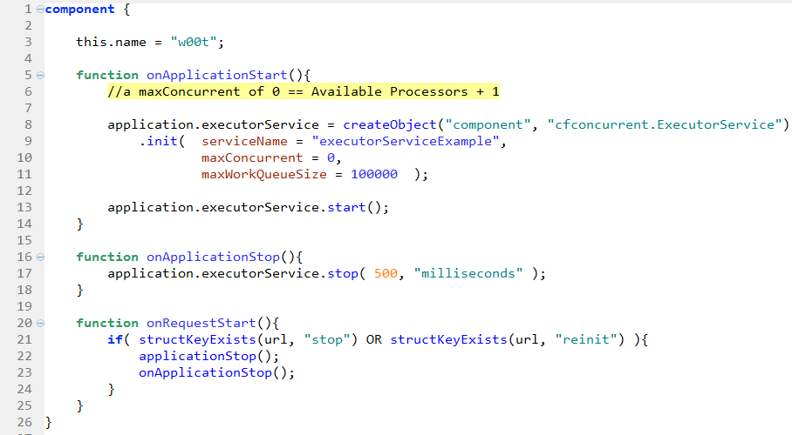
Using an ExecutorService

Slide 55
Using an Executor Service

Slide 56
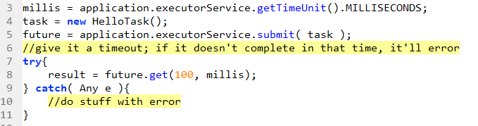
Executor Service and Timeouts

Slide 57
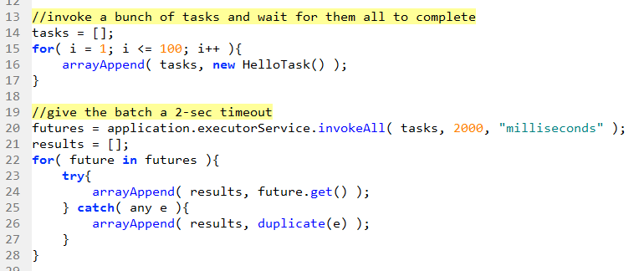
Executor Service and Timeouts

Slide 58
ScheduledThreadPoolExecutor Overview
1. Construct an app-scoped service
2. Submit Runnable tasks using API methods:
service.scheduleAtFixedRate( …)
service.scheduleWithFixedDelay( …)
Notes:
Originally, I was going to show you how to do all of this with the java objects directly; however, while developing the presentation and all the examples, patterns emerged and it was obvious that a library needed to be written to kind of lube the friction between CF and Java.
Very important to know though that it’s not a “wrapper” library… I’m not hiding Java from you… just making it a bit easier to contend with.
And if you don’t want to use it but want to work with Java directly, you can either look at cfconcurrent’s code, or look in the code samples that you can download with this presentation

Slide 59
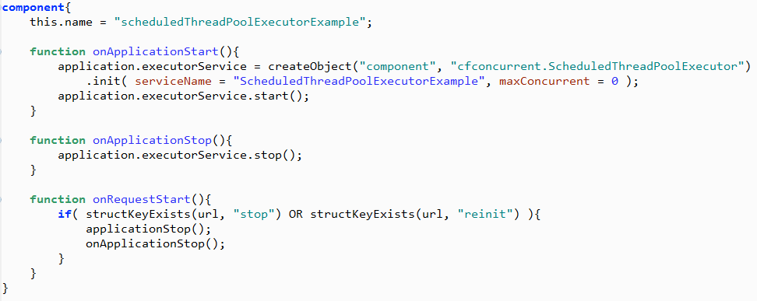
Start a ScheduledThreadPoolExecutor

Slide 60
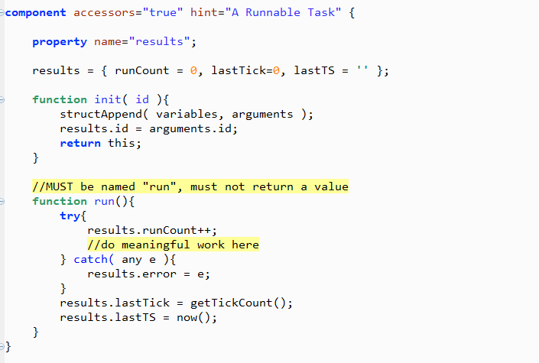
Create a ‘Runnable’ Task

Slide 61
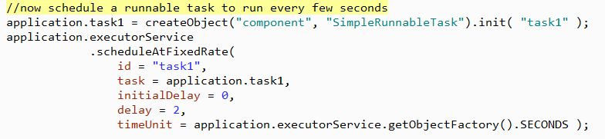
Schedule the Task

Slide 62
ExecutorCompletionService Overview
1. Construct an app-scoped service
2. Create and schedule a “Completion Task”:
3. Submit “Work” Tasks using API
submit( …)
4. Completion task periodically processes completed tasks
Notes:
Originally, I was going to show you how to do all of this with the java objects directly; however, while developing the presentation and all the examples, patterns emerged and it was obvious that a library needed to be written to kind of lube the friction between CF and Java.
Very important to know though that it’s not a “wrapper” library… I’m not hiding Java from you… just making it a bit easier to contend with.
And if you don’t want to use it but want to work with Java directly, you can either look at cfconcurrent’s code, or look in the code samples that you can download with this presentation

Slide 63
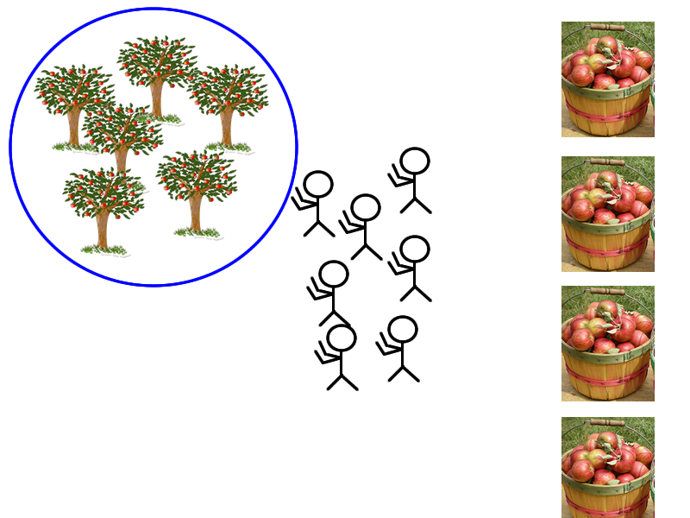
“Work Queue”
“Completion Service” →
“Completion Queue” →

Slide 64
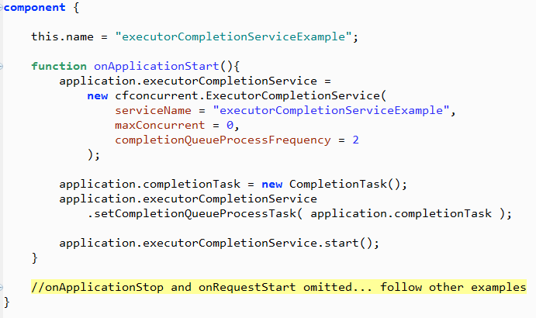
Start an ExecutorCompletionService

Slide 65
Task to process Completion Queue
What is this thing?

Slide 66
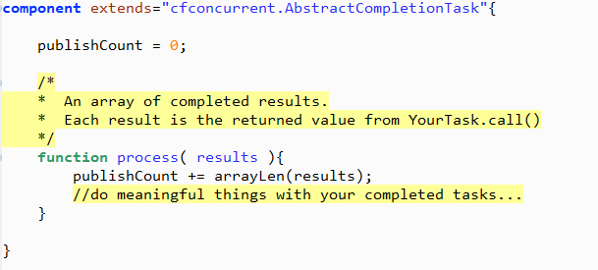
Task to process Completion Queue
Note: extends AbstractCompletionTask

Slide 67
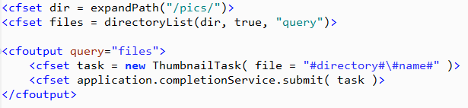
ExecutorCompletionService: Submit tasks

Slide 68
ExecutorCompletionService: Some thoughts on Previous Example
1. Put the directoryList in a new Scheduled Task
2. That task can then submit tasks to the ECS
3. Thus the entire process becomes async
4. Perfect use case for Fork-Join!

Slide 69
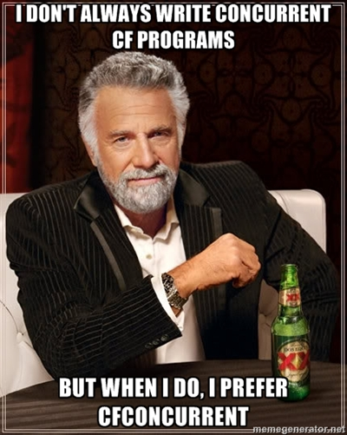

Slide 70
Resources
Official Java Tutorial
http://docs.oracle.com/javase/tutorial/essential/concurrency/executors.html
JavaDoc (provides a lot of explanation and examples)
http://docs.oracle.com/javase/7/docs/api/java/util/concurrent/package-summary.html
Books
Thoroughly covers modern Java concurrency. Provides lots of Don’t do this, as well:
http://www.amazon.com/Java-Concurrency-Practice-Brian-Goetz/dp/0321349601/
Covers Java as well as Groovy, Scala, and Clojure. Excellent examples
http://pragprog.com/book/vspcon/programming-concurrency-on-the-jvm
Articles
Good java.util.concurrent overview
http://www.vogella.de/articles/JavaConcurrency/article.html
Explanation of the Java Memory Model, what’s wrong with it, and JSR 133 which addressed the JMM’s shortcomings
http://www.ibm.com/developerworks/java/library/j-jtp02244/index.html

Slide 71
References
http://gee.cs.oswego.edu/dl/classes/EDU/oswego/cs/dl/util/concurrent/intro.html
http://en.wikipedia.org/wiki/ColdFusion#Adobe_ColdFusion_8
http://en.wikipedia.org/wiki/Java_concurrency
http://gee.cs.oswego.edu/dl/concurrency-interest/index.html
http://en.wikipedia.org/wiki/Java_version_history

