Slide 1
ServiceNow
Corporate PowerPoint Template
July 2026 v2.3

Slide 2

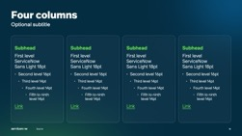




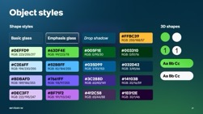
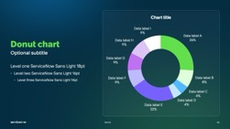

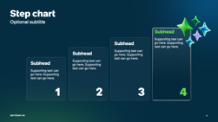
Welcome to the Corporate PowerPoint
Template
You are in the Template
1
Start with the Template
Link to the Toolkit
You are in the Corporate PowerPoint Template,
your starting point for every great presentation.
Use this file as your working deck.
To keep the file size of the Template manageable,
many slides have been migrated into a Toolkit file
linked to the right.
This companion file has additional slides and layout libraries for specific needs—Al platform visuals, Safe Harbor notice, timelines, org charts, brand icons, charts, maps, gradients, and more!
Browse the Toolkit to find slides and design elements you need, then copy and paste them into your working deck.
2
Copy and paste design elements from the Toolkit

Slide 3
V2.0-V2.3 updates, Q4 2025-Q3 2026
Corporate PowerPoint Template and Toolkit changes and additions
  Optimized file size in both Corporate Template and Toolkit
  Additional tools and slides now available in the Corporate Toolkit
  Streamlined Master Slides
  Included a closing slide in the Master Slides to clearly mark the end of the set
  Brand photography updated
  2026 copyright
  Updated EMEA map in the Corporate Toolkit
  Updated Marketecture slides to the latest version in the Corporate Toolkit
  Clarified guidance on color usage for positive and negative callouts in the Corporate Template
  Additional optimization, bug fixes, and layout adjustments
  Adjusted kerning issue to resolve overlapping fonts in titles and headers

Slide 4
Quick-start
Using this template
Windows
macOS
Save the template to your machine.
  Click “File” then “Save As.”
  Make sure the file type is PowerPoint Template (.potx).
  By default, PowerPoint will save to the Custom Office Templates folder; save the file there.
Delete old templates from your machine.
  If you have any old templates saved to your machine, delete them in the “File” > “New from Template” dialog.
  Right-click the old template thumbnail and select “Delete.”
  Note: templates you want to delete must not be in use / open.
Create a new file using the template.
  Click “File” then “New” then select “Custom / Personal.”
  Under “Custom / Personal” select the “ServiceNow Corporate Template” option.
Save the template to your machine.
  Click “File” then “Save As Template.”
  Make sure the file type is PowerPoint Template (.potx).
  By default, PowerPoint will save to the Templates folder; save the file there.
Delete old templates from your machine.
  If you have any old templates saved to your machine, navigate there (Documents > Custom Office Templates) and delete them.
Create a new file using the template.
  Click “File” then “New from Template.”
  Select the template from the thumbnails and click “Create.”

Slide 5

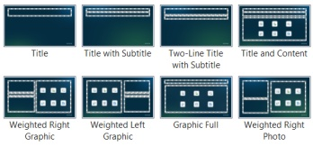


Use layouts within this template
Applying a slide layout
With a slide selected, click on the “Home” tab.
Select the “Layout” flyout menu.
Choose the Layout that is most appropriate
for your content.
Resetting a slide layout
With a slide selected, click on the “Home" tab.
Select the “Reset” button in the upper left corner
of the menu to update Layout formatting. This updates the placeholder location, text size, spacing, color, etc.

Slide 6


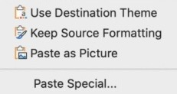


Importing slides from other templates
When pasting slides from one presentation into another, a “Paste Options” menu will appear with three choices: “Use Destination Theme, Keep Source Formatting, and Paste as Picture.”
Choose “Use Destination Theme.”
Theme colors
Will automatically update to the new template, and you may need to adjust some manually.
Pasting text
Use “Paste and Match Formatting” to avoid introducing new fonts.
Recommendation
Like to minimize
formatting and have a clean template? Read on.
Paste your on-slide
content onto a similar layout in the new template.
Choose the option
“Use destination theme” to retain the original style.
Windows
macOS

Slide 7


Font check
Confirm ServiceNow Sans is displaying properly
This template uses
our custom font,
ServiceNow Sans.
Use the checker to the right to ensure you have the font installed.
If you do not have the font, download and install it from the Brand Center. After installing the font, be sure to quit PowerPoint and re-open.
Rg
Tf
Do both rows look the same?
Yes.
Great, you have the fonts installed.
No.
Download and install fonts from the Brand Center.
ServiceNow Sans Bold
ServiceNow Sans Light

Slide 8
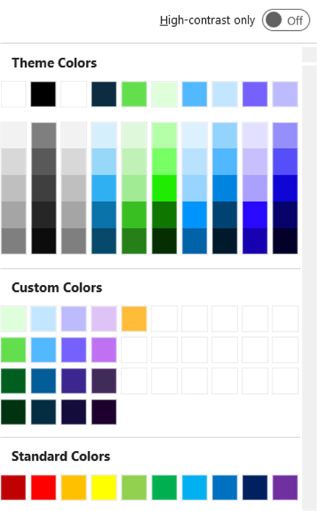

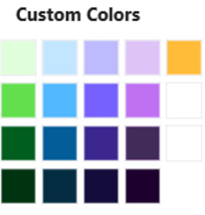
Using PowerPoint color chips
Looking for more guidance on color usage? Visit the Brand Center
Theme colors follow a specific order based on the brand color palette. This approach improves readability in data visualizations such as charts and graphs.
PowerPoint auto-generates tints and shades based on the primary theme colors. These are not in the brand palette. Please do not use these.
Custom Colors are the full brand color palette.
Orange,
negative callouts or warnings
#FFBC39
RGB 255/188/57
Wasabi Green,
positive callouts or growth
#63DF4E
RGB 99/223/78
Standard Colors are default colors in PowerPoint and not generated from the brand palette.
Please do not use these.

Slide 9
Cover stand alone
Speaker first and last name
Job title and company

Slide 10
Cover with subtitle
Optional subtitle
Speaker first and last name
Job title and company

Slide 11
Cover with multiple speakers
Speaker first
and last name
Speaker first
and last name
Speaker first
and last name
Speaker first
and last name
Job title and company
Job title and company
Job title and company
Job title and company

Slide 12
Table of contents
## | Chapter 1
## | Chapter 2
 | ## | Chapter 2A
 | ## | Chapter 2B
 | ## | Chapter 2C
 | ## | Chapter 2D
## | Chapter 3
 | ## | Chapter 3A
 | ## | Chapter 3B

Slide 13
Title only
Source

Slide 14
Title with subtitle
Optional subtitle
Source

Slide 15
Title
First level ServiceNow Sans Light 16pt
  Second level ServiceNow Sans Light 14pt
    Third level ServiceNow Sans Light 12pt
      Fourth level ServiceNow Sans Light 12pt
        Fifth to ninth level ServiceNow Sans Light 12pt
Let AI and automation transform experiences with ServiceNow CRM.
Link to ServiceNow Sans Light
Source

Slide 16
Title
Optional subtitle
First level ServiceNow Sans Light 18pt
  Second level ServiceNow Sans Light 16pt
  ServiceNow AI Platform unifies AI + Data + Workflows
    Third level ServiceNow Sans Light 14pt
      Fourth level ServiceNow Sans Light 14pt
        Fifth to ninth level ServiceNow Sans Light 14pt
Let AI and automation transform experiences with ServiceNow CRM.
Inspire loyalty, boost productivity, and grow revenue.
Link ServiceNow Sans Light
Source

Slide 17
Two columns
Optional subtitle
Subhead
Subhead
First level ServiceNow Sans Light 18pt
  Second level ServiceNow Sans Light 16pt
    Third level ServiceNow Sans Light 14pt
      Fourth level ServiceNow Sans Light 14pt
                Fifth to ninth level ServiceNow Sans Light 14pt
Let AI and automation transform experiences with ServiceNow CRM.
Link ServiceNow Sans Light
First level ServiceNow Sans Light 18pt
  Second level ServiceNow Sans Light 16pt
    Third level ServiceNow Sans Light 14pt
      Fourth level ServiceNow Sans Light 14pt
        Fifth to ninth level ServiceNow Sans Light 14pt
Let AI and automation transform experiences with ServiceNow CRM.
Link ServiceNow Sans Light
Source

Slide 18
Three columns
Optional subtitle
Subhead
Subhead
Subhead
First level ServiceNow
Sans Light 18pt
  Second level 16pt
    Third level 14pt
      Fourth level 14pt
            Fifth to ninth level 14pt
Link ServiceNow Sans Light
First level ServiceNow
Sans Light 18pt
  Second level 16pt
    Third level 14pt
      Fourth level 14pt
        Fifth to ninth level 14pt
Link ServiceNow Sans Light
First level ServiceNow
Sans Light 18pt
  Second level 16pt
    Third level 14pt
      Fourth level 14pt
        Fifth to ninth level 14pt
Link ServiceNow Sans Light
Source

Slide 19
Four columns
Optional subtitle
Subhead
Subhead
Subhead
Subhead
First level ServiceNow
Sans Light 18pt
  Second level 16pt
    Third level 14pt
      Fourth level 14pt
        Fifth to ninth
        level 14pt
Link
First level ServiceNow
Sans Light 18pt
  Second level 16pt
    Third level 14pt
      Fourth level 14pt
        Fifth to ninth
        level 14pt
Link
First level ServiceNow
Sans Light 18pt
  Second level 16pt
    Third level 14pt
      Fourth level 14pt
        Fifth to ninth
        level 14pt
Link
First level ServiceNow
Sans Light 18pt
  Second level 16pt
    Third level 14pt
      Fourth level 14pt
        Fifth to ninth
        level 14pt
Link
Source

Slide 20
Quote, this layout can use multiple lines of text, the top quote mark will move automatically.
Speaker first and last name
Job title and company

Slide 21
Layout for a large statement that spans multiple lines.

Slide 22
Divider
Optional subtitle

Slide 24
Demo intro desktop
ServiceNow AI Platform unifies
AI + Data + Workflows

Slide 25
Demo intro tablet
ServiceNow AI Platform unifies
AI + Data + Workflows

Slide 26
Demo intro mobile
ServiceNow AI Platform unifies
AI + Data + Workflows

Slide 31
Thank you

